Slide 1


GÉANT – we’re GLAD to meet you!
Cross e-infra training and technical support
Annabel Grant, GÉANT, Nov 2017
www.geant.org

Slide 2
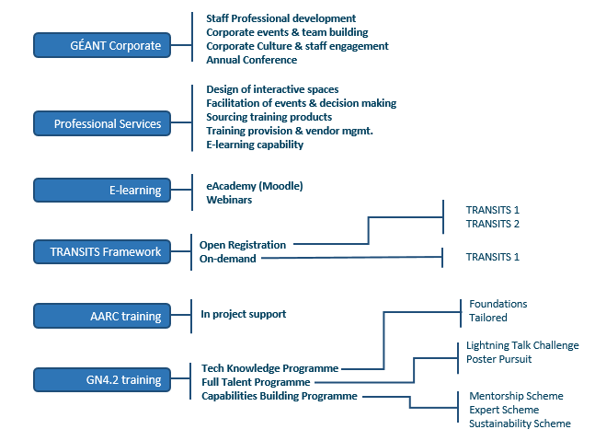
GÉANT Learning and Development (GLAD)portfolio is designed to support learning, reinforce effectiveness and motivate performance
Notes:
What GLAD believes in:
’The illiterate of the future will not be those who can’t read or write, but those who can’t learn, unlearn and relearn’
Learning is a vehicle to manage change and enable progress
GLAD has expertise in:
Design of interactive learning spaces, annual staff events and team building
Sourcing and organization of technical and non-technical training events
Meeting and decision making facilitation
Training provision and training vendor management
eLearning and Webinar organization and management
For its beneficiaries, GLAD provides the following resources:
f2f training delivery
Online eLearning delivery and knowledge dissemination (eAcademy)
Funding for professional development and learning (incl., mentorship, experts)
Capability building and NREN sustainability

Slide 3
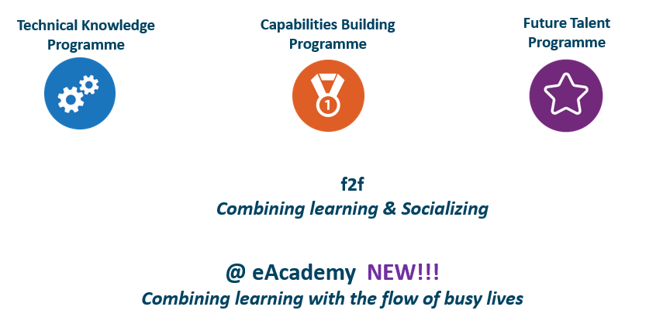
Project training boosts growth by harnessing the power of network, physical and human
Notes:
Technical Knowledge Programme focuses on developing and maintaining state-of-the-art technical knowledge and expertise
Capabilities Building Programme focuses on boosting sustainability through collaborative learning practices within the community that can cover technical and non-technical areas of expertise
Future Talent Programme focuses on renewal and innovation of ideas and expertise by attracting new talent into the community

Slide 4

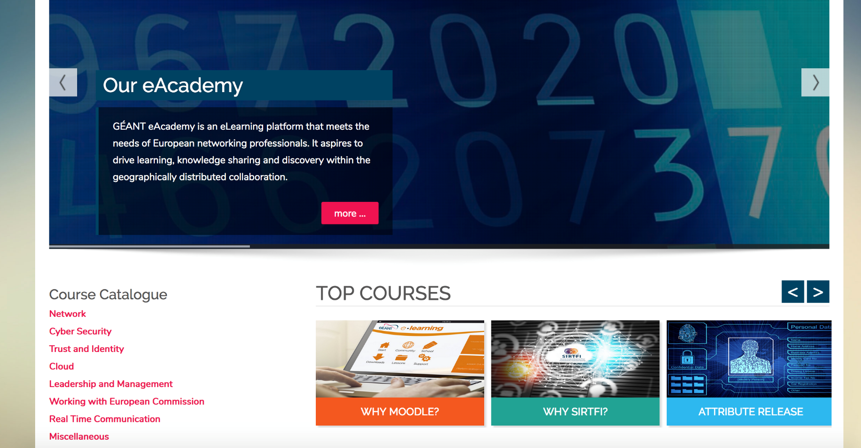

https://e-academy.geant.org/moodle/
Notes:
e-Academy has an ambition to become a ‘one stop’ elearning space for the European networking professionals providing them with interactive learning experiences and knowledge anytime, anywhere.
Based on an open-source Moodle platform, it is geared to offer contextualised, GÉANT focused knowledge in technical areas, such as network, trust and identity, security, cloud, and leadership and management, for instance public speaking and presentation skills. The hosting possibilities of the platform allow to include interactive learning materials, videos, e-lectures, simulations, e-coaching, virtual classroom, polls, forums and much more.
eAcademy is envisaged as a resource that hosts GN4.2 Training products and educational content designed and developed by the NREN community.

Slide 5
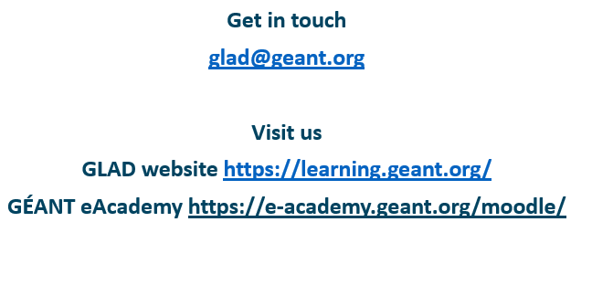
GÉANT – get in touch and let’s get started!

Slide 6

Thank you!
www.geant.org
© GEANT Limited on behalf of the GN4 Phase 2 project (GN4-2).
The research leading to these results has received funding from the European Union’s Horizon 2020 research and innovation programme under Grant Agreement No. 731122 (GN4-2).

