Slide 1
OpenAIRE Advance
Support & Training
Iryna Kuchma
EIFL
Pedro Principe
University of Minho
#DI4R2017 – Connecting the building blocks for Open Science, 30 Nov. Brussels

Slide 2
Who we are?
Open Access experts
Institutional, national and international perspectives on Open Science policies & e-Infrastructures
Info & Computer Science experts
Legal experts
Legal & policy recommendations
Data communities
Best practices for data
Linking to data infrastructures
Building efficient e-Infra technologies
State of the art technologies (big data, linked data)
A 50 partners’ partnership
In 24x7 operation since 2010

Slide 3
Two faceted e-Infrastructure
33 expert nodes all over Europe: Open Science training & support, OA policy alignment, Technical assistance...
Human Network
Integrated Scientific Information System with access to 22,683,218 publications; 606,489 datasets; 1,006 data providers, 800Κ publications linked to projects from 14 funders
Digital Network

Slide 4
Open Science services for all
RESEARCHERS & RESEARCH COMMUNITIES
CONTENT PROVIDERS MANAGERS
FUNDERS & RESEARCH ADMINISTRATORS
3rd party SERVICE PROVIDERS
Services at all levels of e-Infrastructure. Services that cover all research life-cycle.
Dashboards for funders, content providers, research communities and institutions.

Slide 5
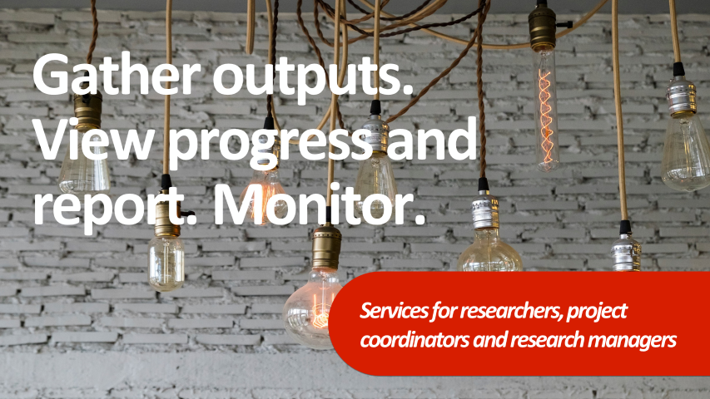
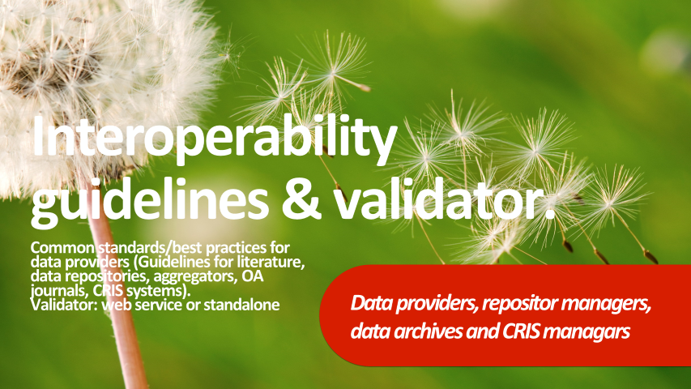

Slide 6
A pan European support & training service for Open Science
HELPDESK
TRAINING
Ask a question
FAQs
Webinars
Workshops
Demos
CONSULTATION
RESOURCES
Legal
Policy
Technical
Guidelines
Copyright Issues
H2020 factsheets

Slide 7
Open Science helpdesk: Support & training (1)
A multiplier approach: Train-the-trainer models targeted at NOADs, NCPs, RIs & key intermediaries to increase capacity to advise on Horizon 2020 requirements & assist researchers in the transition to open data by default & Open Science practices.
Collaboration with e-infrastructures, research Infrastructures & related projects such as FOSTER+, OpenAIRE-Connect, EUDAT, EGI, GEANT, EDISON, FIT4RRI, OpenUP, LEARN, OpenMinted & FutureTDM to develop tailored training materials & disciplinary case studies to support training efforts on OA, open data, RDM & Open Science.

Slide 8
Open Science helpdesk: Support & training (2)
Practical, how-to style resources & interactive training materials that set Open Science principles into practice
The roadshow model to help NOADs to engage people in different regions & foster local support networks & collaborations.
Multi-module Open Science kit for life sciences, social sciences & humanities (FOSTER), computing, engineering & other disciplines
OpenAIRE Services Training: services & tools, targeting different stakeholders via webinars, workshops, etc.

Slide 9
Open Science helpdesk: Support & training (3)
From European to national: 2-4 training events per country;
10-20 at EU level by the end of year three;
100 trainers;
at least 50 participants at each training events.
Training programmes with NOADs hosting at least 60 workshops, 50 webinars and 20 train-the-trainer events, reaching to over 11,000 participants in total.

Slide 10
Open Science helpdesk: Support & training (4)
Helpdesk for data providers (registration & compliance issues)
End user technical support for the portal functionalities & tools
D-net software support & 3rd party service providers support (APIs)
Technical guidelines for software platforms, metadata validation, integration of services

Slide 11
Iryna Kuchma
iryna.kuchma@eifl.net @irynakuchma

Slide 12
www.openaire.eu
@openaire_eu
facebook.com/groups/openaire
linkedin.com/groups/OpenAIRE-3893548
info@openaire.eu

