Slide 1
OIDC-Agent
Better Software for Better Science.
Gabriel Zachmann, Bas Wegh, Marcus Hardt
KIT
hardt@kit.edu
DI4R
Brussels, 11/2017
RIA-653549

Slide 2
Outline
Background: The INDIGO AAI
Background: INDIGO OIDC services
Background: OIDC-Refresher
Foreground: OIDC-Agent

Slide 3
The INDIGO AAI*
First one to suggest token based AAI
Based on many use cases from the project:
CMS, Climate/Ophidia, TRUFA, CTA, Molecular Dynamics, Algae Bloom, Arts & Humanities, ...
Design from scratch
Green grass approach
Requirements from 13 use-cases
Map our architecture to existing technologies and approaches
OpenID Connect (OIDC)
AARC Blueprint Architecture
*Work done by: Andrea Ceccanti, Marcus Hardt, Paul Millar, Bas Wegh

Slide 4
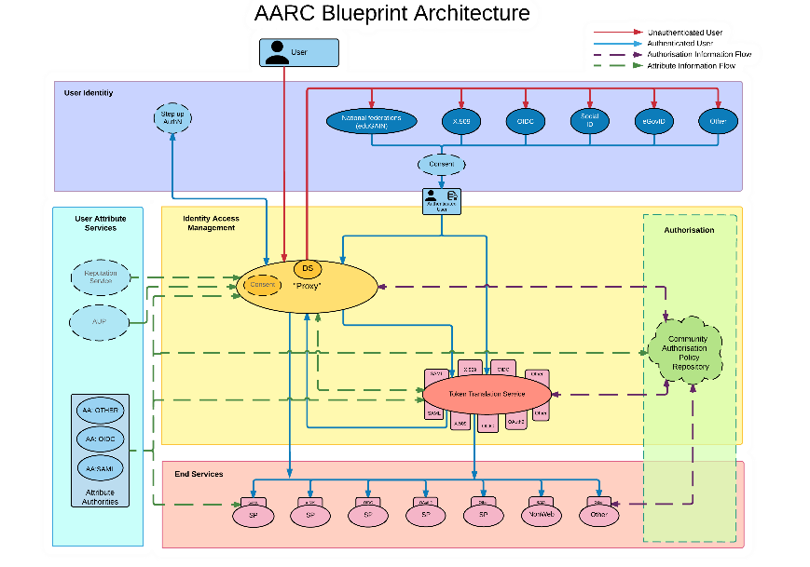

Slide 5
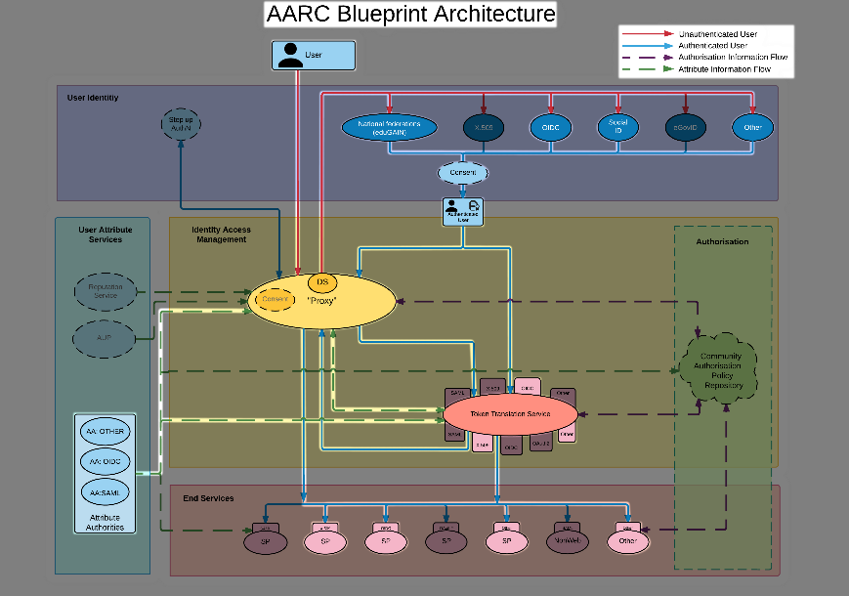

Slide 6
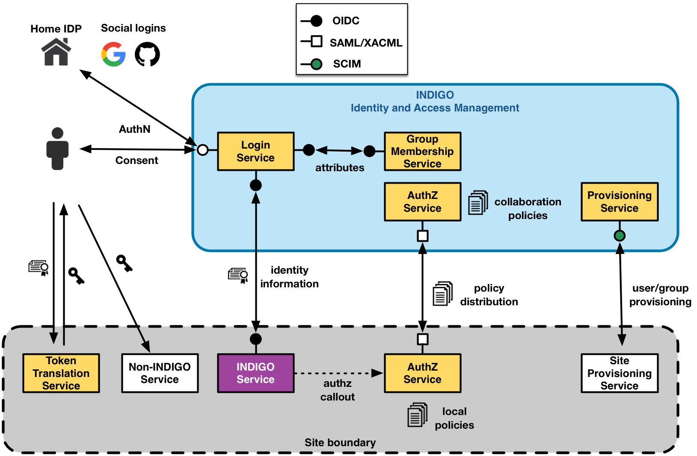
INDIGO IAM
The Identity and Access Management (IAM) service
Authenticates users with supported mechanisms (SAML, X.509, Google, username/password, …)
Provides a persistent id for the user and other attributes (e.g., group membership) to relying applications via standard OpenID Connect interfaces
Provides the ability to link X.509 certificates, SAML and OpenID Connect accounts to the IAM account
Provides group membership management and registration service for the managed organization
Can be configured to support automatic organization enrollment for users authenticated by selectedSAML identity providers
Provides SCIM standard provisioning endpoints to expose organization membership information

Slide 7
INDIGO Services that support OIDC
WaTTS: Token Translation Service (generates X.509 certificate)
DataLifeCycle services to query qualities of storage systems:
CDMI-QoS
CDMI-Web
dCache
WebDav
OpenStack Keystone: INDIGO extensions allow OIDC authentication
Prototype working with Human Brain AAI

Slide 8
OpenID-Connect OIDC refresher
OIDC defines many tokens; We only use these:
AccessToken:
Standard Token to authenticate to OIDC services
Short-lived (typically 15min)
RefreshToken:
Guess what?
Long lived (upon revocation)
May only be used to obtain new AccessToken(s)
Is bound to a specific client
OIDC clients have to be registered with the OIDC provider
I.e. your twitter app is registered with the google OIDC-P
OIDC supports several flows for authentication
Oauth2 Code flow (standard web flow)
Password flow (default cmdline flow

Slide 9
OIDC-Agent: What’s in the package?
Motivation:
CMDline + API access require non-web authentication
Guiding Pattern: ssh-agent
oidc-agent
Daemon that handles OIDC tokens and communitcation
oidc-gen
Tool to register the client with an OIDC provider
Use password grant flow and autoconfiguration to dynamically register the client
Store encrypted OIDC data (RefreshToken, ClientID, ClientSecret)
oidc-add
Tool to decrypt / load / remove account info and pass to agent
oidc-token
Tool to obtain AccessToken

Slide 10
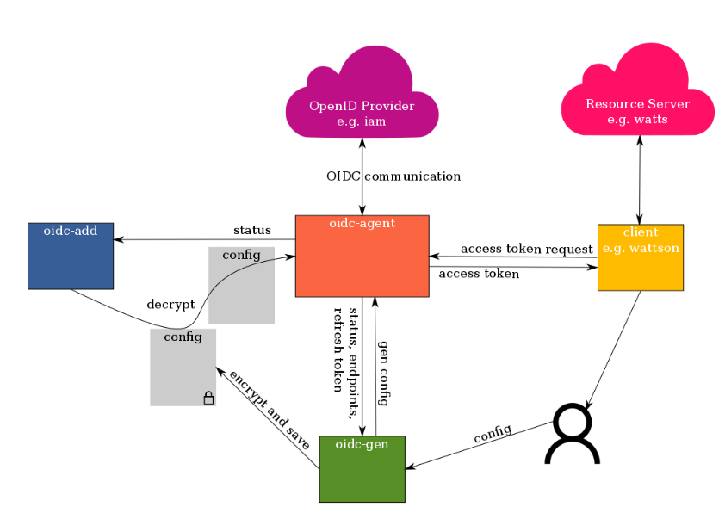
OIDC-Agent Architecture

Slide 11
Quick usage
After reboot:
eval `oidc-agent`
Once in a lifetime:
oidc-gen <name>
For now: ask OIDC-P admin to enable refresh tokens for the password flow
oidc-gen –f <file> <name>
Use password flow to get RefreshToken
Each time you need a new token:
oidc-token <name>
DEMO
:wq

Slide 12
Security features
Privilege separation:
oidc-add and oidc-gen
Only access to local disk and oidc-agent (via IPC), no network required
oidc-agent
The only component with network access, disk access only required for ca-bundle
oidc-token
Only IPC communication
Decrypted credentials only in RAM
All disk-stored credential are crypted using libsodium
Use own free() method to wipe memory when deallocating

Slide 13
Future work
Password grant type and dynamic registration are incompatible for security reasons
Right now this requires the user to communicate with OIDC-P admin after registration
Will be fixed by implementation of a local webserver (oauth2 code flow)
Then also google will work (they don’t support password flow at all)
IAM about to support the device-code-flow (draft RFC)
Implement privilege separation

Slide 14
Questions?
https://github.com/indigo-dc/oidc-agent
https://indigo-dc.gitbooks.io/oidc-agent

