Slide 1
Alessia Bardi and Paolo Manghi
Institute of Information Science and Technologies - CNR
OpenAIRE services in support of “Open Science as-a-Service”
Digital Infrastructures for Science Conference
1st of December 2017, Brussels
Paolo Manghi

Slide 2




Open Science publishing
Research Infrastructures
Scholarly Communication Infrastructure
Publishing packages of products to enable reproducibility
Publishing an up-to-date record of research products metadata and links
Publishing of all kinds of research products and semantic links in between
Research literature:
Articles, docs, white papers
Enabling reproducibility
Research
data
01101010
01100001
11010010
e-infra Tools &
Services
Research
data
01101010
01100001
11010010
Open Science
Publishing
Enabling transparent
evaluation
Research
Software
Scientific process
Notes:
Highlight difference between citation and other kinds of relationships

Slide 3

Open Science publishing vision
Research Infrastructure
Scholarly Communication Infrastructure
Literature
Repository
Research literature:
Articles, docs, white papers
Scientists and RI services
Continuous Publishing
Research
data
01101010
01100001
11010010
Data
Repository
citation
Research
data
partOf
01101010
01100001
11010010
e-infra Tools &
Services
partOf
01101010
01100001
11010010
Software
Repository
Repeat, Reproduce,
Reuse, Evaluate
Other products: methods, workflows, protocols
Research
Software
Scientific process
Package
Repository
01101010
01100001
11010010
Provenance: e.g. created by
01101010
01100001
11010010
Notes:
Highlight difference between citation and other kinds of relationships

Slide 4
Barriers to Open Science publishing
Research Infrastructure
Scholarly Communication Infrastructure
Research Communities lack culture of Open Science publishing
Focus (funding) is not in scholarly communication practices
No practices and tools for Open Science
Repositories lack support to Open Science publishing
No best practices for software or other products
Links between products are not curated/disregarded
“Frozen” publishing Vs “Continuous” publishing
Publishing
Repeat, Reproduce,
Reuse, Evaluate
Notes:
Highlight difference between citation and other kinds of relationships

Slide 5


The OpenAIRE Infrastructure
European (and beyond) infrastructure for Open Science
Networking infrastructure: Open Access/Science advocacy and support, global alignment and interoperability, etc.
Technical infrastructure: services for monitoring of Open Access/Science and Research Impact for funders and communities

Slide 6
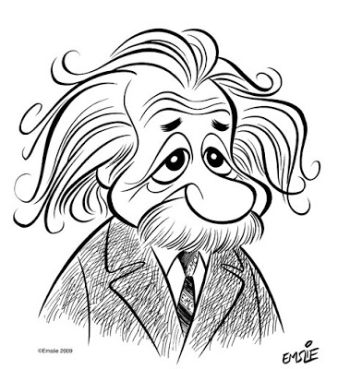


OpenAIRE technical infrastructure
Deposit products (DOI)
Stats:
Research impact
Open Science monitor
Claim links between products
fund
01101010
01100001
11010010
01101010
01100001
11010010
01101010
01100001
11010010
fund
01101010
01100001
11010010
01101010
01100001
11010010
23M publications
600,000 datasets
500,000 links
3250 repositories
De-duplicate
Inference
Harvest
Harmonize
Repositories of publications, datasets,
projects, software and other products

Slide 7

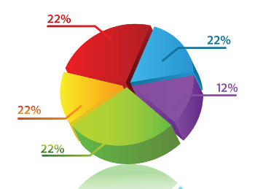


Open Science as-a-Service (OSaaS)
Researchers
OSaaS
Search-Navigate-Monitor-Research Impact
Stream
Funder
Research Community (Infrastructure) Dashboard
Organization
Project
community
Catch-All-Notification Broker
Software
Product
source
Articles
Publication
Data
Software
Subscription & Notification
Projects
Data
Packages
Articles
Data
Software
Repositories

Slide 8
Open Science as-a-Service
Research Community Dashboard

Slide 9
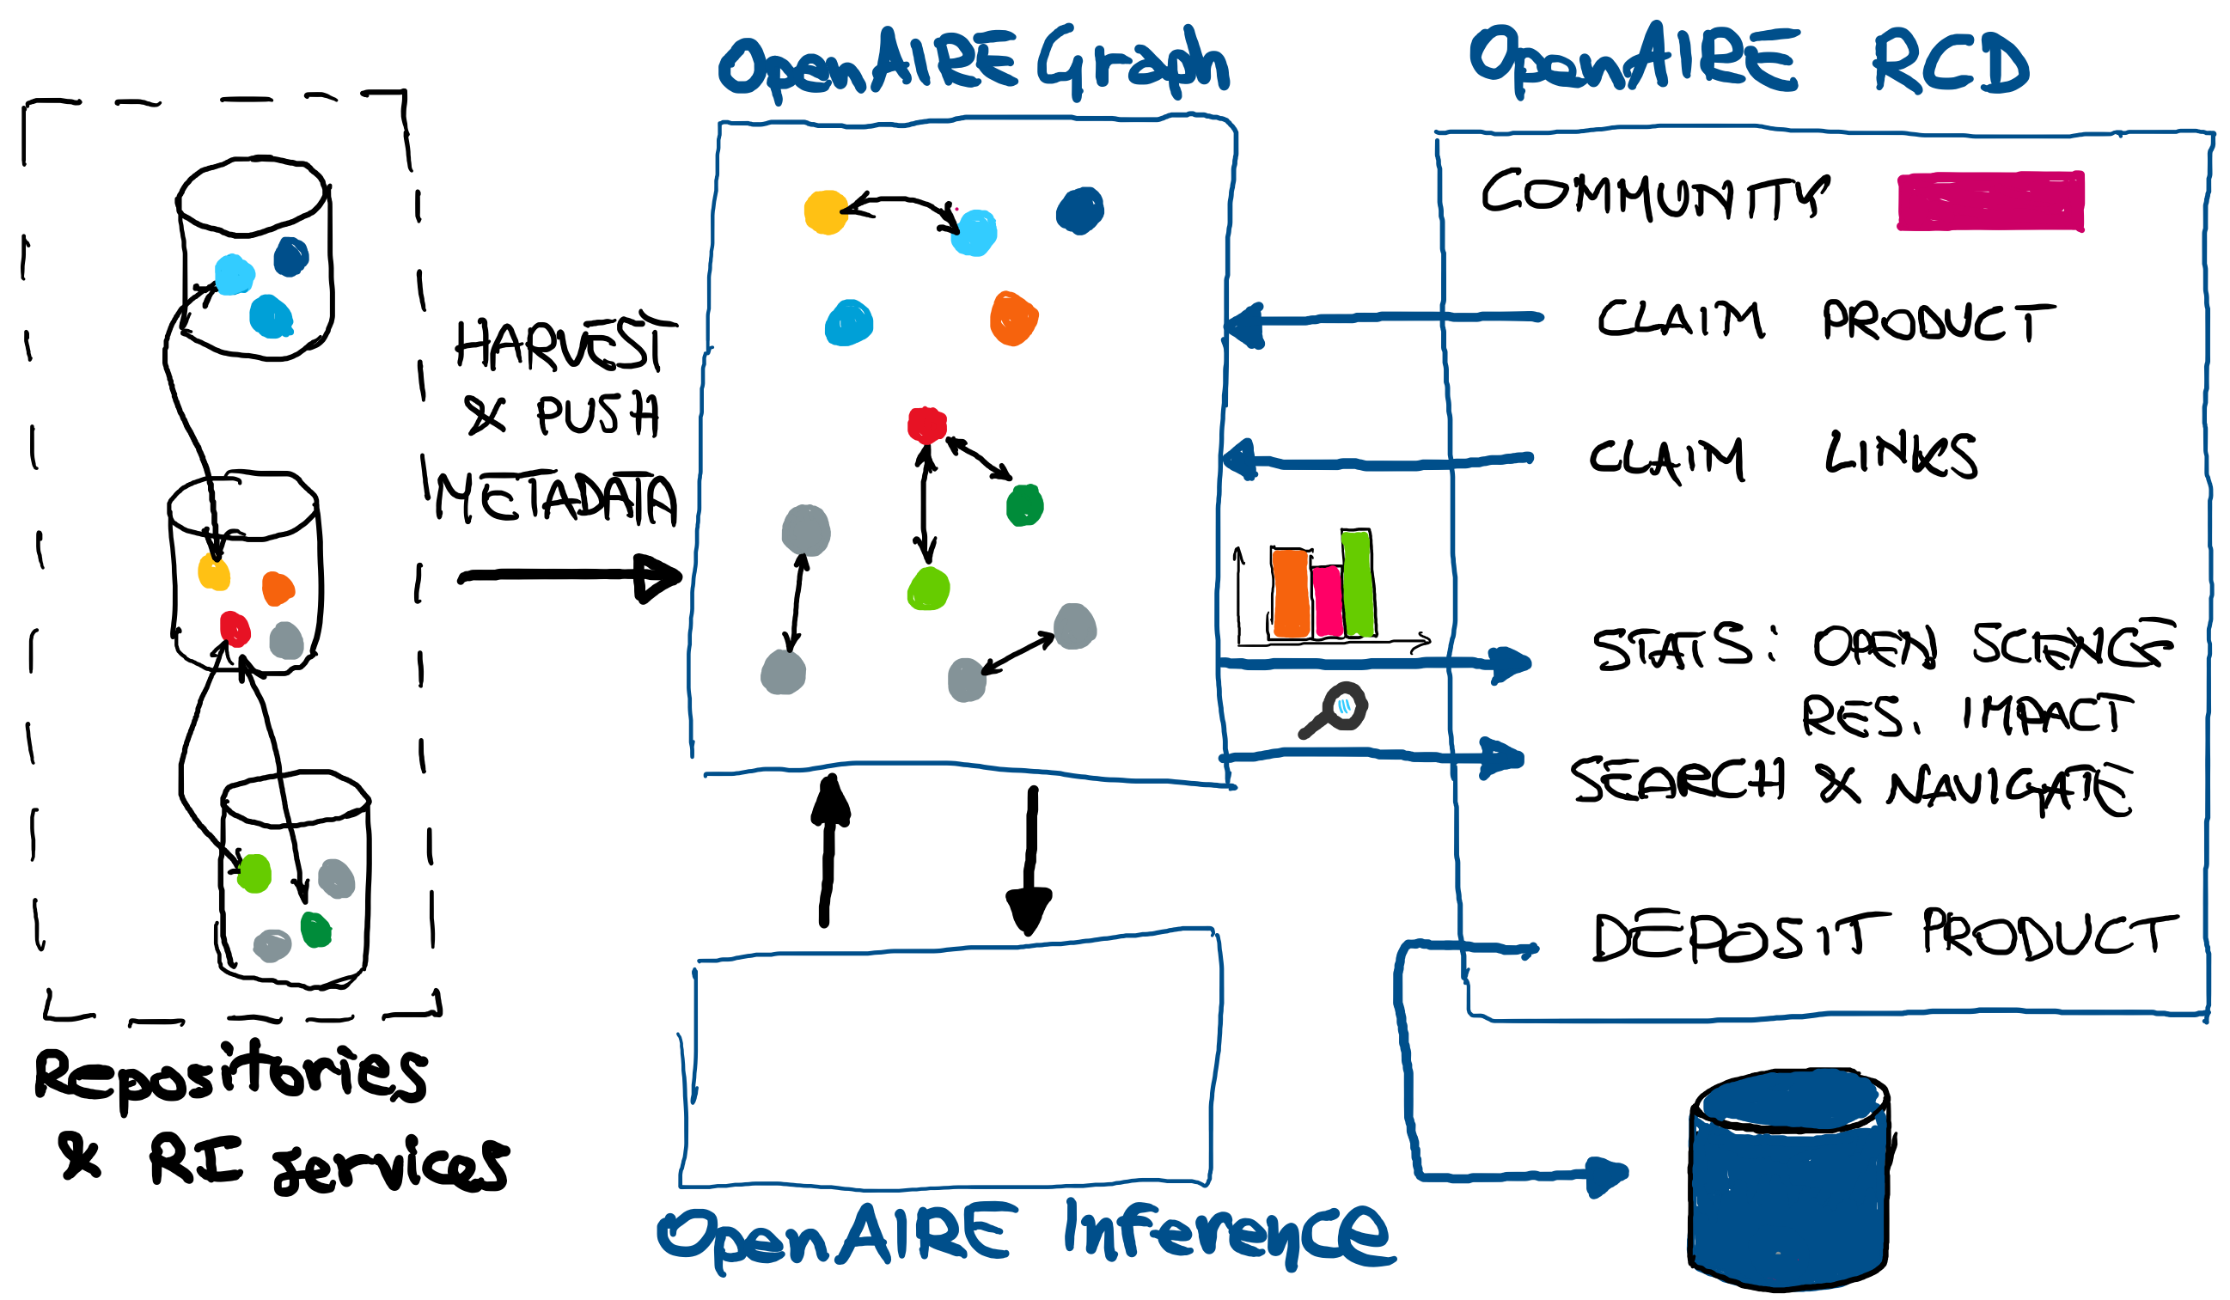
Research Community Dashboard

Slide 10
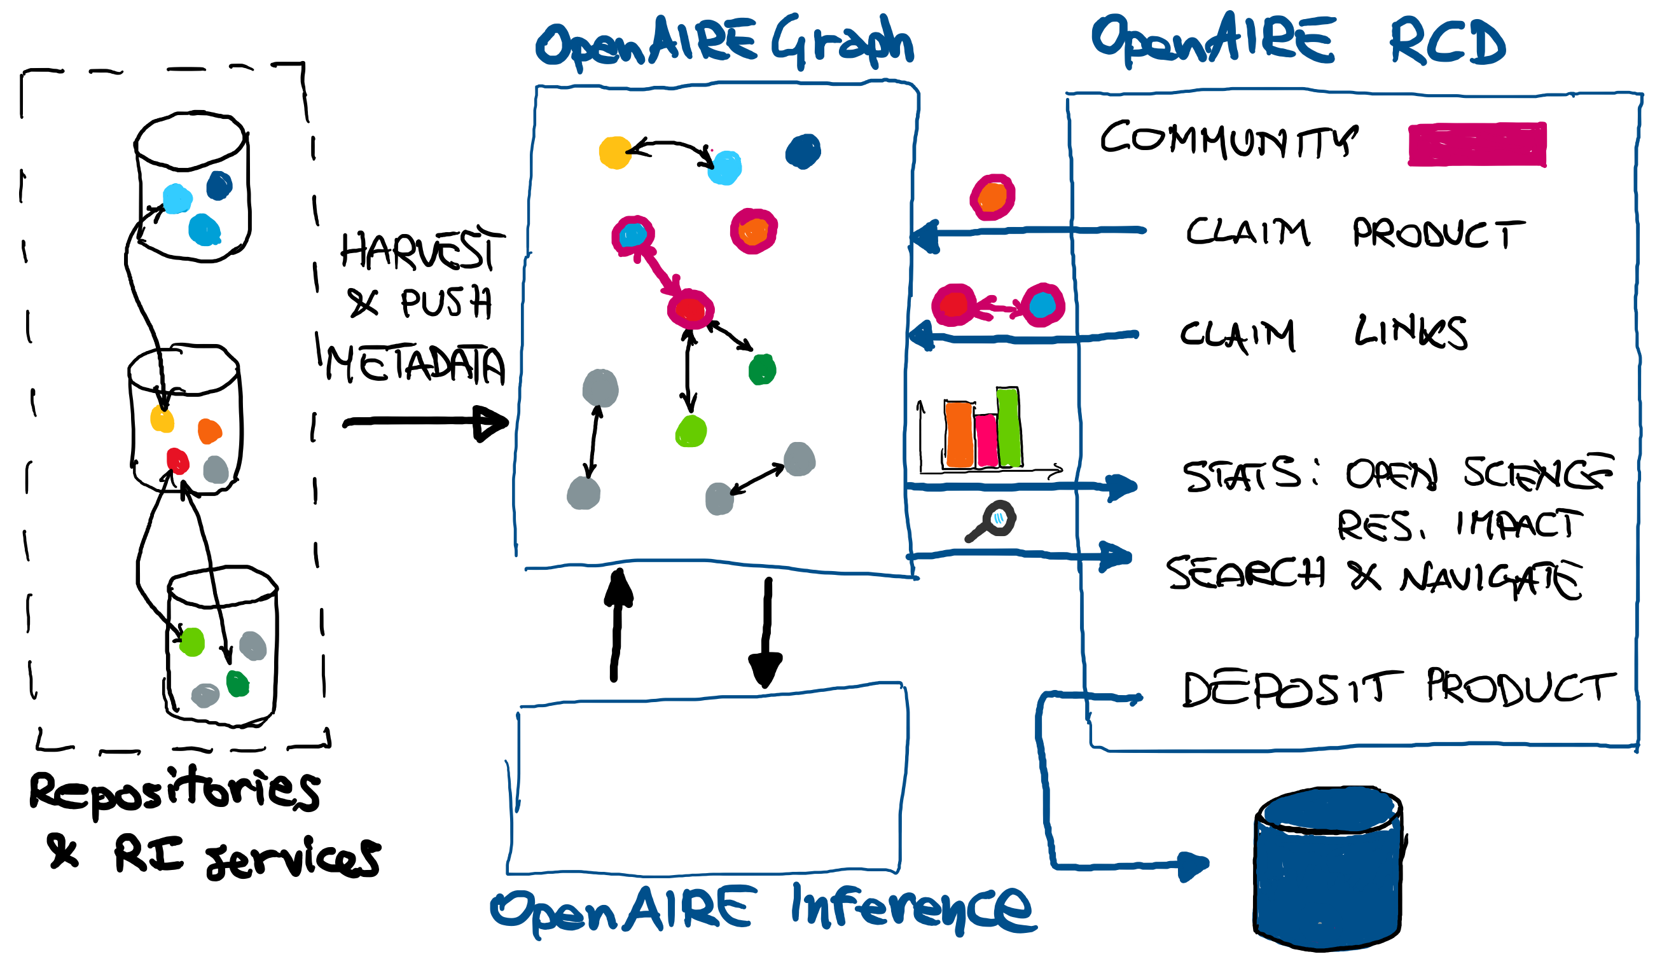
Research Community Dashboard

Slide 11
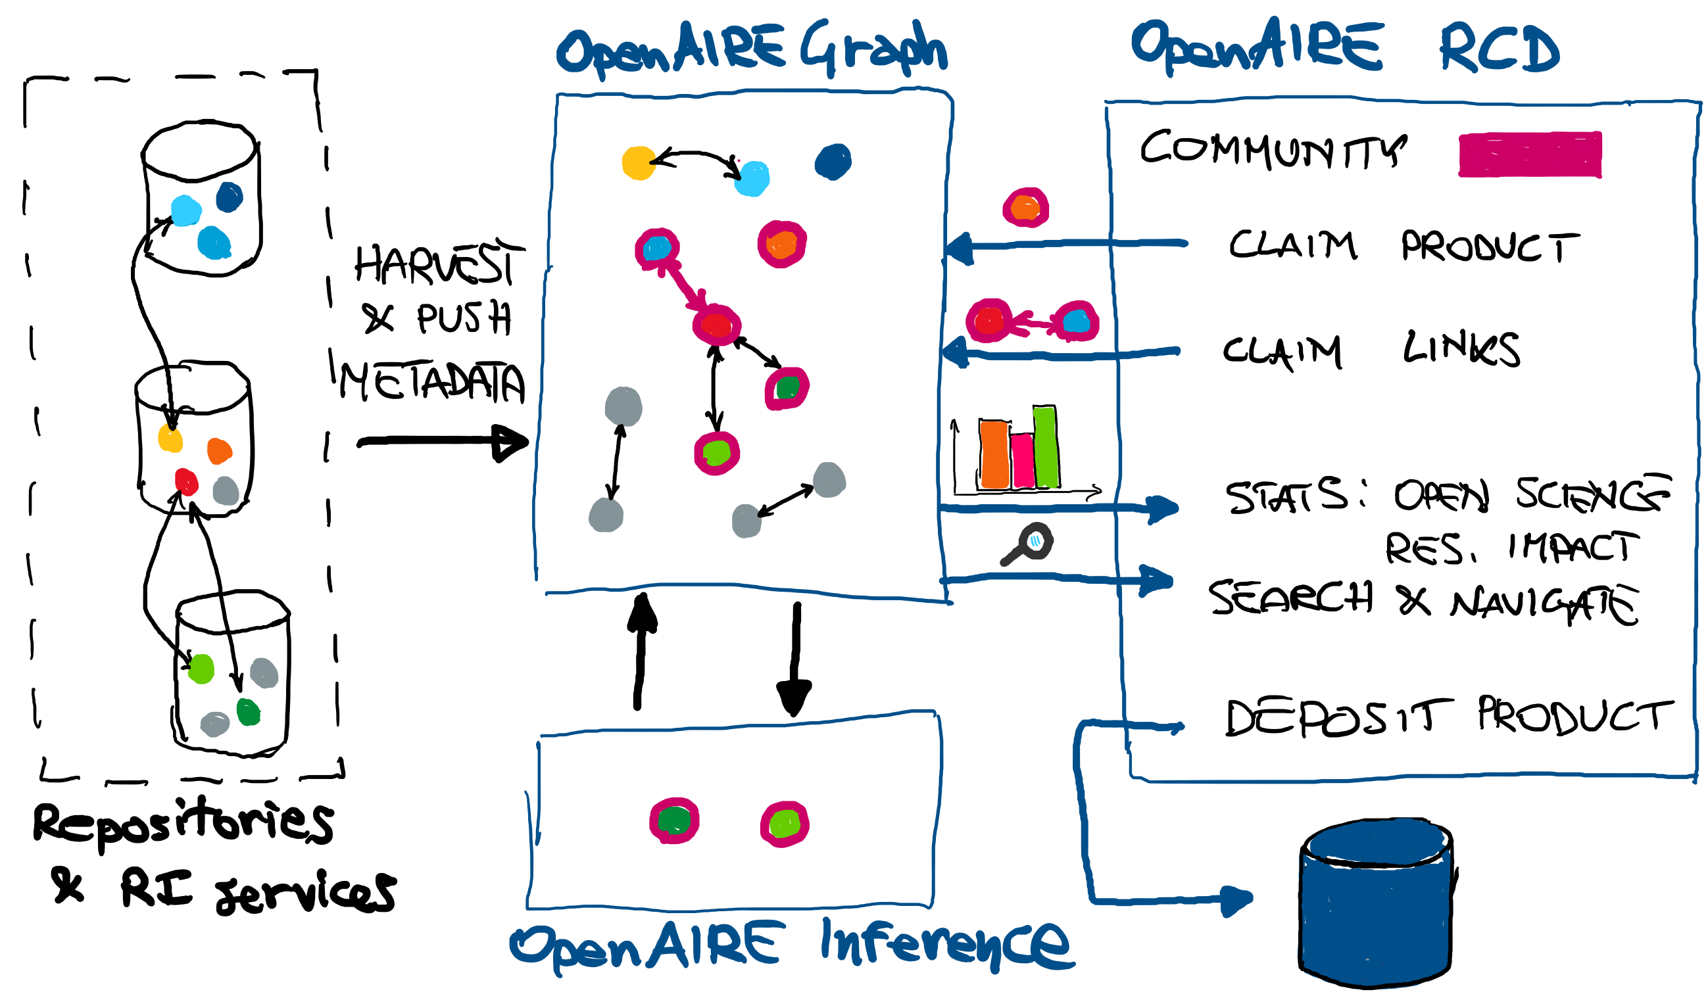
Research Community Dashboard

Slide 12
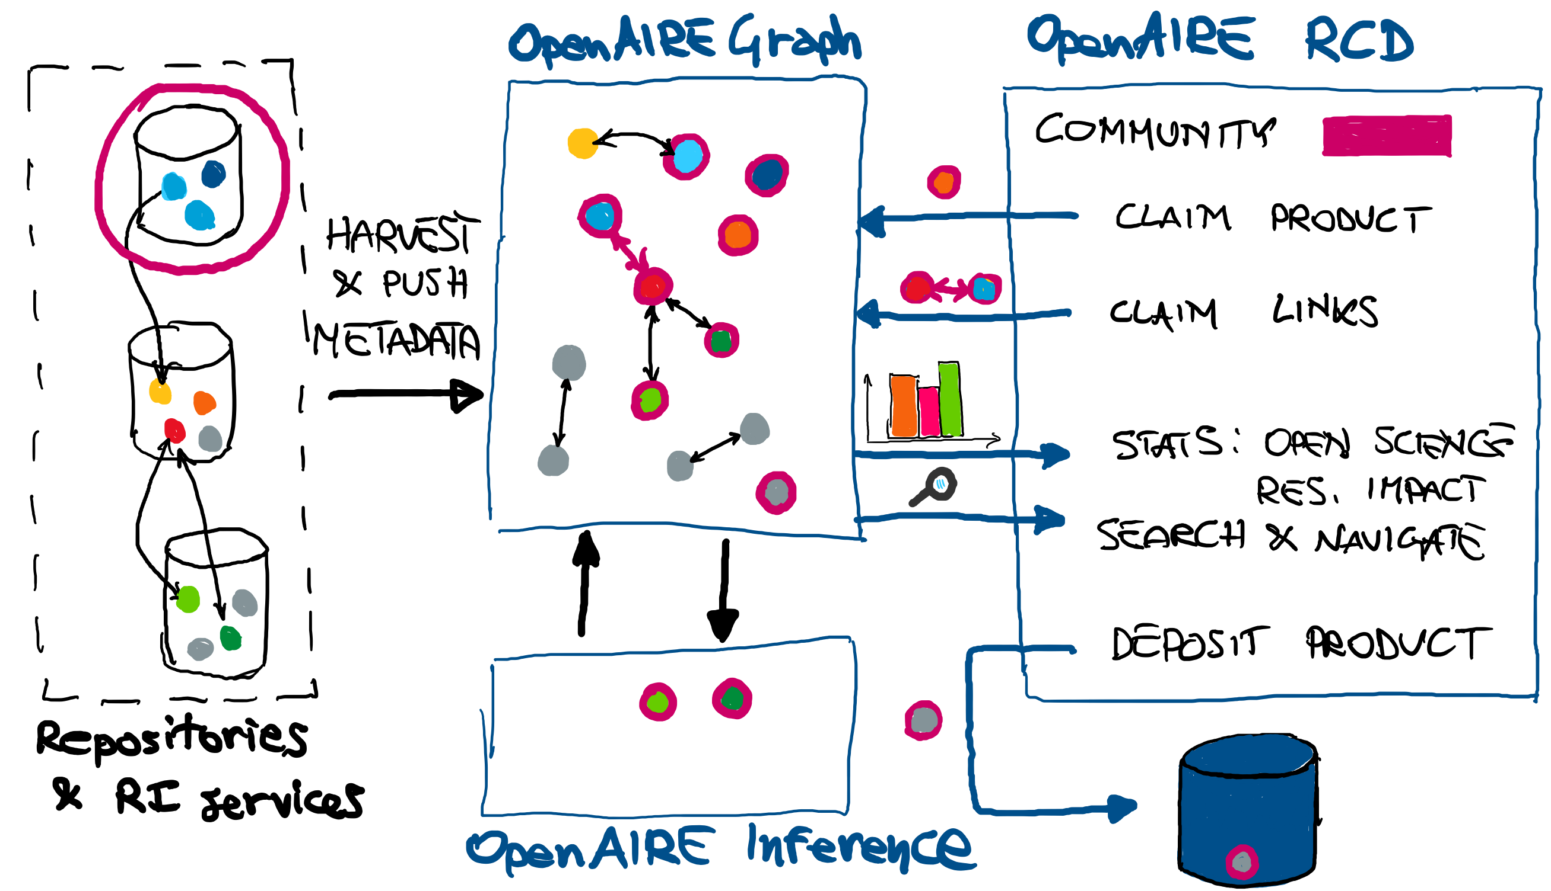
Research Community Dashboard

Slide 13
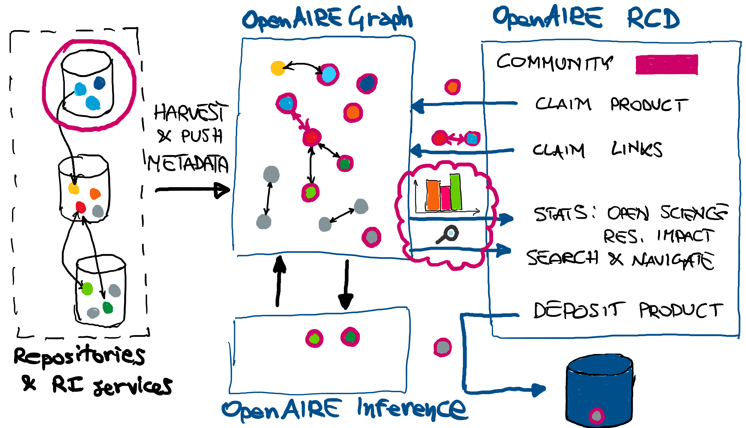
Research Community Dashboard

Slide 14
Benefits for research communities
Community-oriented Open Science publishing tools
Collaborative curation of a community-specific scholarly communication information space
Community-oriented research impact and Open Science monitoring
Scientists can continue using RI services and publishing practices, but, if needed, can find support for publishing/interlinking any kind of products
Community information space to share, discovery, interlink, and reuse (reproduce) scientific results
Reporting to funders, development of scientific reward strategies inclusive of all products of science

Slide 15
OpenAIRE Research Communities
EGI (Marios Chatziangelou, Giuseppe Della Rocca)
Fishery and Acqaculture (Julien Barde)
Marine Environmental Science (Stephane Pesant)
Neuroinformatics (Christian Barillot
PARTHENOS (Franco Nicolucci, Achille Felicetti)
Environment and Economy (Phoebe Koundouri, Achilleas Vasillopulous)
On board
ELIXIR (Rafael Jimenez, Theodore Dalamagas, Thanasis Vergoulis)
INSTRUCT (Evangelia D. Chrysina, Antonio Rosato, Chris Morris)
OpenRiskNet (Haralambos Sarimveis, Thomas Exner)
Ecology and Evolution (Antica Culina, KNAW)
EGA (Jordi Rambla, Mauricio Moldes)
Da|ra (Brigitte Hausstein)
Under
evaluation

Slide 16
Open Science as-a-Service
Catch-All Broker Service

Slide 17
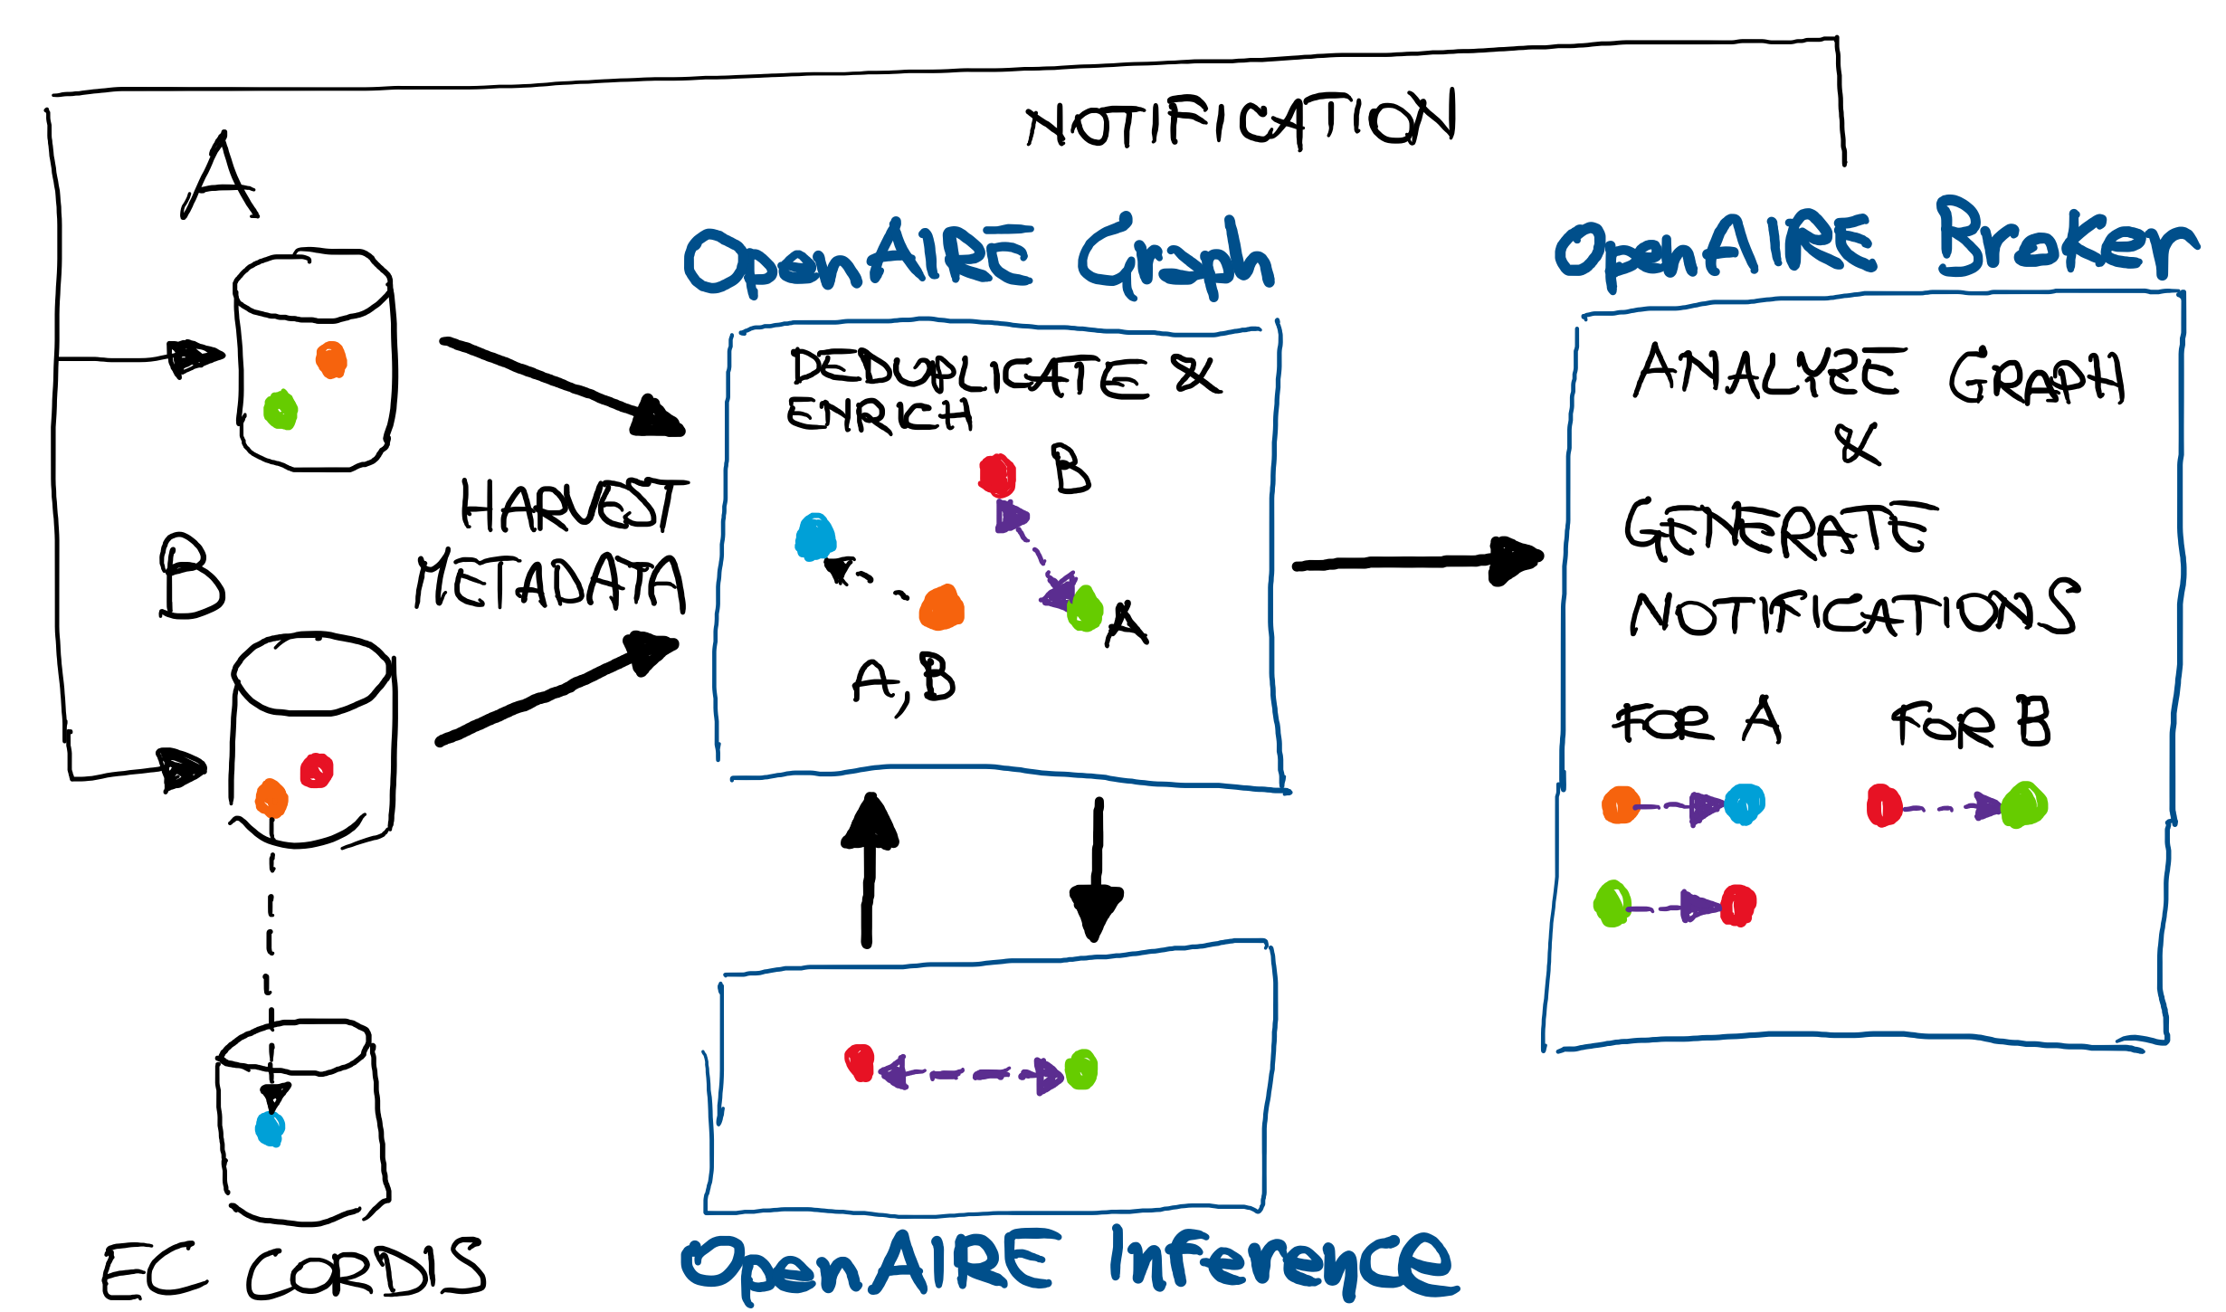
Catch-All Broker Service

Slide 18
Benefits for repositories
“Almost real-time” exchange of information: notifications about links to other products, missing properties, missing products, and possible errors in the metadata
Extending repository metadata models to Open Science practices
Promoting addition of links from/to products of any kind
Keeping their collection up-to-date: alerts, enrichments, additions
Fostering notification-based and federated dissemination of knowledge
Promoting repositories as pro-active and interactive elements of the scholarly communication Infrastructure
Notes:
Open Science enabling factors:
Publishing of all kinds of research artefacts
[Publishing packages of artefacts]
Publishing an up-to-date record of research artefacts metadata and links

Slide 19


OpenAIRE towards Open Science
Research Community Dashboard
Catch-All Notification Broker
Served on-demand according to the OSaaS approach
Customizable by different disciplines and providers, each with different practices and maturity levels
Framework aligning communities and repositories on practices addressing transparent evaluation and reproducibility

Slide 20
Alessia Bardi and Paolo Manghi
name.surname@isti.cnr.it

