Slide 1
The Partnership for Advanced Computing in Europe | PRACE
Marjolein Oorsprong
Communications Officer

Slide 2
PRACE | Communications
Target Audiences
Scientific communities
Industry
Education
Policy makers and funders
HPC ecosystem (other RI, HPC technology developers & vendors, …)
Press & media
General public, interlocutors
PRACE organisation and governance (internal)

Slide 3
PRACE | Communications
Targeted Communication (1 of 4)
Industry > PRACE SHAPE Programme
prace-ri.eu/hpc-access/shape-programme/
Notes:
SHAPE, the SME HPC Adoption Programme in Europe is a pan-European, PRACE-based programme supporting HPC adoption by SMEs. The Programme aims to raise awareness and equip European SMEs with the expertise necessary to take advantage of the innovation possibilities opened up by High Performance Computing (HPC), thus increasing their competitiveness.
HPC is a powerful technology that can enable the development of new products or services, reduce time-to-market and cost of R&D or increase quality. The opportunities opened up by HPC are vast and an increasing number of SMEs turn to HPC in order to create new business opportunities.
The Programme will help European SMEs overcome barriers to using HPC, such as cost of operation, lack of knowledge and lack of resources. It will facilitate the process of defining a workable solution based on HPC and defining an appropriate business model.
SHAPE flyer, webpages on prace-ri.eu

Slide 4
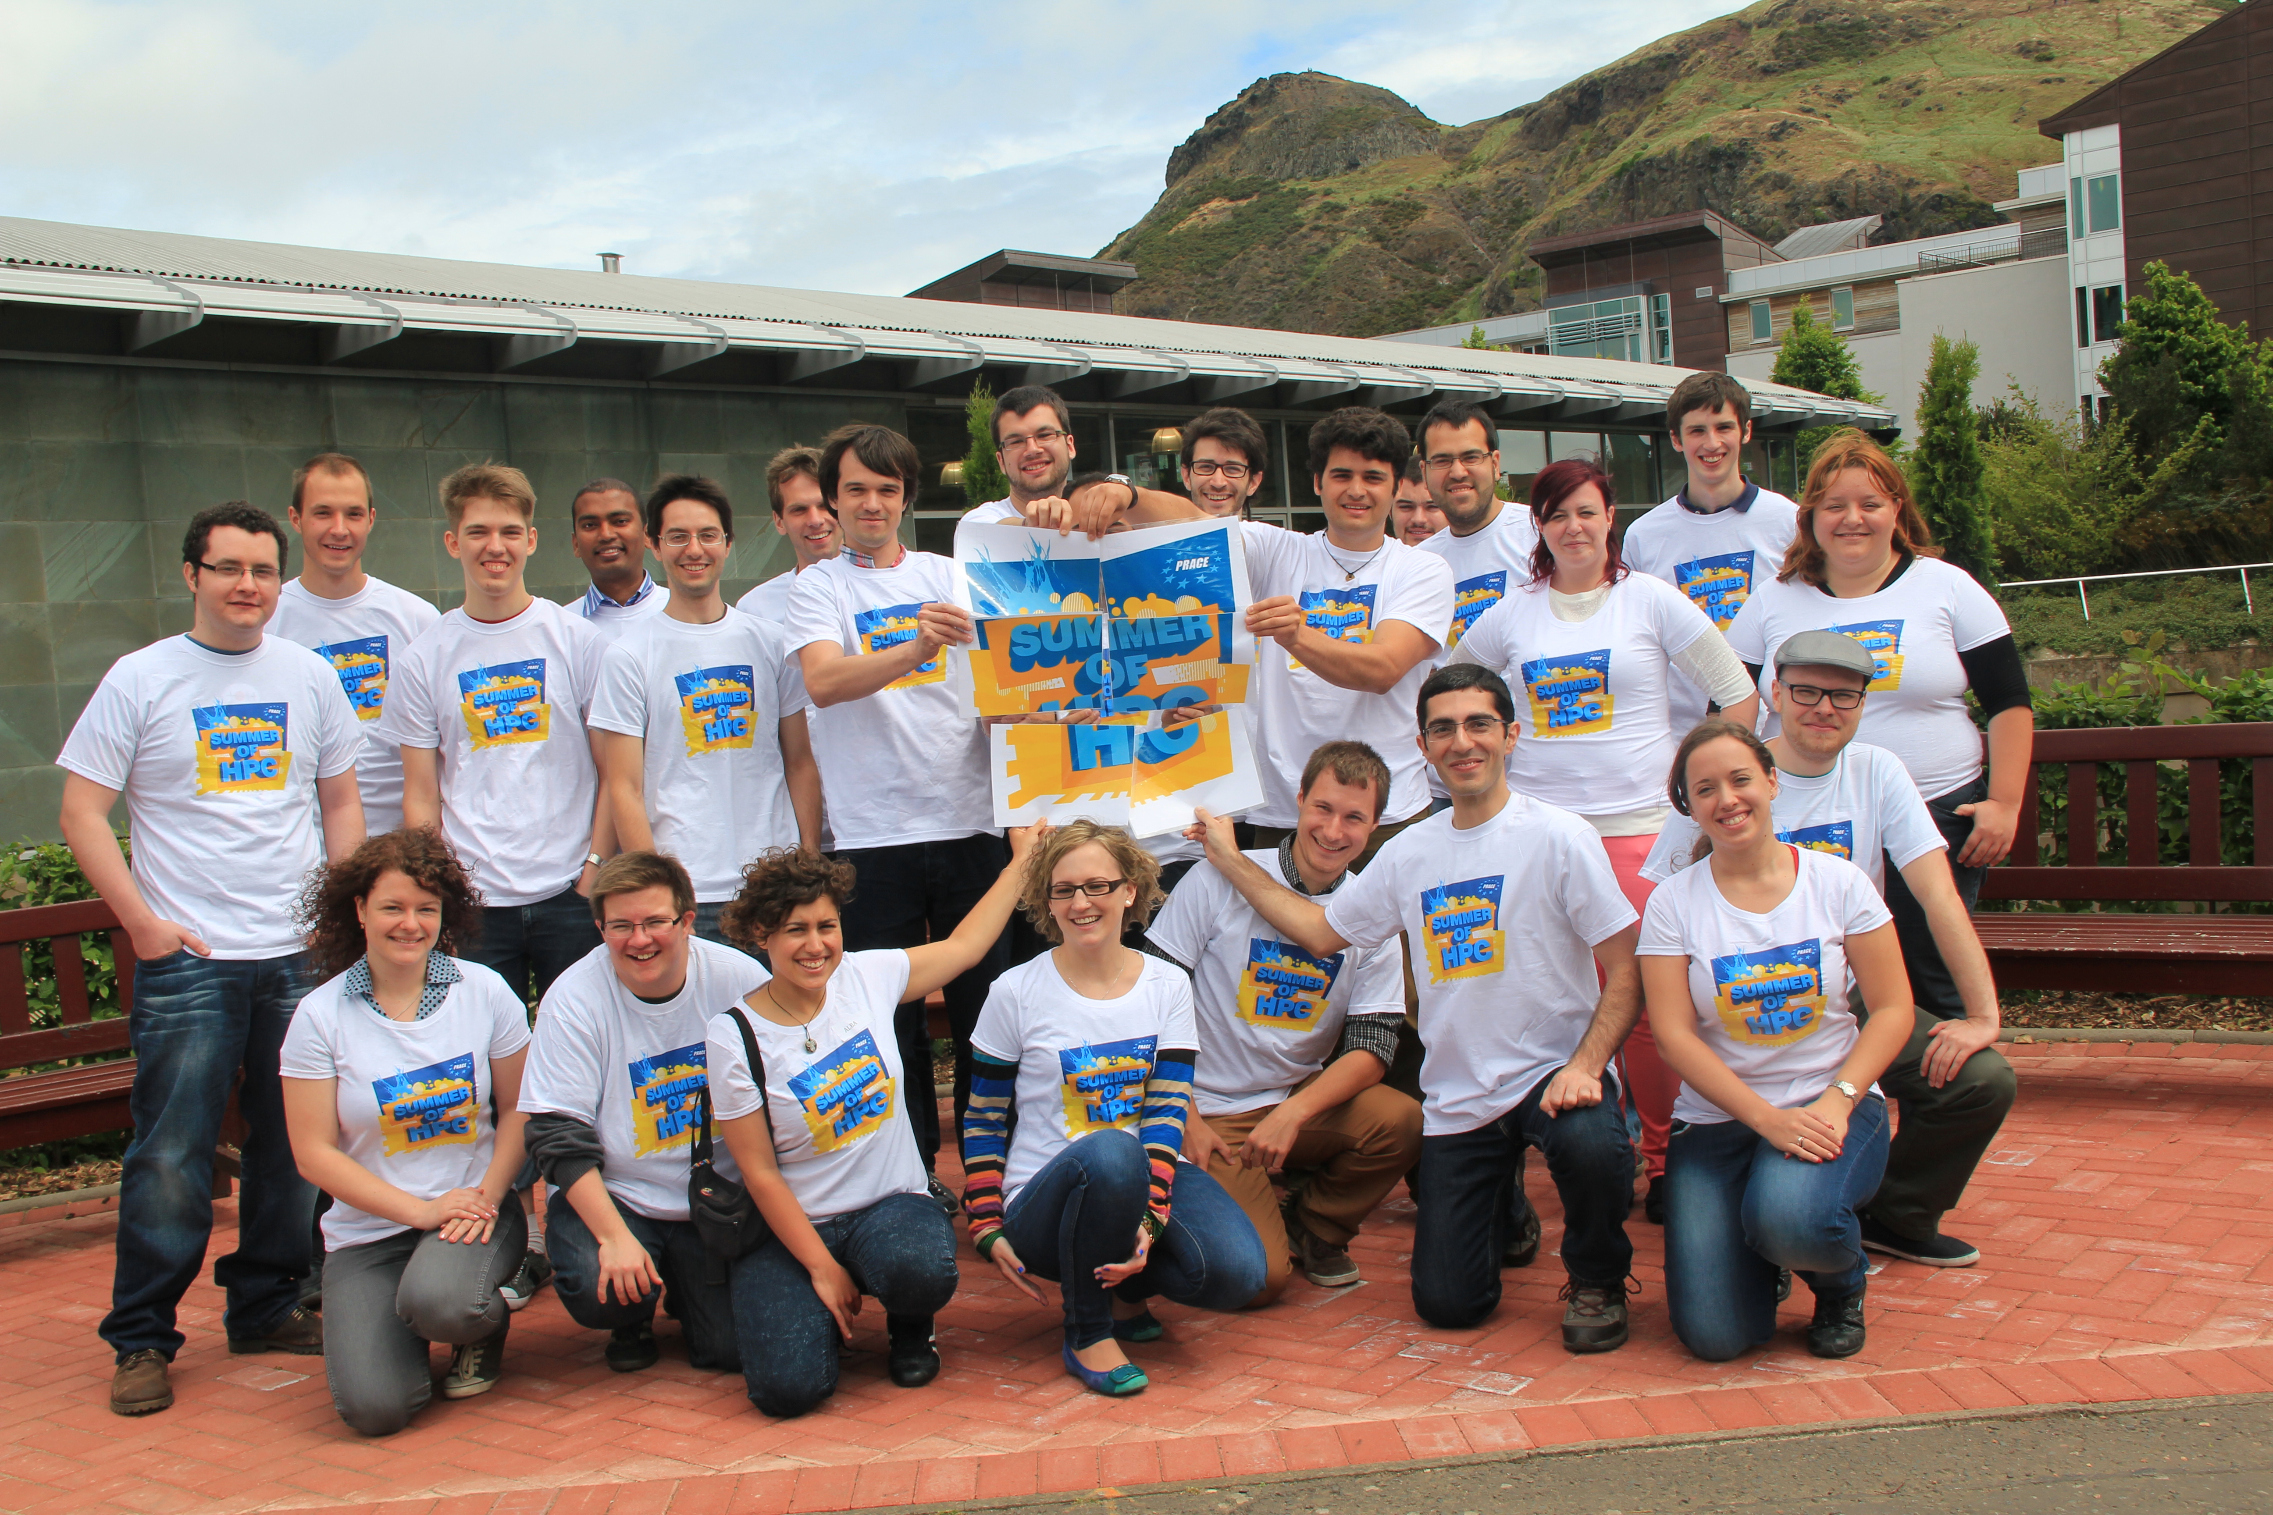
PRACE | Communications
Targeted Communication (2 of 4)
Education > PRACE Summer of HPC Programme
summerofhpc.prace-ri.eu/
Notes:
Dedicated webpage
Blog
Facebook > www.facebook.com/SummerOfHPC
YouTube > www.youtube.com/channel/UC1pO4e1CvNnaxB0YoKgOS2w
Twitter > @SummerOfHPC

Slide 5
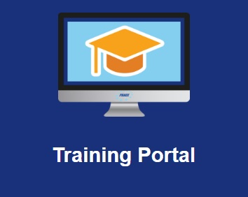
PRACE | Communications
Targeted Communication (3 of 4)
Education > Outreach to Universities
prace-ri.eu/outreach-to-universities/
Notes:
PRACE’s one-stop shop for the latest student-centric information, educational opportunities and more
Activities are especially designed to encourage advanced HPC, Computational Science, Simulation and Data Science studies and highlight their benefits and value.

Slide 6
PRACE | Communications
Targeted Communication (4 of 4)
General Public > Science Fairs & Museums, Games
www.prace-ri.eu/game_corner
Notes:
Shooting stars came out of the PRACE-1IP “Dare to Think the Impossible” campaign that targeted school kids with videos and a game – to gain their interest in supercomputers > http://www.prace-ri.eu/daretothinktheimpossible/

Slide 7
PRACE | Communications
Measure Impact
Social media statistics via HootSuite
Google analytics for the PRACE website
Analytics via our MailerLite mass mailing system
Media analytics for advertisements (in preparation)

Slide 8
PRACE | Communications
Contact Marjolein Oorsprong
http://www.prace-ri.eu/contact-prace
Phone (office direct): +32 2 613 09 27
M.Oorsprong@staff.prace-ri.eu
Notes:
We do not send messages on behalf of other organisations via our MailerLite system ( > 11 000 contacts)

