Slide 1

The European Open Science Cloud
Matthew Viljoen, EGI Foundation
(Slides kindly provided by Carmela Asero, EOSC

Slide 2
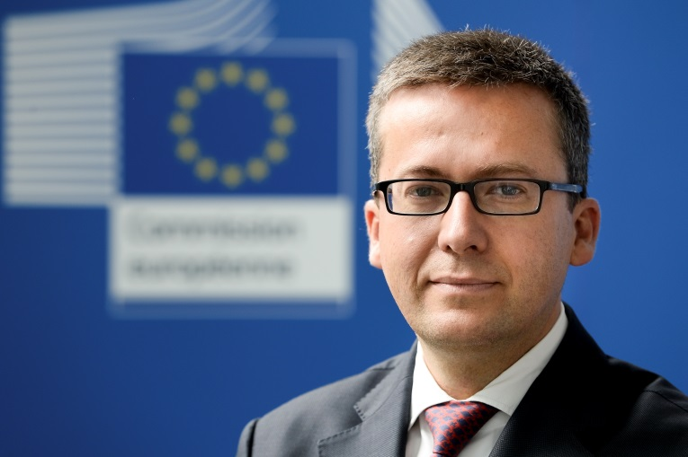
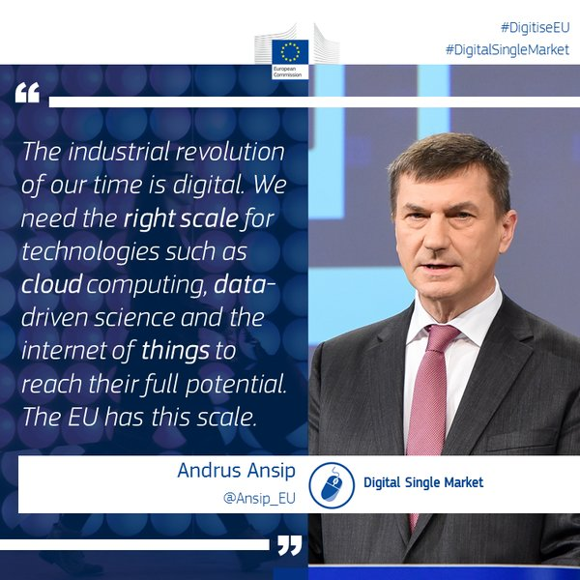
The Commission vision
"Europe's final transition must be one from fragmented data sets to an integrated European Open Science Cloud. By 2020, we want all European researchers to be able to deposit, access and analyse European scientific data through a European Open Science Cloud.."
Speech by Commissioner Carlos Moedas in Amsterdam, NL: “Open science: share and succeed”, 4 April 2016
Notes:
2

Slide 3
COM 2016/178 - European Cloud Initiative : 3 pillars (19 April 2016)
https://ec.europa.eu/digital-single-market/en/news/communication-european-cloud-initiative-building-competitive-data-and-knowledge-economy-europe
1. European Open Science Cloud (EOSC)
  Integration and consolidation of e-infrastructures
  Federation of existing research infrastructures and scientific clouds
  Development of cloud-based services for Open Science
  Connection of ESFRIs to the EOSC
2. European Data Infrastructure (EDI)
  Development and deployment of large-scale European HPC, data and network infrastructure
3. Widening access and building trust
  eGovernment (EU eGovernment Action Plan 2016-2020 – accelerating the digital transformation of government) SMEs, industry, citizens.
DG RTD

Slide 4
Key challenges
Still a lack of widespread awareness of the value of data and of incentives for data sharing.
Lack of common standards to ensure inter-operability of data.
Not enough hardware capacity for scientific computing, storage, connectivity.
Fragmentation and lack of coordination over different scientific communities and countries.
Need to translate recent changes in privacy, data protection and copyright rules to the research data domain.

Slide 5
EOSC: the vision
The cloud will federate existing and emerging horizontal and thematic data infrastructures, effectively bridging todays fragmentation and ad-hoc solutions.
It will provide 1.7m EU researchers an environment with free, open services for data storage, management, analysis and re-use across disciplines.
It will add value (scale, data-driven science, inter-disciplinarity, data to knowledge to innovation) and leverage current and past infrastructure investment (10b per year by MS, two decades EU investment)..

Slide 6
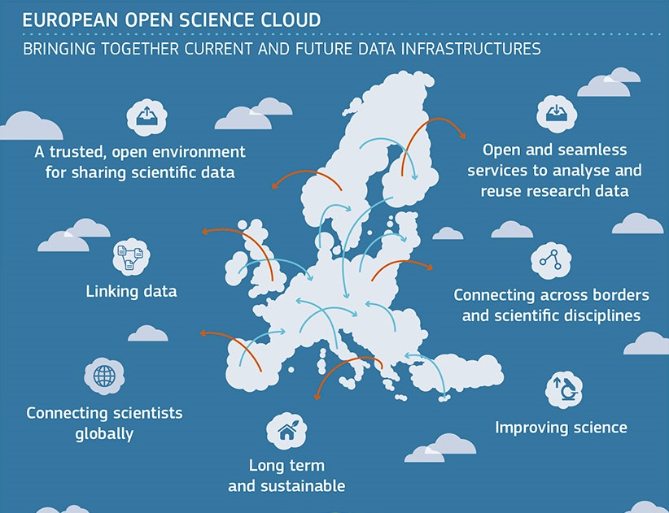

Slide 7
A truly common European vision
The European Commission (e.g. DG RTD, DG CNECT)
OSPP - representing all sectors, including business (19 Sept 2016)
8 (technical) Expert Groups – notably HLEG - EOSC
Member States (ministries & national funding agencies)– workshop on 29 June 2016
Council - 29 November 2016 COMPET Council: first state of play on the EOSC
EP (ITRE, IMCO) – INI Report expected in Jan 2017
EESC, CoR and other stakeholders with advisory roles
Discipline specific scientific communities & participants in H2020 execution (e.g. Dec 2016 – start of INFRADEV-4 project)
Global partners(e.g. OECD, G7) - March 2017 joint workshop

Slide 8
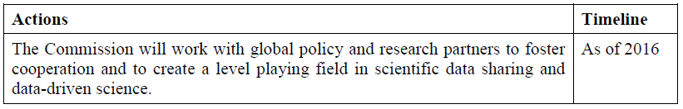
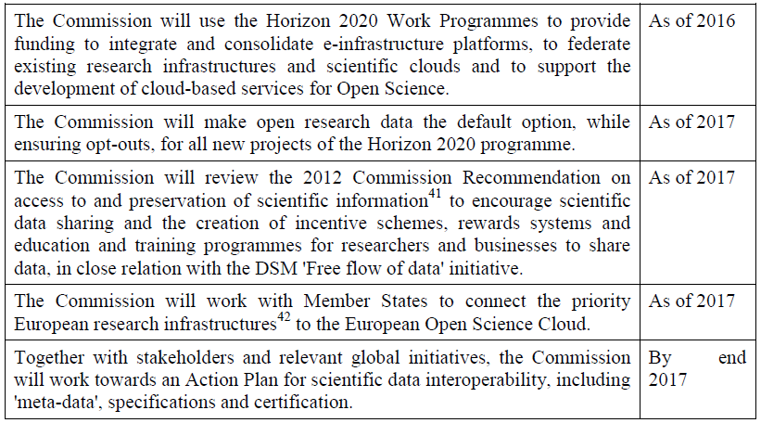

Vision & Action
European Open Science Cloud (EOSC)
OECD, RDA, G7
WP2018-20
01.01.2017
EG on Rewards &
EG on Skills
FAIR Action Plan
DG RTD

Slide 9
Commission High Level Expert Group
European Open Science Cloud (HLEG EOSC)
Set up on 16 September 2015.
Mission: vision for EOSC and recommendations
10 members – 8 EU and 2 non-EU observers (JAP/AUS).
Chair: Professor Barend Mons until December 2016.
Listed in the Commission transparency register.
4 meetings, 2 stakeholder workshops, several external presentations, extensive community engagement.
Report on 10 October 2016, > 2000 downloads, one of biggest Communication successes of DG RTD
9

Slide 10
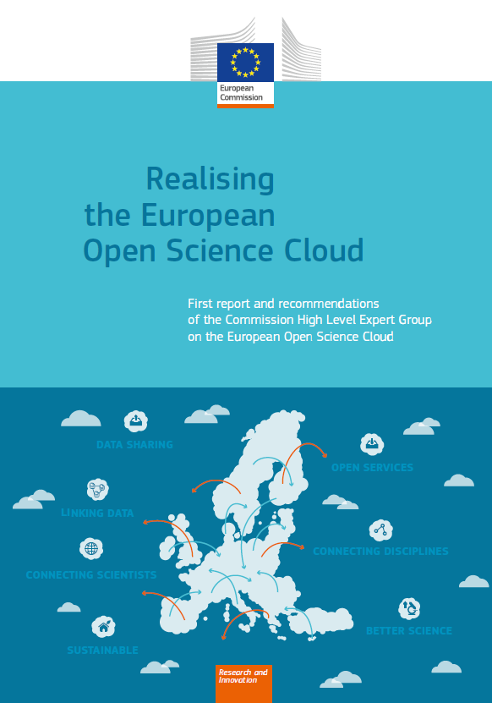
HLEG EOSC report (11 October 2016)
Publication of First report by the Commission High Level Expert Group on the European Open Science Cloud
Including recommendations on Policy, Governance and Implementation
http://ec.europa.eu/research/openscience/index.cfm?pg=open-science-cloud

Slide 11
Recommended Action in the HLEG Report
Innovative (new) funding schemes.
Connect key national scientific data infrastructure / ESFRIs ("the gems" of Europe).
Modern reward and recognition practices to support data sharing and re-use.
Training and career perspective for core data experts (fund a concerted effort to locate and develop Data Expertise in Europe).
Cross-disciplinary collaboration: review, funding and infrastructure.
Data formatting, terminology/identifier mappings and provenance to be organised –interoperability plans (DMPs).
One governance (light, international).
Rules of Engagement for both use and service provision in the EOSC.
Appropriate data management and stewardship of research proposals and funding.

Slide 12
EOSCPilot project
To support the Commission in the first phase in the development of the European Open Science Cloud (EOSC).
WPs on
  Governance, Policy, Architecture
  Science Demonstrators and Services
  Interoperability
  Skills
  Stakeholder Engagement
http://cordis.europa.eu/project/rcn/207500_en.html
http://www.eoscpilot.eu/

Slide 13
EOSC funding and governance – Phase 1 – 2017/19 (simplified)
Integration of e-infrastructures
EGI
EUDAT
GEANT
Very
many
others…
Space data
Horizon
2020
Catalogue of services
Federation of scientific data infrastructures
Member
States
+ RFOs
Thematic
Clouds
Connecting
ESFRIs
Governance mechanism
Aggregation of needs
Joint programming
Join procurement
FAIR data sharing
Metadata
Certification
Data stewardship
Scientific users
DATA & SERVICES
Universities
ESFRIs
as users
Research
libraries
EIROs
RTOs
National
research
centres
Data
repositories
Notes:
13

Slide 14
EOSC funding and governance – Phase 2 – 2020 (simplified)
Action Plan on FAIR Data
Single EOSC legal vehicle
EU
Joint
e-infrastructures
EOSC catalogue
of FAIR data
Joint programming
for research data
Joint procurement
tool
Member
States
+ RFOs
ESIF support
… …
Human
resources
EOSC governance
board
Global
partners
Scientific users
DATA & SERVICES
Universities
ESFRIs
as users
Research
libraries
EIROs
RTOs
National
research
centres
Data
repositories
Notes:
14

Slide 15
Thank you
Matthew Viljoen
matthew.viljoen@egi.eu
EOSCpilot Service Pilots task leader

Slide 16
Supplimentary slides

Slide 17
Commission High Level Expert Group
European Open Science Cloud (HLEG EOSC 2017-18)
Setup in May 2017. First meeting: end of June 2017
Mission: advise on practical implementation (governance, funding, legal, organisational aspects)
Chair: Silvana Muscella
e-IRG delegate Toivo Räim is member of this group
10 members – 8 EU and 2 non-EU observers (USA/AUS)
Soon to be published in the Commission transparency register.
4 meetings, (co-located) workshop(s), several external presentations, extensive community engagement.
Final report expected by end of 2018
17

Slide 18
EOSC Summit 12 June 2017
Data culture, data stewardship, practical and policy tools
Adoption and implementation of FAIR data principles
Research data infrastructures and services
Sustainable funding and governance
High-performance computing, big data & super-connectivity
Webstraming
https://webcast.ec.europa.eu/european-open-science-cloud-summit
18

Slide 19
Work Programme 2018-20
One or more new topics for EOSC very probably included in next WP. Additional funding to be provided by the EC for the EOSC, especially to support setup of the governance, federation, coordination activities across Member States and others.
Options for these actions, with different sets of instruments, under discussion.
RI Programme Committee – initially planned mid-June postponed to last week of June to allow fine tuning of EOSC related actions with outcome of EOSC Summit.
e-IRG activities taken into account, likely in a different form and within governance frame.
June will be eventful…Stay tuned!
19

Slide 20
Complexity
Expert advice (OSPP, Cloud & FAIR EGs)
Governance
Sustainable business/funding model
H2020 funding – ESFRIs, INFRADEV, EINFRA
Interoperability of data & data infrastructures (Action Plan, …)
H2020 policy (ORD, DMPs & long-term preservation)
Federation of data infrastructures & services across disciplines and MS
MS policy & guidance (ORD, DMPs, …)
Interface with stakeholders (RDA, e-IRG)
Connection of major European RIs (e.g. ESFRIs & clusters)
Interface with MS (EP, RWP, ERAC, ERA WG5)
Research data from EU and MS research projects
Interface with OECD/GSF – S&T G8
Global level playing field

Slide 21
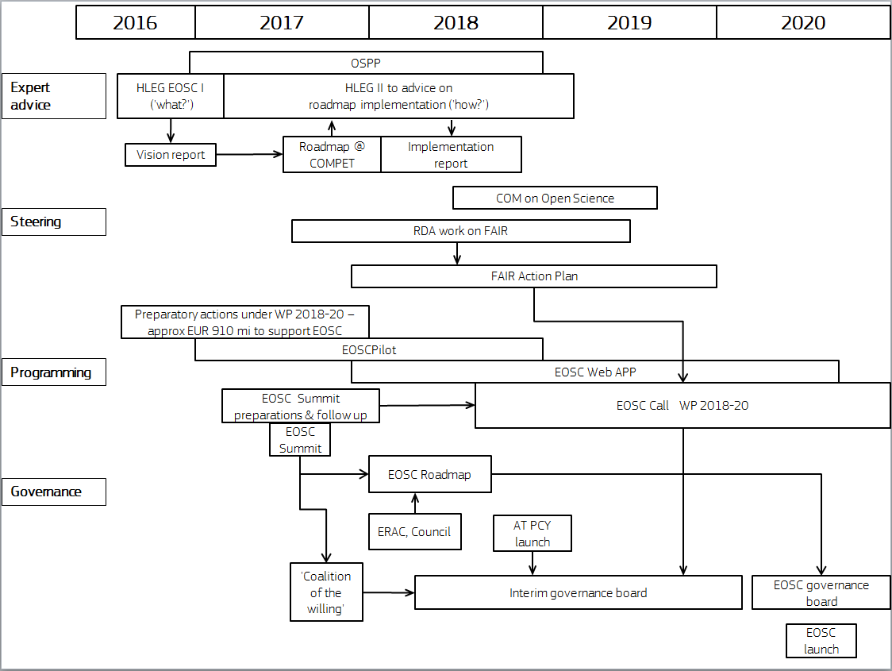
Multi-stakeholders effort
DG RTD

Slide 22

Not a cloud 'made in Brussels'

Slide 23
From vision to action: core functions of the EOSC
Data stewardship, incentives and tools – setting the framework conditions for scientists to be able to share and re-use open data (e.g. open data policies, conditional research funding, data publishing, data stewardship, DMPs),
Standard setting and certification - a common language/interface (e.g. standards for metadata, specifications for making data FAIR, certifications for data service providers).
Cataloguing of research data, service availability and user needs (i.e. a full catalogue of services needed by scientists to find, store, share and process research data).

Slide 24
From vision to action: core functions of the EOSC
Provision of core common services, ensuring affordable and sustainable access to data analytics and computation to EU researchers, regardless of their disciplines or where they are located.
Establishing rules of engagement, terms and conditions for contributing to and benefitting from data services for all stakeholders (e.g. data/service users, data providers, operators of infrastructures, commercial service providers).
Agenda setting, identifying priorities at EU level for new or upgraded research data infrastructures and services.

Slide 25
What next?
Setting up EOSC first stage implementation
EOSC Summit on 12 June 2017
(endorsing EOSC Statements)
Declaration of intent & Coalition of the Willing - end of summer 2017
Funding decision on EOSC in WP 2018-20 – Oct2017
Roadmap for governance and funding – Nov 2017
Interim EOSC governance board – winter 2017
EOSC Web App - spring 2018
FAIR Action Plan - summer 2018
CAB REQUEST
H2020 (WP 2018-20) to support
Open Data & EOSC
(3 O's Strategy)
Independent expert studies are being launched by the EC, in March-April 2017, expecting results before the end of 2017, (alternative models of governance and co-funding of the EOSC).
The H2020-funded projects EOSCpilot (DG RTD) and elnfraCentral (DG CNECT), both launched in January 2017, and the project resulting from the Call EINFRA-12-2017 (DG CNECT) will provide key building blocks in 2018, of the future shaping of the EOSC.
The first Report and Recommendations provided by the HLEG-EOSC in 2016
DG RTD

Slide 26

Roadmap for governance and funding
October 2017
4 Layers – architecture, governance, funding, timeline
2 Phases of implementation
EOSC Summit – June 2017
  OSPP Opinion – Spring 2017 → to be submitted to COMP Council
  EOSCPilot outputs – 2017-2018
  HLEG EOSC and FAIR expert group inputs
  EGI Conference Session

Slide 27
Questions?
EOSC Team
Carmela Asero
Patrick Brenier (DHou)
Jean-Claude Burgelman (HoU)
Wainer Lusoli
Mihaela Meresi
Website http://ec.europa.eu/research/openscience/eosc
E-mail RTD-EOSC@ec.europa.eu
Notes:
27

