Slide 1
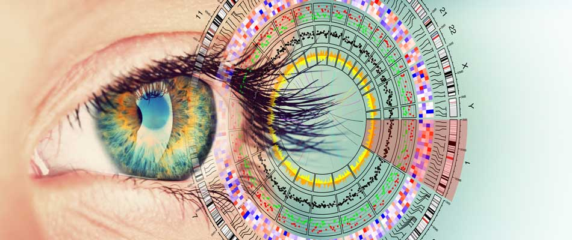

EOSC Pilot Pan Cancer Science Demonstrator update
Sergei Iakhnin
European Molecular Biology Laboratory (EMBL)

Slide 2
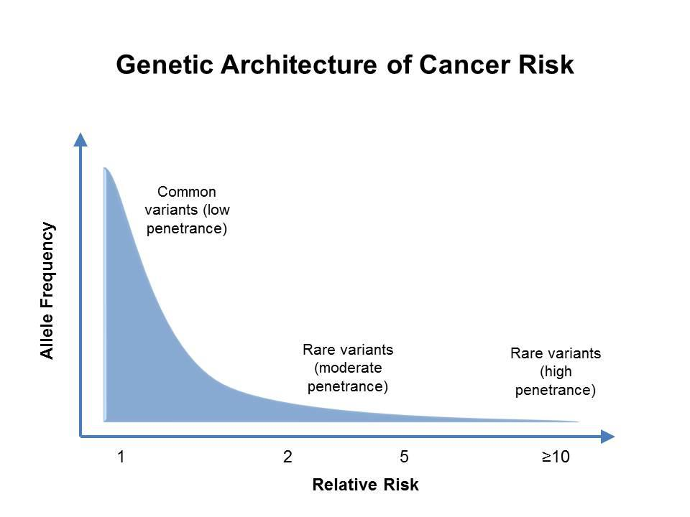
Cancer.gov

Slide 3
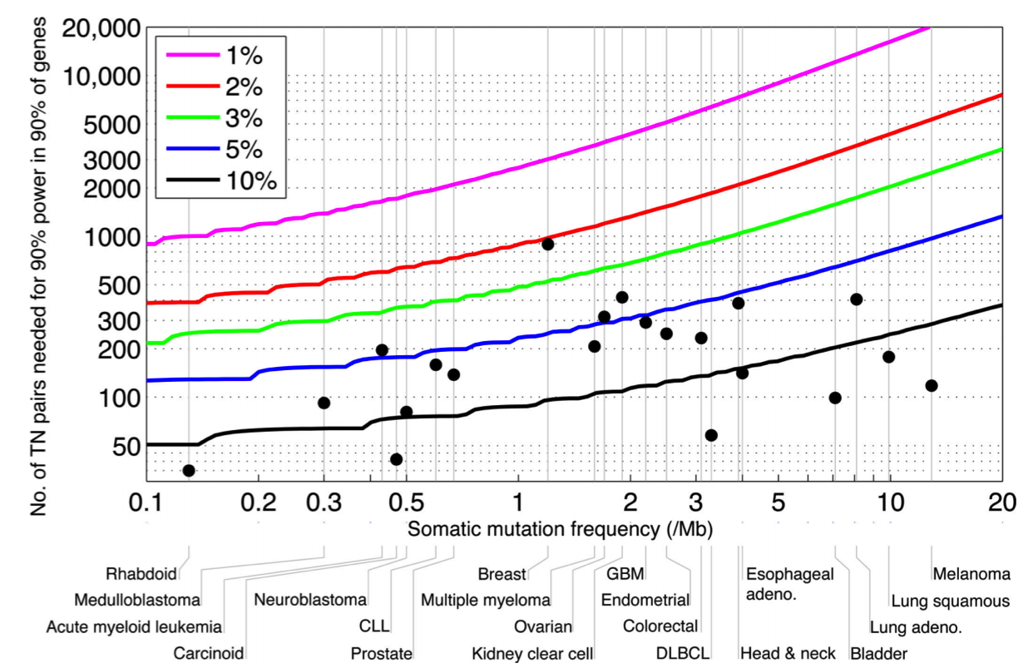
5300 samples required to detect candidate cancer genes mutated in >=2% of patients with melanoma, with 12.9 mutations per Mb
MS Lawrence et al, Nature 2014

Slide 4
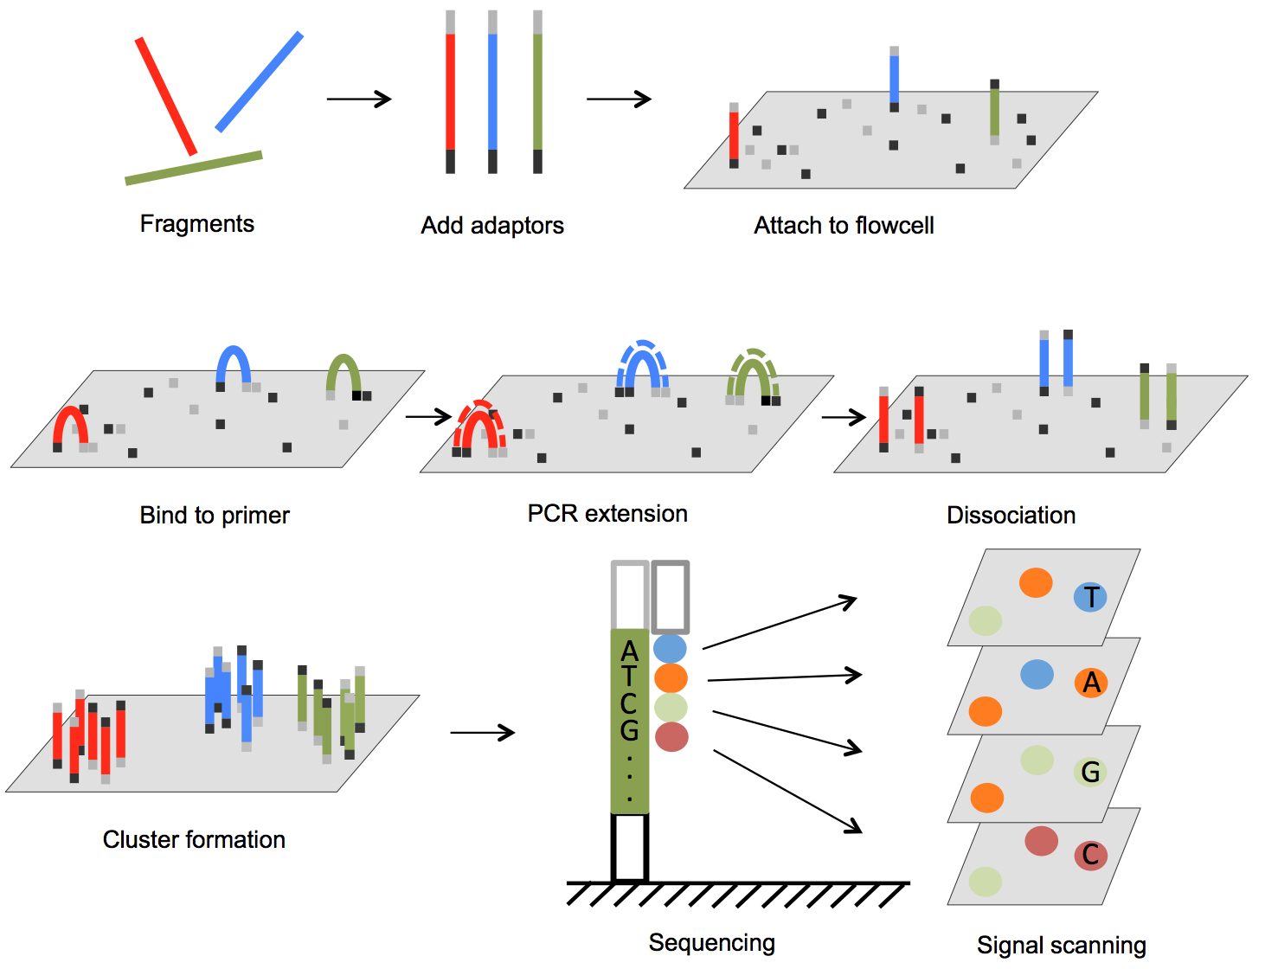
Illumina Sequencing
Yuan Lu et al. (2016)

Slide 5
Somatic Mutation Caling
Cibulskis et al., Nature Biotech 2013

Slide 6
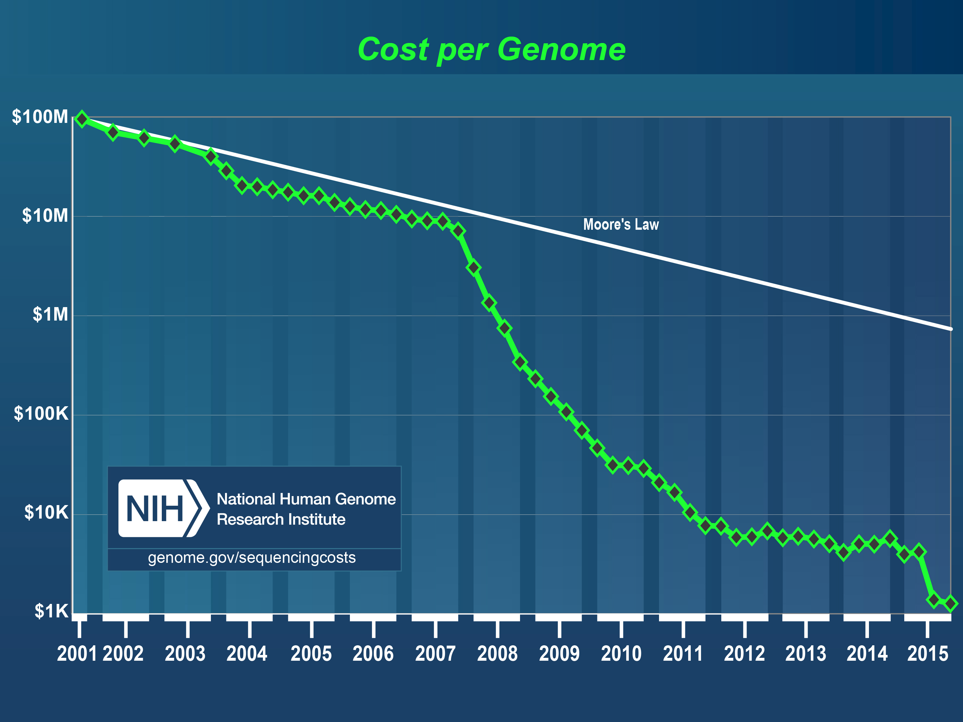
Cost of Sequencing

Slide 7
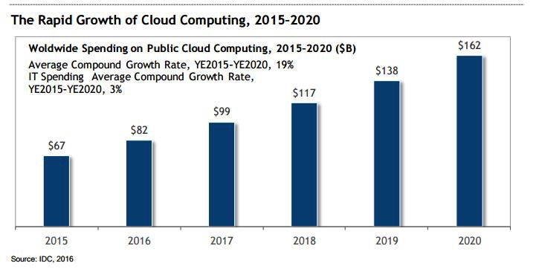
Growth of Cloud Computing

Slide 8
Cloud Computing in bioinformatics
Adoption of cloud computing technology in bioinformatics is growing
  Increased data-set size
    1000 GP – 200 TB
    PCAWG – 750 TB
    ICGC – 1.2 PB
    HCA – ~50 PB
  Availability of cloud computing environments
    AWS/GCP/Azure - global
    EMBL-EBI Embassy Cloud - UK
    Open Science Data Cloud - US
    de.NBI - Germany
    European Open Science Cloud – Europe
    DNANexus, Seven Bridges Genomics, etc.
  Desire to share best-practices and establish standards
    Docker ecosystem
    Global Alliance for Genomics and Health

Slide 9
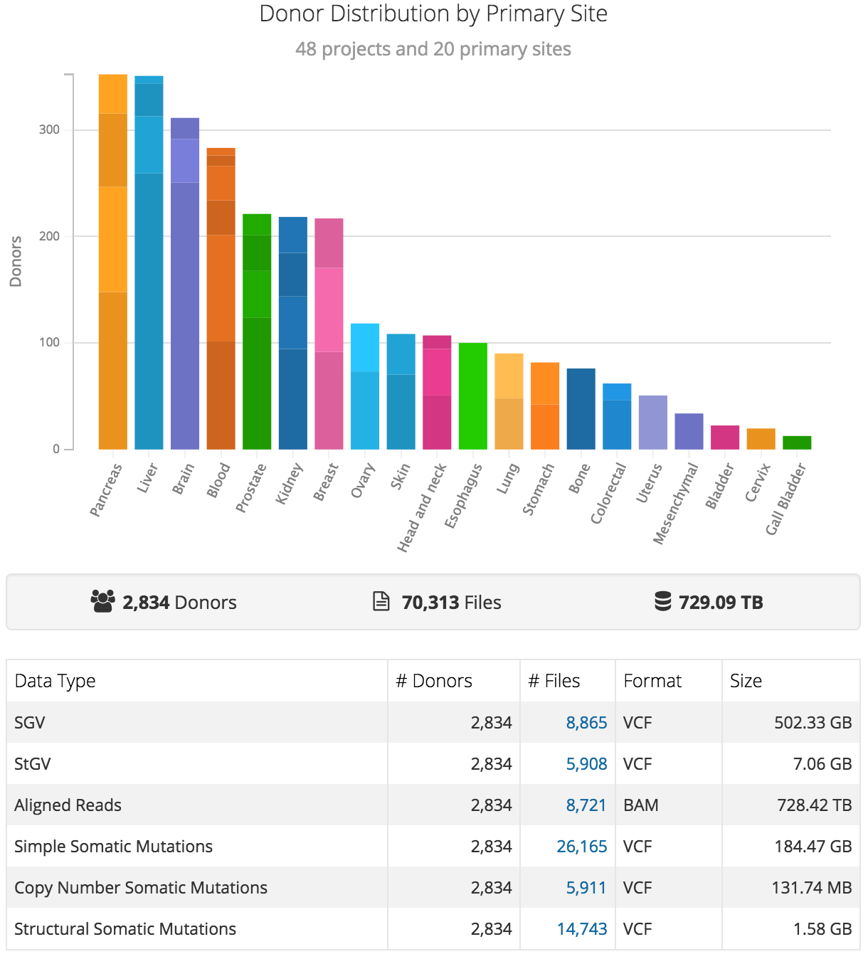

The Pan-Cancer Analysis of Whole Genomes Project (PCAWG)
The International Cancer Genome Consortium (ICGC)
Stein, Knoppers, Campbell, Getz & Korbel, Nature 2015
https://dcc.icgc.org/pcawg

Slide 10
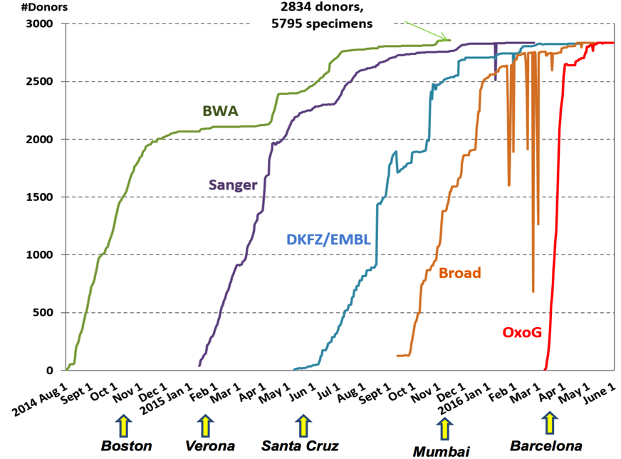
PCAWG Data Processing Timeline
Pipeline | Potential Time Savings
BWA | 10 months
Sanger | 8 months
DKFZ/EMBL | 5 months
Broad | 5 months
OxoG | 2 months
Large-Scale Uniform Analysis of Cancer Whole Genomes in Multiple Computing Environments, C. Yung et al, 2017

Slide 11
Requirements for scientific computing on the cloud
Provisioning
Configuration Management
Workflow
Operations Management
Manage infrastructure
Cloud-agnostic
Health metrics
Troubleshooting
Highly distributed
System-of-record

Slide 12


https://github.com/llevar/butler
Butler
Enabling rapid cloud-based analysis of thousands of human genomes via Butler, S. Yakneen et al, 2017 - https://doi.org/10.1101/185736

Slide 13
Butler Framework

Slide 14
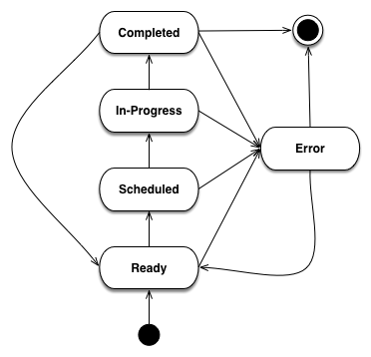
Analysis State Tracking

Slide 15
Configuration Management

Slide 16
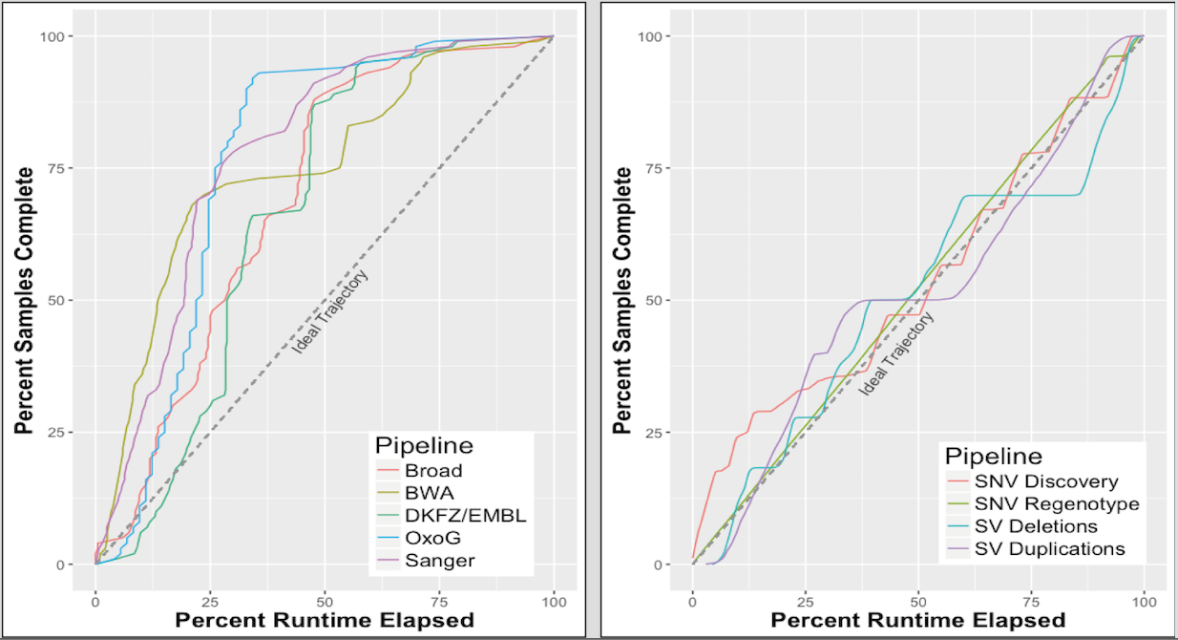
Butler usage in PCAWG on Embassy Cloud – 2015-2016
  1500 cores, 5.5 TB RAM, 750 TB primary NFS storage, 50 TB scratch storage.
  Germline variant detection and genotyping of 100M variants across PCAWG cohort of 2834 whole-genome-sequence T/N sample pairs – 6 passes through 750 TB.

Slide 17
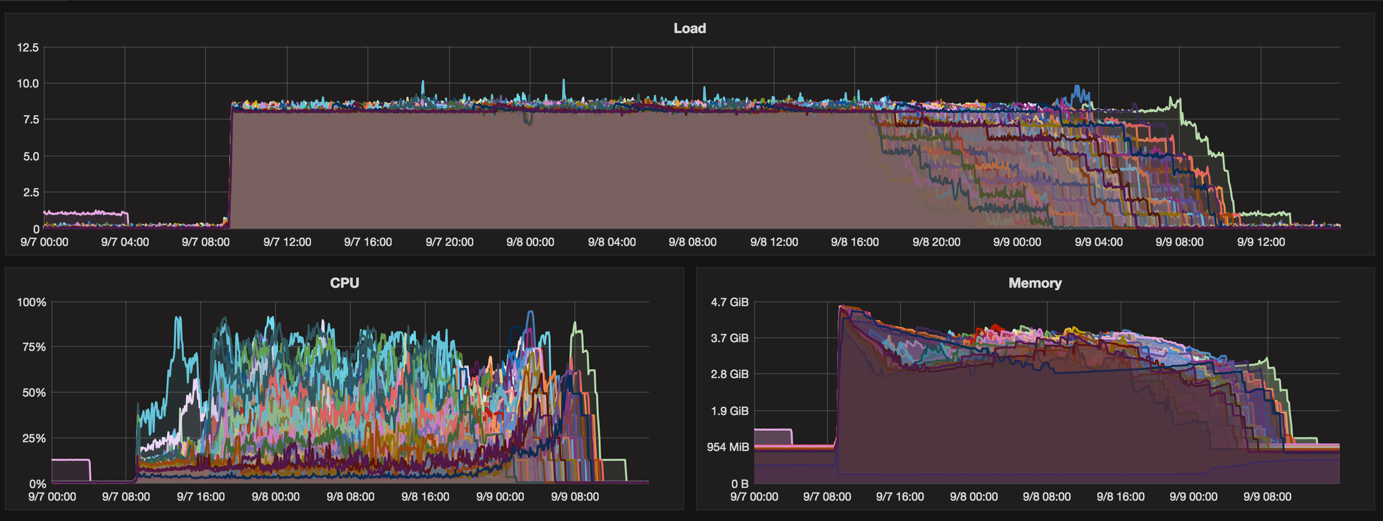
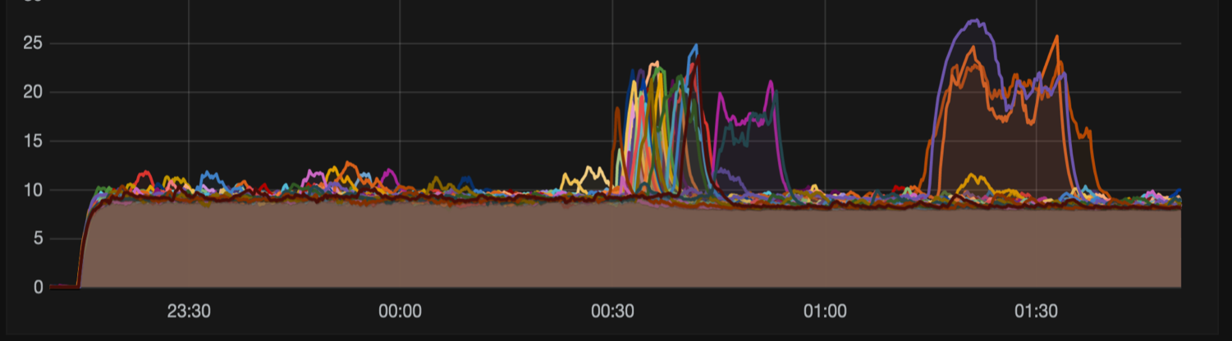
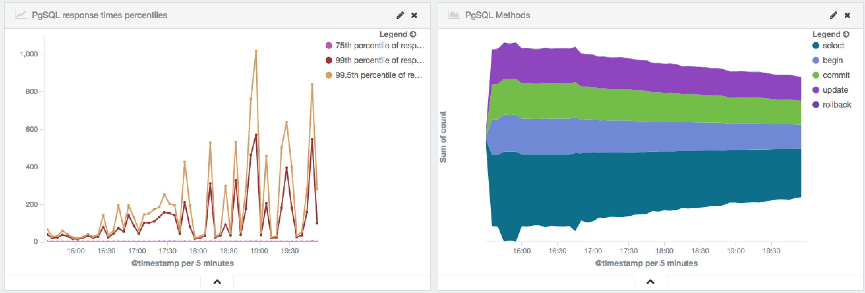
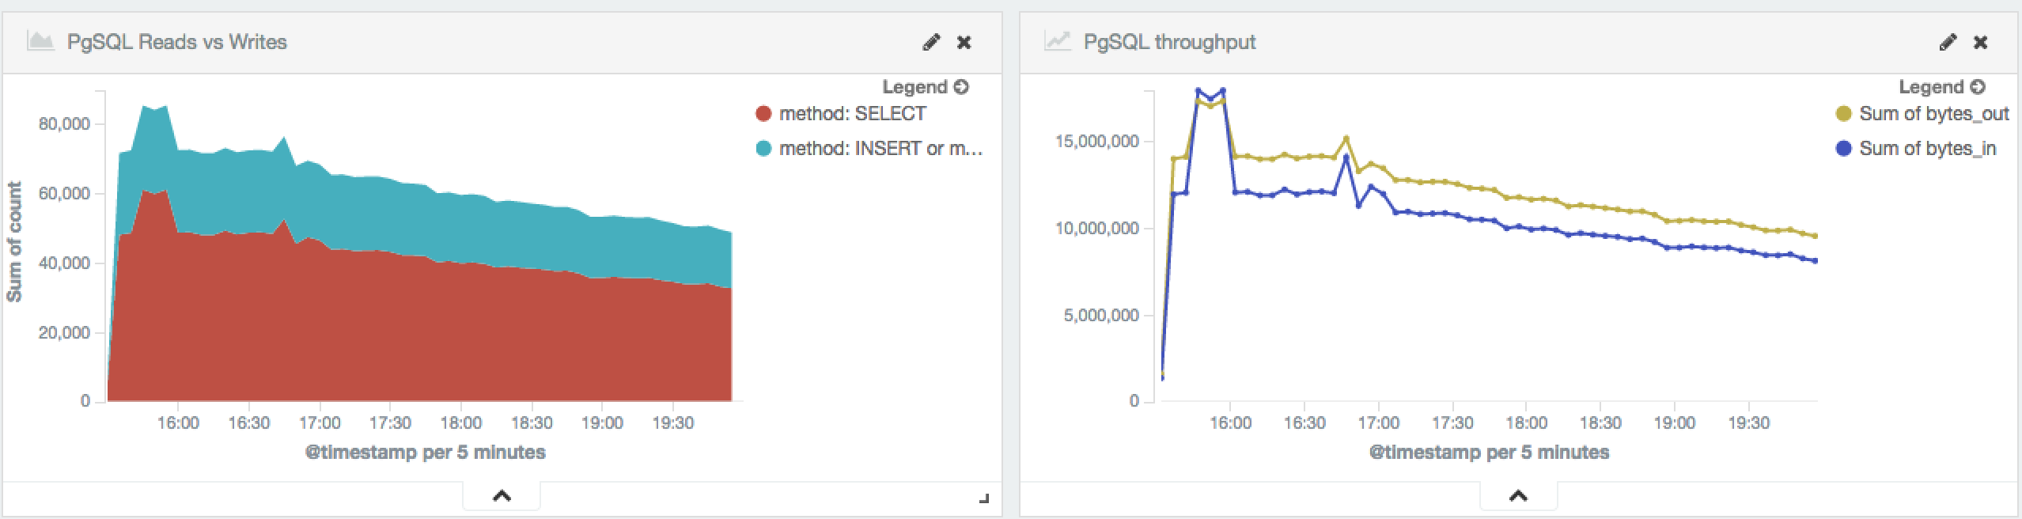
Normal Operation
Infrastructure “event”
Database metrics harvested from logs

Slide 18

Butler goals for EOSC Pilot
Deploy to multiple clouds
Distribute test data sets
Orchestrate an analysis across multiple environments

Slide 19
Current Status for EOSC
Resources secured at multiple sites
  EMBL/EBI Embassy Cloud – 1000 vCPU, 4TB RAM, 1PB storage
  ComputeCanada – 1000 vCPU, 4TB RAM, 500 TB storage
  Cyfronet – 500 vCPU, 2TB RAM, 500 TB storage
  Amazon Web Services – still in negotiation
Butler deployment
  EMBL/EBI – deployed in multiple tenancies and tested at scale
Data availability
  EMBL/EBI – 1000 genomes data, full PCAWG data available

Slide 20
Next Steps for EOSC Pilot
Deployment
  ComputeCanada – infrastructure available as of early September, deployment underway
  Cyfronet – infrastructure available as of mid-September, deployment pending
Data Availability
  ComputeCanada – need to establish mechanisms for deploying data
  Cyfronet – deployed OneData to move data from EMBL/EBI, now resolving deployment issues
Analysis
  Initial testing with 1000 Genomes Project data – Oct – Nov, 2017
  Processing of cancer data – Nov – Dec, 2017

Slide 21
Acknowledgements
EMBL
Jan Korbel
Sebastian Waszak
Tobias Rausch
Rupert Lueck
PCAWG
PCAWG-TECH
PCAWG-QC
PCAWG-8
EMBL/EBI
Andy Cafferkey
David Ocana
Charles Short
Steven Newhouse
Ewan Birney
Dario Vianello
Erik van den Bergh
Sanger Institute
Peter Campbell
Adam Butler
Keiran Raine
OICR
Lincoln Stein
Vincent Feretti
Brian O’Connor
Christina Yung
Dennis Yuen
George Mihaiescu
Broad Institute
Gad Getz
DKFZ
Chris Lawerenz
Rolf Kabbe
Manuel Prinz
EGI
Gergely Sipos
Matthew Viljoen
Enol Fernández

