Slide 1
AENEAS: an SKA Regional Centre for Europe
Rob van der Meer
ASTRON (Netherlands Institute for Radio Astronomy)
Collaborating e-infrastructures - Meeting 4, Montreal

Slide 2
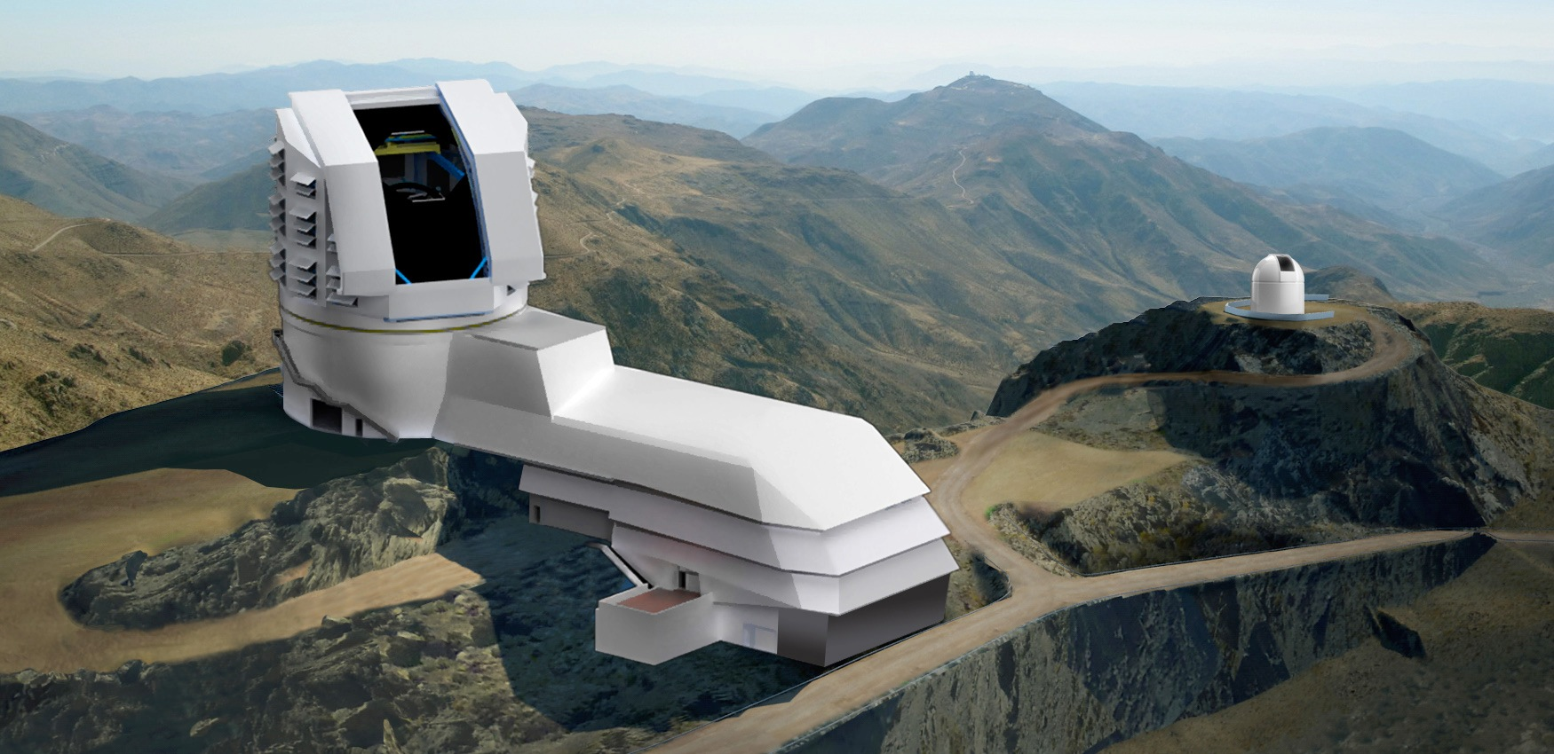
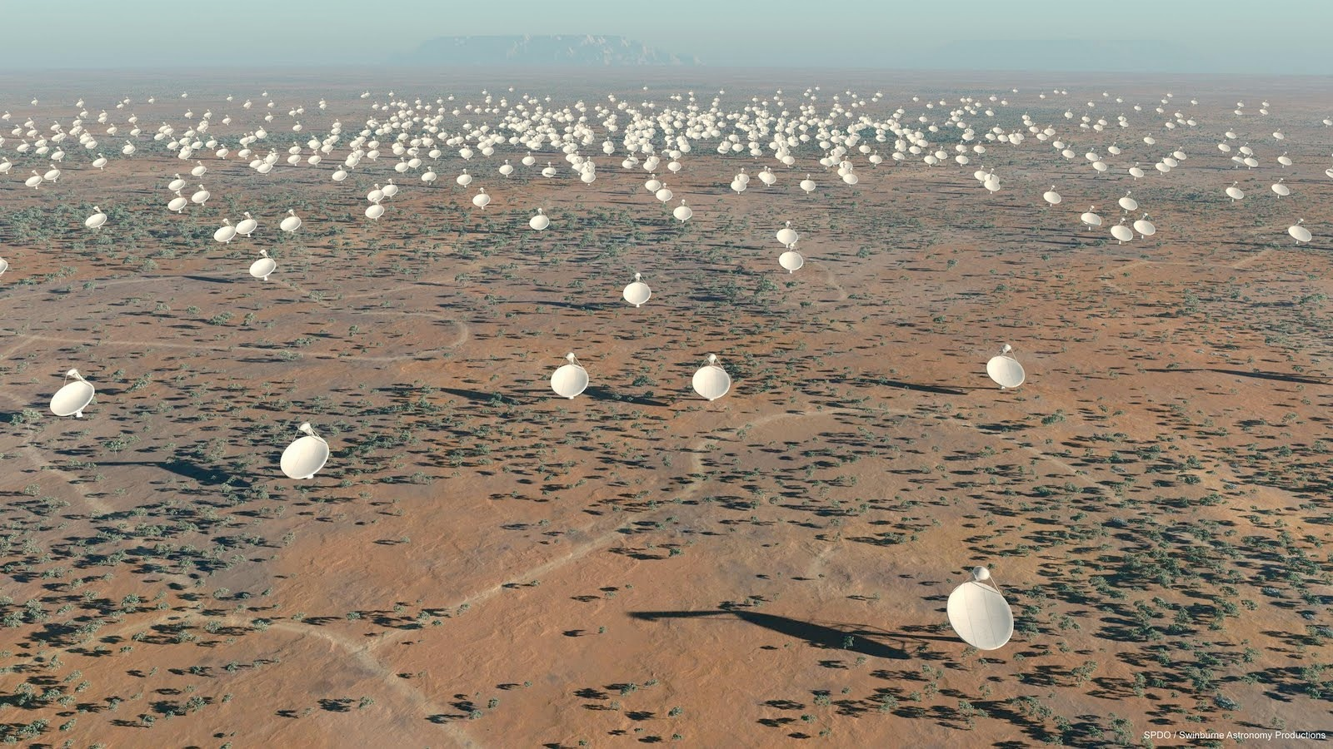
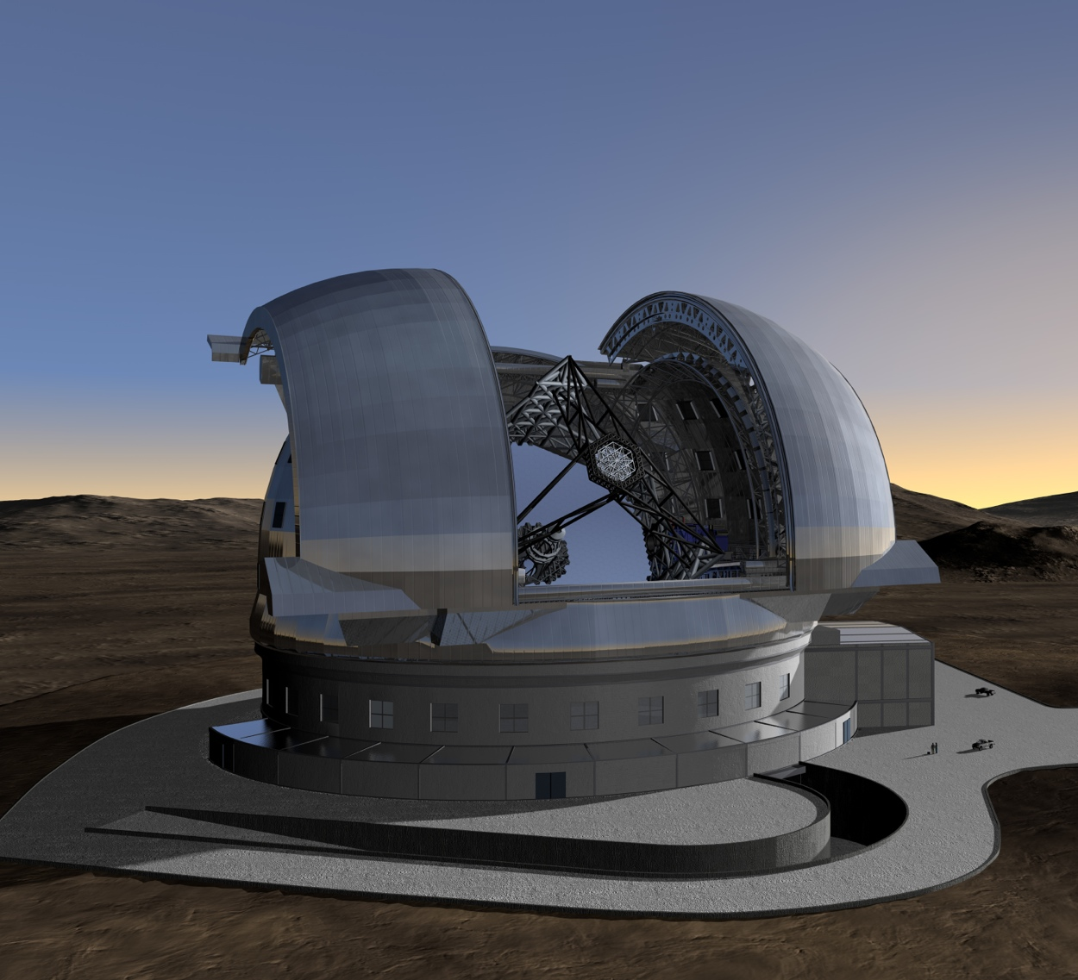
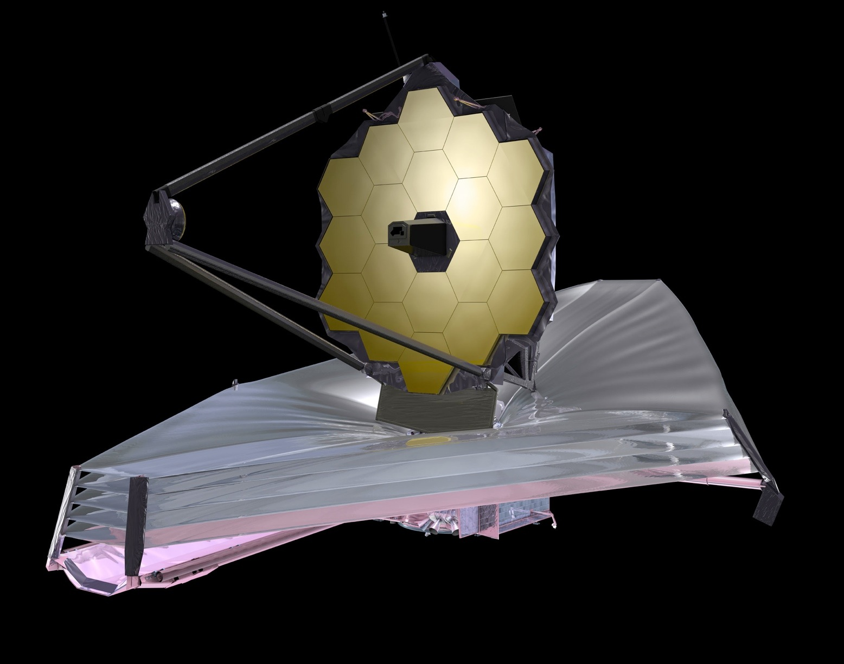
Data Intensive Astronomy
Science is increasingly driven by large data sets
Massive data collections and large scientific collaborations
Most science extraction is based on the archived data
Current instruments already producing petascale datasets
New science infrastructures will produce exascale data!

Slide 3
The Square Kilometre Array
Australia
Canada
China
India
Italy
Netherlands
New Zealand
South Africa
Sweden
UK
SKA Headquarters
at Jodrell Bank, UK
Potential new members: Spain, Portugal, Germany, France, others…
Host country for SKA-Mid
Host country for SKA-Low

Slide 4
What is an SKA Regional Centre?
Astronomers
Funding Agencies
Place to find their data
Place to analyze their data
Place to find support
Way to fund science
Way to maximize investment
Way to spur innovation
Science
Data
Centre
SKA Regional Centre
Observatories
Industry
€
Place to curate their data
Place to develop new capabilities
Place to support their users
Place to find new challenges
Place to collaborate with academia
Place to test new technologies

Slide 5
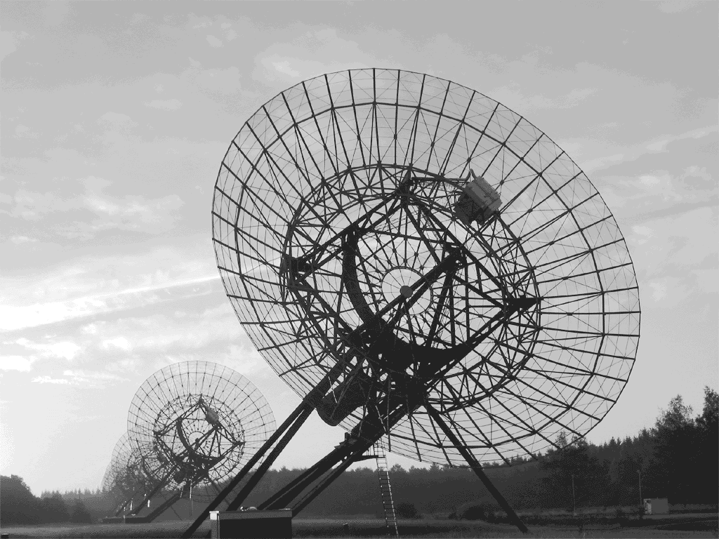
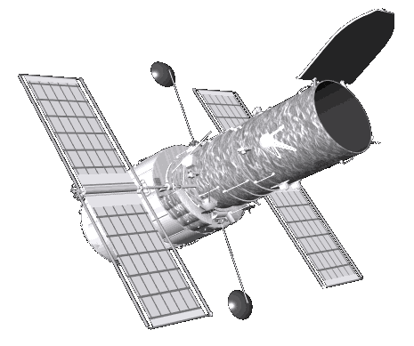
Connections Beyond Astronomy
Academic partnerships
Different research communities
Multiple data collections
WSRT
Pipelines
Science
Data
Centre
SKA Regional Centre
User
Support
Technology development
e2e
LOFAR
€
User support
€
€
Valorization
JIVE
Industry partnerships

Slide 6
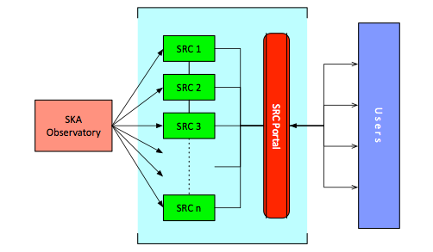
SKA Regional Centres
Science Data Centres (SDCs) will likely host the SKA science archive
Provide access and distribute data products to users
Provide access to compute and storage resources for users
Provide analysis capabilities
Provide user support
Multiple regional SRCs, locally resourced

Slide 7
Global Network of Centres

Slide 8
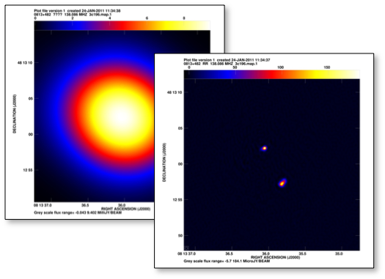
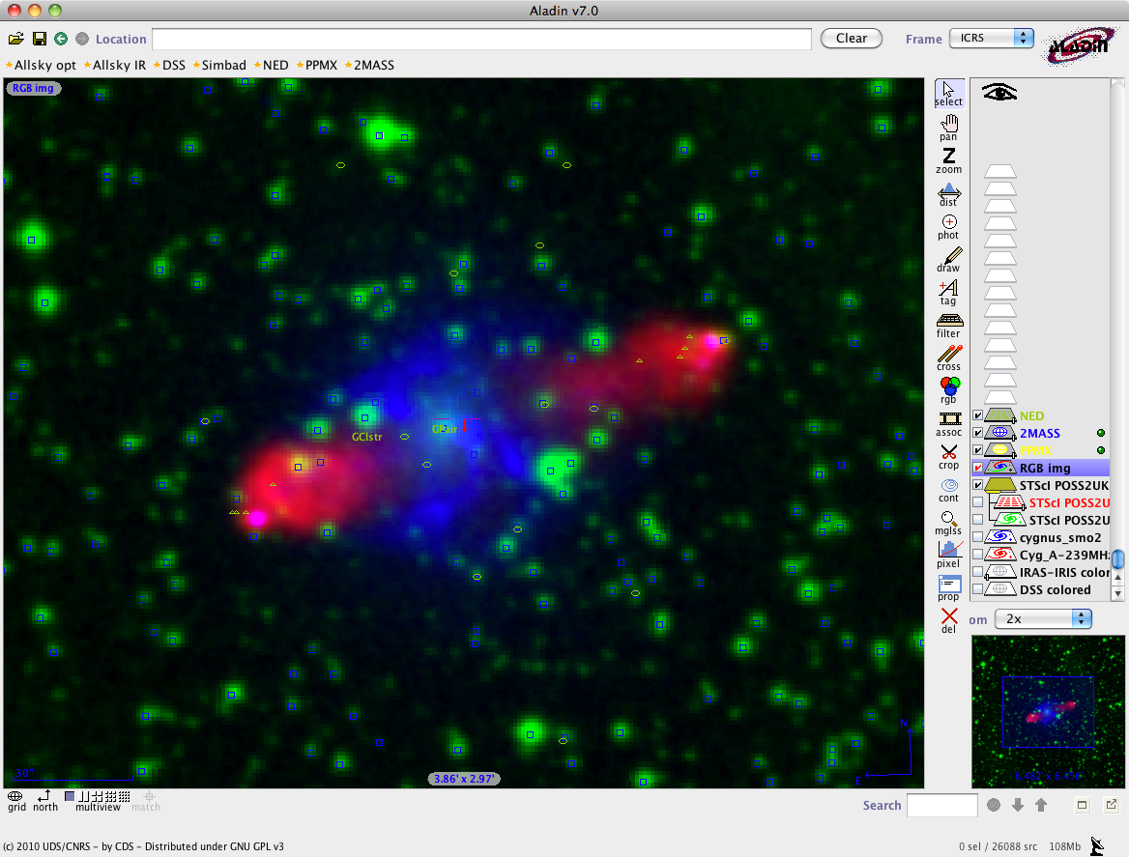
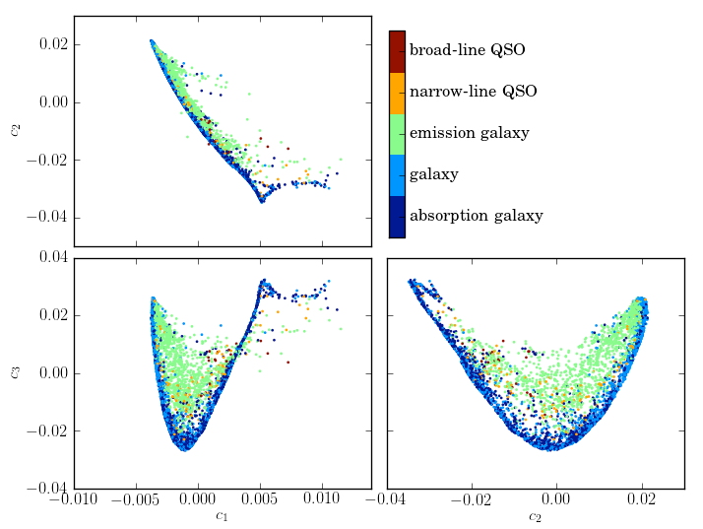
Regional Centre Functionality
Data Discovery
Data Processing
Data Mining
Observation database
Quick-look data products
Flexible catalog queries
Integration with VO tools
Publish data to VO
Multi-wavelength studies
Catalog cross-matching
Transient classification
Feature detection
Visualization
Reprocessing
Calibration and imaging
Source extraction
Catalog (re-)creation
DM searches

Slide 9
European SKA Regional Centre
Create a European-scale, federated Regional Centre for the SKA
Provide resources for SKA science extraction to users
Coordination with ICT communities, industry, and service providers
Facilitate shared development, interoperability, and innovation
European counterpart for engagement with other SRCs internationally

Slide 10
Design and specification of a distributed, European SKA Regional Centre to support the pan-European astronomical community in achieving the scientific goals of the SKA
EC Horizon 2020 (€3 million)
13 countries, 28 partners, SKAO, host countries, e-infrastructures (EGI, GÉANT, RDA), NREN’s
Three year project (2017-2019)
WP1: Project Management
WP2: Governance Structure and Business Models
WP3: Computing and Processing Requirements
WP4: Data Transport and Optimal European Storage Topologies
WP5: Data Access and Knowledge Creation
WP6: User Services

Slide 11
Importance of SKA RC’s
Regional Centres will be essential for the scientific success of the SKA
SRCs will be the primary interface for SKA science extraction
An international network of SRCs will be required to serve the SKA community
A European SKA Regional Centre will be a key part of that network
The AENEAS project is a first step in establishing such an European SRC

Slide 12
AENEAS planning
2017-10 Survey for requirements gathering
2017-12 Inventory of potential ESDC resources
2018-06 ESDC User requirements
2018-06 Site Catalogue Storage and networking
2018-09 Analysis of compute load, data transfer, data storage
2018-12 Design recommendation
2018-12 AAI requirements and architectural design
2019-12 ESDC preliminary implementation plan

Slide 13
AENEAS planning
The AENEAS project is a first step in establishing such an European SRC
AENEAS is building a community.
Gathering requirements from users, resource providers, funding agencies.
Listening to other parties in the world.
Building towards consensus on design.

Slide 14
Thank you

Slide 15
Back-up slides for discussion

Slide 16
Division of Responsibilities
Essential SRC functions:
Development and provision of long-term SKA Science Archive
Provision and management of computational resources for post-processing and analysis
User support for SKA Science Archive data products and analysis
Provide platform for continued development of software (pipelines and tools)
Joint SKAO/SRC functions:
User support for SKAO data products
User support for SKAO provided software and tools
Distribution of SKA data packs to users (potentially SDP or SRC)

Slide 17
Boundary Conditions
SKA Regional Centres must adhere to the data policies as defined by SKA
SRCs must meet minimum requirements to join the network
An accreditation process for SRCs in the network will be defined by SKAO
SRCs will be heterogeneous in nature with common, core functionality
Some SRCs may provide additional or community-specific functionality
SRCs must support the Key Science Project Teams as well as general users
Support for regional SRCs will come from the local communities

Slide 18
Open Questions
Where will the SKA science archive data be hosted?
How will that data be transported from the sites to Europe?
How can we take optimal advantage of existing infrastructure?
What are the processing requirements and technologies to consider?
What interfaces, tools, and techniques will users need for analysis?
How do we setup and operate an international network of SRCs?

