Slide 1
Lightning talk:
ELIXIR Competence Center
Kimmo Mattila

Slide 2
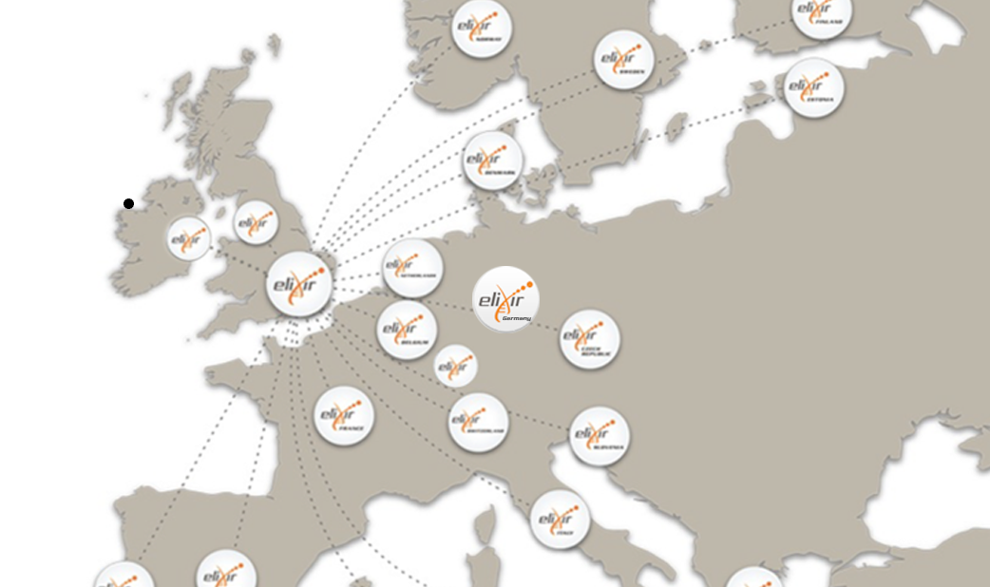
ELIXIR: Introduction
ELIXIR: Research infrastructure focused on life science data. Supported by EMBL-EBI and 20 European countries
(over 180 research
Organizations).
ELIXIR competence center ( part of EGI-Engage
project) aimed to facilitate and promote usage of
EGI resources among ELIXIR and molecular biology
research community.
EGI-Engage Final Review: Lightning talk Elixir
Notes:
Introduce the ELIXIR RI (not the CC!)
1 slide
<number>

Slide 3
ELIXIR Competence Center
Goals: Match EGI services to the goals of ELIXIR Compute Platform project and life science community in general:
Computing
Storage and Data transfer
Authentication and authorization
Applications and tools
EGI-Engage Final Review: Lightning talk Elixir
Notes:
Introduce the ELIXIR RI (not the CC!)
1 slide
<number>

Slide 4
ELIXIR Competence center members
CESNET (https://www.cesnet.cz/)
CNRS IFB-core (https://www.france-bioinformatique.fr)
CSC ( http://www.csc.fi)
EMBL-EBI (http://www.ebi.ac.uk/)
GRNET (https://grnet.gr/en/)
SurfSARA (https://www.surf.nl/over-surf/werkmaatschappijen/surfsara)
Other collaborators: (Open Science Grid, other ELIXIR nodes)
EGI-Engage Final Review: Lightning talk Elixir
Notes:
Introduce the CC, including why ELIXIR needed it (how it intends to help ELIXIR), why now, why the chosen membership, and how was their work organized (expertise, monthly calls, etc.)
1 slide
<number>

Slide 5
ELIXIR Competence center:
Time-line
1. Technical evaluation of integrating local clouds to EGI Federated cloud
9/2015 - 2/2016
best-practices and experiences reported
2. Scientific use cases as demonstrators
12/2015 – 8/2017
selection
implementation (including technical development) and testing
reporting the results
EGI-Engage Final Review: Lightning talk Elixir
Notes:
Introduce the CC, including why ELIXIR needed it (how it intends to help ELIXIR), why now, why the chosen membership, and how was their work organized (expertise, monthly calls, etc.)
1 slide
<number>

Slide 6
EGI-Engage Competence center: Achievements
Achievements in EGI-Engage (online services, applications, usage statistics, publications, events, etc.) detailing the research impact of the achievements, answering the questions: how the result will improve the work of researchers and enable them in their advanced data processing tasks? What is the research impact, in case results were already deployed in production?
(approx. 3 slide)
EGI-Engage Final Review: Lightning talk Elixir
Notes:
This is the main part of the talk – What was achieved
<number>

Slide 7
Results of Scientific use cases
1. Insyght
Complex genome comparison environment can be launched in EGI-federated cloud from the AppDB
2. META-Pipe
Computationally heavy part of a metagenomics pipeline can be executed is a case specific virtual cluster in EGI-federated cloud
EGI-Engage Final Review: Lightning talk Elixir
Notes:
This is the main part of the talk – What was achieved
<number>

Slide 8
EGI-Engage Competence center: Scientific use cases
3,4 Marine metagenomics and PhenoMeNal
Linking external cloud resource providers to the EMBL-EBI Cloud portal
Bottlenecks (orchestration and authentication) in using EGI Federated Cloud were recognized and are now being resolved.
5. JetStream
Interoperability between JetStream cloud (US) and EGI Federated cloud was tested.
Images from EGI work in JetStream but not vice versa
EGI-Engage Final Review: Lightning talk Elixir
Notes:
This is the main part of the talk – What was achieved
<number>

Slide 9
Technical achievements
ELIXIR VO and ELIXIR compatible authentication available in EGI Federated Cloud
CILogon can be used to create proxy certificates
AppDB: Web interface can be used for distributing virtual appliances
EGI Federated Cloud resource integration process and has been tested and improved
rOCCI, jOCCI, OpenStack Cli and Terraform can be used manage the VMs
EGI-Engage Final Review: Lightning talk Elixir
Notes:
This is the main part of the talk – What was achieved
<number>

Slide 10
Lessons learn
Technologies that are applied must be compatible with the technologies and skills of the user community: ( authentication, environment orchestration, user interfaces and repositories)
Operations and user politics of EGI Federated Could needs to developed to attract cloud service providers ( OLA, accounting, support ...)
EGI-Engage Final Review: Lightning talk Elixir
Notes:
<number>

Slide 11
Elixir Competence Center: Future Plans
ELIXIR CC has shown that EGI Federated Cloud can be used for life science data analysis.
All the use cases will continue to evolve even after the ELIXIR CC.
EGI Federated Cloud is just one option for ECP, use cases and life science community in general.
Development is needed in many levels to keep the EGI FedCloud feasible platform for researchers.
EGI-Engage Final Review: Lightning talk Elixir
Notes:
Here you can mention how the results will be picked up in the Comp Platform, in EXCELERATE, in the follow-up CC, and/or maybe in a new cluster project for biomedical RIs
<number>

