Slide 1
EGI Technical Forum
Lyon, 19-23rd September

Slide 2
User & Technical Forums
Sessions
Driven by what we (the project or EGI.eu) want to cover
Training
Benefit from people being in one place for some time
Workshops
Allow the community to come together through collaborating projects
Papers & Posters
Permanent peer reviewed record of progress
Demonstrations
Cutting edge activities from the community

Slide 3
Content Generation
Task Leaders → EGI-InSPIRE Sessions
Communities → Training & Workshops
EGI.eu C*O → Sessions
Individuals → Papers, Posters & Demonstrations

Slide 4
EGI Technical Forum 2011
Dates: 19 – 23 Sep
Venue: Lyon Congress Centre (http://www.ccc-lyon.com)
Monday 19: French Grid Day, IGE event
Tuesday 20 to 22: Main tracks
Friday 23: Meetings & workshops
CfP: Opens at the User Forum
Website: www.egi.eu/tf2011 (coming soon)

Slide 5
Community Wide Event
Meeting Theme:
Move towards clouds & virtualisation in EGI
CloudScape → EGI UF → EGI WS → EGI TF
OGF 33: WG meetings related to grids,
e.g. SAGA, GLUE, PGI, OCCI, etc.
Grid 2011: Provide peer review publications

Slide 6
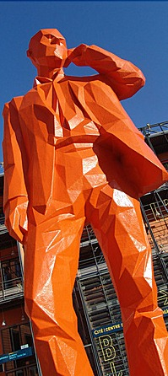
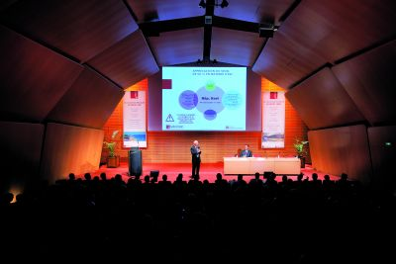
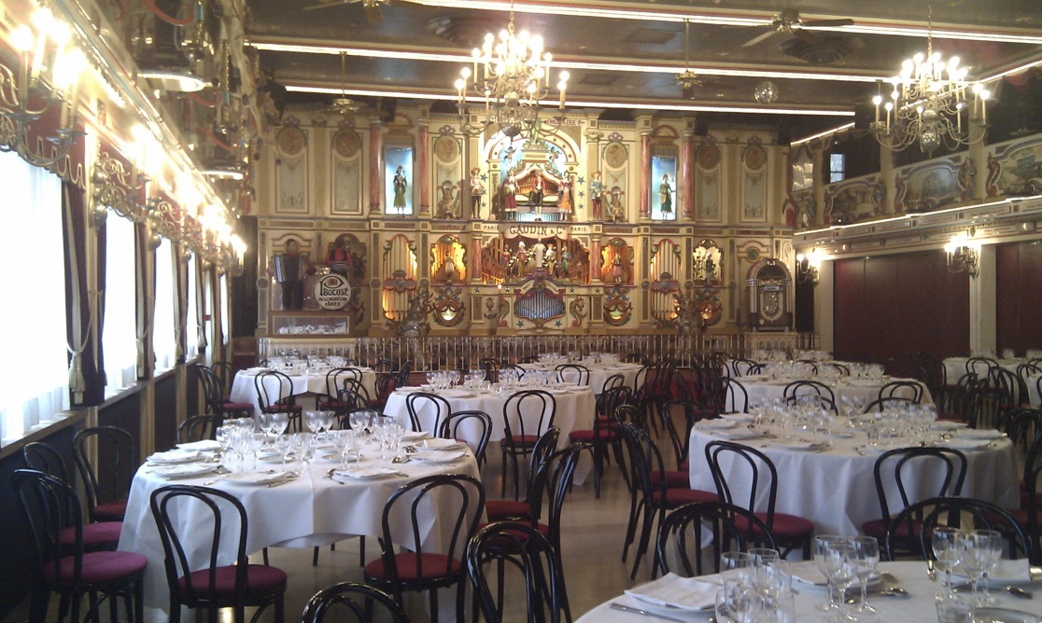
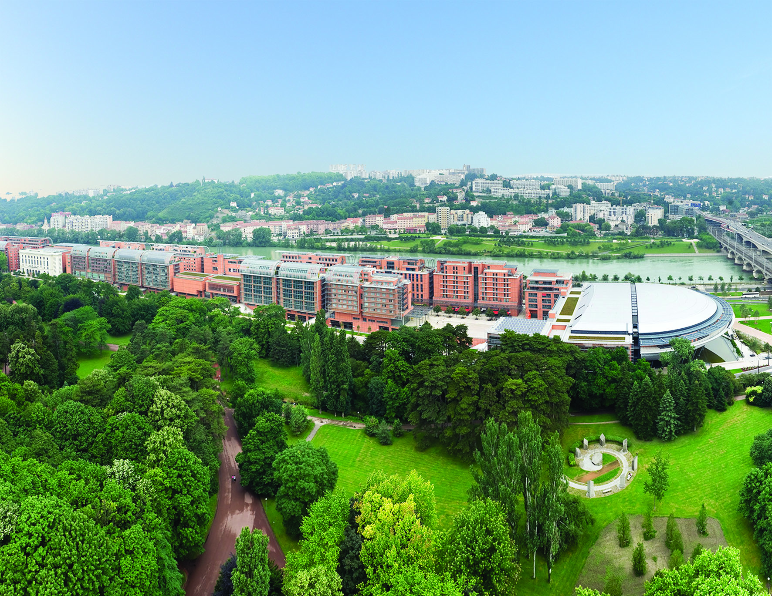
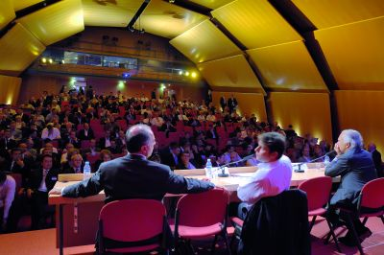
EGI Technical Forum 2011

Slide 7
Room | Pasteur (300) | Rhone 3 (175) | Rhone 2 (75) | Rhone 2 (75) | Rhone 4 (40) | St Clair 3 (120) | St Clair 1 (60) | St Clair 2 (60) | St Clair 4 (45)
Monday (19th)
9:00-10:30 | French Grid Day | GlobusWorld Europe | Operations | EGI Business Models | Workshops |  |  |  | Delegated Content
11:00-12:30 | French Grid Day | GlobusWorld Europe | Operations | EGI Business Models | Workshops |  |  |  | EGI-TF PC
14:00-15:30 | French Grid Day | GlobusWorld Europe | Operations | EGI Business Models | Workshops |  |  |  | EGI-InSPIRE
16:00-17:30 | French Grid Day | GlobusWorld Europe | Operations | EGI Business Models | Workshops |  |  |  | EGI.eu Content
Tuesday (20th)
9:00-10:30 | Opening Plenary | Opening Plenary |  |  |  | Opening Plenary?
11:00-12:30 | Policy | User Support | Operations | Technology - Globus | Workshops | SIENA | OGF | OGF
14:00-15:30 | Policy | User Support | Operations | Technology - Globus | Workshops | SIENA | OGF | OGF
16:00-17:30 | Policy | User Support | Operations | Technology - Globus | Workshops | SIENA | OGF | OGF
Wednesday (21st)
9:00-10:30 | Technical Plenary | Technical Plenary |  |  |  | Technical Plenary?
11:00-12:30 | External Relations | User Support | Operations | Technology | Workshops | Grid2011 | OGF | OGF
14:00-15:30 | External Relations | User Support | Operations | Technology | Workshops | Grid2011 | OGF | OGF
16:00-17:30 | External Relations | User Support | Operations | Technology | Workshops | Grid2011 | OGF | OGF
Thursday (22nd)
9:00-10:30 | Technical Plenary | Technical Plenary |  |  |  | Technical Plenary?
11:00-12:30 | HUC | EGI-InSPIRE CB | Operations | EUMEDGrid-Support | Workshops | Grid2011 | OGF | OGF
14:00-15:30 | HUC | EGI Council | Operations | EUMEDGrid-Support | Workshops | Grid2011 | OGF | OGF
16:00-17:30 | HUC | EGI Council | Operations | EUMEDGrid-Support | Workshops | Grid2011 | OGF | OGF
Friday (23rd)
9:00-10:30 | Grid2011 | Workshops | OpenNebula | EUMEDGrid-Support | Workshops |  | OGF |  | OGF
11:00-12:30 | Grid2011 | Workshops | OpenNebula | EUMEDGrid-Support | Workshops |  | OGF |  | OGF
14:00-15:30 | Grid2011 | Workshops | OpenNebula | EUMEDGrid-Support | Workshops |  | OGF |  | OGF
16:00-17:30 |  | Workshops | OpenNebula |  | Workshops |  | OGF

Slide 8
Next Steps
Is this enough space?
What are your activity needs? Be selective!
Workshops, training, posters & demos
Open at the UF
Close 1st Week June
Announce before end of June
Grid2011 & OGF do their own calls
Grid2011: Papers (Workshops → EGI?)
OGF: Session call in July

