Slide 1
FedCloud Usage

Slide 2
Usage models
See:
https://docs.google.com/document/d/1_E-Iq5sIJGXGYSBvWiAFGjhlYDPbyiq46Xh2g0VmXgc/edit#heading=h.5o5gi94ovwx5

Slide 3
Infrastructure status
20 resource centres
15 OpenStack
4 OpenNebula
1 Synnefo
Operations following issues closely:
2 sites suspended
Now also checking GGUS response times

Slide 4
Federated cloud usage statistics
 | 2017 Jan-Aug | 2016 Jan-Aug | 2017 Increment
Total CPU time consumed (millions hours) | 9.3 | 6.4 | 40%

Slide 5
Usage: last 12 months
1.6M users
+500 users
2 VREs
Piloting / testingVO
+80 users

Slide 6
Increase in cloud usage in last 18 months
Biological sciences
Structural biology: WeNMR (existing, +43%)
Marine and Freshwater Biology: EMSO - European Multidisciplinary Seafloor and water-column Observatory (starting, +44.6%)
Earth sciences
Earth Geohazards ESA exploitation platform (starting, +6,100%)
Agricultural Sciences
Agriculture, Forestry and Fisheries (starting, +826%) – EGI-Engage infrastructure integration action
Humanities
Arts/Musicology: Peachnote (active, constant usage)
Humanities: DARIAH Research Infrastructure (starting, +607%) – EGI-Engage Competence Centre
Multi-disciplinary support
D4Science (starting, +288%)

Slide 7
Applications on Demand Service (AODS)
A scalable platform to offer scientific applications ‘as elastic services’
Applications that are not offered as Thematic Service
User-friendly registration and access interfaces
Tools to port and share new applications
Distributed support for end-users and application integrators
Included in the EGI Service Portfolio
Ownership responsibilities on EGI Foundation

Slide 8
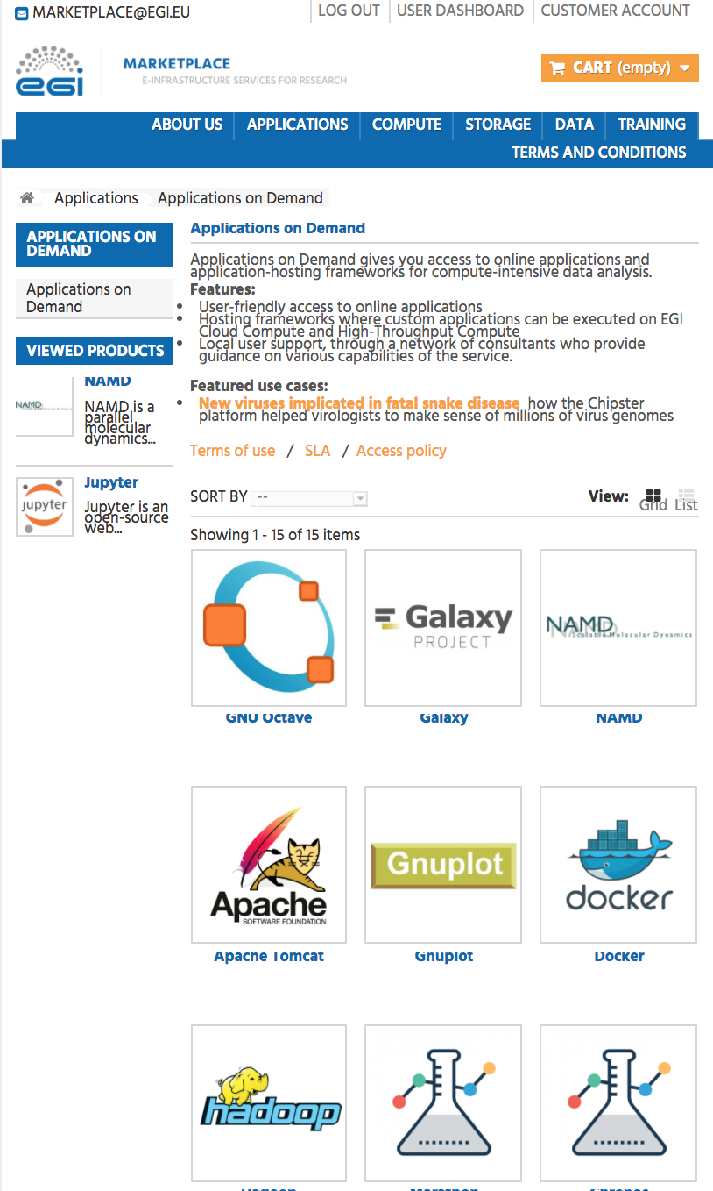
How to access the AoD service
http://marketplace.egi.eu
Approval by distributed Support Team
Thematic services, Applications on demand

Slide 9
AoDS: Integrating diverse services into a single framework
Cloud, HTC sites - 5
Application frameworks - 3
Applications - 15
Support experts
App. App.
1 … K
Application hosting framework
App. App.
1 … L
Application hosting framework
1
2
Cloud, HTC, storage sites
Usage stats
EGI
Accounting system
Marketplace
Users
Application hosting framework 3
Scientific publications
Identity vetting
suspend users
App. 1
…
App. M
National support teams
Usage stats
Thematic services, Applications on demand

Slide 10
Managed Services / Thematic Services
EGI starting to look into fully managed services:
Jupyter: container based on Kubernetes
Users confined to the containers on VMs, no direct incoming access to the VMs
Kubernetes deployment done manually but already testing some ansible recipes
Galaxy: several pilot implementations
One relying on INDIGO-IM/EC3
One relying on docker containers + docker-compose
Thematic services will come with EOSC-hub:
In the proposal: Clarin, DODAS, ECAS, GEOSS, OPENCoastS, WeNMR, EO, DARIAH, LifeWatch
Some of them rely on INDIGO components (orchestration)
More are expected to come during the project lifetime

Slide 12
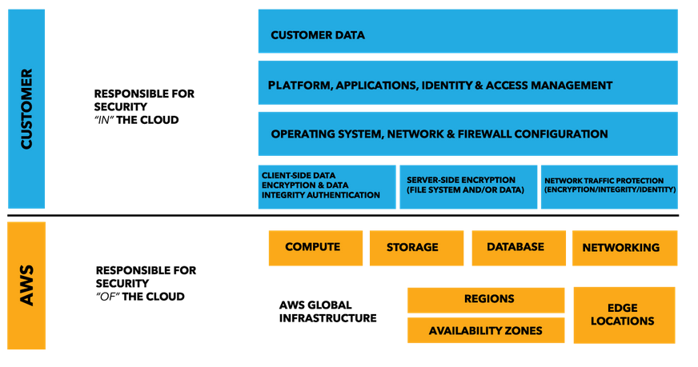
Disseminate the shared responsibility model
© https://aws.amazon.com/compliance/shared-responsibility-model/

