Slide 1
Resource Center Integration into EGI Federated Cloud

Slide 2
EGI Cloud Federation
Grid of clouds
Harmonised operational behaviour
Open Technology stack based on standards
Scalable computing platform supporting applications and services in research and science

Slide 3
A Federated IaaS Cloud for research
Users
Providers
Single-Sign On via Check-in
Appliance Library
Resource discovery
Single GUI dashboard
Computation near data
Support international communities
Operational and security processes
A/R Monitoring
Accounting
Technology agnostic
Notes:
network with like-minded providers

Slide 4
Integration with resource providers
Providers keep complete control on their resources
Enable access to a Virtual Organisation into local porjects with EGI credentials, SLA based
Set of extra components using OpenStack APIs to retrieve provider information and make it available to EGI services
No (major) changes in operational activities
Provide support through EGI channels
Comply with the operational and security procedures. These are based on best practices and common requirements
Most well-operated providers already have these activities in place, so the additional task for a site manager is to acknowledge to EGI that the task has been performed.

Slide 5
AAI: Check-in
eduGAIN
Check-in enables single sign-on to services (web and non-web) through eduGAIN and other identity providers
Users without institutional accounts can access services through social media or other external accounts
Services connected to Check-in can be made available to +2,000 universities and institutes with little or no administrative overhead
Institutional IdP
Social IdPs
Virtual Organization
EGI Check-in
EGI Infrastructure
EGI Service
EGI Service
Architecture based on
blueprint
Notes:
An established community may already have group management solutions, and may want to use it for authorization. CheckIN can aggregate these authorization information with the authentication information coming from the IdPs.

Slide 6
Integration of OpenStack with Check-in
OpenID Connect (OIDC)
Industry standard
Web and non-web friendly (OAuth2.0)
Supported by OpenStack since Icehouse
OpenStack Providers need to:
Configure OpenStack support for OIDC
Add EGI Check-in as IdP for OpenStack
Configure mapping of Check-in users to local projects as agreed with VOs
https://wiki.egi.eu/wiki/AAI_guide_for_OpenStack

Slide 7
Additional integration
A single VM with software components that use the public OpenStack interfaces
VMI replication, Accounting, Information discovery
Packaged as Docker containers, available at docker hub https://hub.docker.com/u/egifedcloud/
Documentation:
https://wiki.egi.eu/wiki/MAN10#Integration_with_EGI_FedCloud_Appliance

Slide 8
AppDB Cloud Marketplace
Open Library of Appliances
Use on clouds or on personal laptop
Re-use, share, associate contextualization
Automatic distribution to cloud providers
EGI endorsed VM images
securely configured and tested

Slide 9
CloudKeeper: AppDB integration
cloudkeeper
cloudkeeper ensures:
Integrity of images
Conversion to appropriate formats
Correct metadata info at glance

Slide 10
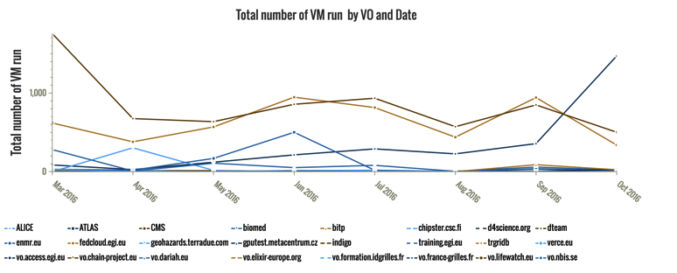
Accounting
Collect, aggregate and display usage information across the whole federation.
Query Nova/ceilometer APIs to produce and send accounting records
Accounting portal for visualization

Slide 11
Integration (Technical) Requirements
EGI Check-in integration
Configuration of OIDC within OpenStack Keystone
1 VM instance with public IP
Expose port 2170 for information discovery
Valid hostname and recognized certificate
Valid credentials to use OpenStack APIs
Enough disk space to handle image download and conversion (< 100GB for generic pilot VO)

