Slide 1
Fusion Competence Centre
Making the Inaccessible Accessible
Shaun de Witt
CCFE
shaun.de-witt@ukaea.uk

Slide 2
Community background and maturity
Background
Fusion – Recreating the Power of the Sun in a small volume
Fusion has a long(ish) history in Europe and closely tied to the EU
Euratom founded in 1957 for creating a specialist market in Europe
BUT is an international community
5 medium scale tokamaks (MST) in Europe
Plus several smaller ones and other types of fusion devices
>100 research centres
Moving towards ITER
Maturity
Mature Processes at each site
But the ‘community’ is still not mature
Notes:
Iter is the next generation of fusion experiment currently under construction in South of France. It is ~100x larger than JET, the current largest. To give an idea of the scale, in the 35 years of JET operations, about 650TB of data has been captued. Iter will produce 2PB a day.

Slide 3
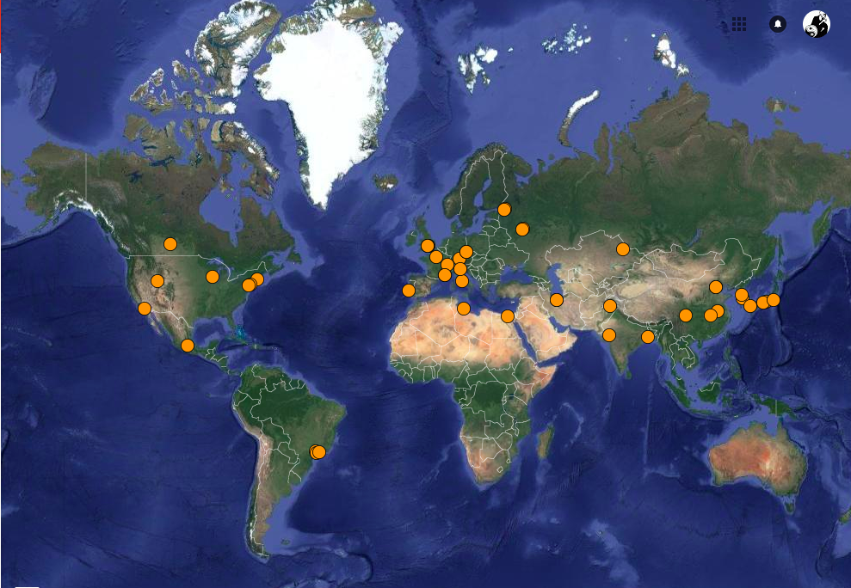
In pictures…

Slide 4
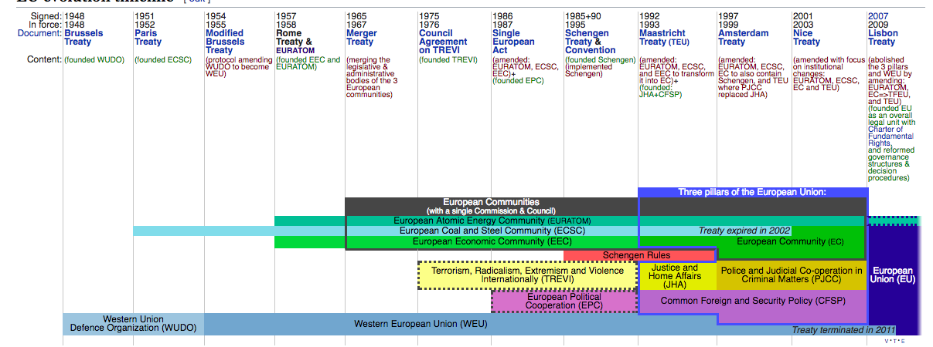
And Another Picture

Slide 5
What we want to setup, test, demonstrate
Running fusion workflows on EOSC resources
Accessing data either at site or through EUDAT services using UDA
Using IMAS
Integrating with local monitoring tools for data access
Investigate use of dynafed for federated data access
Investigate other communities for which UDA might be of interest.
Demonstration of a reporting tool for auditing, tracking and provenance
Notes:
UDA is Iter’s Unified Data Access Layer. It provides an abstraction layer which is storage and format agnostic, with formant information held in a central DB (allowing data model changes without the need to recompile code). API supports basic get/put operations from user perspective, but behind the scenes it can also do subsetting, subsampling etc. Data resyurned in a C-like strcture
IMAS is the Iter Integrated Modelling Environment – all data processing and analysis will use IMAS

Slide 6
Members, roles, effort, external partnerships
Member acronym | Role in the CC | Effort
CCFE (data provider) | Coordinator, UDA expertise, RDM, outreach | 19(+3)
CEA (data provider) | IMAS Integration, UDA expertise, outreach | 13(+1)
FZJ | hosting, resourcing, integration | 7
PSNC | Integration, AAI, dynpart, outreach, workflows | 10(+5)
STFC | Integration, hosting, resourcing, dynafed | 12
External partner | Type of partnership
ITER | Coordination with ITER, provision os use cases

Slide 7
Required ‘common’ and ‘federation’ services
Common Services
Possibly all! – preservation services may be less relevant at the moment but may be of interest at ITER scale
Federated Services
AAI, Monitoring, Helpdesk, VM Catalogue(if this means containers)
Define/estimate capacity requirements also where possible
Capacity from the CC members – 100TB storage, 50-100 cores
Capacity expected from external providers – TBD
In call, we have not anticipated resources from outside but stated extra capacity may be requested if experiment is successful
Notes:
WP6 will provide the following types of Common Services:
WP6.1 Discovery and access
WP6.2 Federated computing (Cloud and HTC grid)
WP6.3 Processing orchestration
WP6.4 Data and metadata
WP6.5 Preservation
WP6.6 Sensitive data
WP5 will provide the following types of federation services:
WP5.1 AAI
WP5.2 Marketplace
WP5.3 Operational Support
WP5.4 Monitoring service
WP5.5 Helpdesk service
WP5.6 Collaborative services (VM Catalogue)

Slide 8
Expected CC outputs
Increase performance of fusion workflows, focusing on experimental data processing use cases
Enable data access, analysis and management seamlessly across multiple research sitesusing on experimental data processing use cases
Report of Assessment of EOSC Services for Fusion
Trialing EGI FedCloud for workflows and integration to IMAS
Investigation of AAI Services and integration into (developing) fusion AAI
Pilot Services for Data Replication and Workflow Submission
Migration from ‘open’ to FAIR data (CCFE)

Slide 9
Open questions
Service provisioning ‘on-demand’ (bursty workflows)
Integration of EOSC Monitoring into site monitoring
Integration and/or provisioning of AAI – we need to integrate into 1 service, not 3
Open and FAIR data
Moving results back to users seemlessly
Data Security and Access statistics
Notes:
Currently most fusion data is not open, but is moving towards it (project starting Early 2019?), and currently none could be considered ‘FAIR’

