Slide 1
ELIXIR Competence Centre
Steven Newhouse
EMBL-EBI
steven.newhouse@ebi.ac.uk

Slide 2
Community background and maturity
ELIXIR is a well established Research Infrastructure for life-science with over 21national nodes and 185 partners
The ELIXIR-EXCELERATE project will deliver a coordinated and integrated COMPUTE, DATA, TOOLS and INTEROPERABILITY platform for life-sciences
EMBL co-leads the the development of the ELIXIR COMPUTE platform as well as driving 3 use-cases (HUMAN DATA, PLANTS & MARINE) communities
ELIXIR-CC will demonstrate the analysis of life-science data on EOSC compatible resources by leveraging the ELIXIR COMPUTE platform.

Slide 3
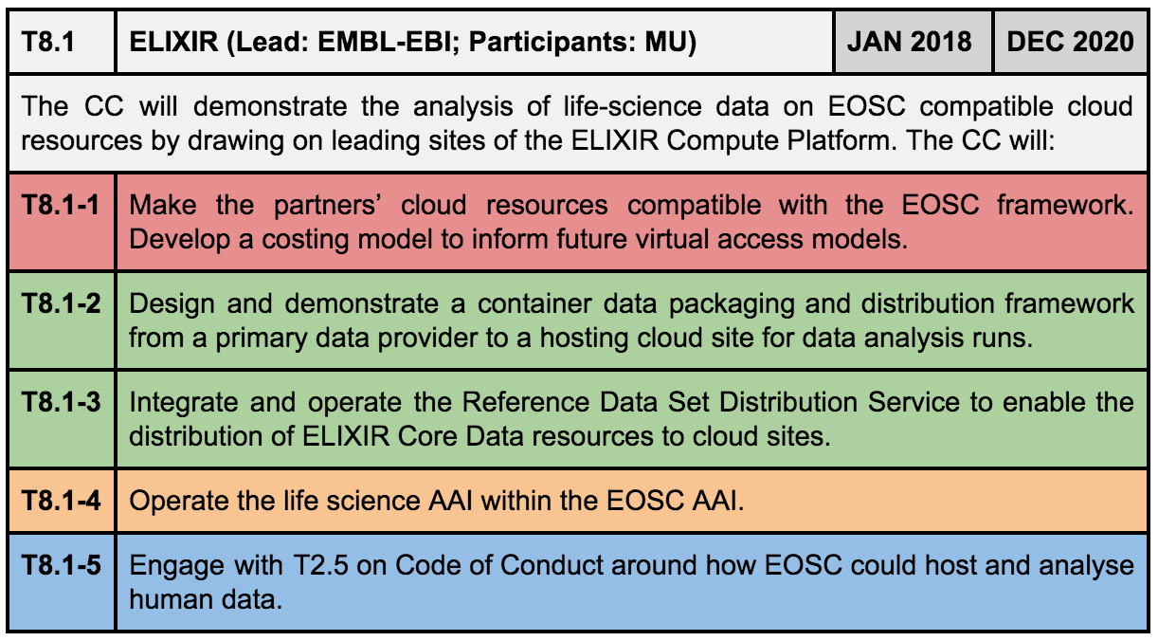
What we want to setup, test, demonstrate

Slide 4
Members, roles, effort, external partnerships
Member acronym | Role in the CC | Effort
EMBL-EBI | LEAD | 24
MU | Partner | 13
CSC | Partner | 12
External partner | Type of partnership
ELIXIR-EXCELERATE | Provider of scientific use cases and platform support

Slide 5
Required ‘common’ and ‘federation’ services
T6.2 to provide federation services for ECP
Engage with {Common | Federation} Data Movement WP??
T5.1 for AAI development and provisioning
Use of T5.4 for AAI and RDSDS monitoring
Engage with EOSC discussions/workshops around SLAs and OLAs
ID | Service Name | Service Type | Capacity Estimate
T6.2 | Federated Compute | Common | TBD
T6.4?? | Data Movement?? | Common | TBD
T5.1 | AAI | Federation | TBD
T5.4 | Monitoring Service (for AAI & RDSDS) | Federation | TBD
T2.4 | Data Sharing Policies | Strategic | TBD
Notes:
WP6 will provide the following types of Common Services:
WP6.1 Discovery and access
WP6.2 Federated computing (Cloud and HTC grid)
WP6.3 Processing orchestration
WP6.4 Data and metadata
WP6.5 Preservation
WP6.6 Sensitive data
WP5 will provide the following types of federation services:
WP5.1 AAI
WP5.2 Marketplace
WP5.3 Operational Support
WP5.4 Monitoring service
WP5.5 Helpdesk service
WP5.6 Collaborative services (VM Catalogue)

Slide 6
Expected CC outputs
Horizon 1 (Year 1) Outputs
RDSDS Deployment across EOSC compatible clouds
Operate ELIXIR AAI as part of EOSC AAI
ID | Work Backlog | Due Date
T8.1-3a | Identify and initiate contact with Cloud Data Hosting Partners | M3
T8.1-3b | Document, package and “deploy” RDSDS interfacing services at Cloud Data Host Partners | M6
T8.1-3c | Identify and procure datasets for RDSDS registration and Distribution to Cloud Hosting Partners | M9
T8.1-2a | Containerise and Document “DataSet Proxy” for Cloud Hosting Partner Deployment | M12
T8.1-2b | Showcase Exemplar Data Set Registration and Subscription Data movement between Source and | M24
T8.1-2c | Showcase Exemplar Data Set Proxy Access model of Datasets | M36
ID | Work Backlog | Due Date
T8.1-4a | Identify status of EOSC AAI implementation and expected engagement with ELIXIR AAI | M6
T8.1-4b | Investigate ELIXIR AAI → de.NBI Cloud integration model and distill lessons learnt to integrate permissions and resource entitlements between IdPs and Services | M6
T8.1-4c | Investigate direct integration of ELIXIR AAI with OpenStack via OpenID Connect or SAML | M12
T8.1-4d | Deploy an exemplar ELIXIR AAI + EOSC AAI integration via a Science Demonstrator | M24

Slide 7
Long-term objectives
To leverage EOSC common and federated services to deliver ELIXIR COMPUTE Platform to it’s users
Align existing ELIXIR common and federated services (e.g. AAI) with EOSC services delivery plans to allow seamless integration
Aspiration: EOSC will provide an integrated/integratable and platform to deliver digital research services for each community
Ability to fully customise the engagement
Ability to leverage the operational scale provided by EOSC

