Slide 1
Radio Astronomy Competence Centre
Supporting the LOFAR community on the European Open Science Cloud
Hanno Holties, Rob van der Meer
ASTRON
holties@astron.nl

Slide 2
Community background and maturity
Scientific field: Radio Astronomy
Astronomy has worked with standards for a long time
Data formats: FITS, MeasurementSet, ...
Interfaces: Virtual Observatory (IVOA)
The International LOFAR telescope
Data intensive science, SKA technology demonstrator
Datasets of 10 TB and more
Low flop/byte ratio, often embarrassingly parallel
Typically low access profile (write once, read few)
Operational since 2012
ASTRON expertise
Telescope & data archive operations & support, R&D (60+ years)
SKA technology R&D, Science Data Center

Slide 3
What we want to setup, test, demonstrate
The RACC aims to:
Support researchers to find, access, manage, and process data produced by the International LOFAR Telescope.
Provide user access to large-scale workspace storage facilities within the EOSC-hub to store and share temporary data and scientific data products.
Empower science groups to deploy their own processing workflows within the EOSC-hub infrastructure.
Lessons learned will serve as input for the design and construction of a European Science Data Center for the Square Kilometre Array (SKA)

Slide 4
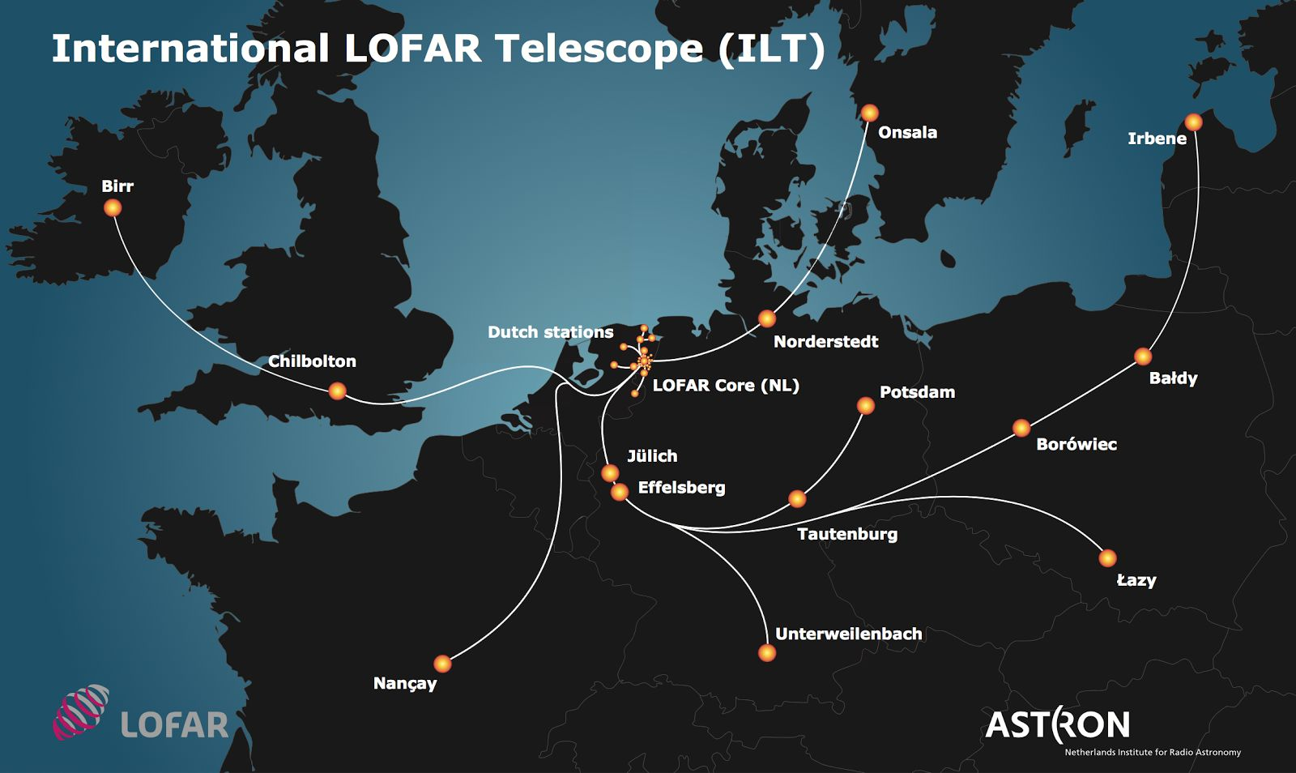
International LOFAR Telescope

Slide 5
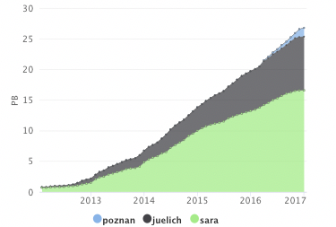
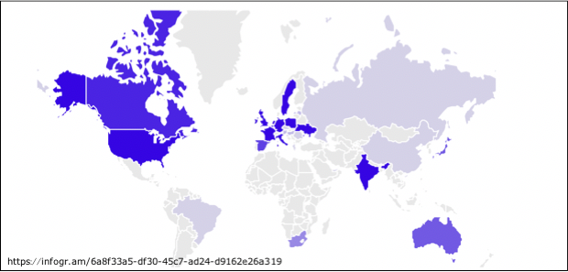
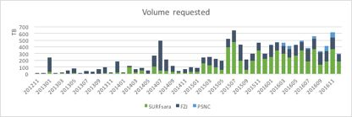
International LOFAR Telescope
35 PB data archive (start 2018)
Distributed over three sites
7 PB growth per year
Worldwide community
Hundreds of active users
Strong European representation
Community challenged by
Data volumes
Computational resources
Network capacity storage - compute

Slide 6
Container based pipeline processing with CWL
EOSC pilot development
Portability
Containers
Singularity
Docker
uDocker
CWL based Workflow management
Open standard

Slide 7
Members, roles, effort, external partnerships
Member acronym | Role in the CC | Effort
ASTRON | Lead, science domain expert, data & service provider | 29 (+3 in WP11)
JUELICH | Infra & service provider | 10
PSNC | Infra & service provider | 10
SURFsara | Infra & service provider | 10
External partners not yet identified
Open to new collaborations!

Slide 8
Required ‘common’ services
Infrastructure
55 PB long term storage (21 PB growth over coming 3 years)
Some tens of million core hours of (mainly) HTC computing
Scale up from 2nd year
Local access to high capacity (shared?) filesystem
5 PB online capacity work & user space
High Bandwidth (~10 Gbps) Storage – Compute (On demand?)
Services – to be selected & integrated in 1st half of project
PID’s (e.g. B2HANDLE)
FAIR sharing (e.g. B2SHARE, B2FIND, also Virtual Observatory)
Long term storage (e.g. B2SAFE/B2STAGE)
Workflow support/orchestration TBD (Data locality! CWL)
Notes:
WP6 will provide the following types of Common Services:
WP6.1 Discovery and access
WP6.2 Federated computing (Cloud and HTC grid)
WP6.3 Processing orchestration
WP6.4 Data and metadata
WP6.5 Preservation
WP6.6 Sensitive data
WP5 will provide the following types of federation services:
WP5.1 AAI
WP5.2 Marketplace
WP5.3 Operational Support
WP5.4 Monitoring service
WP5.5 Helpdesk service
WP5.6 Collaborative services (VM Catalogue)

Slide 9
Required ‘federation’ services
Services – to be selected & integrated with in 1st half of project
AAI – Service(s) TBD
Pilot with SURFnet on Science Collaboration Zone (Comanage)
Look into EGI, EUDAT, INDICO alternatives
Operational Support & Monitoring (for community support & auditing/reporting)
Support for CWL and deploying container images (Docker/Singularity/uDocker) on HTC systems for portable deployment
Relation to collaborative service?
Notes:
WP6 will provide the following types of Common Services:
WP6.1 Discovery and access
WP6.2 Federated computing (Cloud and HTC grid)
WP6.3 Processing orchestration
WP6.4 Data and metadata
WP6.5 Preservation
WP6.6 Sensitive data
WP5 will provide the following types of federation services:
WP5.1 AAI
WP5.2 Marketplace
WP5.3 Operational Support
WP5.4 Monitoring service
WP5.5 Helpdesk service
WP5.6 Collaborative services (VM Catalogue)

Slide 10
Expected CC outputs
POC Activities
Port processing workflows to EGI (M1 – M12)
Integration & Verification compute & storage (M4 – M12)
MS35 – Assessment & Integration/Validation Plan (M13)
Pilot Activities
AAI Integration (M7 – M15)
Metadata harvesting & PID registration (M7 – M15)
User Workspace (M10 – M15)
Preparing the Production Environment (M10 – M18)
MS36 – Online platforms available (M18)
Service Exploitation (M13 – M36)

Slide 11
Open questions
Will a standard/preferred AAI solution emerge?
Will there be homogeneity of resource infrastructure services?
Coordination of training & service availability for Competence Centers
(RA)CC is early user but should support services from ~M18
Need to select services to integrate with early in project
RACC community training planned for 2nd half of the project
How is this supported from WP11
Resource availability (funding, planning)
Container support on HTC clusters
On demand international network capacity
Storage – compute
Science DMZ/Research Data Zones?

