Slide 1
WP8 – Competence Centres [M01-M36]
WP Kickoff, Amsterdam, January 2018.
Gergely Sipos (EGI Foundation)
WP8 coordinator
gergely.sipos@egi.eu

Slide 2
Agenda
Session 1
Introduction
CC presentations (based on common template) – 8x10’
Session 2
Discussion of (common) challenges
Collaborative tools, Detailed workplans, Meetings, Metrics, Team membership, Key Exploitable Results (KERs)
OpenAIRE-Advance collaboration
Next steps
Thursday – Join if you can:
Training needs and plans (WP7, WP8, WP9, WP10, WP11)
Technical Coordination and Training (WP10, WP11)

Slide 3
Tasks and leaders
Task nb., title | Task leader | Deputy/technical leader | Represented Research infrastructure
WP8.1 ELIXIR / EMBL-EBI | Steven Newhouse | Susheel Varma | ELIXIR
WP8.2 Fusion / CCFE | Shaun de Witt |  | ITER
WP8.3 Marine / IFREMER | Thierry Carval |  | Euro-Argo, SeaDataNet
WP8.4 EISCAT_3D / EISCAT | Ingemar Häggström | Carl-Fredrik Enell | EISCAT_3D
WP8.5 EPOS-ORFEUS / KNMI | Luca Trani | Javier Quinteros | EPOS
WP8.6 Radio astronomy / ASTRON (SurfSARA) | Hanno Holties | Rob van der Meer | LOFAR, SKA
WP8.7 ICOS / University of Uppsala | Alex Vermeulen |  | ICOS, eLTER
WP8.8 Disaster Mitigation Plus / Academia Sinica | Eric Yen | Simon Lin

Slide 4
CC overview (WP8+WP11)
WP8 supports the design, integration and dissemination of new, community-specific e-Infrastructure service platforms. […] Activities are complemented by WP11 to deliver training to research communities and related relevant data providers and data scientists.
Objectives
Running proofs of concept to test the feasibility of use cases, based on specific scientific and technical requirements defined by high impact research communities.
Conducting pilots to define and test the architecture of solutions.
Preparing the production environments to make platforms available to users beyond the CC.
Defining business models to sustain the solutions within EOSC after the end of the project.
Members
EGI Foundation, CSC, ACK Cyfronet, ASTRON, CCFE (UKAEA), CEA, CESNET, CINECA, CNRS, EAA , EISCAT, EMBL, GFZ, GRNET, IFREMER, INGV, JUELICH, KIT, LUND, MARIS, MU, NOA, PSNC, SNIC (UU), STFC, SURFsara (ASTRON), ULG, AS (ASGC)

Slide 5
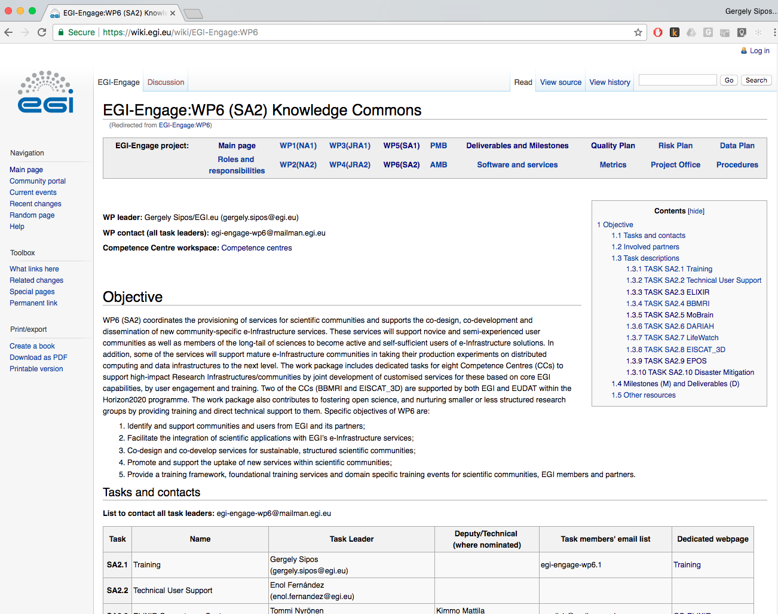
A bit of history: CCs in EGI-Engage WP6 (2014-2017)
ELIXIR
BBMRI
MoBrain
DARIAH
LifeWatch
EISCAT_3D
EPOS
Disaster Mitigation

Slide 6
SLIDE FROM FINAL EC REVIEW
EGI-Engage PY1 → PY2 → PY3 → EOSC-Hub
Requirement collection & system design
Tests, evaluation
Dissemin./
Exploitation
ELIXIR | Compute Platform with AAI 5 use cases are defined | Operates in 3 nodes | Application demos | ELIXIR AHM ’17, AHM ’18 | CC in EOSC-hub
BBMRI | Private clouds | Deployed at biobank-SE Under setup in biobank-CZ | Workflows and PIDs | BioBanking annual event
MoBrain | Community portal | Done | Done | 75+ events | TS in EINFRA12
 | Cryo-EM in the cloud (SCIPION) | Done | Done
 | GPGPU application gateways | Completed | Completed
DARIAH | Data repository | Done | Completed | 20 events | TS in EOSC-hub
 | Real-time search | Done
 | Application gateway | Completed
LifeWatch | Cloud infra. Services & VREs | Marine VRE, GBIF | Cloud site in Seville | Approx 10k users | TS in EOSC-hub
 | Apps. for citizen science | Done | Done
EISCAT_3D | Data Portal | Done–Proof-of-concept | Done (For Proof of Concept) | EISCAT Symposium ’16 | CC in EOSC-hub
 | Data & Compute Portal | Completed | Extended portal | EISCAT Symp’17
EPOS | 3 use cases are defined | Completed | Completed- AAI, Compute, Data |  | CC in EOSC-hub
Disaster Mitigat. | 2 simulation gateways | gWRF and iCOMCOT gateways | Completed | 3 cases: Typhoon Haiyan MY flood ‘14-15 Forest fire dust | CC in EOSC-hub
 |  |  |  | Climate change cases
Co-development
Operation
Cloud certification work in EOSC-hub
23 deliverables and 3 milestones in 30 months

Slide 7
Competence Centres in EOSC-hub
EOSC hub
A federated integration and management system for EOSC
Service catalogue: https://wiki.eosc-hub.eu/display/EOSC/Service+catalogue
Thematic services
Common services
Data analytics & Community-specific Services
WP5
WP6
WP5
WP7
Federation Services
AAI, Accounting, Monitoring, Operations, Security
Added value services
Compute, data, software management, curation & preservation
Open Collaboration Services
Application/software repository, Configuration management, Marketplace
integration
WP6
Basic infrastructure
Compute and storage
integration
WP10: Tech. support, Service roadmaps
WP11: Training
incubate
Competence Centres
Competence Centres
WHO:
Research community experts
Service providers
Technology providers
WHAT:
Run proof-of-concepts and pilots
Service co-creation
Bring new services into the catalogue
Dissemination and training
WP7, WP11

Slide 8
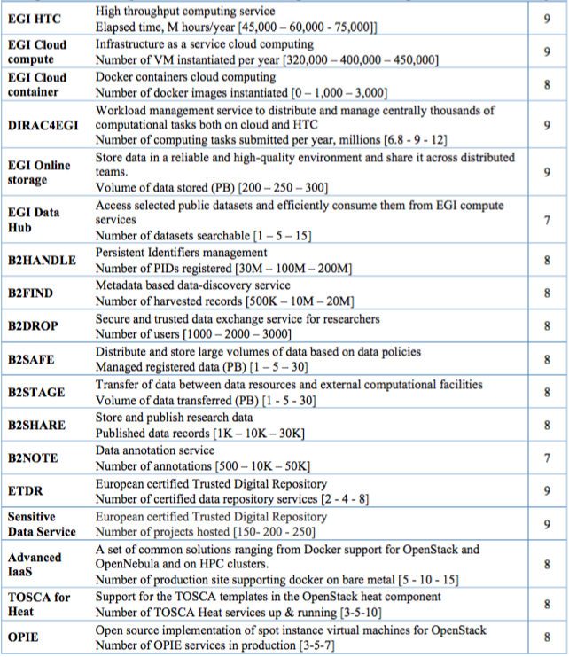
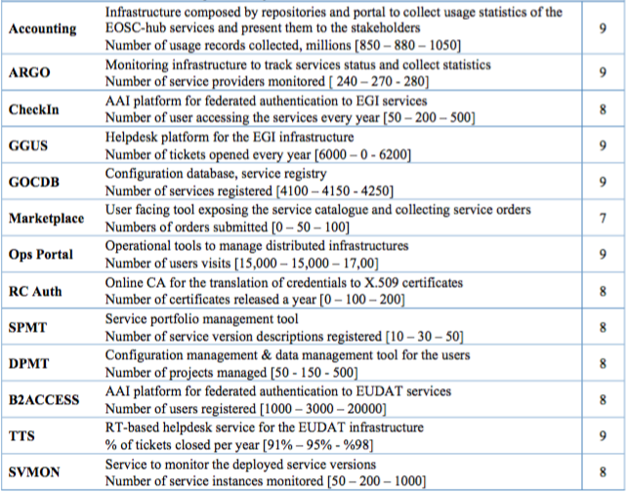
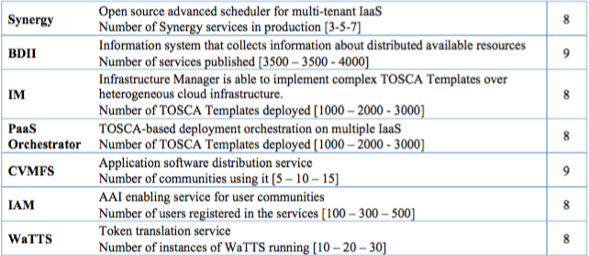
Basic infrastructure and Added value services:
WP6
WP5
Open Collaboration services:
integration
integration
Competence Centres
integration
Federation services:
WP5

Slide 9
EC Milestones and deliverables
Nb. | Title | Description | Lead beneficiary | Type | Due date
M35 | Technology assessment, architecture integration & validation plan for CCs |  | EGI Foundation | Report | PM13 (Feb 2019)
M36 | Online platforms from Competence Centres are available |  | EGI Foundation | Other | PM18 (Aug 2019)
D8.1 | Report on progress, achievements and plans of the Competence Centres | Status report about the prototypes, pilots and production services that were setup by the Competence Centres, together with their further development plans to EOSC services. | EGI Foundation | Report | PM18 (Aug 2019)
D8.2 | Final report on Competence Centre key results and exploitation status and plans | Final report about the achievements of the Competence Centres, and plans for evolving, operating and exploiting the CC prototypes/pilots/services beyond the project. | EGI Foundation | Report | PM36 (Dec 2020)

Slide 10
CC presentations – 8x10’
Community background and maturity
What you want to setup/test/demonstrate in the CC
CC members, their roles, effort (table) + External partnerships
Required Common services (WP6) with capacity; Required federation tools (WP5)
Expected CC outputs with milestones for at least the first 12 months
Open questions (e.g. technological) → input for WP11 training, WP10 technical support, WP12 Business models and procurement, …

