Slide 1
Disaster Mitigation Competence Centre
Eric Yen
Academia Sinica Grid Computing Centre (ASGC), Taiwan
Eric.Yen@twgrid.org

Slide 2
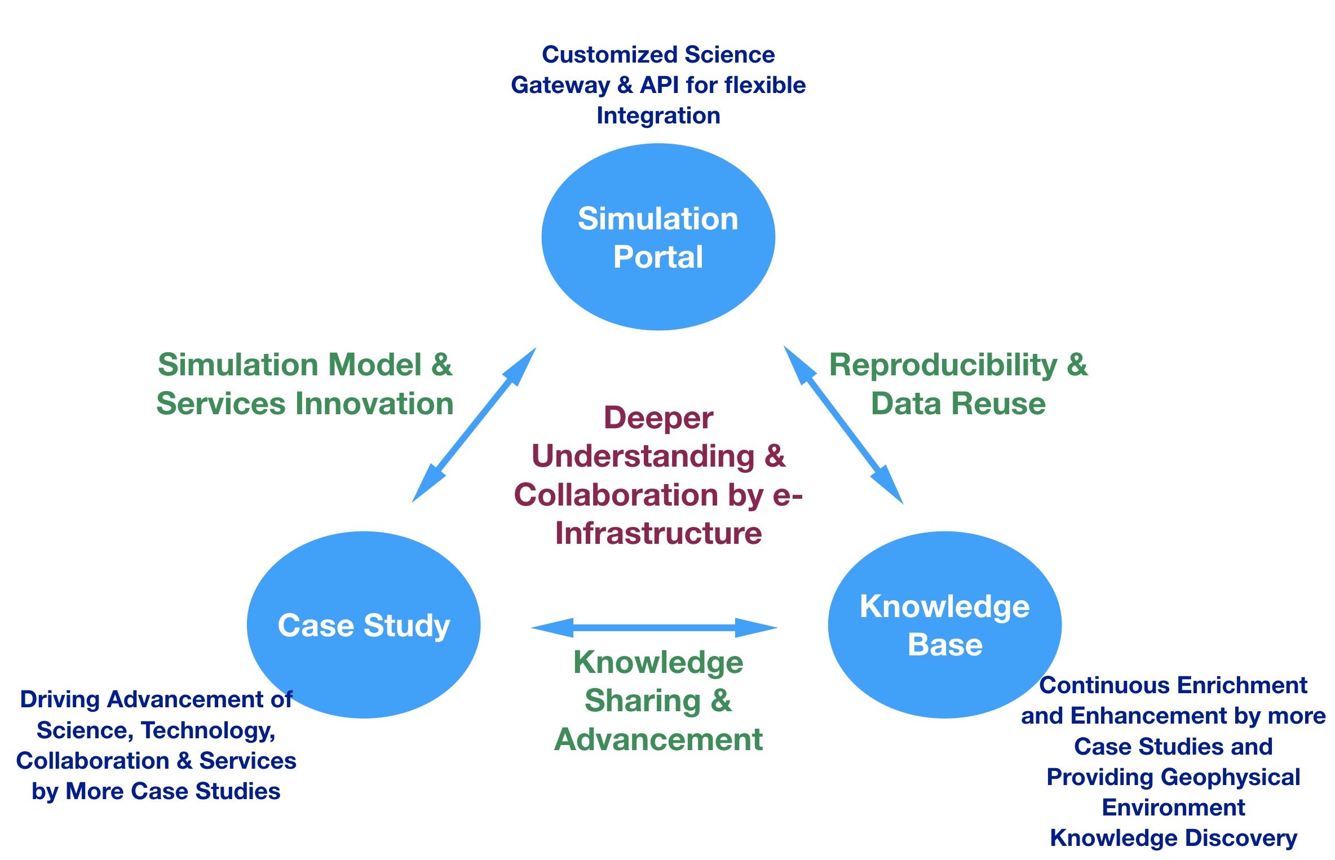
Community background and maturity
DMCC in EGI-Engage during March 2015 and August 2017
Open collaboration model based on deeper understanding & moving towards Open Science
Simulation Portals: Tsunami, Weather, Storm Surge
Partners: TW, PH, MY, ID, DE
Case studies conducted
Storm surge (Typhoon Haiyan, PH)
Flood (MY)
Dust transportation (ID)
Enlarge the impacts
EGI
APAN Disaster Mitigation WG
Asi@Connect Proj
UNESCO

Slide 3
What we want to setup, test, demonstrate
Storm surge simulation web portal
Long-distance dust transportation on fore fire and biomass burning
Weather simulation on flood
EGI Infrastructure:
Federated computing (Cloud and HTC grid)
And other Common services
Others: Container for WRF simulations over distributed resources

Slide 4
Members, roles, effort, external partnerships
Member acronym | Role in the CC | Effort
AS (TW) | Coordinating scientific study, case study, tech support, training & dissemination | 36
ASTI (PH) | Case study (Storm surge), User support | 2
HCMUT (VN) | Case study (Landslide), User support | 2
UPM (MY) | Case study (Flood), User/Tech support, infrastructure | 2
HAII (TH) | Case study (Dust trans, Flood), User/Tech support | 6
ITB (ID) | Case study (Dust trans), User support | 2
UD (IN) | Case study (Flood), User support | 2
NII (JP) | Tech support, infrastructure | 2
CESNET (CZ) | EOSC infrastructure, tech support | 6
LRZ (DE) | Advanced visualization | 2
External partner | Type of partnership
APAN Disaster Mitigation WG | Extension of collaboration framework and case studies
Asi@Connect Project | Source of scientific analysis and case study implement.

Slide 5
Required ‘common’ and ‘federation’ services
Required Common Services
Federated computing; Data and metadata; Sensitive data
Required Federation Services
AAI; Marketplace; Collaborative services
Define/estimate capacity requirements also where possible
Capacity from the CC members: 100+ CPU cores, 1PB disk, and regional networking
Capacity expected from external providers: 100+ CPU cores
Notes:
WP6 will provide the following types of Common Services:
WP6.1 Discovery and access
WP6.2 Federated computing (Cloud and HTC grid)
WP6.3 Processing orchestration
WP6.4 Data and metadata
WP6.5 Preservation
WP6.6 Sensitive data
WP5 will provide the following types of federation services:
WP5.1 AAI
WP5.2 Marketplace
WP5.3 Operational Support
WP5.4 Monitoring service
WP5.5 Helpdesk service
WP5.6 Collaborative services (VM Catalogue)

Slide 6
Expected CC outputs
Deliverables
EOSC Technology assessment and integration plan (milestone in month 6): Goal is to integrate Asia Pacific regional infrastructure with EOSC framework and making use of EOSC services for DMCC+ applications.
Online services integrated into a unified e-infra platform (milestone in month 21): Finish planned case studies by simulation portals over EOSC framework and EOSC services.
Tasks
Demonstrate the effective collaboration model to engage end users, scientific groups, technical groups, infrastructure support group, user support groups and simulation facility in partner countries to accomplish the planned case studies based on deeper investigation of the underlying causes.
Make the existing DMCC regional e-Infrastructure compatible with EOSC framework and support the case studies and shares of data, tools and knowledge to DMCC+ partners and potential collaborators in Asia, Europe and other continents.
Open Data: Make data, tools, processes, and derived results from the case studies sharable through EOSC framework and services.
Dissemination & Outreach: Collaborate with APAN Disaster Mitigation Working Group, series of master classes on the DMCC+ simulation facilities, web portals and hands-on trainings will take place in various Asia countries. More user communities and cloud resource providers in Asia would be engaged through the EGI-APAN collaboration framework.

Slide 7
Expected CC outputs
Deliverables
EOSC Technology assessment and integration plan (milestone in month 6): Goal is to integrate Asia Pacific regional infrastructure with EOSC framework and making use of EOSC services for DMCC+ applications.
Online services integrated into a unified e-infra platform (milestone in month 21): Finish planned case studies by simulation portals over EOSC framework and EOSC services.
Milestone
PM6: Integration Plan for EOSC framework and DMCC+ applications
PM9: Improving storm surge simulation model on typhoon Haiyan case study
PM12: Storm surge simulation portal online (pilot)

Slide 8
Open questions
Integration of simulation portals with the federated Cloud/HPC
Extending the EGI Infrastructure (incl. AAI, operation, monitoring and accounting framework) to Asian partners
Training
DMCC+ services and collaborations
EOSC-Hub services
Serving as a (Open Science) hub for Asian scientific communities on various applications

