Slide 1
ICOS/LTER Competence Centre
Inter-RI integration focused on Ecosystem observations
Alex Vermeulen
ICOS ERIC
Alex.Vermeulen@icos-ri.eu

Slide 2
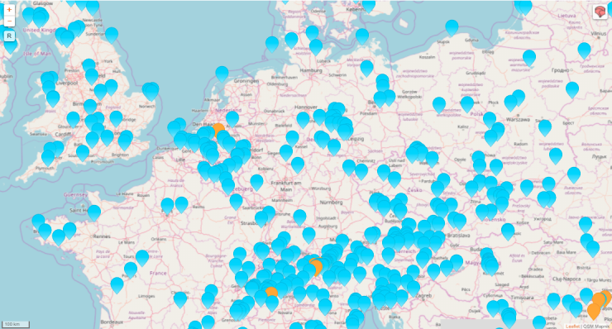
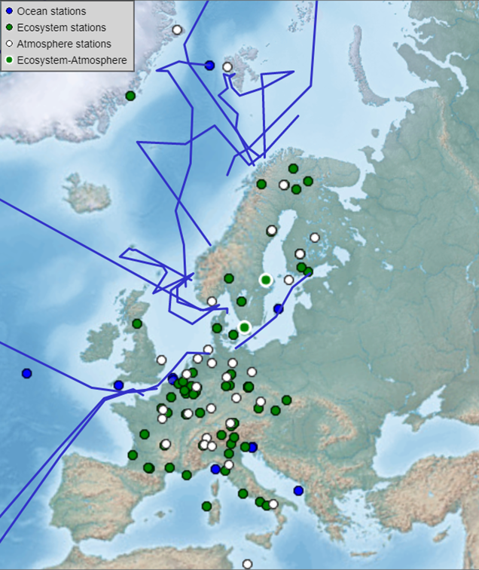
Community background and maturity
eLTER (emerging ESFRI RI) 'network of networks'.
national networks of LTER sites (for ecosystem research and monitoring)
larger areas (LTSER platforms) supporting socio-ecological studies.
ICOS RI (landmark ERIC)
Multi domain (ecosystem, atmosphere, ocean)
Greenhouse gas budget
12 member states 127 stations

Slide 3
What we want to setup, test, demonstrate
The ICOS/LTER CC will integrate the ICOS Carbon Portal and eLTER’s data management system DEIMS with the EOSC-Hub infrastructure, including station footprints and GHG concentration analysis tools, as well as other tools as needed by the RI’s communities.
The CC will prototype a platform that will enable the RI data portal users to:
Deploy RI Data from long-term e-infrastructure storage with the use of PIDs
Stage and couple ICOS RI and eLTER Data with TC/Cloud computing resources
Use container compute service to process ICOS RI and LTER datasets
Automatically orchestrate containers in the EOSC-Hub infrastructure based on data location and distribution.

Slide 4
ICOS Data Flow
B2STAGE
B2SAFE
B2SHARE
VRE (EGI)
Datacite
User 1
User 2
User 3
Diverse user communities, including data producers and other portals
B2FIND
Finalized and elaborated
data products
External metadata
registry & catalogue
services
ICOS Carbon Portal
Data ingestion
PID and DOI minting
Metadata services
Data discovery & access
Usage tracking
Data visualisation
Long term archiving
Repository administration
Preservation planning
User community support
B2SAFE
B2FIND
VRE (EGI)
ICOS
repository
(data, metadata)
Ecosystem Thematic
Centre
Oceanic Thematic Centre
Atmospheric Thematic Centre
Calibration
Labs
Standardized processing, quality assurance & control
High performance and throughput computing
services
Measurement stations
(National networks)
Sensor data
B2STAGE

Slide 5
Members, roles, effort, external partnerships
Member acronym | Role in the CC | Effort
ICOS ERIC | WP8 | 10 PM
LTER | WP8 | 5 PM
EGI (Cyfronet, CESNET) | integration support + capacity provisioning | 2 PM
EUDAT (SNIC-PDC+Jülich) | integration support + capacity provisioning | 2 PM
External partner | Type of partnership
WMO | WMO Information System, OSCAR, WIGOS
RDA | CC participates in relevant WGs
GEO | Link to GEOSS, Geo-C initiative

Slide 6
Required ‘common’ and ‘federation’ services
WP6.1 Discovery and access
WP6.2 Federated computing (Cloud and HTC grid)
WP6.3 Processing orchestration
WP6.4 Data and metadata
WP6.5 Preservation
WP5.1 AAI
WP5.3 Operational Support
WP5.4 Monitoring service
WP5.5 Helpdesk service
WP5.6 Collaborative services (VM Catalogue)
Notes:
WP6 will provide the following types of Common Services:
WP6.1 Discovery and access
WP6.2 Federated computing (Cloud and HTC grid)
WP6.3 Processing orchestration
WP6.4 Data and metadata
WP6.5 Preservation
WP6.6 Sensitive data
WP5 will provide the following types of federation services:
WP5.1 AAI
WP5.2 Marketplace
WP5.3 Operational Support
WP5.4 Monitoring service
WP5.5 Helpdesk service
WP5.6 Collaborative services (VM Catalogue)

Slide 7
Expected CC outputs
M8.7.1: ICOS CC Technology assessment and architecture/integration plan (M04)
D8.7.2: Beta version ICOS Carbon Portal/eLTER integration with EOSC (M14)
D8.7.3: Production version ICOS Carbon Portal/eLTER integration with EOSC (M18)

Slide 8
Open questions
Both RI’s are operational entities
Show must go on
Developments are based on needs of internal and external users of the RI’s
Developments follow science so requirements develop continuously
Services must be 100% reliable
“Not our problem” is unacceptable

