Slide 1
EOSC-hub WP9: Joint Digital Innovation Hub
Sy Holsinger, EGI Foundation
Senior Strategy and Policy Officer - WP9 Manager
EOSC-hub Kick-off Meeting (WP9), 9 Jan 2018, Amsterdam

Slide 2
Content Outline
Project overview
WP9 Overview
Partner Intros
Budget breakdown
Deliverables and Milestones
KPIs
Management tools
W9.1 Details
Open Actions

Slide 3
Project Overview

Slide 4
EOSC-hub mobilises providers from 20 major digital infrastructures, EGI, EUDAT CDI and INDIGO-DataCloud to jointly offer services, software and data for advanced data-driven research and innovation

Slide 5
Project figures
100 Partners, 76 beneficiaries (75 funded)
3874 PMs, 108 FTEs, more than 150 technical and scientific staff involved
€33,331,18 of which the European Commission funds €30,000,000
€2,155,540 (~8 FTEs) are co-funded by the EGI Foundation and its participants + €1,221,094 (~5 FTEs) from EGI participants
36 months: Jan 2018 – Dec 2020 (18 month reporting period)

Slide 6
Mission
The project will create the Hub a federated integration and management system for the future EOSC
Resources and Services
Processes and policies
Federated operations
Federation “core” services

Slide 7
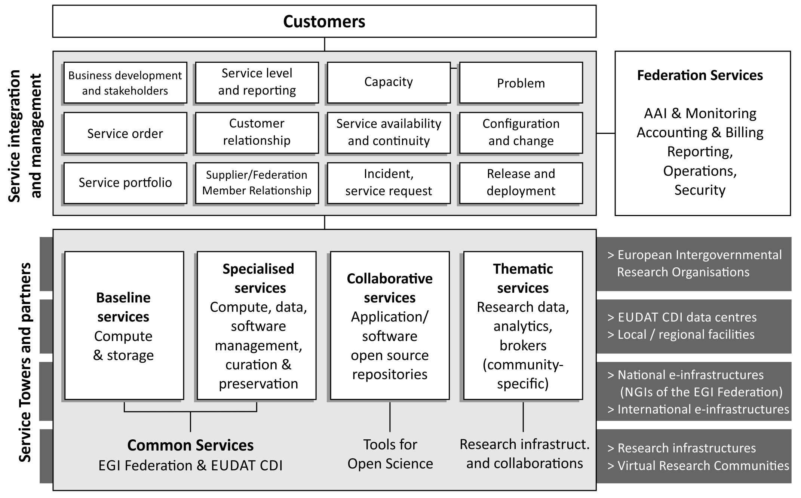
Service Integration and Access Management

Slide 8
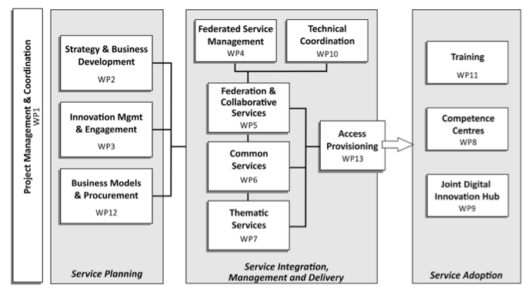
Work packages

Slide 9
Key Exploitable results
Integration of common software and services for storage, compute and data
Thematic services and Research Data
Federation and collaboration service and tools (Marketplace, Accounting, Security, Helpdesk, Monitoring)
Procedures and policies for federated service management
Purchasing and procurement framework
Training platform and materials
Technical standards roadmap
Strategy roadmap

Slide 10
WP9 Overview

Slide 11
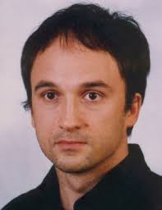
WP9 Management
WP9 Manager + WP9.1 Leader
Sy Holsinger
EGI Foundation
WP9 Deputy
Roberta Piscitelli
EGI Foundation
WP9.2 Task Leader
Marcin Plociennik PSNC
WP9.3 Task Leader
Nuno Varandas
F6S

Slide 12
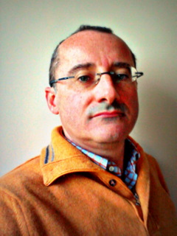
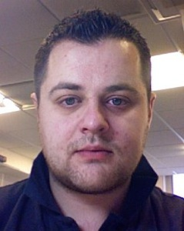
WP9 Support
Tomek Żok
PSNC
Claudio Arlandini
CINECA
Giuseppe Fiameni
CINECA
Egidijus Jarasunas F6S
Peter Coveney
UCL
David Wright
UCL
Stefan Zasada
UCL

Slide 13
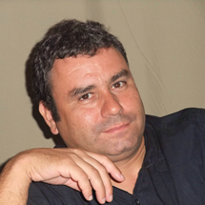
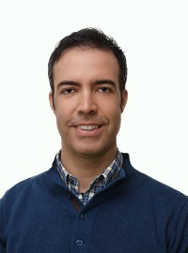
WP9 Business Pilots – Lead Contacts
Agustín Monteoliva
Ecohydros
Matteo Longoni
Moxoff
Rodrigo Fernandes
Bentley Systems
Adam Majewski
Koma Nord
Jose Collazo
Hidronav
Dimitris Panopoulos
SUITE5

Slide 14
WP9 Budget
Partner | T9.1 | T9.2 | T9.3 | TOTAL PM | Duration | FTE | Direct personnel costs | Other direct cost
EGI Foundation | 12.0 | 12.0 | 6.0 | 30.0 | 36 | 0.8 | 240,000 € | 7,500 €
CINECA | 0.0 | 12.0 | 6.0 | 18.0 | 36 | 0.5 | 90,000 € | 4,500 €
UCL | 7.0 | 0.0 | 0.0 | 7.0 | 36 | 0.2 | 35,000 € | 1,750 €
PSNC | 6.0 | 24.5 | 6.0 | 36.5 | 36 | 1.0 | 186,150 € | 6,250 €
F6S | 10.0 | 0.0 | 15.0 | 25.0 | 36 | 0.7 | 100,000 € | 6,250 €
Ecohydros | 0.0 | 14.0 | 0.0 | 14.0 | 18 | 0.8 | 58,100 € | 1,800 €
Moxoff Spa | 0.0 | 20.0 | 0.0 | 20.0 | 12 | 1.7 | 60,000 € | 1,800 €
Yottacle | 0.0 | 15.5 | 0.0 | 15.5 | 12 | 1.3 | 38,750 € | 1,800 €
Bentley Systems | 0.0 | 14.0 | 0.0 | 14.0 | 14 | 1.0 | 58,800 € | 1,800 €
Koma Nord | 0.0 | 12.5 | 0.0 | 12.5 | 18 | 0.7 | 60,000 € | 1,800 €
IDEGO Group | 0.0 | 13.5 | 0.0 | 13.5 | 18 | 0.8 | 60,075 € | 1,800 €
Hidronav | 0.0 | 13.9 | 0.0 | 13.9 | 18 | 0.8 | 50,499 € | 1,800 €
CESGA | 0.0 | 2.0 | 0.0 | 2.0 | 18 | 0.1 | 9,500 € | 1,800 €
SUITE5 | 0.0 | 9.2 | 0.0 | 9.2 | 18 | 0.5 | 59,800 € | 1,800 €
AIDIMME | 0.0 | 17.0 | 0.0 | 17.0 | 18 | 0.9 | 59,551 € | 1,800 €
TOTAL | 35.0 | 180.1 | 33.0 | 248.1 |  | 11.8 | €1,166,225 | €44,250

Slide 15
Project Budget Breakdown by WP

Slide 16
WP9 Objectives
Create partnerships with SMEs/industry, innovation clusters, accelerators and investors that stimulate innovation (new products, services). Provide access to funding/grants, and increase visibility. Facilitate access to e-Infrastructure resources to support pilots, prototyping, scaling-up, design, performance verification, testing, demonstration, etc.
Offer business oriented coaching to “accelerate” market uptake and exploitation results of pilots and Competence Centers. Connect with the Pan-European network of DIHs and selected regionals. Share best practices and competencies to expand the knowledge/human capital between the public and private sector. Develop long-term business relationships outside of/beyond the project.

Slide 17
EOSC-hub Joint DIH (WP9): Tasks/Activities
WP9 Joint Digital Innovation Hub
T9.1 | Joint DIH ecosystem (Lead: EGI Foundation) | Establishing and evolving of the DIH Collaborating with other DIHs Managing the DIH platform/tool
T9.2 | Business Pilots (Lead: PSNC) | Coordinating pilots (6 initially selected in open call) Ensuring access to services and tech support Assessing and validating results Identifying additional experiments
T9.3 | Commercialization Support (Lead: F6S) | Identifying business opportunities from the pilots Supporting technology transfer process models Mentoring program towards pilots and competence centres Defining pre-commercial agreements

Slide 18
Deliverable and Milestones
Deliverable | Lead Beneficiary | Author | Due Date (month) | Type | Dissemination Level
D9.1 Initial Business Pilots Overview & Work Plans | PSNC | Marcin Plociennik | M03 March 2018 | Report | CO
D9.2 Joint Digital Innovation Hub Intro and Strategy | EGI.eu | Sy Holsinger | M06 June 2018 | Report | PU
D9.3 Business Pilots Results | PSNC | Marcin Plociennik | M21 Sept 2019 | Report | CO
D9.4 Joint Digital Innovation Hub Final Results and Sustainability Plan | EGI.eu | Sy Holsinger | M36 Dec 2020 | Report | PU
Milestone | Lead Beneficiary | Author | Due Date (month) | Means of verification
MS37 Business Pilot Success Stories | EGI.eu | Sy Holsinger Marcin Plociennik | M24 Dec 2019 | Published Online

Slide 19
Task and Deliverable Timelines
PM1
PM6
PM12
M18
PM24
PM30
PM36
T9.1
Joint DIH
T9.2
Business Pilots
T9.3
Commercialization Support
PM3
PM21
PM6
PM24
PM36
D9.1
1st Business Pilot Work plans
D9.3
Business Pilot Results
D9.2
Joint DIH Strategy
D9.4
Joint DIH Final Results
M9.1
Publication of Business Pilot Success Stories

Slide 20
WP9 Relation to other WPs
Exploitable Services
WP2: Service Portfolio/Catelogue
New services
Innovation Input
DIH
Engagement Strategy
WP3: Innov Mgmt./ Comms / Open Calls
Marketing Support
Open Call Mgmt.
Provisioning
WP6 or WP13?
Expertise
Mentoring
WP8: CCs

Slide 21
Project KPIs – WP9
KPI# | Name | Area | BT | ST
KPI03 | Services/technologies increased in TRL via the DIH | T | 7 | 10
KPI04 | Published business pilot success stories | SE | 5 | 8
KPI05 | Signed (pre-)commercial agreements for EOSC-hub services from DIH | SE | 3 | 6
O = operational, T = technical, SE = socio-economic
BT = base target, ST = stretch target

Slide 22
Management Tools
WP9 Information + Action Tracking
Confluence: https://confluence.egi.eu/display/EOSC/WP9+Joint+Digital+Innovation+Hub
Google Drive: https://drive.google.com/drive/folders/0B2VDZ6gys8DjOFUtUmNlcERSdjQ
Meeting agenda
Indico: https://indico.egi.eu/indico/category/228/
Virtual Conference system
GoToMeeting (reoccurring link to be set up once decided on date/time)
Mailing lists (to be set up once possible)
WP9 General
Pilots
Skype
Add contacts to confluence page

Slide 23
Key Exploitable Results
Mainly from Business pilots (Software & Services)
https://confluence.egi.eu/display/EOSC/From+DoA%3A+Expected+project+results+and+exploitation+path

Slide 24
IPR – Consortium Agreement
Section 8: Results
8.1 Ownership of Results
Results are owned by the Party that generates them.
8.2 Joint ownership
Joint ownership is governed by Grant Agreement Article 26.2 with the following additions:
Unless otherwise agreed
Each of the joint owners shall be entitled to use their jointly owned Results for non-commercial research activities on a royalty-free basis, and without requiring the prior consent of the other joint owner(s), and
Each of the joint owners shall be entitled to otherwise Exploit the jointly owned Results and to grant non-exclusive licenses to third Parties (without any right to sub-license), if the other joint owners are given:
(a) at least forty-five (45) calendar days advance notice including the right to object or require specific conditions; and
(b) Fair and Reasonable Conditions.
The Parties agree to adopt the following licenses for Project’s Results:
(1) Creative Commons CC-BY 4.0 for documents, reports, training material, presentations, etc. unless otherwise agreed and for justified reasons;
(2) An OSI-approved license (http://opensource.org/licenses), for any new software developed within the Project;
(3) In order to comply with the open access policy and maximise possibility for reuse of results, EOSC-hub partners, together, agree not to further develop software released with a non-open license and which cannot be re-released using an OSI-approved license.
The resulting software code, tools and interfaces developed as part of the EOSC-hub Project released as open source code will be provided via source code repositories such as, but not limited to, GitHub or SourceForge

Slide 25
WP9.1 Details

Slide 26
WP9.1 Objectives and Activities
Objectives
Coordinate the WP
Manage the project's Joint Digital Innovation Hub (DIH) ecosystem
Key activities
Create models to facilitate e-Infrastructures to target and engage the private sector
Facilitate collaboration within regional and European Innovation Hubs
Promote open innovation to leverage resources available in the e-Infrastructure network and strategically manage business innovation processes
Set up panel discussions and interviews, to gather needs and requirements of the private sector

Slide 27
WP9.1 Key Results
Key results:
Established Joint Digital Innovation Hub
Formulated strategy for its evolution
Defined technical facilities to support the Joint Digital Innovation Hub
Formulated sustainability plan for the Joint Digital Innovation Hub

Slide 28
WP9.1 Workplan
Preparation stage
Prepare initial text for project website
Write the strategy for the digital innovation hub (D9.2 – June’18)
Set up the technical and non-technical environment to support the DIH
Stakeholders identification (Industry, start-ups, collaboration institutions, technical and business services)
Set up panel discussions and interviews, to gather needs and requirements of the private sector
Develop business models to facilitate e-Infrastructure interaction with private sector (starting with WP13?)
Plan networking, matchmaking, brokerage and dissemination events:
Venue hire
Host events
Define how to help the product and service design process for SMEs using e-infrastructures

Slide 29
WP9.1 Workplan
Initiation stage
Provide companies with insight on e-infrastructure technologies and related trends
Support companies to identify and test ideas using e-infrastructure services
Help companies to create new partnerships
Contribute to T9.3 in developing partnership programmes for SMEs:
Go-to-market program (production/commercialisation/strategy and business modeling/ resource provider involvement / sales and investors network)
Pre-commercial development program (service development /prototyping and testing / demonstration pre-commercialisation/ funding & scalability)

Slide 30
EGI Business Engagement
+150
8
~20
# business contacts
# use cases completed
13
3
# SMEs who filled the intake questionnaire
# MoUs with private sector organisations

Slide 31
EGI Business Use Cases
8 business use cases
Main service used:
EGI Cloud Compute
Sectors:
Computer-aided design
Computational fluid dynamics
Earth Observation
Manufacturing/Engineering
Music
Radio-astronomy
Industry representatives
9 SMEs, 2 large enterprises
9 countries: Belgium, Czech Republic, France, Germany, Italy, Netherlands, Spain, Switzerland, UK

Slide 32
EGI Pay-for-Use - History
2013
2014
2015
2016
2017
Exploratory document
Kick-off of proof of concept
Adapted tools to support price setting/negotiation/reporting (GOCDB, e-GRANT, Accounting Portal)
Established agreement framework: - services, prices, processes
- Letter of Intent from EGI providers
In production: https://wiki.egi.eu/wiki/Pay-for-use
- Transition from e-GRANT to the EGI Marketplace as front-end and order management

Slide 33
EGI Pay-for-Use - Results
~30
7
# involved providers
# signed Letter of Intent (+4 in PY2)
3
2
Financial transactions in discussion
Financial transactions completed

Slide 34
Open Actions
WP9 Meetings
Day and time?
Don’t want to create a Doodle each time, better to block off
Mailing Lists
Set up lists: WP9 General and Pilots
Workspace
Populate Confluence
Communication/Dissemination/Events
Record - https://confluence.egi.eu/display/EOSC/Dissemination+Activities
Prioritize - https://docs.google.com/spreadsheets/d/1SVs7M9lb2LnsjmPRn6sc44KSTymdpiRPCldxXhiIgsU/edit#gid=2053634289
Trainings
IPR/KER
Results from business pilots?
Risks
To be provided: https://confluence.egi.eu/display/EOSC/Risk+registry
Digital Innovation Hub
Where is it hosted? e.g. what tool?
Contacts
Creating a database of other DIHs and relevant business contacts for engagement
Project Results
See Sergio’s slides or email to AMB

Slide 35
Useful links
http://go.egi.eu/EOSC-hub-doa
http://go.egi.eu/EOSC-hub-budget
https://confluence.egi.eu/display/EOSC/Home
https://indico.egi.eu/indico/category/211/

Slide 36
sy.holsinger@egi.eu
Thanks! Questions?
@syholsinger
EOSC-hub Kick-off Meeting, 9 Jan 2018, Amsterdam

