Slide 1
EOSC-hub Innovation Management
Sergio Andreozzi, Roberta Piscitelli
Strategy and Policy Team, EGI Foundation
T3.1 Innovation Management, EOSC-hub
EOSC-hub Kick-off Meeting, 9 Jan 2018, Amsterdam

Slide 2
Content Outline
Definitions
Project results, exploitation, dissemination, IP, IPR, innovation, innovation management
Innovation management in EOSC-hub
Activities
Templates
Short-term actions

Slide 3
From needs to impact
Impact (benefits)
Exploitation of results
Dissemination of results
Communication measures
Identification, review of results (protect if appropriate)
project results
EOSC-hub project
internal communication
4 years
start
end
(best effort)
Communication of project
Communication measures
Challenge of the H2020 call (needs/wants)

Slide 4
Definition: (Project) Result
“means any tangible or intangible output of the project, such as data, knowledge or information, that is generated in the project, whatever its form or nature, whether or not it can be protected, as well as any rights attached to it, including intellectual property rights”
Horizon 2020 Rules for Participation

Slide 5
Definition: Exploitation
The use of results:
in further research activities other than those covered by the action concerned
in developing/creating/marketing a product/process
in creating and providing a service
in standardisation activities
Horizon 2020 Rules for Participation

Slide 6
Definition: Dissemination
The public disclosure of the results by any appropriate means (other than resulting from protecting or exploiting the results), including by scientific publications in any medium
Horizon 2020 Rules for Participation
“to make people aware of the project and its results,
to encourage use of the project results”

Slide 7
Definition: Intellectual Property (IP)
Products of the mind
Products of research & experimentation
Products of creativity
Intellectual Property can be a valuable asset
Like physical property
Intellectual property can be traded, sold, bought, leased, used as collateral, or given away
Examples: software, designs, databases, reports, roadmaps

Slide 8
Definition: Intellectual Property Right (IPR)
Legal “rights” to protect your Intellectual Property
Patents (technical inventions)
Copyright (e.g., software, written works, engineering drawings)
Design rights (appearance)
Database rights (creation and arrangement of data)
Trade marks
Utility Models/petty patents
Non-disclosure agreements
Etc.
IP protection is a decision related to
the approach to exploitation of a project result

Slide 9
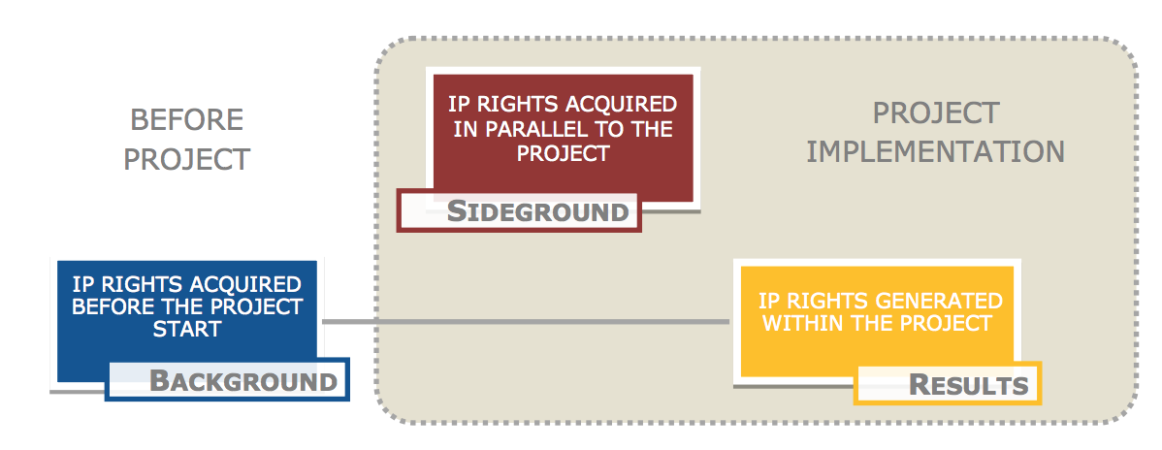
Forms of IP asset
more information in: European IPR Helpdesk: How to manage IP in Horizon 2020: Grant preparation stage

Slide 10
Definition: Innovation
A new (or improved) entity (or creation), which when used can produce tangible benefits, satisfying users needs and wants
exploitation
Results/Invention
Innovation
Impact: The benefits derived from the innovation; The larger the benefit, the larger the impact

Slide 11
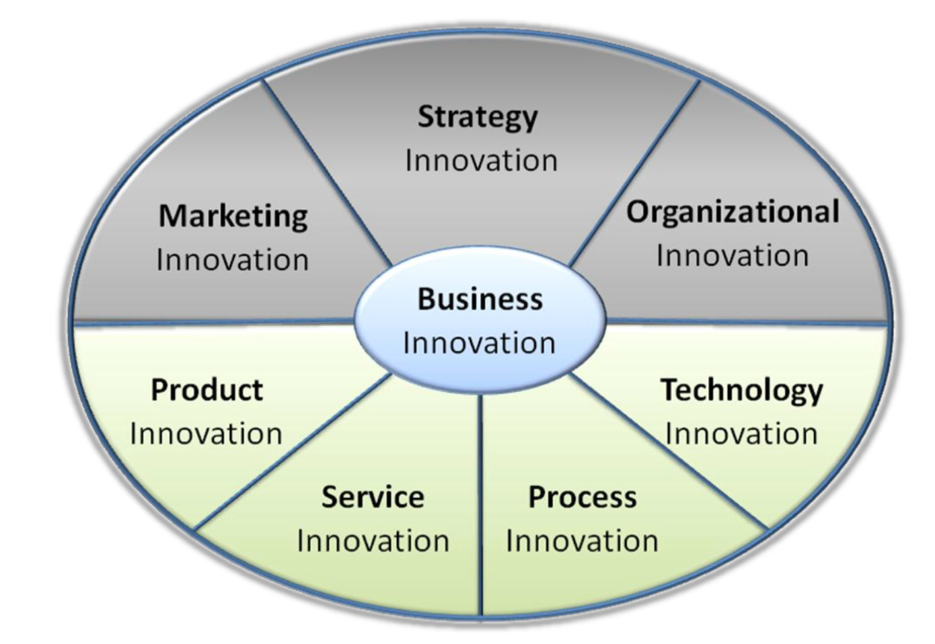
Types of innovation

Slide 12
Definition: Innovation Management (EC definition)
“Overall management of:
all activities related to the understanding needs,
with the objective of successfully identifying new ideas and managing them,
in order to develop new products and services which satisfy these needs.
Innovation management starts at the point of capturing the creative works and finishes when a product or a services is deployed.”
The set of activities within the project include:
capturing, assessing, protecting and managing project results and related IPR, through dissemination (telling) to exploitation (getting the results and IPR used)

Slide 13
Innovation Management in the EOSC-hub project

Slide 14
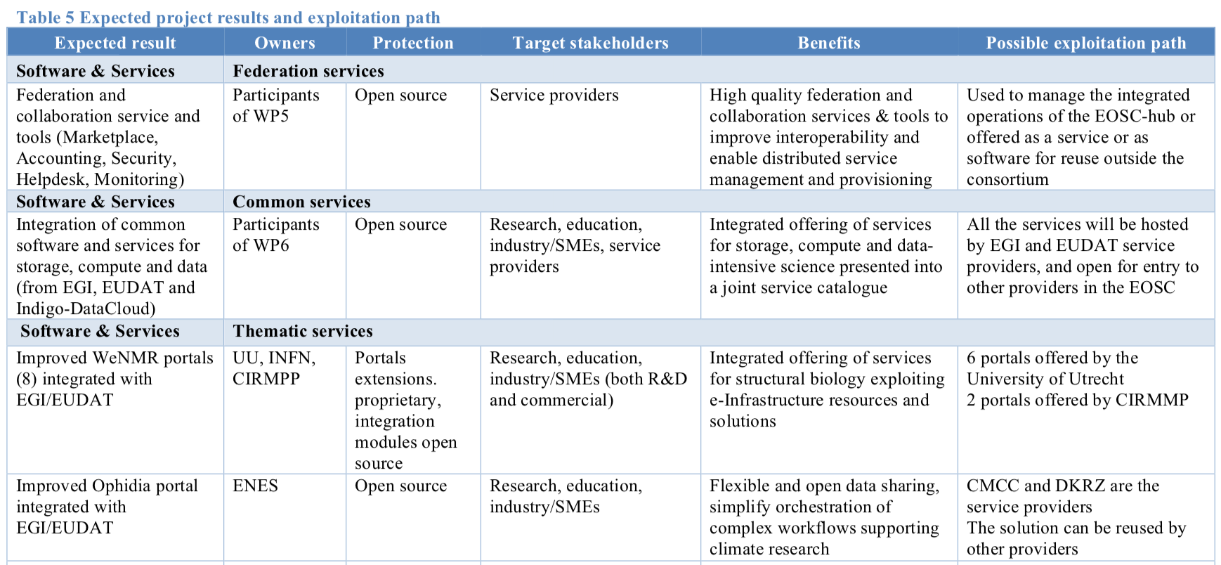
Innovation management started at the preparation phase
Several “open calls” to select partners and ideas, e.g.:
Thematic services (open call for idea generation + integration projects + adopted results)
Competence centres (open call for idea generation + concepts for CCs)
Digital Innovation Hub (open call for idea generation + pilots + adopted results)
Initial analysis of main project results, approach to IP, market, exploitation and dissemination approach
See section 2 of the Description of Work

Slide 15
Types of expected project results
Software and service
Technical specifications
Policies and procedures
Documents and reports
Business models
Summary of the expected results: https://confluence.egi.eu/x/EoDL

Slide 16
Innovation Manager (Role)
Responsible for:
Setting up a lightweight innovation management system for the project
Coordinating the identification of project results
Supporting the definition of the best IP protection approach
Maintain the dissemination and exploitation plan
Accountable to the Activity Management Board (AMB)
Reports to the PMB and the GA as required
Innovation management function is embedded in Task 3.1
Sergio Andreozzi (Innovation Manager)
Roberta Piscitelli (Deputy)

Slide 17
Not an isolated activity
The design of the processes will also consider appropriate connections with:
Continual improvement (T1.3)
Management of technical evolution (WP10)
Management of service evolution (T2.2)

Slide 18
Supporting activities
Definition of an innovation management plan (M8)
Roles, processes, tools, templates
A mature draft will be available in Q1
Workshop on innovation management and its elements (M6)
Two webinars to provide guidance on updating the analysis on the project results (M16+M30)
Support desk for project partners

Slide 19
Project results and aggregate project results
Key
Aggregate Project Result 1
Supporting
Project result 1
Aggregate Project Result 2
Each Aggregate project result is an aggregation of several result that are targeted at the same audience and participate in providing the expected benefits
Aggregate results can be Key or Supporting, according to the result of the prioritization
Project result 2
Project results catalogue
Aggregate Project results catalogue

Slide 20
Project result (draft template)
Characterisation
Innovation and benefits
Dissemination
Target audience
Intellectual Property Rights
Actions
Type of result
Exploitation
Timeline
Dissemination channels and set of actions that will be put in place to disseminate the output
https://confluence.egi.eu/x/sIAhAQ

Slide 21
Aggregate project results (draft template)
Characterisation
Innovation and benefits
Dissemination
Type and actions
Intellectual Property Rights
Market analysis
Risks analysis
Type of result
Exploitation
Timeline
Project result components
Evaluation
Impact
Dissemination channels and set of actions that will be put in place to disseminate the output.
Relevance to project impacts
Key or Supporting?
https://confluence.egi.eu/x/fgUHAQ

Slide 22
Key Exploitable Results (KERs)
The most relevant results of the project
A subset of the aggregate project results selected considering 4 main criteria
Key Exploitable Result
Innovation
Impact
Exploitability
Benefits

Slide 23
Actions for WP managers
During the Kick-off event – individual WP meetings
Review of the expected aggregate project results arising from the WP
Start from the analysis part of the DoW: https://confluence.egi.eu/x/EoDL
Update the content in: https://goo.gl/t12v64
By 26 January 2018
Provide feedback on the templates to describe:
Project results: https://confluence.egi.eu/x/sIAhAQ
Aggregate project results: https://confluence.egi.eu/x/fgUHAQ

Slide 24
Actions for all partners
Starting from 1st February 2018
Create initial project results and aggregate project entries in Confluence
Update/review the entries
Every time you finalise a deliverable (mandatory)
At M16 and M30 (mandatory)
Record all dissemination actions related to project results in : https://confluence.egi.eu/display/EOSC/Dissemination+Activities
Dissemination -> Exploitation -> Impact

Slide 25
By the end of the project, for each Key Exploitable Result, we need a story
Description
Innovation
What is new or improved
Benefits
Exploitation
Who will exploit the result? For what?
Use cases and/or success stories
Dissemination & communication
General description

Slide 26
Summary
Innovation management
Fundamental activity to ensure that project results are captured, assessed, prioritised, protected, disseminated and exploited
Processes, tools and templates being defined
It’s a collaborative work
Your contribution is essential to ensure that we maximise the impact of the project and we are able to demonstrate it

Slide 27
This presentation is based on material from:
Maximising the impact of H2020 projects (slides), E. Sweeney
https://goo.gl/ThMtCm
Your guide to IP in Horizon 2020, EU IPR Helpdesk
https://www.iprhelpdesk.eu/sites/default/files/documents/EU-IPR-IP-Guide.pdf
How to manage IP in Horizon 2020: Grant preparation stage, EU IPR Helpdesk
https://www.iprhelpdesk.eu/sites/default/files/newsdocuments/FS_How_to_manage_IP_in_H2020_grant_preparation_0.pdf
Exploitt: methodology for industrial exploitation and take-up
http://www.focusonfof.eu/downloads/results/exploitt-dossier.pdf

Slide 28
Thanks! Contact:
sergio.andreozzi@egi.eu
roberta.piscitelli@egi.eu
EOSC-hub Kick-off Meeting, 9 Jan 2018, Amsterdam

