Slide 1
EOSC-hub IT Service Management
Sy Holsinger, EGI Foundation – Senior Strategy and Policy Officer
WP1.3 CSI Leader/WP9 Manager/WP11.3 Task Leader
EOSC-hub Kick-off Meeting, 9 Jan 2018, Amsterdam

Slide 2
Content Outline
Intro to IT Service Management
History and overview of FitSM
EOSC-hub implementation
Key activities and expected results

Slide 3
Intro to ITSM

Slide 4
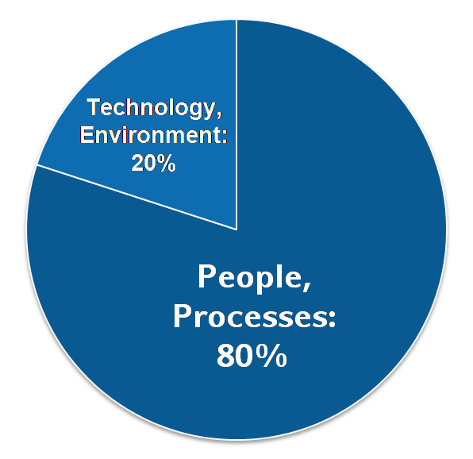
IT Service Management
Why IT service management (ITSM)?
About 80% of all IT service outages originate from "people and process issues"
Duration of outages and degradations significantly dependent on non-technical factors
IT service management
Focuses on the provision of high quality IT services that meet customers' and users’ expectations
Defines, establishes and maintains service management processes through assigned roles and responsibilities
Reasons for service outages
[Gartner]

Slide 5
ITSM Success Factors
People
Processes
Technology
Skills
Awareness
Defined activities
Responsibilities
Support people in their roles
Effectiveness and repeatability
Increase process effectiveness and efficiency
Typical tools for service management:
Workflow support tool
(Trouble) ticket tool
Wiki
Excel sheets
Word templates
…
Typical service management processes:
Service portfolio management
Service level management
Incident management
Change management
Capacity management
Information security management
…

Slide 6
What is a process?
Definition following FitSM-0:
Process: Set of activities that bring about a specific objective or set of results from a set of defined inputs.
3 basic facts about IT service management processes:
ITSM processes support the delivery of IT services
To provide one IT service to a customer, often several processes are needed
An IT service being successfully delivered is the result from many processes successfully operating and interacting

Slide 7
What comprises a process?
Set of interrelated activities
Roles and responsibilities
Goal(s), objectives
Clearly defined inputs, triggers and outputs

Slide 8
Roles and Responsibilities (People)
SMS owner (x1)
SMS manager (x1)
Process owner (optional; x1 per process)
Process manager (x1 per process)
Case owner (x1 per case – e.g. SLA, incident)
Member of process staff
Service owner (x1 per service)
(Internal) ITSM consultant
(Internal) ITSM auditor
Process owner
1
1..*
Process manager
1
1..*
Process staff member

Slide 9
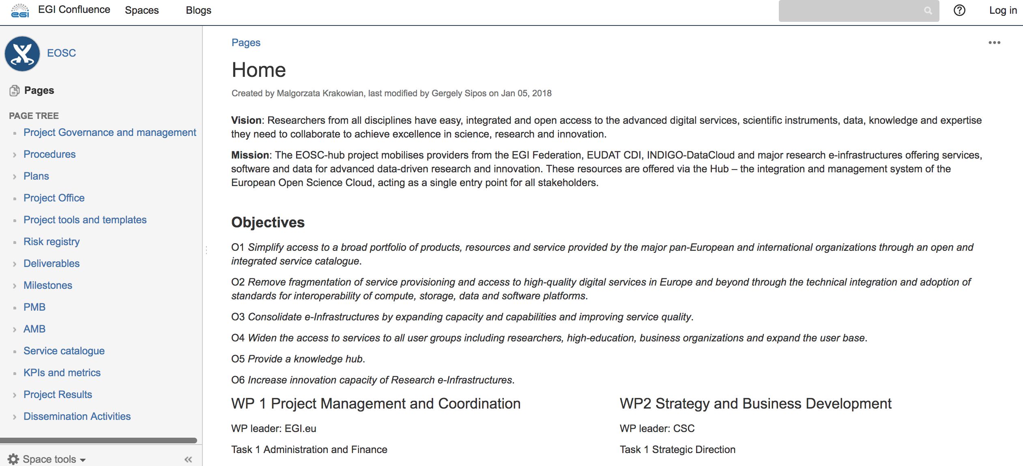
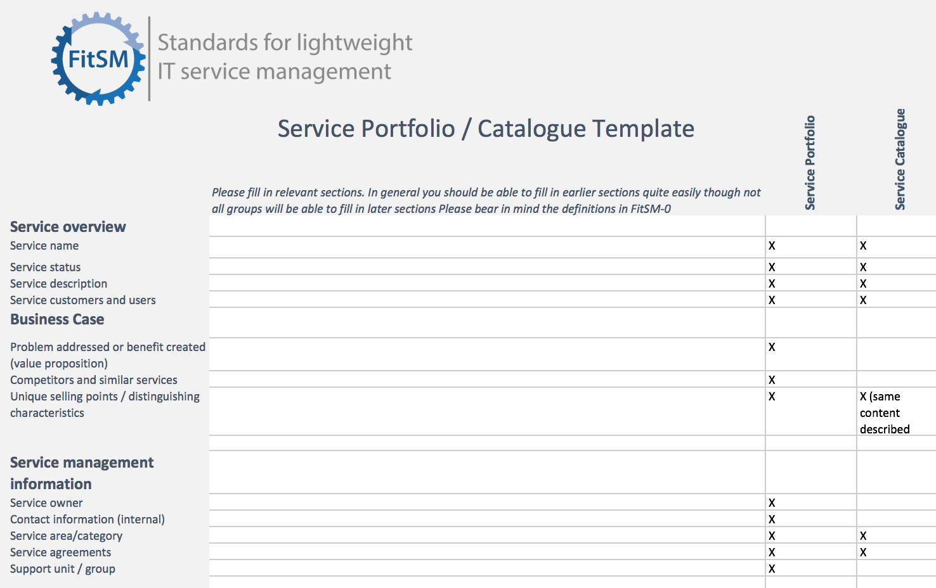
Tools (Technology)
Ticket tool
e.g. GGUS, JIRA
Wiki
e.g. Confluence, Wikimedia
Templates
e.g. Word docs, Excel, Google Apps, Forms

Slide 10
History and Overview of FitSM

Slide 11
History of the FitSM standard
2012
2013
2015
2017
FedSM Project starts (FP7)
- Initial Goal: Help e-Infrastructures increase professional service delivery (Client partners: EGI, CSC, PLGrid)
Creation of FitSM
- Realization of market gap for lightweight approach
- Formalised standard and training certification scheme
Commercialization (FedSM ends – Sept)
- Established ITEMO (non-profit to host FitSM license and maintain standard)
- Contract Negotiation with Certification Authority (TUV SUD)
- Accreditation of training organisations
Sustainability
- ~1000 certificates awarded
- 15+ Accredited Training Organisations
- New certification authority (ICO-Cert)

Slide 12
What is FitSM?
Standards family for lightweight IT service management
Suitable for IT service providers of any type and scale
Main design principle: Keep it simple!
All FitSM parts are freely released under Creative Commons licenses
FitSM is operated and managed by ITEMO (non-profit)
Certification is provided through ICO-Cert
www.fitsm.eu
The development of FitSM was originally funded by the European Commission through an EC-FP7 project "FedSM“

Slide 13
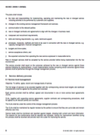
Third way for ITSM
‘Full’ commercial ITSM
FitSM Solution
More achievable
More suitable
Path to ‘full’ ITSM
Freely available
No/little formal ITSM
ISO/IEC 20000

Slide 14
FitSM Standard Family and Licenses
Core Standard
FitSM-0
Overview & vocabulary
Normative
FitSM-1
Requirements
FitSM-2
Objectives and activities
FitSM-3
Role model
Informational
Implementation aids
FitSM-4
Selected templates and samples
FitSM-5
Selected implementation guides
FitSM-6
Maturity and capability assessment scheme

Slide 15
FitSM Process Model
Service Portfolio Management
Most strategic
Service Level Management
Service Reporting
Service Availability and Continuity Management
More strategic
Capacity Management
Information Security Management
Customer Relationship Mgmt
Supplier Relationship Management
Incident and Service Request Mgmt
Problem Management
Configuration Management
More operational
Change Management
Release and Deployment Mgmt
Continual Service Improvement

Slide 16
FitSM-0: Overview and Vocabulary
FitSM-0 defines 70 important terms from the IT service management context
In alphabetical order:
Accessibility of information
Activity
Assessment
Audit
Availability
Capability
Capacity
Change
Classification
Closure
Competence
Compliance
Confidentiality of information
Configuration baseline
Configuration item (CI)
Configuration management database (CMDB)
Continuity
Customer
Document
Effectiveness
Efficiency
Escalation
Federation member
Federator
Incident
Information security
Information security control
Information security event
Information security incident
Integrity of information
IT service
IT service management (ITSM)
Key performance indicator (KPI)
Known error
Management system
Maturity
Nonconformity
Operational level agreement (OLA)
Operational target
Policy
Post implementation review
Priority
Problem
Procedure
Process
Record
Release
Request for change
Risk
Role
Service
Service acceptance criteria (SAC)
Service catalogue
Service component
Service design and transition package
Service level agreement (SLA)
Service management
Service management plan
Service management system (SMS)
Service portfolio
Service provider
Service report
Service request
Service target
Supplier
Top management
Underpinning agreement (UA)
Underpinning contract (UC)
User
Value

Slide 17
Key concepts: Service vs. Service Component
A service usually provides value when taken on its own – unlike the specific service components they are composed of composed of different service components, which may:
Enable the service (enabling service components);
What the customer has asked to be provided
Enhance the service (enhancing service components)
Added to make the service more attractive to the customer
Service
Customer

Slide 18
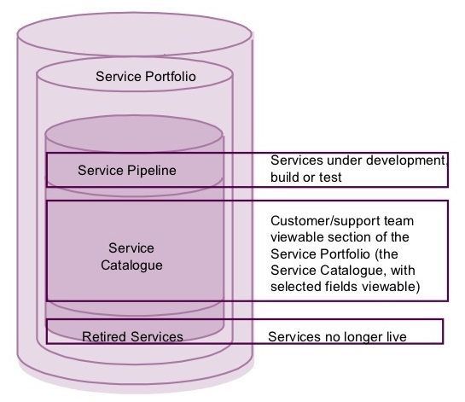
Key concepts: Service Portfolio vs. Service Catalogue
The service portfolio is the basis for the service catalogue
Customer

Slide 19
Key concepts: SLA vs. OLA
Customer
Service level agreements (SLAs)
Service A
Service B
Service C
(IT) service
provider
Service components
Operational level agreements (OLAs)
Underpinning agreements (UAs)
Internal groups or federation members
Suppliers

Slide 20
FitSM-1: Requirements
FitSM-1 defines 85 requirements that should be fulfilled by an organisation (or federation) offering IT services to customers
Compliance with the 85 requirements can be regarded as a "proof of effectiveness"
The 85 requirements are structured as follows:
16 general requirements (GR)
69 process-specific requirements (PR)
Consideration of the 14 IT service management processes from the FitSM process model
Between 2 and 8 requirements per process

Slide 21
FitSM Training and Certification Programme
Expert Level
2 days
2 days
ITIL Expert, ISO/IEC 20000 consultant and auditor
Expert training in IT service management
Expert Bridge
Advanced Level
2 days
2 days
Advanced training in
service planning and delivery
Advanced training in
service operation and control
Foundation Level
Foundation training in IT service management
1 day

Slide 22
EOSC-hub ITSM Implementation

Slide 23
FitSM Process Model mapped to EOSC-hub
WP2.2
Service Portfolio Management
WP4.1
Service Level Management
WP5.2
Service Reporting
Service Availability and Continuity Management
WP4.3
Capacity Management
More from Matthew Viljoen after
WP4.4
Information Security Management
WP4.2
Customer Relationship Mgmt
WP4.1
Supplier Relationship Management
Incident and Service Request Mgmt
WP4.5
Problem Management
Configuration Management
WP4.6
Change Management
Release and Deployment Mgmt
WP1.3
Continual Service Improvement

Slide 24
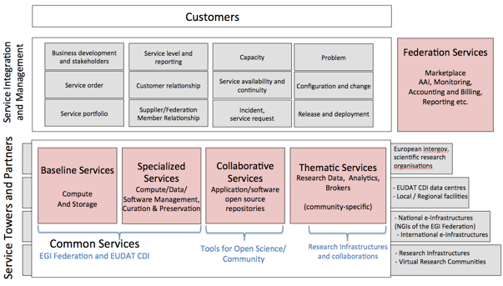
SIAM in EOSC-hub
Service Integration and Management (SIAM)
An approach to managing multiple suppliers of services and integrating them to provide a single business-facing IT organisation
Offers multiple structures to be explored during project

Slide 25
Key activities and results

Slide 26
Key activities and expected results
WP1.3: Service Management System, Continual Improvement
Integrated service management system (Confluence)
Conducted 2 audits (ITEMO) on the level of conformity and effectiveness of service management processes according to the FitSM
WP2.2: Service roadmap, Portfolio and Catalogue
Defined and managed Service Portfolio
Published Service Catalogue
WP4 and WP5: Federated Service Management and Tools
Established and operational service management processes
Implemented service management tools and support
WP11.3 FitSM Training and Certification
Delivered ~15 FitSM training courses and ~150 certificates
1st course held 8-9 Jan 2018 (Foundation) - 15 participants

Slide 27
sy.holsinger@egi.eu
Thanks! Questions?
@syholsinger
@FitSM_Standard
EOSC-hub Kick-off Meeting, 9 Jan 2018, Amsterdam

