Slide 1
EOSC-hub Kick-Off-Meeting WP6 - Introduction Andreas Schott (MPCDF)
09 January 2018

Slide 2
Outline
Objectives and generic action items (regarding integration and maintenance) (15 min)
Presentation of the 6 task leaders (each 5-10 min)
Some additional relevant information from experts as time permits, e.g. DataHub, B2NOTE, B2SHARE, …
Formal things (~1 hour + 1,5 hours on Wednesday)
Notes (everyone should contribute): https://docs.google.com/document/d/1vjA4UOMJ0wu5TDf_31BYCdM8G2HmhTZ3xp0VWEPCkiI/edit#

Slide 3
Tasks – defined by service area
Task 6.1 deals with services for discovering digital data and IT-system resources as well as services that provide access to these discovered resources.
Tasks 6.2 and 6.3 address orchestration of data, compute and storage resources and the services for analysis purposes, data reduction, metadata enrichment and indexing. These tasks integrate and maintain the federated and orchestrated computing capacity within the EOSC-hub.
Task 6.4 covers the area of data management where data entities, with provenance and associated meta data are registered as data objects, often bundled as data collections, with provenance information and annotations. The task ensures maintenance and integration of data management services with those services that are predominantly required in other phases of the research lifecycle.
Task 6.5 focuses on the integration of trusted digital repository services and long term preservation
Task 6.6 addresses the integration of sensitive data services, which play an important role in multiple disciplines, due to the legal framework requirements unable to be covered by the generic data management processes.

Slide 4
WP6 General Objectives
Maintain the high quality of the baseline and advanced common services from the evolving service catalogue according to a maintenance plan, ensure that these services are developing according to the requirements of users, thematic services and competence centres, and provide support and contribute to the documentation
Integrate the storage, compute and data services from different infrastructures and ensure their discoverability, accessibility, interoperability, reusability and integrity
Integrate the common services with federation and collaboration services as well as the integration with the thematic services and competence centres.

Slide 5
General integration and maintenance activities
The service descriptions in the EOSC-hub service catalogue.
The interfaces that provide information about the actually provided service versions.
The integration of monitoring probes to report to the EOSC-hub monitoring system.
The accounting probes to report on service usage to the EOSC-hub accounting system.
The connectors that import information from the EOSC-hub infrastructure configuration information system.
The connectors to the EOSC-hub federated AAI.
Further general activities: gathering integration requirements, maintaining the rolling integration plan, maintaining
the software and enable standard interfaces and protocols that support the thematic services, integrate with the
collaborative platforms, and provide feedback about emerging risks for fulfilling the integration and maintenance plan.
WP6 is applying standards, neither developing nor negotiating standards

Slide 6
Tasks - defined by service area and not by concrete services or products!
Task 6.1: Discovery and Access (DKRZ)
Task 6.2: Federated Compute (EGI.eu)
Task 6.3: Processing and Orchestration (CSIC)
Task 6.4: Data and Metadata Management (CINECA)
Task 6.5: Preservation (CINES)
Starting month 7
Task 6.6: Sensitive Data (SIGMA2)
starting month 13

Slide 7
Task Leader
T6.1 Discovery and access - Heinrich Widmann widmann@dkrz.de
T6.2 Federated computing - Enol Fernández enol.fernandez@egi.eu
T6.3 Processing orchestration - German Molto gmolto@dsic.upv.es, Miguel Caballer micafer1@upv.es
T6.4 Data and metadata - Paolo D’Onorio De Meo p.donoriodemeo@cineca.it
T6.5 Preservation - Marion Massol massol@cines.fr
T6.6 Sensitive data - Francesca Iozzi maria.f.iozzi@uninett.no

Slide 8
WP6 Service Experts (known so far, TL not mentioned)
EGI Services | T6.1,T6.2,T6.3,T6.4 | Diego Scardaci, diego.scardaci@egi.eu | EGI Foundation
EUDAT CDI services | T6.1,T6.4 | Mark van de Sanden mark.vandesanden@surfsara.nl | SURFsara
B2FIND | T6.1 | Heinrich Widmann widmann@dkrz.de (>1803 : Claudia Martens martens@dkrz.de ) | DKRZ
B2STAGE/HTTP API | T6.1 | Paolo D'Onorio De Meo | CINECA
EGI Datahub | T6.1 | Lukasz Dutka lukasz.dutka@cyfronet.pl | Cyfronet
INDIGO IAM/VOMS/ARGUS | T6.1 | Andrea Ceccanti andrea.ceccanti@cnaf.infn.it | INFN
B2DROP | T6.1 | Sander Apweiler | Juelich
B2SAFE (data&md management) | T6.4 | Claudio Cacciari, .cacciari@cineca.it | CINECA
B2HANDLE | T6.4 | Tobias Weigel, weigel@dkrz.de | DKRZ
B2NOTE | T6.4 | Yann Le Franc, ylefranc@gmail.com | eSDF
All B2services | T6.4 | Mark van de Sanden mark.vandesanden@surfsara.nl | SURFsara
CVMFS | T6.2 | Catalin Condurache catalin.condurache@stfc.ac.uk | CVMFS
GPGPU cloud support | T6.2 | Viet Tran viet.ui@savba.sk | IISAS
DIRAC | T6.2 | Andrei Tsaregorodtsev atsareg@in2p3.fr | IN2P3
CREAM/BDII | T6.2 | Marco Verlato Marco.Verlato@pd.infn.it | INFN

Slide 9
WP6 (task) budget https://docs.google.com/spreadsheets/d/1y4q0QDpPTIMPNM8odnyJB57e0pmDG9oxbFioXSdOTcQ/edit#gid=182007249
Partner | Avg. PM Rate | T6.1 Discovery and access | T6.2 Federated Compute | T6.2 Federated Compute/Cloud | T6.3 Processing and orchestration | T6.4 Data and metadata management | T6.5 Preservation (data and software) | T6.6 Sensitive Data | TOTAL PM | Duration | FTE
ACK CYFRONET | 5,500 € | 43.0 |  |  | 8.0 |  |  |  | 51.0 | 36 | 1.4
CESNET | 4,200 € |  |  | 11.0 |  |  |  |  | 11.0 | 36 | 0.3
CINECA | 5,000 € | 11.0 |  |  |  | 18.0 |  |  | 29.0 | 36 | 0.8
CINES | 7,076 € |  |  |  |  |  | 18.0 |  | 18.0 | 36 | 0.5
IN2P3-CPPM | 4,652 € |  | 15.0 |  |  |  |  |  | 15.0 | 36 | 0.4
CSC | 6,040 € | 9.0 |  |  |  | 14.0 |  | 6.0 | 29.0 | 36 | 0.8
CSIC | 6,000 € |  |  | 18.0 | 4.0 |  |  |  | 22.0 | 36 | 0.6
DANS-KNAW | 7,000 € |  |  |  |  |  | 12.0 |  | 12.0 | 36 | 0.3
DKRZ | 8,600 € | 19.0 |  |  |  | 10.0 |  |  | 29.0 | 36 | 0.8
EGI Foundation | 8,000 € | 6.0 |  | 6.0 |  |  |  |  | 12.0 | 36 | 0.3
eSDF | 6,200 € |  |  |  |  | 12.0 |  |  | 12.0 | 36 | 0.3
JUELICH | 7,200 € | 9.0 |  |  |  |  |  |  | 9.0 | 36 | 0.3
PSNC | 5,100 € |  |  |  | 9.0 |  |  |  | 9.0 | 36 | 0.3
GRNET | 6,200 € |  |  | 7.0 |  | 5.0 |  |  | 12.0 | 36 | 0.3
IASA | 5,000 € |  |  | 10.0 |  |  |  |  | 10.0 | 36 | 0.3
IISAS | 4,200 € |  |  | 9.0 |  |  |  |  | 9.0 | 36 | 0.3
INFN | 5,800 € | 18.0 | 15.0 | 0.0 | 4.0 |  |  |  | 37.0 | 36 | 1.0
LIP | 4,800 € |  |  | 3.0 |  |  |  |  | 3.0 | 36 | 0.1
MPCDF | 8,200 € |  |  |  |  | 6.0 |  |  | 6.0 | 36 | 0.2
SIGMA2 | 9,825 € |  |  |  |  | 6.0 |  |  | 6.0 | 36 | 0.2
UiO | 9,825 € |  |  |  |  |  |  | 12.0 | 12.0 | 36 | 0.3
SNIC (UU) | 8,000 € |  |  |  |  | 6.0 |  |  | 6.0 | 36 | 0.2
SRCE | 4,200 € |  |  | 2.0 |  |  |  |  | 2.0 | 36 | 0.1
STFC | 6,600 € |  | 3.0 |  |  |  |  |  | 3.0 | 36 | 0.1
SURFsara | 6,760 € |  |  |  |  | 27.0 |  |  | 27.0 | 36 | 0.8
UPV | 5,000 € |  |  | 4.0 | 18.0 |  |  |  | 22.0 | 36 | 0.6
TOTAL | €6,345 | 115.0 | 33.0 | 70.0 | 43.0 | 104.0 | 30.0 | 18.0 | 413.0 |  | 11.5

Slide 10
Formal Things
WP6 Work Plan
Preliminary definition of lead authors for each deliverable
Preliminary definition of milestone owners in PY1
Define WP6 regular meetings
Define/assess preliminary quality metrics
Define (WP and task) team memberships
Identify Key Exploitation Results (KERs)
EOSC-hub/OpenAIRE Advance collaboration - Assessment and impact of the work plan on WP6

Slide 11
Formal Things: WP6 Work Plan
Please, store it in the following spreadsheet: https://docs.google.com/spreadsheets/d/1COZzwEArRexybn1zXx9D14vXNKWqAlH7mnWEWMuIZ0M/edit#gid=1510378844
Check the "instructions" tab before start to fill in your WP tab.
Detailed 12 month work plan specifying distribution of activities by task
To be finally approved by end of Jan 2018.
Try to plan on a granularity of 3month if appropriate.

Slide 12
Formal Things: WP6 Deliverables Lead authors
https://confluence.egi.eu/display/EOSC/Deliverables
D6.1 (M11): First release of common services SW
D6.2 (M14): First report on the maintenance and integration of common services
D6.3 (M23): Second release of common services SW
D6.4 (M26): Second report on the maintenance and integration of common services
D6.5 (M34): Third release of common services SW
D6.6 (M36): Third report on the maintenance and integration of common services
To be approved by end of Jan 2018

Slide 13
Formal Things: Milestone owners
Confluence page: https://confluence.egi.eu/display/EOSC/Milestones
Indicate dependencies where possible
To be approved by end of Jan 2018

Slide 14
Formal Things: Regular meetings
Define meeting schedule under your WP6 folder: https://indico.egi.eu/indico/category/225/
Videoconferences
frequency?
periodic date?
Tasks / full WP?
F2F-Meetings
“developer” meeting

Slide 15
Formal Things: Quality Metrics
Google spreadsheet: https://docs.google.com/spreadsheets/d/1e7mpWgoP45wLNz_OTZn31cekUckYAKxVSqhaexZChFU/edit#gid=0
Preliminary quality metrics
Final target is defining 5 quality metrics per WP
Some examples
Number of scientific publications supported
Number of engaged SMEs/Industry
Number of entries in the service catalogue
Amount of VMs instantiated
Number of users per thematic service
Number of training modules produced and kept up-to-date

Slide 16
Formal Things: Team Membership
https://confluence.egi.eu/display/EOSC/AMB (Resources)
Primary Contact for each WP partner/participant.
List of involved persons for each WP task

Slide 17
Formal Things: Key Exploitation Results (KERs)
Identify KERs in the Catalogue of Project Results: https://confluence.egi.eu/display/EOSC/Project+Results

Slide 18
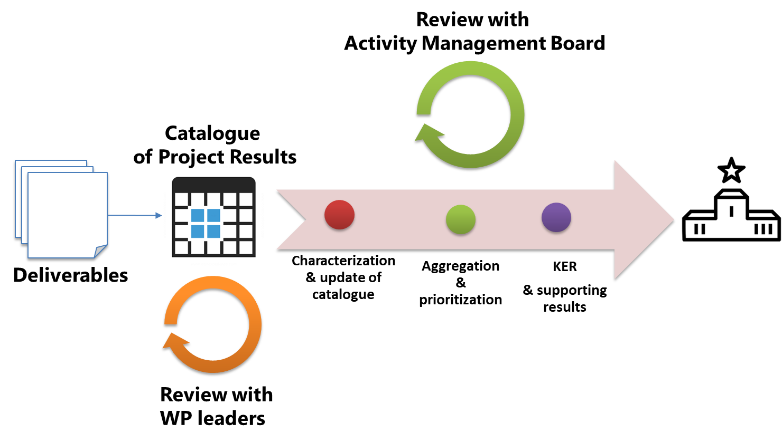
Identify WP Key Exploitation Results (KERs)
KERs need to be early identified in each WP
Refer to table 5 in GA (pp. 222) or DoA (pp. 36) as starting point
Identify additional output during WP meetings at KoM
Innovation mgmt presentation at KoM
Tue the 9th of Jan 9:50 AM
Methodology to identify, describe, exploit and disseminate KERs
IPRs, market segment, commercialisation and other exploitation paths, etc.
Templates will be made available

Slide 19
Formal Things: EOSC-hub/OpenAIRE
Assessment and impact on the WP6 work plan
https://docs.google.com/spreadsheets/d/1nzQ25XV0BNlzYxmoSZiOuSySdvOWUaDCziauOQyfFcI

Slide 20
AMB Composition
Name | Partner | Role
Johannes Reetz | MPCDF | AMB co-chair
Diego Scardaci | EGI Foundation | AMB co-chair
Yannick Legrè | EGI Foundation | WP1 leader
Marjut Andler | CSC | WP2 leader
Sara Garavelli | TRUST IT | WP3 leader
Matthew Viljoen | EGI Foundation | WP4 leader
Pavel Weber | KIT | WP5 leader
Andreas Schott | MPCDF | WP6 leader
Claudio Cacciari | CINECA | WP7 leader
Gergely Sipos | EGI Foundation | WP8 leader
Sy Holsinger | EGI Foundation | WP9 leader
Giacinto Donvito | INFN | WP10 leader & TC
Giuseppe La Rocca | EGI Foundation | WP11 leader
Sergio Andreozzi | EGI Foundation | WP12 leader
Malgorzata Krakowian | EGI Foundation | WP13 leader

Slide 21
Collaborative tools
EOSC-hub Confluence space:
https://confluence.egi.eu/display/EOSC/Home
https://confluence.egi.eu/display/EOSC/WP6+Common+Services%3A+Integration+and+Maintenance
WP6 Google Drive Shared Folder https://drive.google.com/drive/folders/0B8jWMwAsaTo-LWo1MGh5M2RXeFU
Mailing lists (in preparation):
EOSC-hub mailing lists to be ready by the KoM
AMB, WP specific
Task ML under request of the WP leaders
Tools are provisional offered under the EGI.eu domain
Switch to the EOSC-hub domain foreseen in January

Slide 22
Any Questions?

