Slide 1
EOSC-hub T6.3 Processing and Orchestration Miguel Caballer (UPV), Germán Moltó (UPV)
9-12 January 2018

Slide 2
T6.3 Processing and Orchestration (DoA)T6.3 - Processing and Orchestration at DoA
Participants: UPV, CSIC, Cyfronet, PSNC, INFN.
Maintenance and integration of orchestration services with the Cloud Compute and Cloud Container services.
Build complex virtual infrastructures based on standards
OASIS TOSCA Simple YAML Profile
Integration of the INDIGO PaaS components as orchestrator for EOSC-hub services.
Adapt them to use the configuration information services (WP5).
Optimisations to speed-up the deployment of virtual appliances.
Maintain the INDIGO Generic Web Frontend (FutureGateway) for building Science Gateways.
The product will be also integrated with the Science Application on-demand platform

Slide 3
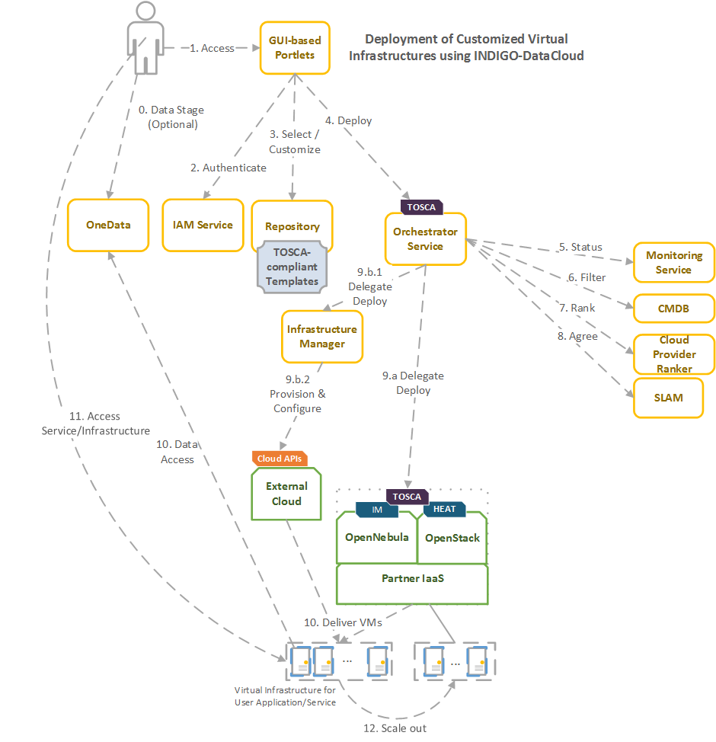
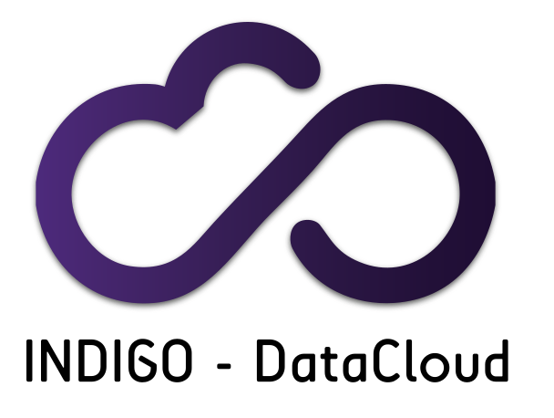
On the INDIGO-DataCloud PaaST6.3 - Processing and Orchestration at DoA
Orchestrator
Monitoring
Cloud Provider Ranker
CMDB
SLAM
IM

Slide 4
Components Processing and Orchestration at DoA
Future Gateway: build Science Gateways
The Orchestrator receives a TOSCA document and fulfil the request.
SLAM (SLA Manager): Allows to retrieve the SLAs specified by the providers.
CMDB (Configuration Manager Database): Includes the information about the endpoints for the Cloud sites and the Virtual Machine Images registered in each site.
Cloud Provider Ranker (CPR): Receives the information obtained from the aforementioned services in order to receive a ranked list of the most appropriate Cloud sites to fulfil the request.
Infrastructure Manager (IM). The IM performs the deployment on Cloud sites that do not natively support TOSCA-based local site orchestration.

Slide 5
Future Gateway
Current status:
Supports TOSCA YAML with INDIGO-DataCloud custom types.
Roadmap:
Integrate with the IaaS and PaaS functionalities deployed in EOSC-HUB.
In the “Applications on Demand” service provided by EGI.
Adjust according to requirements coming from the other Tasks/use cases
Integrate with EGI AAI.

Slide 6
Orchestrator
Current status:
Supports TOSCA YAML with INDIGO-DataCloud custom types.
Depends on Zabbix, CMDB, SLAM, CPR, and IM.
Roadmap:
Integrate with EGI AAI.
Replace Zabbix with the monitoring services provided in EOSC-HUB
ARGO.
Integrate with AppDB.

Slide 7
SLAM
Current status:
Used in INDIGO PaaS.
Roadmap:
The integration of SLAM in EOSC-HUB requires to adopt the authorization framework provided in EOSC-HUB and provide means for providers to describe SLAs.

Slide 8
CMDB
Current status:
Used in INDIGO PaaS.
Roadmap:
AppDB could replace the role currently performed by the this component.

Slide 9
Cloud Provider Ranker (CPR)
Current status:
Used in INDIGO PaaS.
Roadmap:
There is no established technology to perform Cloud brokering in EGI FedCloud.
CPR could be promoted as a component to perform the task of Cloud site selection.
It can be integrated both at the level of the Orchestrator and/or VMOps Dashboard.

Slide 10
Infrastructure Manager (IM)
Current status:
Supports TOSCA YAML with INDIGO-DataCloud custom types.
Already integrated in the VMOps Dashboard.
Support a wide range of Cloud back-ends:
OCCI, OpenNebula and OpenStack (using native APIs).
Public providers: AWS, Azure, GCE.
To perform hybrid deployments across multiple Cloud sites.
Roadmap:
Integrate with EGI AAI.
Integrate with AppDB to get VM images URL.

