Slide 1
WP6.6 – Sensitive Data
PARTNERS: 18PM, SIGMA2/UiO, CSC
EOSC-hub Kick-off Meeting – Amsterdam, Science Park - 9-11 January 2018

Slide 2
Sensitive Data
WHAT IS IT? Personal Data revealing information regarding racial or ethnic origin, political opinions, religious or philosophical beliefs, trade-union membership, data concerning health, sexual life, childs ect...
Regulated by the coming GDPR (May 2018):
Stronger safeguards to protect privacy
More opportunities to share

Slide 3
IT Solutions for sensitive data
Local / Special services
Initiatives to implement solutions that allow cross-borders research on sensitive data , community specific, biobanks
Our VISION / Our mission: a network of fully interoperable services for the benefit of single users, user communities

Slide 4
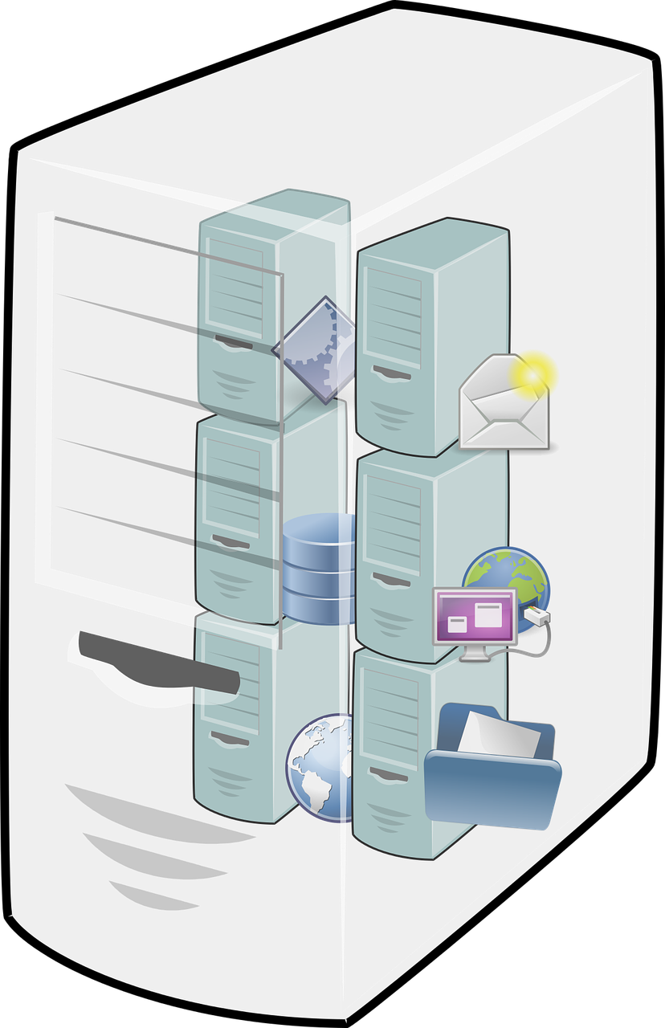
TSD - Norwegian Services for Sensitive Data
GATEWAYS
2-FACTORT AUTH
HPC
CENTRAL STORAGE
VIRTUAL HOTEL
Notes:
ePouta secure cloud is a closed environment that meets elevated information security level regulations as defined by the governmental authorities in Finland.
Suitable for all fields of science
Developed to large extent within ELIXIR Finland (located at CSC)
Service provider is CSC – also a EUDAT service provider
ISO/IEC27001 certified
The cloud service combines virtual computational resources with the customers' own resources using a dedicated network connection (OPN or MPLS)
Not only a platform for processing of data but also integrated secure layered storage

Slide 5
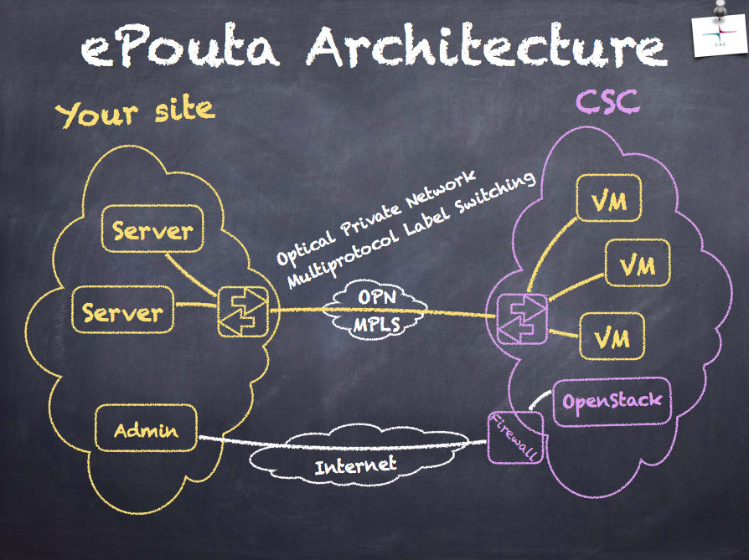
ePouta Architecture
sc
Notes:
ePouta secure cloud is a closed environment that meets elevated information security level regulations as defined by the governmental authorities in Finland.
Suitable for all fields of science
Developed to large extent within ELIXIR Finland (located at CSC)
Service provider is CSC – also a EUDAT service provider
ISO/IEC27001 certified
The cloud service combines virtual computational resources with the customers' own resources using a dedicated network connection (OPN or MPLS)
Not only a platform for processing of data but also integrated secure layered storage

Slide 6
WP 6.6 – High-level objectives
Fostering the provisioning and usage of production quality services designed to provide secure IT-platforms for generic sensitive data processing to single users and user communities
Enhancing the integration with other services , especially services in the EOSC-HUB
NB: The task will start in M13.

Slide 7
Some milestones
Expanding the computing capacity by allowing computing on ePouta instances from TSD resources (integration TSD-ePOUTA)
Enabling publication of anonymized metadata on central repositories (integration with B2SHARE/B2FIND/B2ACCESS)
Ensure interoperability of the secure servers so that data processing workflows can be exchanged between services by enabling a common Registry for secure Docker containers (integration with the UDOCKER?)

Slide 8
INTEGRATION TSD-ePUOTA
Use case scenario: The user need more computing capability.
The TSD closed network is expanded into the ePouta secure cloud infrastructure.
Notes:
A case study to enhance the interoperability between existing services for sensitive data.

Slide 9
INTEGRATION WITH THE B2SHARE/B2ACCESS/B2FIND
Use case scenario: Users wants to make the anonymized metadata available on public repository
B2Find
B2share
B2Access
checksum
Handle server
B2Access IdP
PID
pXXaccount
pYY account
TSD
Data
Data
pXX
users
pYY
users
PYY
PXX
Notes:
Solution: the users upload data together with metadata through a B2SHARE instance running inside TSD. The anonimized metadata are store in a database which is synced with a repository outside TSD availible upon proper autorization and autentication mechanism (es B2ACCESS).

Slide 10
More…
Establishing a liaisons with:
T2.4 with regards to data sharing policies and GDPR compliance
Code of Conduct for sensitive data currently under development by the Life Science community
Strengthen the cooperation with the ELIXIR CC (T8.1)

