Slide 1
EOSC-hub Activity Plan for T6.1. Discovery and Access Heinrich Widmann (DKRZ)
EOSC-hub Kickoff Meeting
09 January 2018
Amsterdam Science Park

Slide 2
Objectives of Discovery and Access (D&A)
EOSC follows the FAIR principles
D&A corresponds to Findability & Accessibility
but Interoperability and Reuseability is also addressed
The major objective is a common D&A layer allowing
[D] search for distributed data in EOSC-hub and beyond
[A] seamless access to data resources whereever they are located
[R] reuse, exchange and staging of data (depending on use case)
Implementation by … → T6.1. Services
[D] MD catalogue and indexer(s) + search engine(s) → B2FIND
[A] AAI tools and PIDs → Indigo IAM / EGI datahub + B2DROP
[R] transfer and staging tools and provenance MD → B2STAGE + B2DROP
Establish consistent interfaces between and to D&A services

Slide 3
T6.1. Initial Services
Name of Service | Expert | Partner | PM | Description | Role in EOSC-hub | Issues and Questions
Indigo IAM | Andrea Ceccanti | INFN | 43 | Identity and Access Management | acts as ‘Attribution Authority’ and IdP for EOSC federated AAI | Same functionality as B2ACCESS ??
EGI DATA HUB | Lukasz Dutka | CYFRONET | 11 | a distributed data store based on Onedata | integrate in EOSC orchestration services, extended acc. to TS | “… on top of the EGI Open Data Platform using Onedata …”
EUDAT B2FIND | Claudia Martens | DKRZ | 17 | Discovery Service of EUDAT, harvests MD from div. repos | Central indexer of distributed (M)Data in and beyond EOSC-hub | Indexer on a ‚higher‘ D-Level
EUDAT B2STAGE | Paolo D'Onorio De Meo | CINECA | 11 | Access and Transfer optimizes data move. and distr. | Integrates its HTTP endpoints with EOSChub | + provenance MD, + publish-subscribe
EUDAT B2DROP | Sander Apweiler | FZJüllich | 9 | Personal workspace, interoperability by B2DROP-API | Integrated with EOSC storage services (oneData, OpenStack Swift, CDMI, EGI Fed.Cloud) | Colloberate with GEANT, coordinates OpenCloudMesh, fed. clouds

Slide 4
D&A: The challenge and conceptual approach
Domain A
1010
3. [R] reuses
Transfer and Staging
+ Provenance
01AB
ReSearcher
1. [D] searches for
Common Interoperability Layer of
D & A
MD Catalogue
+ Common MD schema
Level of Interoperability and Accessibility
AAI tool
+ MD Handling
2. [A] accesses
Domain B
010101010101010
ReSearcher
010101010101010
Data Producer
010101010101010
Digital Object of Desire
Level of Granularity and Discoverability

Slide 5
D&A: A first Integration Plan for T6.1. services
XYXY
Common Interoperability Layer of
D & A
EOSChub
01AB
1010
IAM
ABBA
010101010101010
010101010101010
010101010101010
010101010101010
Data Hub

Slide 6
T6.1 Work Plan PM01-PM12
Activity identifier | Task Name | Start date (mm/yy) | End date (mm/yy) | Status | Dependencies | Issues
6.1.1 | Organize task internal cooperation : email list and regular telcos | 01/18 | 02/18 | Open | WP5.6 Collaborative tools provided by
6.1.2 | First proposal for service portfolio → catalogue | 02/18 | 11/18 | Ongoing | → D6.1 (M11)
6.1.3 | Integration and Maintenance Plan | 02/18 | 02/19 | Open | → D6.2 (M14)
6.1.4 | Define ‘Quality Metrics’ and ‘Key Exploitable results’ | 02/18 | 08/18 | Planned
6.1.5 | Collect and index MD from data stores (EGI hub, B2SAFE) in B2FIND | 03/18 |  | Planned
6.1.6 | Set up B2STAGE workflow, e.g. input from EGI data store … output stored in B2DROP | 03/08 ? |  | Planned | 10.3.1 (Thematic Services)
6.1.? | ….

Slide 7
Open Questions, Concerns and Ideas
How to communicate, coordinate and orchestrate activities ?
How to keep track with the roadmap and meet the deliverables ?
Who develops new interfaces or sub-services ?
How can ‘Thematic Services’ drive and ‘Competence Center’ evalaute the WP6(.1) services ?
… ??? Your questions and ideas !!! …

Slide 8
D&A: Levels of Interoperability
MD provider
Schema A
010101010101010
010101010101010
010101010101010
Common MD Schema
Schema B
Disciplines
010101010101010
Schema C
010101010101010
Domain Agnostic and Generic Services
Communities and RI‘s with
Domain Specific Schemas and Data models
Homogenity
Levels of
Interoperability
Heterogenity

Slide 9
FitSM training
FitSM is a standards family for lightweight IT Service Management (ITSM). The kick-off meeting offers the opportunity to be trained and certified in the FitSM, which is supported by the project. The Foundation level training provides an introduction to the basic IT service management concepts and terms, outlines the purpose and structure of FitSM standards and their relationship to other standards and understand the process framework underlying FitSM, and details the formal requirements defined within it.
The training will take place on Mon afternoon (8 Jan) and Tue mid-day (9 Jan), allowing attendance of the opening plenary. Only participants who register in advance can be admitted to the training. A limited number of participants is admitted, however, it is available to any interested project members and is highly recommended for task leaders and WP managers. Other training events will be organized during the project for anyone unable to attend due to clashes.
Project IT Service Management activities will be organized in line with FitSM, which facilitates service management in IT service provision, including federated scenarios. Through FitSM, the project aims at conducting effective IT service management in a federated environment and achieving a baseline level of ITSM that can act in support of ‘management interoperability’ in federated environments where disparate organisations must cooperate to manage services.

Slide 10
Points to address :
WP Managers and task coordinators are requested to address the following points:
Appoint WP members per task to set up WP and task mailing lists
Define WP results and key exploitable results
Define PM01-PM12 work plan by detailing the distribution of activities per partner
Appoint lead authors and contributing organizations for each deliverable/milestone due in PM12
Discuss use of collaborative tools in the WP (mailing lists, information and documentation sharing in Confluence, action tracking/Jira, collaborative workspaces, meeting agenda management/Indico, document management, etc.)
Define quality metrics per WP
[WP6, 5, 7] Define usage metrics for each production service of the EOSC-hub catalogue to be used to measure virtual access in WP13
WP meetings are open and participation is primarily intended for WP managers, task coordinators, and WP experts, however, WP meetings are open, and members of other relevant WPs are welcome to attend.

Slide 11
KoM – Expected Output from WP meetings (1/2)
WP Work plan
Detailed 12 month work plan specifying distribution of activities by task
To be approved by end of Jan 2018
Preliminary definition of lead authors of each deliverable
To be approved by end of Jan 2018
Preliminary definition of milestone owners in PY1
To be approved by end of Jan 2018
Indicate dependencies where possible

Slide 12
KoM – Expected Output from WP meetings (2/2)
Define WP regular meetings
Preliminary quality metrics
Final target is defining 5 quality metrics per WP
Some examples
Number of scientific publications supported
Number of engaged SMEs/Industry
Number of entries in the service catalogue
Amount of VMs instantiated
Number of users per thematic service
Number of training modules produced and kept up-to-date

Slide 13
KoM – Expected Output from WP meetings (3/3)
Start to define team membership
A template will be provided to collect names, mailing lists per task, etc.
Identify the Key Exploitation Results (KERs)
EOSC-hub/OpenAIRE Advance collaboration
Assessment and impact on the WP work plan

Slide 14
Expected Output from WP meetings (2/2)
Define WP → T6.1. regular meetings (per sub-task ? Monthly ?!)
Preliminary quality metrics
Final target is defining 5 quality metrics per WP (not per task ?!)
Some examples ( → for T6.1)
Number of scientific publications supported → maybe 1
Number of engaged SMEs/Industry → ??
Number of entries in the service catalogue → six to ten services ??
Amount of VMs instantiated → instances for what ?
Number of users per thematic service → ?? 1 to 1000 ??
Number of training modules produced and kept up-to-date → ca. 2 (for the whole workflow) to 10 (one per service)

Slide 15
Expected Output from WP meetings (3/3)
Start to define team membership → see expert list + …
A template will be provided to collect names, mailing lists per task, etc. → !!??
Identify the Key Exploitation Results (KERs)
EOSC-hub/OpenAIRE Advance collaboration
Assessment and impact on the WP work plan

Slide 16
Collaborative tools
EOSC-hub Confluence space:
https://confluence.egi.eu/display/EOSC/Home
AMB: https://confluence.egi.eu/display/EOSC/AMB
Indico AMB:
https://indico.egi.eu/indico/category/218/
Mailing lists (in preparation):
EOSC-hub mailing lists to be ready by the KoM
AMB, WP specific
Task ML under request of the WP leaders
Google drive shared folder (in preparation)
Tools are provisional offered under the EGI.eu domain
Switch to the EOSC-hub domain foreseen in January

Slide 17
Kick-off preparation
KoM – Amsterdam 8-12 Jan 2018
https://indico.egi.eu/indico/event/3548/overview
Task leaders involvement
Invitations to the KoM, present WP objectives, organise briefings, etc.
Fill in the check list
https://docs.google.com/spreadsheets/d/13r8sO7wwfRAdBfpR2GCghj5epjkKEqmDlBocMLnYRuk
Invited experts
Please, keep up-to-date the spreadsheet
https://docs.google.com/spreadsheets/d/1SEGSonsEUp45wAD6GSPG-Ny7CpKyeWGIwFIWTBAVL0o

Slide 18
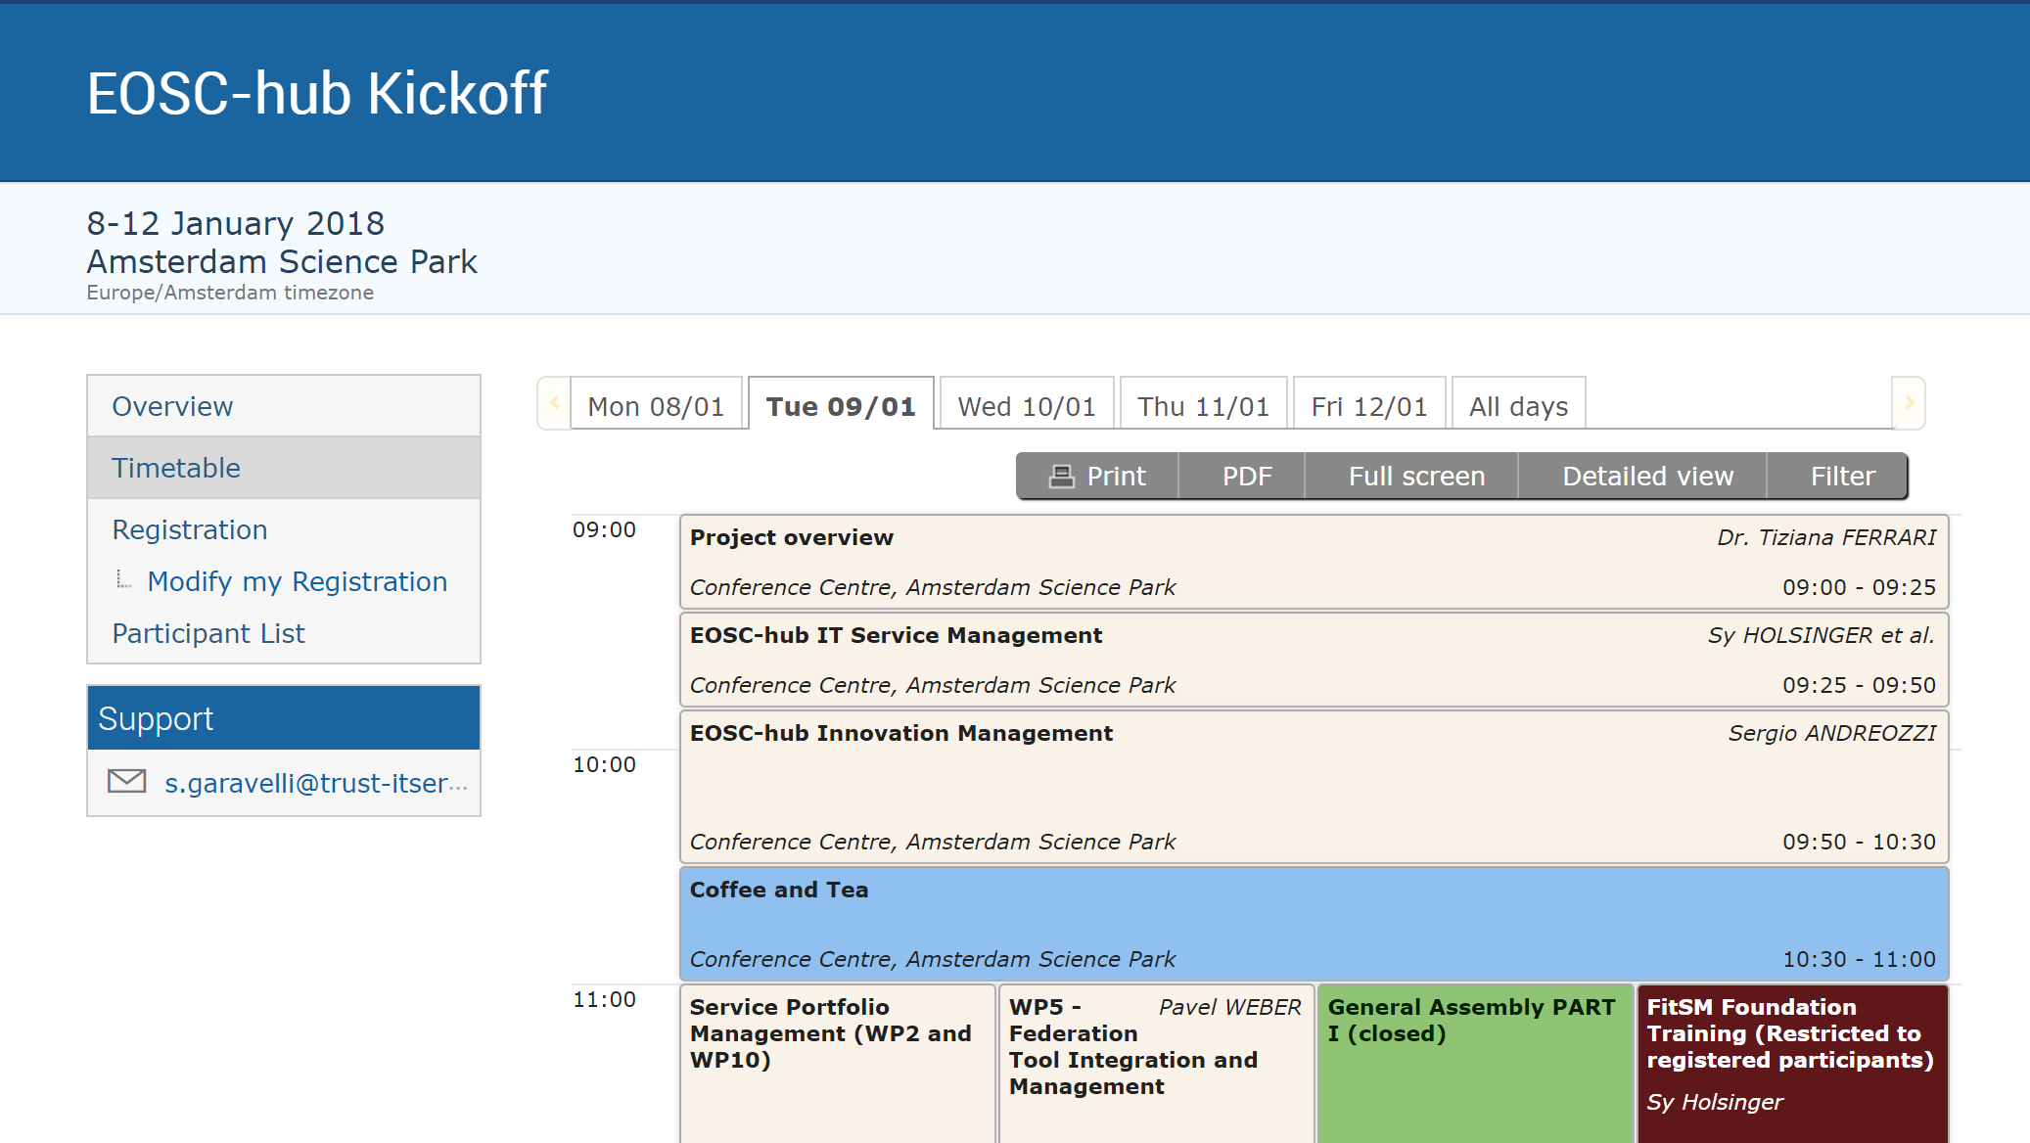
Kick-off agenda

Slide 19
WP Work Plan – Table per task
Activity identifier | Task Name | Start date (mm/yy) | End date (mm/yy) | Status | Dependencies | Issues
10.3.1 | Description 1 | 01/18 | 03/18 | Done
10.3.2 | Description 2 | 02/18 | 05/18 | Ongoing
… |  |  |  | Planned
10.3.N | Description N |  |  | Planned | 10.3.1
Activity identifier | Task Name | Start date (mm/yy) | End date (mm/yy) | Status | Dependencies | Issues
10.3.1 | Description 1 | 01/18 | 03/18 | Done
10.3.2 | Description 2 | 02/18 | 05/18 07/18 | Ongoing
… |  |  |  | Planned
10.3.N | Description N |  |  | Planned | 10.3.1
Activity identifier: task number + incremental id
Task Name: short description
Status: Planned/Ongoing/Done
Dependencies: list of activity identifiers
A tool to record the WP Work Plans will be provided soon

Slide 20
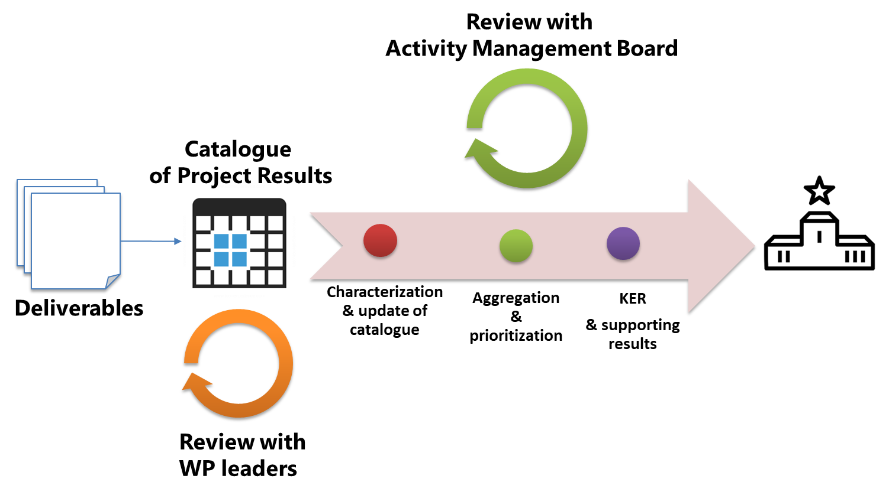
Identify WP Key Exploitation Results (KERs)
KERs need to be early identified in each WP
Refer to table 5 in GA (pp. 222) or DoA (pp. 36) as starting point
Identify additional output during WP meetings at KoM
Innovation mgmt presentation at KoM
Tue the 9th of Jan 9:50 AM
Methodology to identify, describe, exploit and disseminate KERs
IPRs, market segment, commercialisation and other exploitation paths, etc.
Templates will be made available

Slide 21
EOSC-hub/OpenAIRE Advance Collaboration
Agreement between the 2 projects
Planned to be signed by March 2018
Draft agreement presented to EC
https://indico.egi.eu/indico/event/3511/contribution/2
WP Leaders have to:
Read the agreement
Assess the impact on their WPs (in particular WP5, WP6, WP7 and WP8)
Suggest changes and collect input for the Technical Coordination and Training plenary session (Thu the 11th of Jan 13:30)
Define the WP Work Plan accordingly

Slide 22
References
EOSC-hub Kick-off agenda
https://indico.egi.eu/indico/event/3548/overview
EOSC-hub confluence space
https://confluence.egi.eu/display/EOSC/Home
EOSC-hub AMB confluence space
https://confluence.egi.eu/display/EOSC/AMB
Indico AMB
https://indico.egi.eu/indico/category/218/

