Slide 1
T3.5 Branding & web-based support tools
Caterina Piagentini, Trust-IT Services
c.piagentini@trust-itservices.com
Amsterdam, 9 January 2018

Slide 2
Outline
Objectives
Partners’ roles & effort
Task results & key exploitable results
Activity Plan M1-M12
Deliverables & Milestones
KPIs & Metrics
T3.5 Branding & web-based support tools 9 January 2018

Slide 3
Objectives
Develop the branding of the project to build a strong, recognisable visual identity of the project
Ensure an innovative and visible EOSC-hub digital presence by developing a collaborative, open source, web platform, including community creation, integrated newsletter tool, RSS feed
Offer users, partners and stakeholders at large smart, easy to use and attractive tools to support their daily work
Build a common EOSC branding to ensure a coordinated communication strategy by all the EOSC-related projects
T3.5 Branding & web-based support tools 9 January 2018

Slide 4
Partners’ roles & effort
Partner | Role | Efforts
TRUST-IT | Lead Partner | 12 PMs
The Team:
Caterina Piagentini (Task Leader), Rob Carrillo, Sara Garavelli, Communications experts
Riccardo Giuntini, Luca di Fiore, Graphic & Web Designers
T3.5 Branding & web-based support tools 9 January 2018

Slide 5
Task results & exploitable results
Task Results
“EOSC” & EOSC-hub branding elements
“EOSC” web platform
EOSC-hub promotional material
Tools supporting the EOSC-hub consortium (comm. & diss. templates), the WP3 activities (newsletter, event management), user & stakeholder engagement activities (website, promotional material, etc)
Exploitable Results
“EOSC” & EOSC-hub branding elements → possible trademark for the future EOSC
“EOSC” web platform → possible web platform for the future EOSC
T3.5 Branding & web-based support tools 9 January 2018

Slide 6
Activity Plan (M1-12) - Branding
January 2018
“EOSC” & EOSC-hub Logo
EOSC-hub Visual guidelines
EOSC-hub Graphic design package (ppt, word, etc. templates) [M3.1]
“EOSC” & EOSC-hub Newsletter templates (internal/external) (to be synch with T3.3)
February 2018
Design of EOSC-hub promotional material (EOSC-hub infographic ”EOSC-hub at a glance” & rollup)
DI4R website visual revamp
March 2018
Design of EOSC-hub promotional material (EOSC-hub flier: mission, results, contribution to EOSC, collaboration with OpenAIRE)
April 2018
Design of EOSC-hub promotional material (EOSC-hub service catalogue)
May 2018
Design of EOSC-hub promotional material “Use cases factsheets”
June 2018
EOSC-hub promotional material for the DI4R event (give aways, etc.)
October 2018 – December 2018
Design of EOSC-hub promotional material needed
All the produced material will be available on Confluence
T3.5 Branding & web-based support tools 9 January 2018

Slide 7
Branding: EOSC-hub logo
Notes:
Logo 1 the EOSC is depicted through the yellow circle in the middle - "the hub" where we can extract the three features from the three half- moon designs that could, in the future, be extracted & used individually, the colours (grey & turquoise) introduce the diversity of the multi components and the lines draw in the circles together
i) the EOSC-hub key features (Hub, Openness, Multi components but diverse) and ii) also the request of the EC of designing a brand that can become in the future the EOSC brand (that’s why we have separated the branding element from the EOSC-hub writing. In this way the branding element can stay in the future and be adopted for example to represent a broader EOSC concept).

Slide 8
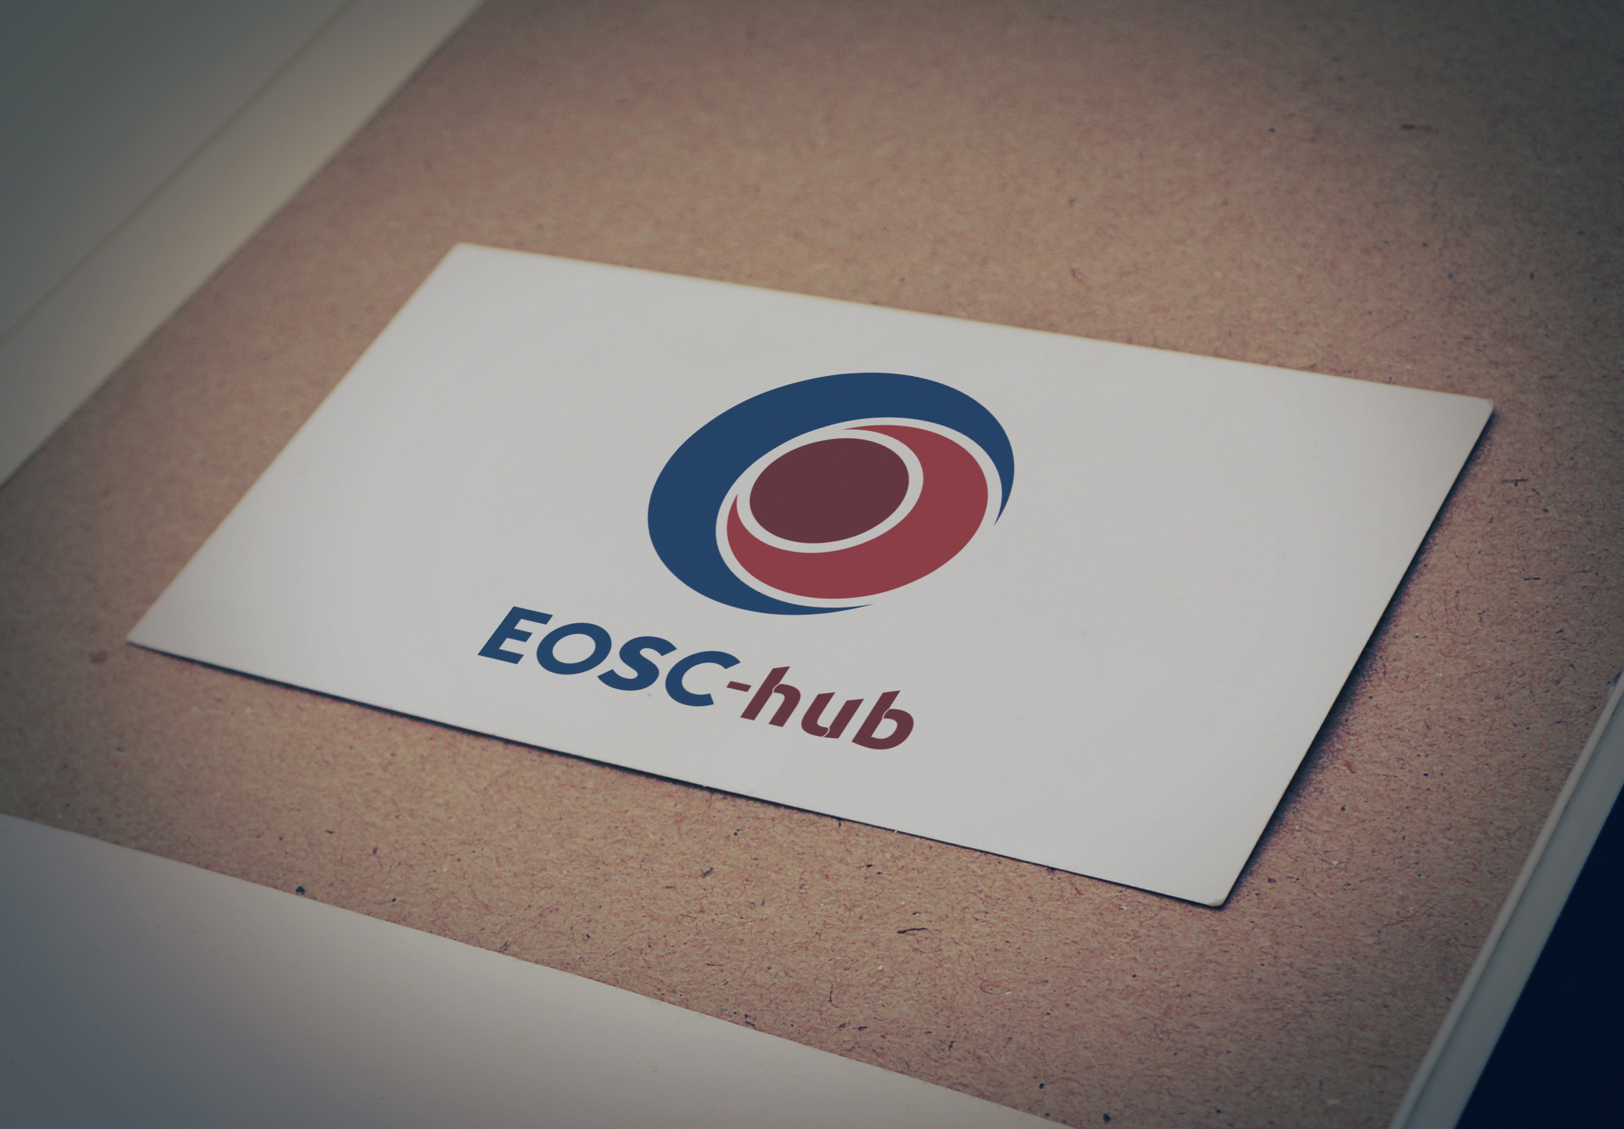
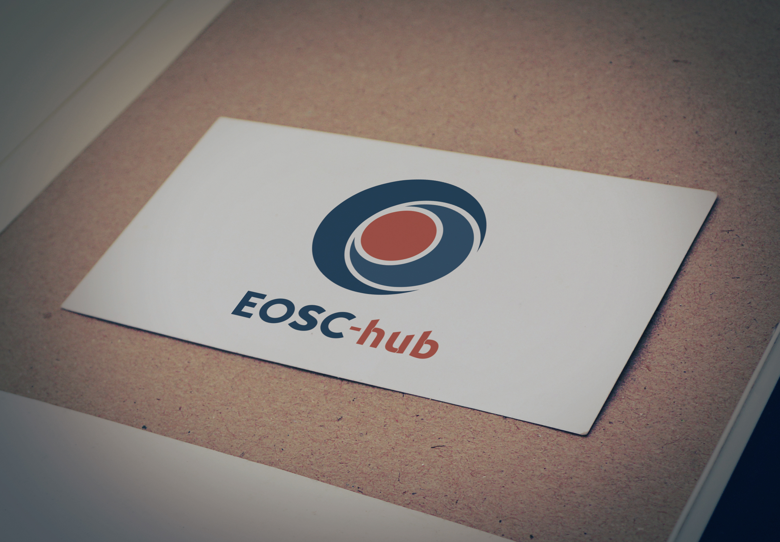
Branding: EOSC-hub logo
T3.5 Branding & web-based support tools 9 January 2018
Notes:
Logo 1 the EOSC is depicted through the circle in the middle - "the hub“. The 2 half moons with contrasting colours introduce the diversity of the multi components which converge towards the main circle.
i) the EOSC-hub key features (Hub, Openness, Multi components but diverse) and ii) also the request of the EC of designing a brand that can become in the future the EOSC brand (that’s why we have separated the branding element from the EOSC-hub writing. In this way the branding element can stay in the future and be adopted for example to represent a broader EOSC concept).

Slide 9
Branding: EOSC-hub Visual Guidelines
Short document describing the EOSC-hub logo and its usage, the EOSC-hub colour palette, typography fonts, visual supporting elements, Icons for social media
Part of M3.1
T3.5 Branding & web-based support tools 9 January 2018

Slide 10
Branding: EOSC-hub Graphic Design Package
Logo
Visual Guidelines
Powerpoint templates (3:4 – 16:9; standard fonts)
Word template (to be used for public report)
???
T3.5 Branding & web-based support tools 9 January 2018

Slide 11
Branding: Newsletter template
Internal
External (EOSC-hub)
External (joint EOSC)
T3.5 Branding & web-based support tools 9 January 2018

Slide 12
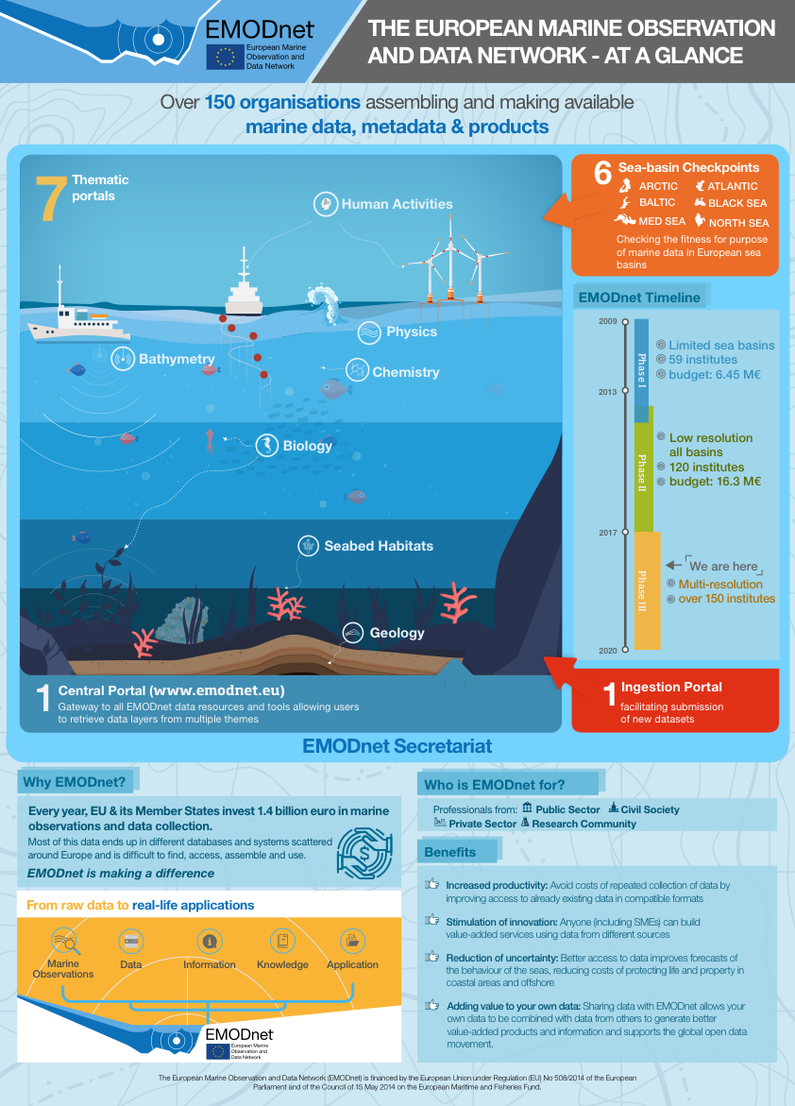
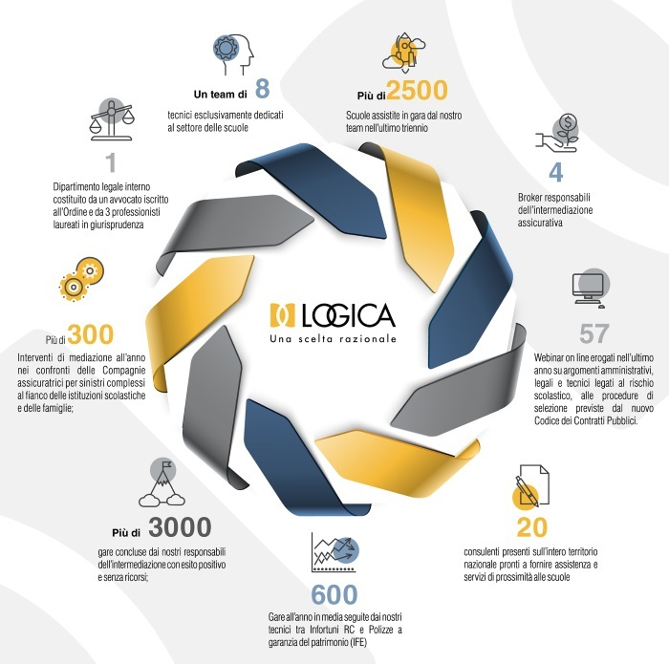
Examples of infographics
T3.5 Branding & web-based support tools 9 January 2018

Slide 13
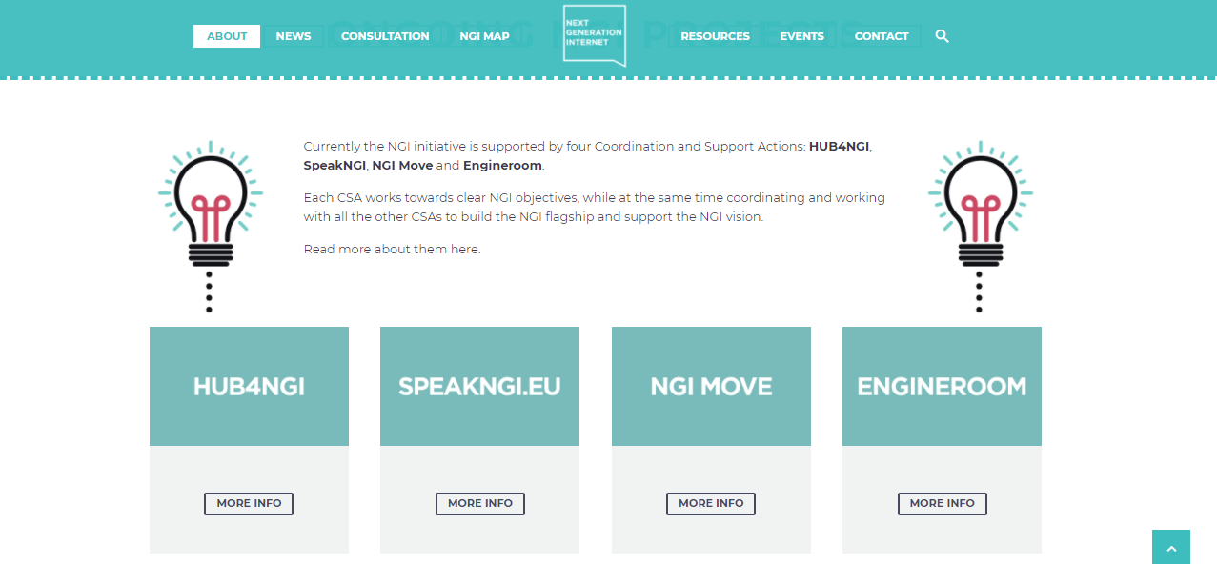
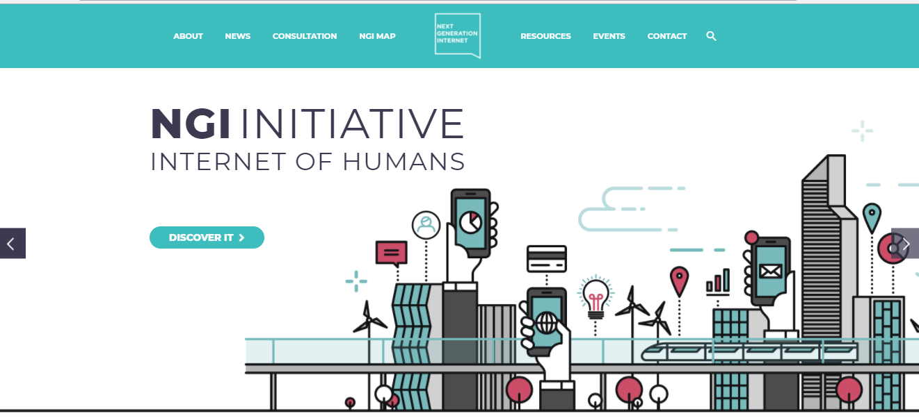
Activity Plan (M1-12) – Web-platform
The NGI model (www.ngi.eu)
T3.5 Branding & web-based support tools 9 January 2018

Slide 14
“EOSC“ Web-platform: main functionalities
Drupal-based CMS
Responsive
Integrated newsletter tool / Database of users
The EOSC-hub website will be hosted by Trust-IT . The owner of the DNS is CESNET
T3.5 Branding & web-based support tools 9 January 2018

Slide 15
“EOSC“ Web-platform: mockup specs
“EOSC” Home Page
Slider dedicated to EOSC (linking to the EC webpage) + EOSC related projects (EOSC-hub, OpenAIRE, EOSCpilot)
Use Cases
Services
Training Material
Events & News section
Highlights from the EOSC-projects
Contact form
EOSC documents
EOSC-related projects
Newsletter subscription (joint newsletter collecting info from EOSC-hub + OpenAIRE + EOSCpilot)
All the content is tagged according to the source (e.g. EOSC hub, OpenAIRE, etc.)
EOSC-hub “area”
Mission
Partners
Links to Use Cases, Services, Training Material, Events & News, Highlights, etc.
Deliverables
Press releases & Articles
Video Gallery
T3.5 Branding & web-based support tools 9 January 2018

Slide 16
“EOSC“ Web-platform: content creation procedures
Set up of an editorial management board (2 members for each project) in charge of:
Proposing the content to be uploaded on the “EOSC” Home Page “main sections” to the project
Producing the joint newsletter (every 3 months)
1-hour call every 2 weeks to discuss and approve the content
All the content is tagged according to the source (e.g. EOSC hub, OpenAIRE, etc.)
EOSC-hub “area”
Mission
Partners
Links to Use Cases, Services, Training Material, Events & News, Highlights, etc.
Deliverables
Press releases & Articles
Video Gallery
T3.5 Branding & web-based support tools 9 January 2018

Slide 17
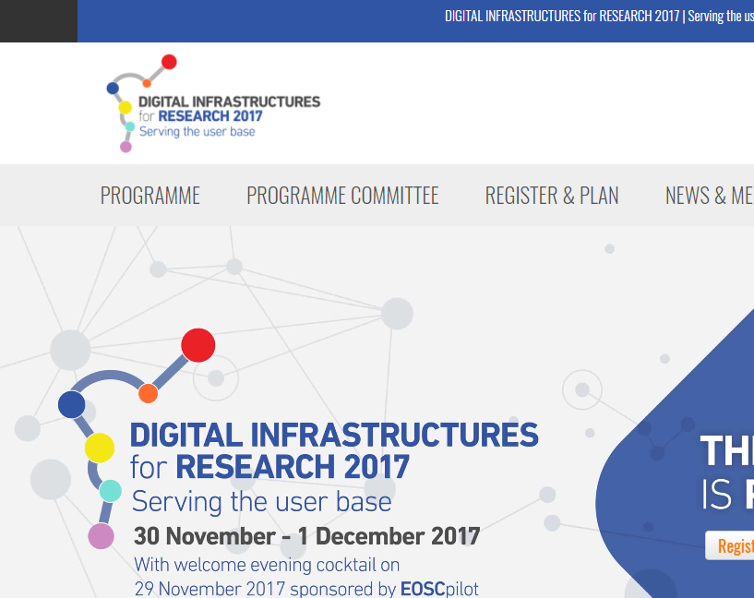
Activity Plan (M1-12) – Web-platform
DI4R website (Feb 2018)
January 2018
Web-platform concept, specs, Home Page mock-up & maintenance procedures (editorial board) – landing page?
February 2018
Consensus on the mock-up with OpenAIRE & implementation
March 2018
Web platform online
Release of a collaborative, open source, results-oriented web platform
Delivery of Drupal tutorial to partners
April – Dec 2018
Continuous manteinance & updates
Re-use DI4R 2017 website
Integrated payment option
Improved programme section, etc.)
T3.5 Branding & web-based support tools 9 January 2018

Slide 18
Activity Plan (M1-12) – Support Tools
Newsletter tool (integrated with the website)
Public events management tools (abstracts submission system, online agenda, etc.) - Drupal based
Internal events management tools (Indico)
Support tools for stakeholder engagement (TBD)
T3.5 Branding & web-based support tools 9 January 2018

Slide 19
Deliverables & Milestones (M1-12)
 | M1 | M2 | M3 | M4 | M5 | M6 | M7 | M8 | M9 | M10 | M11 | M12
M3.1 EOSC-hub logo, templates and project branding
M3.2 EOSC-Hub Web Platform launch
T3.5 Branding & web-based support tools 9 January 2018

Slide 20
KPIs & Metrics
No relevant KPIs / Metrics identified for Task 3.5
T3.5 Branding & web-based support tools 9 January 2018

