Slide 1
EOSC-hub
WP10 Technical Coordination
Giacinto Donvito (INFN)
WP10 Leader and TC
11 January 2018

Slide 2
Outlook
WP10 introduction:
  Tasks, scopes, output
WP10 next actions
WP10: interactions with others WPs
EINFRA-21 projects: how they could help EOSC-Hub

Slide 3
WP10 Tasks and activities
T10.1 Technical Roadmap (Lead: INFN; Participants: CYFRONET, CSIC, KIT, SURFsara) -> Giacinto Donvito
T10.2 Service Catalogue Technical Evolution (Lead: SURFsara; Participants: EGI.eu, INFN) -> Mark van de Sanden
T10.3 Community Requirement Analysis and Technical support (Lead: EGI.eu; Participants: CYFRONET, CCFE, CINECA, CSIC, INFN, SURFsara) -> Diego Scardaci
T10.4 Common service building requirements and gap analysis (Lead: CSIC; Participants: Cyfronet, EGI.eu, INFN, SURFsara) -> Pablo Orviz

Slide 4
WP10 Tasks and activities: Task 10.1
T10.1 Technical Roadmap
  Definition, maintenance and enforcement of the technical roadmap
    This activity will leverage the expertise of the Technology Committee members to scout new or emerging technologies, architectures and services. Input and requirements will be collected also by WP2, WP3, WP5, WP6, WP7, WP8 and WP9. The Technology Committee will analyse and prioritise requirements, and propose changes for AMB / PMB approval. Requests that imply major changes to the service portfolio will be evaluated together with T2.2.
  Service Architecture
    This task is responsible for defining and maintaining the overall service architecture of the services of the EOSC Hub portfolio.
    The architecture will be comprehensive to include all service categories: Common, Thematic, Collaborative and Federation, and will take into account dependencies and interfaces among the services and service components.
  Technical Service Evolution
    This second activity will ensure that the roadmap for the evolution of each service is coherent with the overarching technical plans and will promote technical convergence of tools coming from WP5 and WP6 (Federation and Common Services), WP7 (Thematic Services), WP8 (Competence Centres) and WP9 pilots (Joint Digital Innovation Hub). Output:
      Two technical roadmaps [M12 and M24], with updates when necessary.
      Contributions to standard bodies or to external technology providers.

Slide 5
WP10 Tasks and activities: Task 10.2
T10.2 Service Catalogue Technical Evolution
  This task will define the project's Rules of Engagement (RoE), including guidelines, policies and procedures to assess conformance of services to the RoE and to the FAIR principles. Compliance to the RoE will be used to brand services in the project as trustworthy and interoperable. The main goals of this task are to define these guidelines and policies, define appropriate procedures to assess the conformance of the candidate services to the RoE and to the FAIR principles and perform the assessment.
  This activity will monitor the evolution of reference standards (and contribute where relevant) and track the evolution of the main software technologies in the Open Source communities. The task will also evaluate external technologies and software stacks that could be included into the Services Catalogue. Output:
  The standards roadmap ensuring service interoperability across different services of the EOSC Hub [1] portfolio;
  The project Rules of Engagement (RoE);
  Evaluation reports about candidate services/software components;
  Recommendations on product or software stacks to support services

Slide 6
WP10 Tasks and activities: Task 10.3
T10.3 Community Requirement Analysis and Technical support
  This task will analyse the requirements collected by the other work packages and provide support to all the user communities engaged before or during the project, including also Thematic Services, Competence Centres and Joint Digital Innovation Hubs, in particular during their starting phase.
  The task will identify appropriate services to satisfy requirements and combine them to define solutions. The team will then support user communities to deploy such solutions in the EOSC-hub infrastructure, identifying the appropriate configuration of the services in collaboration with WP5 and WP6 experts and WP13 service operators/managers. When a complete solution cannot be designed with the existing services in the portfolio, a new service building requirement describing the identified gaps will be created and submitted to T10.4.
  In addition, when a new service will be included in the portfolio, this task will assist the service administrator with the deployment in the infrastructure. This task will also support WP11 contributing to the training programme and the documentation preparation.

Slide 7
WP10 Tasks and activities: Task 10.4
T10.4 Common service building requirements and gap analysis
  The task will handle the requirements that the T10.3 flagged as not addressable by a simple set of services already present in EOSC-hub service catalogue. The team will perform a deeper requirement analysis, considering external services or extending the EOSC-hub service catalogue. The outcome will be a set of prioritised solutions submitted to T10.1 for roadmap evolution. Solutions that imply major changes to the service portfolio will be evaluated in collaboration with T2.2.
  This activity is especially important during the starting phase of the Thematic Services, Competence Centres and Joint Digital Innovation Hubs; but it will continue throughout the project to review use cases from new communities. This does not apply to application level services.
  T10.4 will also take care of the interaction with external entities, e.g. the EOSCpilot project or others Open Source projects, in order to assess the added value of their services, understand their impact on the current ones and finally propose new candidate services to be included into the project catalogue.

Slide 8
WP10 output: Deliverables
Title | Lead Beneficiary | Author | Due Date (month) | Status | Type | Dissemination Level | Link
D10.3 EOSC Hub Technical Architecture and standards roadmap v1 | INFN |  | M09 (09/2018) |  | Report | PU
D10.5 Requirements and gap analysis report v1 | INFN |  | M12 (12/2018) |  | Report | PU
D10.1 EOSC Hub Technical Roadmap v1 | INFN |  | M12 (12/2018) |  | Report | PU
D10.4 EOSC Hub Technical Architecture and standards roadmap v2 | INFN |  | M18 (06/2019) |  | Report | PU
D10.6 Requirements and gap analysis report v2 | INFN |  | M24 (12/2019) |  | Report | PU
D10.2 EOSC Hub Technical Roadmap v2 | INFN |  | M24 (12/2019) |  | Report | PU

Slide 9
WP10 output: milestones
Title | Lead Beneficiary | Author | Due Date (month) | Status | Means of verification
M10.1 Technical Roadmap first intermediate update | INFN |  | 01 Jul 2019
M10.2 Technical Roadmap v2 revision | INFN |  | 01 Jul 2020

Slide 10
WP10 Next steps: Technical Committee
Accountable to the PMB, the Technology Committee (TCOM) guides and works with the AMB with responsibility for: (1) Defining, maintaining and evolving the technical roadmap, (2) Stimulating and supervising the contribution to open source community projects and standards bodies, (3) Ensuring compliance to standards and security in defining and assessing the acceptance criteria for the evolution of the service catalogue. The Technology Coordinator (TC) chairs TCOM. Members from project partners (as well as external experts when needed) are appointed by the PMB on proposal by the AMB.
As WP10 we will provide as soon as possibile a list of names to the AMB with a clear indication of the technical area covered.

Slide 11
WP10 Next steps: Technical Committee
The initial proposal for technical areas is:
  Data access and reuse
  Data preservation/curation/provenance
  Data analysis solutions
  HTC/HPC Compute
  Cloud Compute
  AAI
  Software Release and SQA
  Federation tools
  Workflow management and user interfaces
  PaaS Solutions
  Security
Comments/suggestions and
improvements are welcome

Slide 12
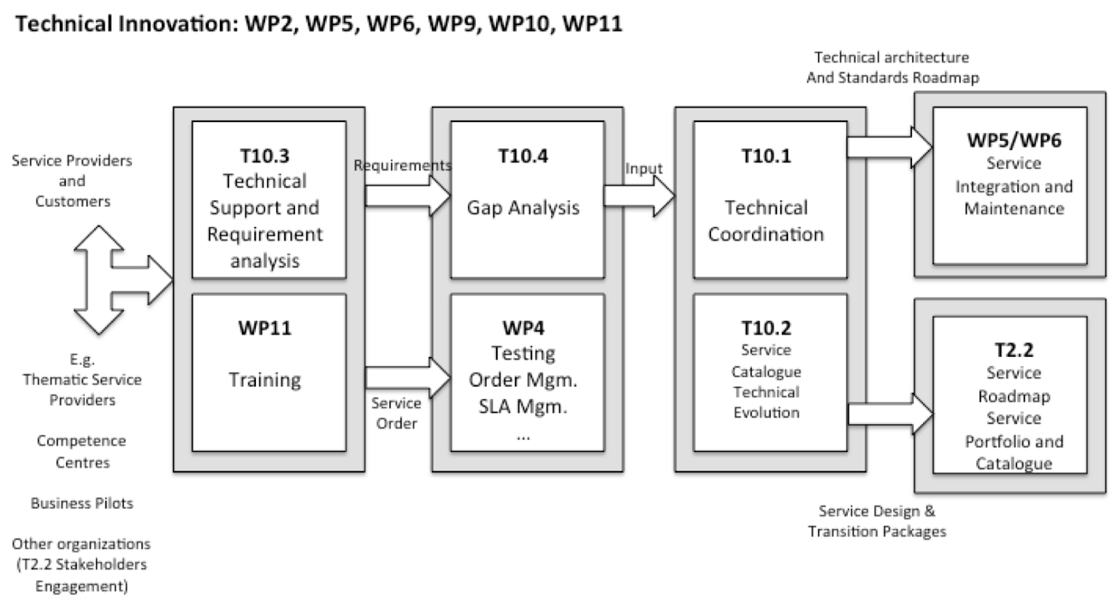
WP10 and relationship with others WPs
This is the actual status of our understanding is not written in the stone, and any comment that could help improving the process, would be very welcome.

Slide 13
WP10 Next steps: interaction with other WPs
WP10 should, as soon as possibile start a deep analysis of the requirements coming from the User communities (WP7, WP8, WP9)
This would be a crucial input for WP10.1 to start working on:
  the “Technical Roadmap v1”
  The “Technical Architecture and standards roadmap”

Slide 14
WP10 Next steps: interaction external bodies
WP10 has to look for RDA working groups that are relevant for our Technical Roadmap and find people that could participate to them.
We have to provide initial feedback on February
And start participating to the meeting already in March.
We need to start soon this activity!!

Slide 15
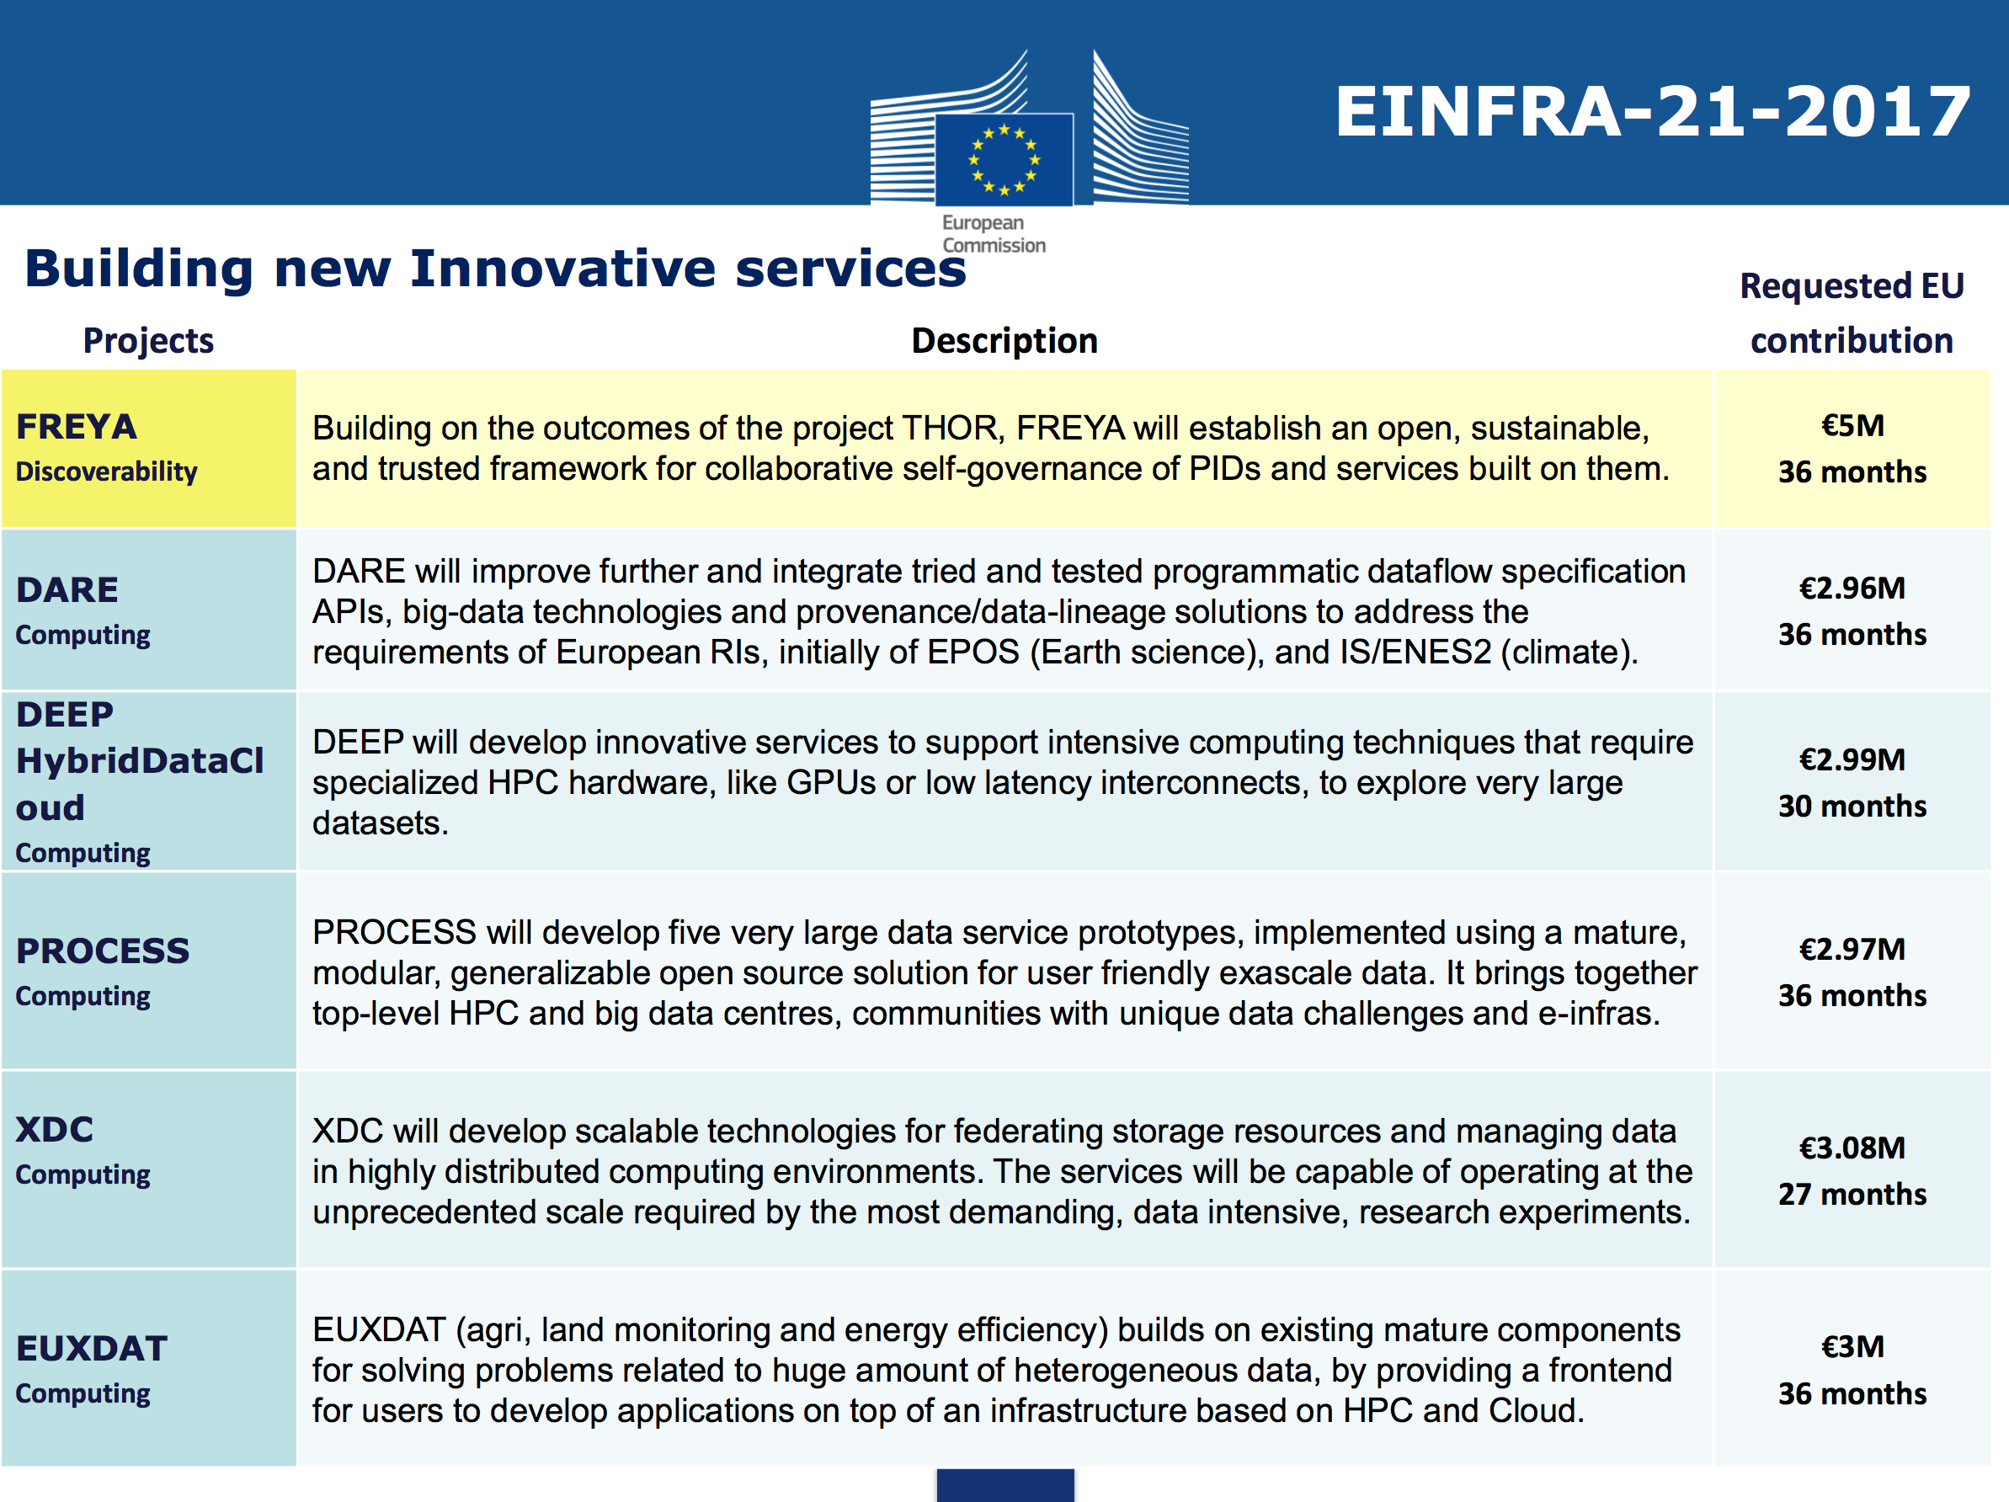
EINFRA-21 projects: how they could help EOSC-Hub

Slide 16
Relationship with EINFRA-21 projects
FREYA: we already are requesting a BoF at RDA P11 with OpenAIRE, FREYA and EOSC-Hub to start discussing possibile room to discuss technical integration developments between the projects that are of relevance to RDA
DEEP-HybridDataCloud: starts from INDIGO-DataCloud experience. Many parteners in common, an easy path to discuss with them. The focus on DL and ML could be of interest for many communities, so could help higher-level services in their implementation phase.
XDC: starts from INDIGO-DataCloud experience. Focused on data management with a variety of use-cases with really high-level scale. This could help in improving the data-management and data-access facilities in the future for EOSC-Hub.
We have to establish a contact with the others 3 projects to better evaluates their output and see if/how they could be useful for EOSC-Hub service catalogue

Slide 17
Feedback from other WPs: WP7

Slide 18
Feedback from other WPs: WP8
We are already planning a series of phone conference with the CC in order to start discussing their technical requirements
This will be an iterative process.

Slide 19
Thank you … and … Questions?

