Slide 1
EOSC HUB Task 4.2: Orders and CRM
Giovanni Morelli
Cineca
g.morelli@cineca.it
EOSC-hub kick-off meeting 9-12 January 2018, Science Park - Amsterdam

Slide 2
WP4: Federated service mng
WP4 WP leader Matthew Viljoen
Task 4.1 Coordination-EGI Foundation Matthew Viljoen
Task 4.2 Orders & CRM - CINECA Giovanni Morelli
Task 4.3 Service Availability, Continuity and Capacity Management/Alessandro Paolini
Task 4.4 Security-STFC David Kelsey
Task 4.5 Incident mgm-BSC David Vicente, Deputy leader Jorge Rodriguez
Task 4.6 Configuration mgm-LIP João Pina Deputy leader: Pablo Orviz
EOSC-hub kick-off meeting 9-12 January 2018, Science Park - Amsterdam

Slide 3
Task 4.2: Orders & CRM
This task will manage orders from customers and their user communities. These orders are received via a consistent front office platform (e.g. a web marketplace). Orders that can be directly handled by the front office platform will be processed with standard SLAs; orders requesting more sophisticated solutions will be handled by the individual service providers. In this second case the goal of the order management activity in the project is to integrate with the existing processes and streamline the information exchange. The orders will be tracked by a ticketing system.
In the after-sale, the task will continue to maintain the communication with the customer to collect, among other activities, customer satisfaction surveys.
EOSC-hub kick-off meeting 9-12 January 2018, Science Park - Amsterdam

Slide 4
Task 4.2: Orders & CRM
Front Office
Platform
Customers and their
user communities
Processed
with standard SLAs
Order
Requesting more
sophisticated solutions*
Handled by the individual service providers
*In this second case the goal of the order management activity in the project is to integrate with the existing processes and streamline the information exchange
EOSC-hub kick-off meeting 9-12 January 2018, Science Park - Amsterdam

Slide 5
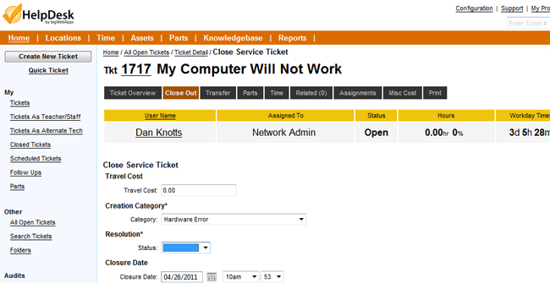
Task 4.2: Orders & CRM
The orders will be tracked by a ticketing system
EOSC-hub kick-off meeting 9-12 January 2018, Science Park - Amsterdam

Slide 6
CRM: Customer Relationship Management
In the after-sale, the task will continue to maintain the communication with the customer to collect, among other activities, customer satisfaction surveys.
Is an approach to manage a company's interaction
with current and potential customers
https://en.wikipedia.org/wiki/Customer_relationship_management
“Strategy used to learn more about customers’ needs and behaviors in order to develop stronger relationships with them”
http://guide.darwinmag.com/technology/enterprise/crm/index.html?
EOSC-hub kick-off meeting 9-12 January 2018, Science Park - Amsterdam

Slide 7
CRM: Customer Relationship Management
Acquiring New Relationships
You acquire new customers by promoting your company’s product and service leadership.
Enhancing Existing Relationships
You enhance the relationship by encouraging excellence in cross-selling and up-selling, thereby deepening and broadening the relationship.
Retaining Customer Relationships
Retention focuses on service adaptability – delivering not what the market wants but what customers want.
EOSC-hub kick-off meeting 9-12 January 2018, Science Park - Amsterdam

Slide 8
Task 4.2: task highlights
Lead: CINECA; Participants: MPG, EGI.eu, VUB
front office platform
(e.g. a web marketplace)
Already available solutions or new ?
Centre, people,…
more sophisticated solutions
individual service providers
Service 1
Service 2
……
Service N
Service Provider 1-1,1-2,…1-J
Service Provider 2-1,2-2,…2-K
……
Service Provider N-1,N-2,…N-L
ticketing system
information exchange
List of available solutions:
RT, Jira,…
List of available solutions:
mailinglist,Jira,Confluence….
communication with the customer to collect, among other activities, customer satisfaction surveys
Require a “company” DataBase:
Which solution for CRM?
EOSC-hub kick-off meeting 9-12 January 2018, Science Park - Amsterdam

