Slide 1
EOSC-HUB Kick-off WP11 Training and Services for Service Operators, Researchers and Higher-Education Task 11.1 Training programme and online services for training
Amsterdam, January 9, 2018
rene.van.horik@dans.knaw.nl
DANS is “linked 3th party of SURFsara”

Slide 2
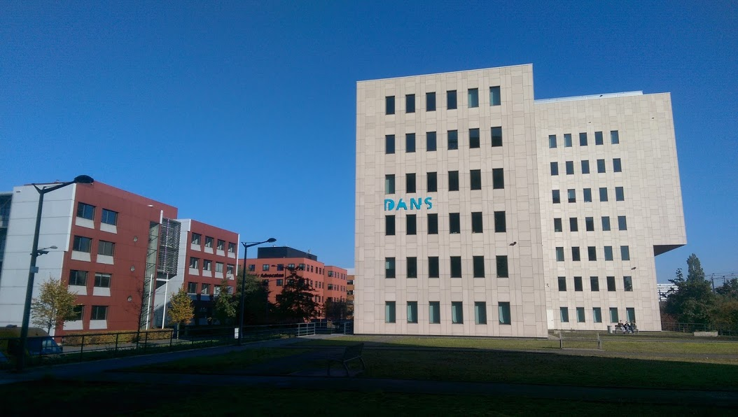
DANS is about keeping data FAIR
Mission: promote and provide permanent access to digital research resources
First predecessor dates back to 1964 (Steinmetz Foundation), Historical Data Archive 1989
Institute of Dutch Academy and Research Funding Organisation (KNAW & NWO) since 2005

Slide 3
Task 11.1 Training programme and online services for training
Objective:
Define and coordinate the annual training plans for supporting research activities

Slide 4
Task 11.1 Training programme and online services for training
Expected impact:
Train people in research and academic organisations preventing lack of skilled and specialised infrastructure operators
Creation of a network of training experts including technology providers within and from outside the consortium
Delivery of trainings in different areas: common and other federated services, data management planning, federated services management, domain-specific trainings

Slide 5
Task 11.1 Training programme and online services for training
Activities:
Maintain a catalogue of training events, training materials, deployable training environments (VMs, containers) and datasets. Contents will be produced by task 2, 3, 4 and 5
Operate a federated IaaS cloud infrastructure (for specific training events)
Provide a system for deployment and configuration of training environments
Provide surveys and feedback forms to link training activities to CRM and continuous service improvement
(We will build upon existing output by EGI, EUDAT and OpenAire)

Slide 6
Task 11.1 Training programme and online services for training
Partners and Resources:
DANS – NL - 4 PM
CESSNET – CZ – 2 PM
EGI.eu – NL – 2 PM?
JUELICH – DE – 3 PM?
IISAS – SK – 1 PM
INFN – IT – 6 PM
Total: 18 PM

Slide 7
Task 11.1 Training programme and online services for training
Relevant Key Performance Indicators:
KPI06: # training events 60 – 75 (so about 2 per month)
KPI07: # trained people 725 – 975

Slide 8
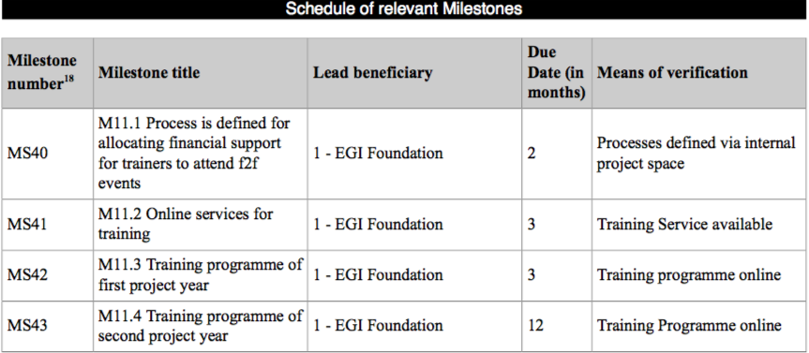
Task 11.1 Training programme and online services for training
T11.1
T11.1
T11.1
T11.1

Slide 9
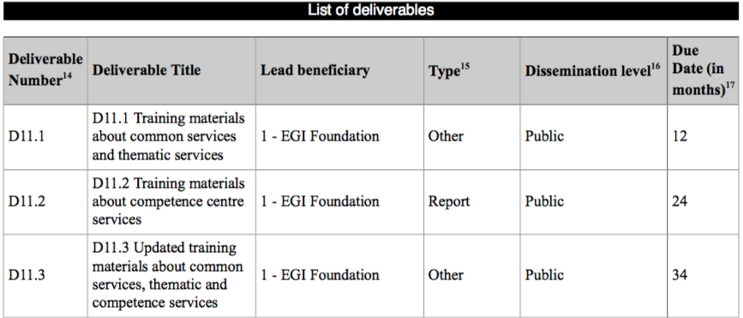
Task 11.1 Training programme and online services for training
T11.1
T11.1

Slide 11
Task 11.2 Data Management Planning
Objective:
Support the implementation of proper DMP for helping research communities to manage their research data efficiently
A data management plan or DMP is a formal document that outlines how data are to be handled both during a research project, and after the project is completed.

Slide 12
Task 11.2 Data Management Planning
Relation with WP5 (T5.3)
“The Data Management Planning (DMP) tool - a web-based service developed by EUDAT and OpenAIRE that guides users to define a customised data management plan for their research project. The service creates a H2020 compliant data management plan on the basis of answers to a series of questions related to a given research project and the related data used and/or produced. The generated Data Management Plan can be used as an attachment to the project documentation.”

Slide 13
Task 11.2 Data Management Planning
Activities:
Advocacy: Provide information about the Why and How of planning RDM and about the DMP review process of major researcher funders (in collaboration with OpenAIRE-Advance).
Guidance: Make information about data services from service providers, TS providers and CCs in the project available to project coordinators when writing a DMP.
Disciplinary support: Flesh out the information above by zooming in on different disciplines or research types such as experimental, observational, or modelling research, with different quantitative and qualitative data types.

Slide 14
Task 11.2 Data Management Planning
Partners and Resources:
DANS – NL - 11 PM
CCFE – UK – 2 PM
Total: 13 PM

Slide 15
Task 11.2 Data Management Planning
T11.2
T11.2
T11.2
T11.2

Slide 16
Task 11.2 Data Management Planning
T11.2

