Slide 1
WP11 – Training and Services for Service Operators, Researchers and Higher-Education
EOSC-hub Kickoff, Amsterdam, January 2018
Giuseppe La Rocca
EGI Foundation
giuseppe.larocca@egi.eu

Slide 2
Agenda of the week
WP11 – Training
Tue 09/01 (13:30 – 15:00 CET) SURFSara VK 3, Amsterdam Science Park
Training needs and plans (WP7, WP8, WP9, WP10, WP11) Thu 11/01 (09:00 – 10:30 CET) CWI Turingzaal, Amsterdam Science Park
Technical Coordination and Training (WP10, WP11, other)
Thu 11/01 (13:30 – 15:00 CET) CWI Turingzaal, Amsterdam Science Park

Slide 3
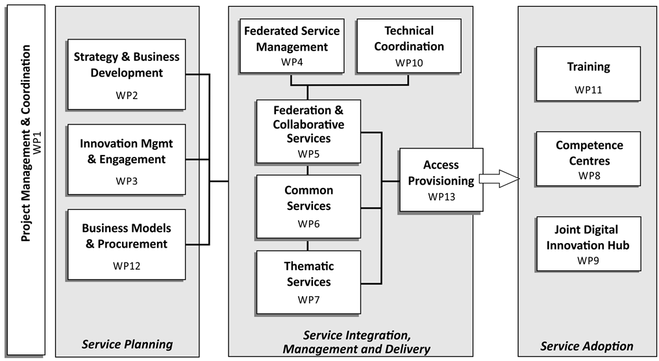
EOSC-hub WPs

Slide 4
Objectives of WP11
WP11 is responsible to define and deliver a training programme to foster the use of digital infrastructures, promote the uptake of Open Science, and support research Data Management Plans (DPM)
The training programme will stimulate the establishment of a “knowledge network” of expertise
WP11 will engage with “champion users”
Support the training activities of end users (WP8), Thematic Services providers (WP7) and Business Pilots (WP9), and support Data Management Plans in collaboration with the OpenAIRE-Advance project

Slide 5
WP11 Tasks
T11.1 Training programme and online services for training (Lead Partner: DANS-KNAW)
T11.2 Data Management Planning
(Lead Partner: DANS-KNAW)
T11.3 Federated Service Management Training and Certification
(Lead Partner: EGI Foundation)
T11.4 Training about common and federated services (Lead Partner: EGI Foundation)
T11.5 Domain-specific training to data providers and data scientists
(Lead Partner: EGI Foundation)

Slide 6
WP11 Task members and roles
Task | Task leader | Deputy
T11.1 | Rene van Horik (DANS-KNAW) | Ilona von Stein (DANS-KNAW)
T11.2 | Rene van Horik (DANS-KNAW) | Ilona von Stein (DANS-KNAW)
T11.3 | Sy Holsinger (EGI Foundation) | Małgorzata Krakowian (EGI Foundation)
T11.4 | Yin Chen (EGI Foundation) | Giuseppe La Rocca (EGI Foundation)
T11.5 | Yin Chen (EGI Foundation) | Giuseppe La Rocca (EGI Foundation)

Slide 7
Deliverables
Deliverable name | Short name | Type | Diss. Level | Due month
D11.1 Training materials about common services and thematic services | DANS-KNAW | O | PU | M12
D11.4 Second Report on training activities, infrastructure and materials | EGI.eu | R | PU | M24
D11.2 Training materials about competence centre services | EGI.eu | R | PU | M24
D11.5 Updated training materials about common, thematic and thematic services | EGI.eu | O | PU | M34
D11.3 Updated training materials about common services, thematic and competence services | EGI.eu | O | PU | M34

Slide 8
Milestones
Milestone name | Short name | Due month | Means of verificationM4
MS40 - M11.1 Process is defined for allocating financial support for trainers to attend f2f events | EGI.eu | M02 | Processes defined via internal project space
MS41 - M11.2 Online services for training | INFN | M02 | Training services available
MS42 - M11.3 Training programme of first project year | EGI | M03 | Training programme online
MS43 - M11.4 Training programme of second project year | DANS-KNAW | M12 | Training programme online
MS44 - M11.5 Training programme of third project year | INFN | M24 | Training programme online

Slide 9
Collaborative tools
Indico page:
https://indico.egi.eu/indico/category/211/
EOSC-hub Confluence page:
https://confluence.egi.eu/display/EOSC/Home
Mailing lists (in preparation):
EOSC-hub mailing lists to be ready by the KoM
Task mailing list will be created on request
EOSC-hub AMB folder
We will use these tools to record the WP meeting outputs
Wiki (in preparation):
All these tools will be provided under the EGI.eu domain. Switch to the EOSC-hub domain foreseen in Jan

Slide 10
Expected outcomes from the meeting
Define a fine grained WP11 work plan M01-M12 to achieve milestones and deliverable as in the DoA
Describe the activities by task
Store WP11 work plan in the shared folder
To be approved by the end of Jan

Slide 11
Expected outcomes from the meeting (cont.)
Preliminary definition of lead authors for each deliverable
Update the Deliverables in the Confluence page: https://confluence.egi.eu/display/EOSC/Deliverables
To be approved by the end of Jan. 2018
Preliminary definition of lead authors for each Milestone
Update the Milestones in the Confluence page: https://confluence.egi.eu/display/EOSC/Milestones
To be approved by the end of Jan. 2018

Slide 12
Expected outcomes from the meeting (cont.)
Define WP11 regular meetings in Indico:
https://indico.egi.eu/indico/category/211/
Define preliminary Quality Metrics (5) to facilitate WP11 daily work and register them in the spreadsheet
Some example:
1.) Number of training events supported (F2F, webinars) (60, 75)
2.) Number of training modules produced
3.) Number of trained users (725, 975)
Define team membership
Provide the "Primary Contact" involved in each tasks. Go to https://confluence.egi.eu/display/EOSC/AMB

Slide 13
Expected outcomes from the meeting (cont.)
Identify the Key Exploitation Results (KERs)
Register KERs in the Catalogue of Project results: https://confluence.egi.eu/display/EOSC/Project+Results
➔Training platform and online service
➔Training material
EOSC-hub/OpenAIRE Advance collaboration
Assessment and impact on the WP work plan
Information on how to store/present the outcome of the assessment will be provided soon.

Slide 14
EOSC-hub / OpenAIRE-Advance
Complementary grants in EINFRA-12
Mandated by the work programme to deliver joint activities
Initial preliminary joint activity plan
https://indico.egi.eu/indico/event/3511/overview
Next steps:
Jan (WP2/5/6/7/8/10): Prioritization of technical integration activities according to impact, demand (define use cases) and available effort in each task
Feb: update of joint activity plan
March: finalization of joint activity plan

Slide 15
Useful links
http://go.egi.eu/EOSC-hub-doa
http://go.egi.eu/EOSC-hub-budget
https://confluence.egi.eu/display/EOSC/Home
https://indico.egi.eu/indico/category/211/

