Slide 1
EOSC-hub WP11.3 Federated Service Management Training and Certification (FitSM)
Sy Holsinger, EGI Foundation – Senior Strategy and Policy Officer
WP1.3 CSI Leader/WP9 Manager/WP11.3 Task Leader
EOSC-hub Kick-off Meeting, 9 Jan 2018, Amsterdam

Slide 2
Content Outline
Partners
Budget and Task Activities
Deliverables and Milestones
FitSM statistics
Additional info on FitSM (for reference)

Slide 3
WP11.3 Members
WP11.3 Leader + FitSM Trainer
Sy Holsinger
EGI Foundation
WP11.3 Deputy + FitSM Trainer
Małgorzata Krakowian
EGI Foundation
FitSM Trainer
Gergely Sipos
EGI Foundation
FitSM Trainer
Giuseppe La Rocca
EGI Foundation

Slide 4
WP11.3 Budget and Activities
Budget
6PM (2PM/yr) – EGI Foundation
Activities
Prepare and deliver FitSM trainings for any consortium member
Formal certification (at least Foundation) is covered by the project
Initial DoA: 2 Foundation, 2 Advanced and 1 Expert training per year
Update: initial focus to be on Foundation, then upper levels in 2nd year
Task KPI: 15 FitSM training courses and 150 certificates
1st course held 8-9 Jan 2018 (Foundation), 15+ participants
Contribute to Project KPIs:
KPI06: #training events (60/75) + KPI07: # trained people (725/975)
Contribute to Impact:
Train people in research and academic organisations preventing lack of skilled and specialised infrastructure operators
Idea: Organize a “FitSM Implementation Experiences” Workshop
Audits: WP1.3 to ensure audits are conducted of the EOSC-hub Service Management System according to FitSM

Slide 5
WP11.3 Deliverables and Milestones
No dedicated deliverable or milestone
Contribution to existing ones
Deliverables: None Relevant
Milestones: MS42, MS43
Training programs for 1st and 2nd year

Slide 6
FitSM Statistics to date

Slide 7
History and Overview of FitSM

Slide 8
History of the FitSM standard
2012
2013
2015
2017
FedSM Project starts (FP7)
- Initial Goal: Help e-Infrastructures increase professional service delivery (Client partners: EGI, CSC, PLGrid)
Creation of FitSM
- Realization of market gap for lightweight approach
- Formalised standard and training certification scheme
Commercialization (FedSM ends – Sept)
- Established ITEMO (non-profit to host FitSM license and maintain standard)
- Contract Negotiation with Certification Authority (TUV SUD)
- Accreditation of training organisations
Sustainability
- ~1000 certificates awarded
- 15+ Accredited Training Organisations
- New certification authority (ICO-Cert)

Slide 9
What is FitSM?
Standards family for lightweight IT service management
Suitable for IT service providers of any type and scale
Main design principle: Keep it simple!
All FitSM parts are freely released under Creative Commons licenses
FitSM is operated and managed by ITEMO (non-profit)
Certification is provided through ICO-Cert
www.fitsm.eu
The development of FitSM was originally funded by the European Commission through an EC-FP7 project "FedSM“

Slide 10
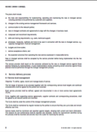
Third way for ITSM
‘Full’ commercial ITSM
FitSM Solution
More achievable
More suitable
Path to ‘full’ ITSM
Freely available
No/little formal ITSM
ISO/IEC 20000

Slide 11
FitSM Standard Family and Licenses
Core Standard
FitSM-0
Overview & vocabulary
Normative
FitSM-1
Requirements
FitSM-2
Objectives and activities
FitSM-3
Role model
Informational
Implementation aids
FitSM-4
Selected templates and samples
FitSM-5
Selected implementation guides
FitSM-6
Maturity and capability assessment scheme

Slide 12
FitSM Process Model
Service Portfolio Management
Most strategic
Service Level Management
Service Reporting
Service Availability and Continuity Management
More strategic
Capacity Management
Information Security Management
Customer Relationship Mgmt
Supplier Relationship Management
Incident and Service Request Mgmt
Problem Management
Configuration Management
More operational
Change Management
Release and Deployment Mgmt
Continual Service Improvement

Slide 13
FitSM-0: Overview and Vocabulary
FitSM-0 defines 70 important terms from the IT service management context
In alphabetical order:
Accessibility of information
Activity
Assessment
Audit
Availability
Capability
Capacity
Change
Classification
Closure
Competence
Compliance
Confidentiality of information
Configuration baseline
Configuration item (CI)
Configuration management database (CMDB)
Continuity
Customer
Document
Effectiveness
Efficiency
Escalation
Federation member
Federator
Incident
Information security
Information security control
Information security event
Information security incident
Integrity of information
IT service
IT service management (ITSM)
Key performance indicator (KPI)
Known error
Management system
Maturity
Nonconformity
Operational level agreement (OLA)
Operational target
Policy
Post implementation review
Priority
Problem
Procedure
Process
Record
Release
Request for change
Risk
Role
Service
Service acceptance criteria (SAC)
Service catalogue
Service component
Service design and transition package
Service level agreement (SLA)
Service management
Service management plan
Service management system (SMS)
Service portfolio
Service provider
Service report
Service request
Service target
Supplier
Top management
Underpinning agreement (UA)
Underpinning contract (UC)
User
Value

Slide 14
Key concepts: Service vs. Service Component
A service usually provides value when taken on its own – unlike the specific service components they are composed of composed of different service components, which may:
Enable the service (enabling service components);
What the customer has asked to be provided
Enhance the service (enhancing service components)
Added to make the service more attractive to the customer
Service
Customer

Slide 15
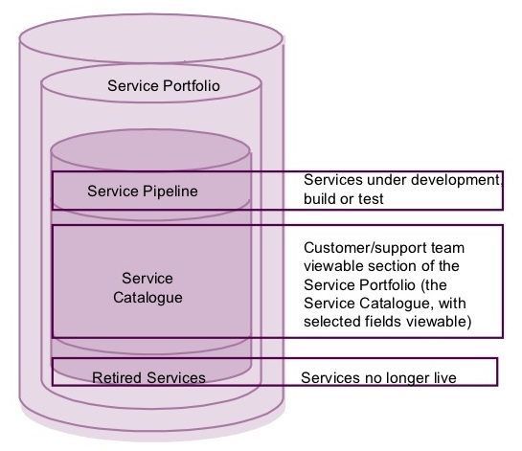
Key concepts: Service Portfolio vs. Service Catalogue
The service portfolio is the basis for the service catalogue
Customer

Slide 16
Key concepts: SLA vs. OLA
Customer
Service level agreements (SLAs)
Service A
Service B
Service C
(IT) service
provider
Service components
Operational level agreements (OLAs)
Underpinning agreements (UAs)
Internal groups or federation members
Suppliers

Slide 17
FitSM-1: Requirements
FitSM-1 defines 85 requirements that should be fulfilled by an organisation (or federation) offering IT services to customers
Compliance with the 85 requirements can be regarded as a "proof of effectiveness"
The 85 requirements are structured as follows:
16 general requirements (GR)
69 process-specific requirements (PR)
Consideration of the 14 IT service management processes from the FitSM process model
Between 2 and 8 requirements per process

Slide 18
FitSM Training and Certification Programme
Expert Level
2 days
2 days
ITIL Expert, ISO/IEC 20000 consultant and auditor
Expert training in IT service management
Expert Bridge
Advanced Level
2 days
2 days
Advanced training in
service planning and delivery
Advanced training in
service operation and control
Foundation Level
Foundation training in IT service management
1 day

Slide 19
Key ITSM activities and expected results for EOSC-hub
WP1.3: Service Management System, Continual Improvement
Integrated service management system (Confluence)
Conducted 2 audits (ITEMO) on the level of conformity and effectiveness of service management processes according to the FitSM
WP2.2: Service roadmap, Portfolio and Catalogue
Defined and managed Service Portfolio
Published Service Catalogue
WP4 and WP5: Federated Service Management and Tools
Established and operational service management processes
Implemented service management tools and support
WP11.3 FitSM Training and Certification
Delivered ~15 FitSM training courses and ~150 certificates
1st course held 8-9 Jan 2018 (Foundation), 15+ participants

Slide 20
sy.holsinger@egi.eu
Thanks! Questions?
@syholsinger
@FitSM_Standard
EOSC-hub Kick-off Meeting, 9 Jan 2018, Amsterdam

