Slide 1
T11.4 Training about common and federated services
Leader: EGI.eu
Participants: CNRS, CYFRONET, GRNET, IASA, IISAS, INFN, SURFsara, CCFE
Duration: PM1-PM36
Dr Yin Chen, yin.chen@egi.eu, EGI Foundation
EOSC-Hub Kick-off, 9-11 Jan 2018, Amsterdam

Slide 2
About the Task (DoW)
Objectives: Define and deliver training contents about common federated services for supporting scientific activities of TS, CCs and research communities
Descriptions:
Develop and deliver training content about the common/federation services
Relevant to TS and CCs, and external research communities
Provide training about all services in Table 2
Milestones: Training Programme of 1/2 project year; M3/12; Training Programme online
Deliverables: Contributed D11.1, D11.3, D11.4, D11.5

Slide 3
Issues To Be Clarified
ITBC#1: Contacts and PMs of each party in T11.4? Are they already the contact points of development WPs?
ITBC#2: How to collaborate with the following activities in T11.1
T11.1: Maintain a catalogue of training events, training materials …
T11.1: Provide a system for deployment and configuration of training env
T11.1: Provide surveys and feedback forms
T11.1: (9K for training events)
ITBC#3: Deliverables: which tasks? Which format?
D11.1: Training materials about common services and thematic Services; Oth; M12: first year training plan -> T11.1, T11.4, T11.5
D11.2: Training materials about competence center services; R; M24 -> T11.5
D11.3: Updated Training materials about common service, thematic and competence services; Oth; M34; EGI.eu -> T11.1, T11.4, T11.5
D11.4: Second Report on training activities, infrastructure and materials; R; M24 -> T11.1, T11.4, T11.5
D11.5: Updated training materials about common, thematic and competence services; Oth; M34 -> T11.1, T11.4, T11.5
ITBC#4: Milestones in what formats?

Slide 4
Table 2: EOSC-Hub service catalogue
Common
EGI HTC
EGI Cloud Compute
EGI Cloud container
DIRAC4EGI
EGI Online storage
EGI DataHub
B2HANDLE
B2FIND
B3DROP
B2SAFE
B2STAGE
B2SHARE
B2NOTE
Services (25)
ETDR
Sensitive Data Service
Advanced IaaS
TOSCA for Heat
OPIE
Synergy
BDII
IM
PaaS Orchestrator
CVMFS
IAM
WaTTS
Collaborative services (2)
AppDB
Repositories
Federation Services (13)
Accounting
ARGO
CheckIn
GGUS
GOCDB
Marketplace
Ops Portal
RC Auth
SPMT
DPMT
B2ACCESS
TTS
SVMON
Thematic Services (9)
ECAS
DARIAH SG
OPENCoastS
GEOSS
EO Pillar
WeNMR
DODAS
LifeWatch
CMI

Slide 5
1st Year Trainings
Objectives: Help TS, CC to choose right services to work with
Main Targeting Audience: TS and CCs but not exclusive
Time lines:
Plan: work with T11.1, schedule of 1st year trainings by M3
First set of training contents about common services: by M12
Priority training delivery: by M6
Other training delivery: by M12
Levels: Introduction and advanced
Training Scope:
Common Services (25)
Collaborative Services (2)
Federated Services (12)
Formats:
Contents (Slides/Guidance/User manuals/Recordings/VMs/Containers): each service should have, need to discuss with T11.1 which platform to use
Webinars: popular requested by TS/CC (by survey)
F2F trainings:
Advanced level including hand-on sessions
Popular requested by TS/CC
Co-organise with EOSC-Hub conferences: Apr, Nov??

Slide 6
2nd Year Trainings
Objectives:
Updates TS, CCs members with new developments
Promote EOSC-Hub services for TS, CC communities and outsiders
Main Targeting Audience: TS, CCs, and their research communities
Time lines:
Plan: work with T11.1, schedule of 2nd year trainings by M12
Update of training contents: by M24
Training delivery: by M24
Levels:
Advanced (for TS, CCs members)
Introduction (for others)
Formats:
Webinars: popular requested by TS/CC (by survey)
F2F trainings:
Advanced level including hand-on sessions
Popular requested by TS/CCs
Co-organise with EOSC-Hub conferences,
Work with T11.5, identify suitable TS, CCs community conferences and training events
Contents (Slides/Guidance/User manuals/Recordings/VMs/Containers): updates

Slide 7
3rd Year Trainings
Objectives:
Complete and maintain quality training materials for EOSC-Hub final services
Promote EOSC-Hub services to TS, CCs and external research communities
(Sustainability)
Main Targeting Audience: all
Time lines:
Update of training contents: by M36
Training delivery: by M36
Levels: all
Formats:
Contents (Slides/Guidance/User manuals/Recordings/VMs/Containers): updated and strategies for sustainability, e.g. e-learning platform, on-line courses etc.
Webinars and F2F trainings: also including external conferences

Slide 8
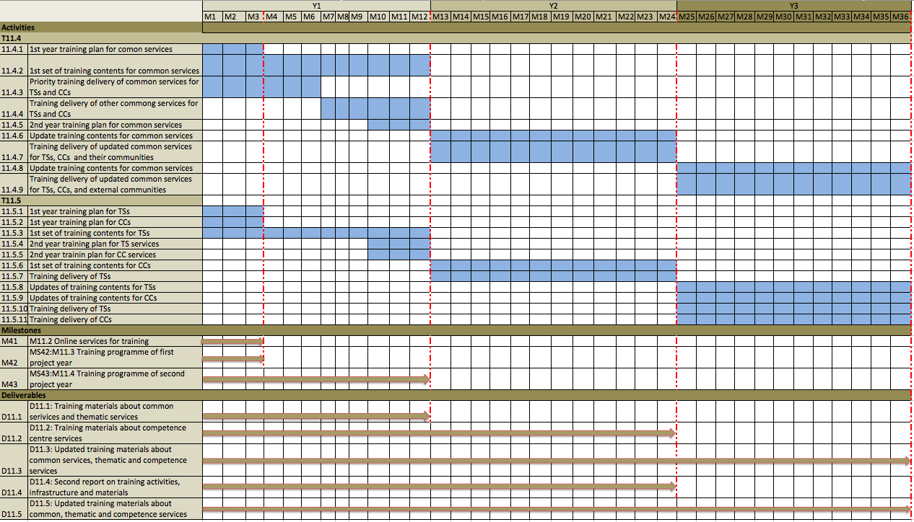
https://docs.google.com/spreadsheets/d/1vHu0T-o-sd72cVkPGOxUI0UFA2p96FtEJenqd5ZkXAU/edit?usp=sharing

Slide 9
Creation of Training Contents
Provided by service owners
T11.4 to provide templates and guidance:
Slides: ppt template
Recordings: guidance for video
Guidance/user manual: templates for wiki
VMs/Containers: guidance
T11.4 to monitor the progress
Plan, responsible staff, timely completion
Quality

Slide 10
Organisation of training events
Training plan
Plan description
Plan preparation check list
Training delivery
Event advertising and communication
Training event organization
Training and feedback collection
Training evaluation
Knowledge learning: e.g., exam/quiz results
User Feedback: feedback analysis
Impacts, e.g., service adoption, promote training to communities etc.
Training Record Template (use tool such as Confluence)

Slide 11
Training Plan and Preparation
Training planning: Completion and Submission PLAN part, no later than 1 month prior to events
Training Preparation: check-list and links
Materials (VMs/containers/slides/guides): completed and reviewed
Advertising message: completed and reviewed
Event webpage: created and online
Event is promoted via right communication channels:
Event facilities: arranged
Registration and logistic information: provided
Request for trainees: provided
Involved people: confirmed
(Budget): approved

Slide 12
Training Delivery
Pre-training activities
Check with event facilities
Training activities
Post training activities:
Upload materials to the event webpage
Collect feedback forms
Clean up e-Infra env after planned time
Complete training record (template check list and links)

Slide 13
Training Evaluation
Recommend to create quiz or exam for each course
Analyse training feedback
Tracking of training impacts, e.g., adoption, coming back trainees, bring new trainees etc.

Slide 14
Tools and Templates
Catalogue of training events, materials (discuss with T11.1)
Internal use
Public use, e.g., towards a sustainable e-learning platform
Training material template
For wiki
For slides
For user manual/guidance
For video
Training record template (plan, preparation, delivery, evaluation)
Training feedback form (discuss with T11.1)
Training event page
Training advertising channels (WP7, 8, 9, communication team)
Users database and training mailing list
Trainers database

Slide 15
Questions and Comments?

Slide 16
T11.5 Domain-specific training to data providers and data scientists
Leader: EGI.eu
Participants: ASTRON, CESNET, CIRMMP, CCMC, CNR, CNRS, CSC, DKRZ, EISCAT, EMBL-EBI, GFZ, GWDG, IFREMER, INFN, LNEC, MEEO, MTA-SZTAKI, MU, SNIC, Sinergise, SURFsara, Terradue, USE, ASGC
Duration: PM1-PM36
Dr Yin Chen, yin.chen@egi.eu, EGI Foundation
EOSC-Hub Kick-off, 9-11 Jan 2018, Amsterdam

Slide 17
About the Task (Final DoW)
Objectives: Define and deliver training contents about common federated services for supporting scientific activities of TSs, CCs and research communities (T11.4), and domain-specific training for data providers and data scientists (T11.5)
Descriptions: Training content (VMs/containers/slides/guides) and events
By CCs, e.g.:
ELIXIR core data resources
EISCAT Data portal
ORFEUS-EIDA e-Infra for EIDA nodes and seismology researchers
LOFAR data school
Master classes about DMCC+
ICOS Carbon Portal
eLTER data management system
By TS providers, e.g.:
ENES: to organize 3 f2f workshops
LNEC: to organize a summer school
ESA: promote training events on the integrated services
USE: provides trainings on PAIRQURS, Citizen Science Services, GBIF, GBIF, Digtal Knowledge Preservation Framework, Remote Monitoring, Smart Sensor
Milestones: Online Training Programme of 1/2 project year [M3/12]
Deliverables: Leads D11.2, contribute to D11.1, D11.3, D11.4, D11.5

Slide 18
Issues To Be Clarified
ITBC#1: Contacts and PMs of each party in T11.5? Are they already the contact points of TS, CCs WPs?
ITBC#2: How to collaborate with the following activities in T11.1
T11.1: Maintain a catalogue of training events, training materials …
T11.1: Provide a system for deployment and configuration of training env
T11.1: Provide surveys and feedback forms
T11.1: (9K for training events)
ITBC#3: Deliverables: which tasks? Which format?
D11.1: Training materials about common services and thematic Services; Oth; M12: (first year training plan) -> T11.1, T11.4, T11.5
D11.2: Training materials about competence center services; R; M24 -> T11.5
D11.3: Updated Training materials about common service, thematic and competence services; Oth; M34; EGI.eu -> T11.1, T11.4, T11.5
D11.4: Second Report on training activities, infrastructure and materials; R; M24 -> T11.1, T11.4, T11.5
D11.5: Updated training materials about common, thematic and competence services; Oth; M34 -> T11.1, T11.4, T11.5
ITBC#4: Milestones in what formats?

Slide 19
1st Year Trainings
Objectives:
Completion of training plan about TSs
Completion of first set of training contents about TSs
Main Targeting Audience:
Structured scientific communities linked to the CCs and TSs
Domain-specific data providers and data scientists
Time lines:
Plan: work with T11.1, schedule of 1st year TSs, CCs trainings by M3
First set of training contents about TSs: by M12
Training Scope:
TSs services (9)
Formats:
Contents (Slides/Guidance/User manuals/Recordings/VMs/Containers): each service should have, need to discuss with T11.1 which platform to use
Depending on TSs: Webinars, F2F trainings, summer schools
Co-organise with EOSC-Hub conferences: Apr, Nov??

Slide 20
2nd Year Trainings
Objectives:
Delivery of TSs trainings
Completion of training contents of CCs
Main Targeting Audience:
Structured scientific communities linked to the CCs and TSs
Domain-specific data providers and data scientists
Time lines:
Plan: work with T11.1, schedule of 2nd year trainings (about TSs, CCs) by M12
First set of Training contents about CCs: by M24
Delivery of planned training about TSs: by M24
Formats:
Contents of TSs (Slides/Guidance/User manuals/Recordings/VMs/Containers): updates
Depend on TSs, CCs’ plan

Slide 21
3rd Year Trainings
Objectives:
Update of TS, CCs training contents
Delivery of TSs, CCs trainings
Main Targeting Audience:
Domain-specific data providers and data scientists
Time lines:
Update of training contents: by M36
Training delivery: by M36
Formats:
Contents (Slides/Guidance/User manuals/Recordings/VMs/Containers): updated
Webinars and F2F trainings:
Tracking of TSs CCs trainings activities

Slide 22
Tools and Templates
Catalogue of training events, materials (discuss with T11.1)
Internal use
Public use, e.g., towards a sustainable e-learning platform
Training material template
For wiki
For slides
For user manual/guidance
For video
Training record template (plan, preparation, delivery, evaluation)
Training feedback form (discuss with T11.1)
Training event page
Training advertising channels (WP7, 8, 9, communication team)
Users database and training mailing list
Trainers database

Slide 23
https://docs.google.com/spreadsheets/d/1vHu0T-o-sd72cVkPGOxUI0UFA2p96FtEJenqd5ZkXAU/edit?usp=sharing

Slide 24
Questions and Comments?

