Slide 1
EOSC-hub WP10 Technical Coordination Giacinto Donvito (INFN) WP10 Leader and TC
9 January 2018

Slide 2
Outline
WP Work Plan
Preliminary definition of lead authors for each deliverable
Preliminary definition of milestone owners in PY1
Define WP regular meetings
Define preliminary quality metrics
Define team membership
Identify the Key Exploitation Results (KERs)
EOSC-hub/OpenAIRE Advance collaboration - Assessment and impact on the WP work plan

Slide 3
Kick-off WP10 agenda
Main Slots:
Service Portfolio Management (WP2 and WP10) -> 9/1/2018 10:00 - 12:30
WP10 - Technical Coordination -> 9/1/2018 12:30 - 15:00
Technical Coordination and Training (WP10, WP11) -> 11/1/2018 12:30 - 15:00
Two sessions where we need to contribute and provide feedback:
Training needs and plans (WP7, WP8, WP9, WP10, WP11) -> 11/1/2018 9:00 - 10:30
Software release, validation, deployment, integration and IT Security Management (WP4, WP5, WP6, WP7, WP10, WP13) -> 11/1/2018 10:00 - 12:30

Slide 4
Collaborative tools
EOSC-hub Confluence space:
https://confluence.egi.eu/display/EOSC/Home
AMB: https://confluence.egi.eu/display/EOSC/AMB
Indico AMB:
https://indico.egi.eu/indico/category/218/
Mailing lists (in preparation):
EOSC-hub mailing lists to be ready by the KoM
AMB, WP specific
Task ML under request of the WP leaders
Google drive shared folder (in preparation)
Tools are provisional offered under the EGI.eu domain
Switch to the EOSC-hub domain foreseen in January

Slide 5
KoM – Expected Output from WP meetings (1/2)
WP Work plan
Detailed 12 month work plan specifying distribution of activities by task
To be approved by end of Jan 2018
Preliminary definition of lead authors of each deliverable
To be approved by end of Jan 2018
Preliminary definition of milestone owners in PY1
To be approved by end of Jan 2018
Indicate dependencies where possible

Slide 6
KoM – Expected Output from WP meetings (2/2)
Define WP regular meetings
Preliminary quality metrics
Final target is defining 5 quality metrics per WP
Some examples
Number of scientific publications supported
Number of engaged SMEs/Industry
Number of entries in the service catalogue
Amount of VMs instantiated
Number of users per thematic service
Number of training modules produced and kept up-to-date

Slide 7
KoM – Expected Output from WP meetings (3/3)
Start to define team membership
A template will be provided to collect names, mailing lists per task, etc.
Identify the Key Exploitation Results (KERs)
EOSC-hub/OpenAIRE Advance collaboration
Assessment and impact on the WP work plan

Slide 8
WP Work Plan – Table per task
Activity identifier | Task Name | Start date (mm/yy) | End date (mm/yy) | Status | Dependencies | Issues
10.3.1 | Description 1 | 01/18 | 03/18 | Done
10.3.2 | Description 2 | 02/18 | 05/18 | Ongoing
… |  |  |  | Planned
10.3.N | Description N |  |  | Planned | 10.3.1
Activity identifier | Task Name | Start date (mm/yy) | End date (mm/yy) | Status | Dependencies | Issues
10.3.1 | Description 1 | 01/18 | 03/18 | Done
10.3.2 | Description 2 | 02/18 | 05/18 07/18 | Ongoing
… |  |  |  | Planned
10.3.N | Description N |  |  | Planned | 10.3.1
Activity identifier: task number + incremental id
Task Name: short description
Status: Planned/Ongoing/Done
Dependencies: list of activity identifiers
A tool to record the WP Work Plans will be provided soon

Slide 9
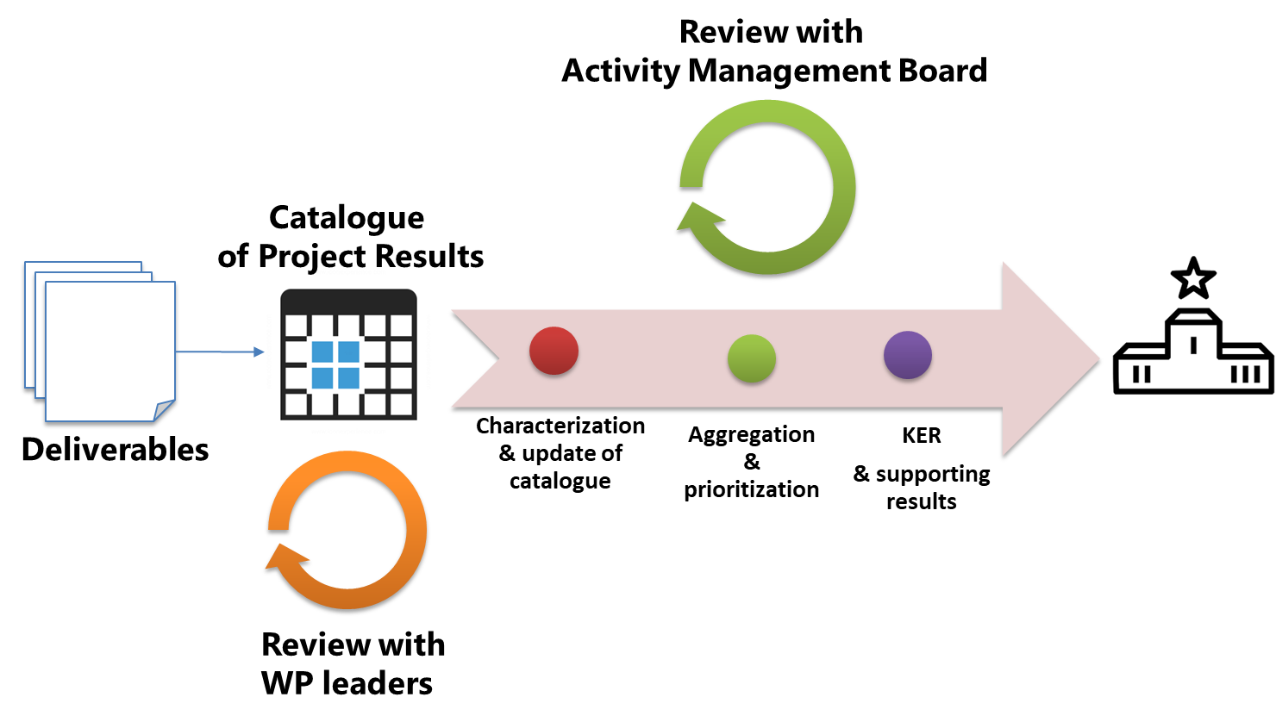
Identify WP Key Exploitation Results (KERs)
KERs need to be early identified in each WP
Refer to table 5 in GA (pp. 222) or DoA (pp. 36) as starting point
Identify additional output during WP meetings at KoM
Innovation mgmt presentation at KoM
Tue the 9th of Jan 9:50 AM
Methodology to identify, describe, exploit and disseminate KERs
IPRs, market segment, commercialisation and other exploitation paths, etc.
Templates will be made available

Slide 10
EOSC-hub/OpenAIRE Advance Collaboration
Agreement between the 2 projects
Planned to be signed by March 2018
Draft agreement presented to EC
https://indico.egi.eu/indico/event/3511/contribution/2
WP Leaders have to:
Read the agreement
Assess the impact on their WPs (in particular WP5, WP6, WP7 and WP8)
Suggest changes and collect input for the Technical Coordination and Training plenary session (Thu the 11th of Jan 13:30)
Define the WP Work Plan accordingly

Slide 11
WP10 Tasks and activities
T10.1 Technical Roadmap (Lead: INFN; Participants: CYFRONET, CSIC, KIT, SURFsara) -> Giacinto Donvito
T10.2 Service Catalogue Technical Evolution (Lead: SURFsara; Participants: EGI.eu, INFN) -> Mark van de Sanden
T10.3 Community Requirement Analysis and Technical support (Lead: EGI.eu; Participants: CYFRONET, CCFE, CINECA, CSIC, INFN, SURFsara) -> Diego Scardaci
T10.4 Common service building requirements and gap analysis (Lead: CSIC; Participants: Cyfronet, EGI.eu, INFN, SURFsara) -> Pablo Orviz

Slide 12
WP10 Tasks and activities: Task 10.1
T10.1 Technical Roadmap
Definition, maintenance and enforcement of the technical roadmap
This activity will leverage the expertise of the Technology Committee members to scout new or emerging technologies, architectures and services. Input and requirements will be collected also by WP2, WP3, WP5, WP6, WP7, WP8 and WP9. The Technology Committee will analyse and prioritise requirements, and propose changes for AMB / PMB approval. Requests that imply major changes to the service portfolio will be evaluated together with T2.2.
Service Architecture
This task is responsible for defining and maintaining the overall service architecture of the services of the EOSC Hub portfolio.
The architecture will be comprehensive to include all service categories: Common, Thematic, Collaborative and Federation, and will take into account dependencies and interfaces among the services and service components.
Technical Service Evolution
This second activity will ensure that the roadmap for the evolution of each service is coherent with the overarching technical plans and will promote technical convergence of tools coming from WP5 and WP6 (Federation and Common Services), WP7 (Thematic Services), WP8 (Competence Centres) and WP9 pilots (Joint Digital Innovation Hub). Output:
Two technical roadmaps [M12 and M24], with updates when necessary.
Contributions to standard bodies or to external technology providers.

Slide 13
WP10 Tasks and activities: Task 10.2
T10.2 Service Catalogue Technical Evolution
This task will define the project's Rules of Engagement (RoE), including guidelines, policies and procedures to assess conformance of services to the RoE and to the FAIR principles. Compliance to the RoE will be used to brand services in the project as trustworthy and interoperable. The main goals of this task are to define these guidelines and policies, define appropriate procedures to assess the conformance of the candidate services to the RoE and to the FAIR principles and perform the assessment.
This activity will monitor the evolution of reference standards (and contribute where relevant) and track the evolution of the main software technologies in the Open Source communities. The task will also evaluate external technologies and software stacks that could be included into the Services Catalogue. Output:
The standards roadmap ensuring service interoperability across different services of the EOSC Hub [1] portfolio;
The project Rules of Engagement (RoE);
Evaluation reports about candidate services/software components;
Recommendations on product or software stacks to support services

Slide 14
WP10 Tasks and activities: Task 10.3
T10.3 Community Requirement Analysis and Technical support
This task will analyse the requirements collected by the other work packages and provide support to all the user communities engaged before or during the project, including also Thematic Services, Competence Centres and Joint Digital Innovation Hubs, in particular during their starting phase.
The task will identify appropriate services to satisfy requirements and combine them to define solutions. The team will then support user communities to deploy such solutions in the EOSC-hub infrastructure, identifying the appropriate configuration of the services in collaboration with WP5 and WP6 experts and WP13 service operators/managers. When a complete solution cannot be designed with the existing services in the portfolio, a new service building requirement describing the identified gaps will be created and submitted to T10.4.
In addition, when a new service will be included in the portfolio, this task will assist the service administrator with the deployment in the infrastructure. This task will also support WP11 contributing to the training programme and the documentation preparation.

Slide 15
WP10 Tasks and activities: Task 10.4
T10.4 Common service building requirements and gap analysis
The task will handle the requirements that the T10.3 flagged as not addressable by a simple set of services already present in EOSC-hub service catalogue. The team will perform a deeper requirement analysis, considering external services or extending the EOSC-hub service catalogue. The outcome will be a set of prioritised solutions submitted to T10.1 for roadmap evolution. Solutions that imply major changes to the service portfolio will be evaluated in collaboration with T2.2.
This activity is especially important during the starting phase of the Thematic Services, Competence Centres and Joint Digital Innovation Hubs; but it will continue throughout the project to review use cases from new communities. This does not apply to application level services.
T10.4 will also take care of the interaction with external entities, e.g. the EOSCpilot project or others Open Source projects, in order to assess the added value of their services, understand their impact on the current ones and finally propose new candidate services to be included into the project catalogue.

Slide 16
WP10 Workflow

Slide 17
WP10 Planning
Phone conference:
How do we want to organise our WP?
I would suggest to run one phone conf per all the WP task once every two weeks.
In the initial phase we may go for a weekly phone conf in order to speedup the startup of the activities.
Management:
I assume that the task leader should follow more closely the practical activities having cross check more often than bi-weekly.
Detailed activities:
The management is asking us a detailed description of the activities that have to be executed in order to accomplish the goals.
I assume we are not ready to provide this today, but I would like to start the discussion soon in the first coming phone conference.

Slide 18
References
EOSC-hub confluence space
https://confluence.egi.eu/display/EOSC/Home
https://confluence.egi.eu/display/EOSC/WP10+Technical+Coordination
WP work plans:
https://docs.google.com/spreadsheets/d/1COZzwEArRexybn1zXx9D14vXNKWqAlH7mnWEWMuIZ0M/edit#gid=1627201107

Slide 19
Any Questions?

