Slide 1
WP11 – Training needs and plans
EOSC-hub Kickoff, Amsterdam, January 2018
Giuseppe La Rocca
EGI Foundation
giuseppe.larocca@egi.eu

Slide 2
Agenda of today
Training needs and plans (WP7, WP8, WP9, WP10, WP11) Thu 11/01 (09:00 – 10:30 CET) CWI Turingzaal, Amsterdam Science Park
Overview about the WP11
Training needs from different WPs:
WP7 (Claudio Cacciari)
WP8 (Gergely Sipos)
WP9 (Sy Holsinger)
WP10 (Giacinto Donvito)
Open Discussion

Slide 3
Objectives of WP11
Define and Coordinate the annual training plans for supporting research activities (T11.1).
Support the implementation of proper DMP for helping research communities to manage their research data efficiently (T11.2).
Deliver of IT service management trainings to learn the fundamentals of IT service management processes and support the professional development of EOSC-hub services (T11.3).
Define and Deliver training contents about Common and Federated services for supporting scientific activities of TS, CCs and research communities (T11.4), and domain-specific training for data providers and data scientists (T11.5).

Slide 4
WP11.1 – Training programme and online services for training
Budget: 18PMs in total
Lead partner: DANS-KNAW
Participants: INFN, CESNET, IISAS and EGI Foundation
Activities:
Maintain a catalogue of training events, training materials, deployable training environments (VMs, containers) and datasets. Contents will be produced by task 2, 3, 4 and 5.
Operate a federated IaaS cloud infrastructure.
Provide a system for deployment and configuration of training environments.
Provide surveys and feedback forms.

Slide 5
WP11.2 – Data Management Planning
Budget: 13PMs in total
Lead partner: DANS-KNAW
Participants: CCFE
Activities:
Advocacy: Provide information about the Why and How of planning RDM and about the DMP review process of major researcher funders.
Guidance: Make information about data services from service providers, TS providers and CCs in the project available to project coordinators when writing a DMP.
Disciplinary support: Flesh out the information above by zooming in on different disciplines or research types such as experimental, observational, or modelling research, with different quantitative and qualitative data types.

Slide 6
WP11.3 – Federated Service Management Training and Certification
Budget: 6PMs in total.
Lead partner: EGI Foundation
Activities:
Prepare and deliver FitSM trainings for any consortium member
Formal certification (at least Foundation) is covered by the project
Initial DoA: 2 Foundation, 2 Advanced and 1 Expert training per year
Update: initial focus to be on Foundation, then upper levels in 2nd year
Idea: Organize a “FitSM Implementation Experiences” Workshop

Slide 7
WP11.4 – Training about common and federated services
Budget: 36 PMs in total
Lead partner: EGI Foundation
Participants: CYFRONET, CCFE, IN2P3-CPPM, EGI Foundation, GRNET, IASA, IISAS, INFN, Nikhef and SURFsara
Activities:
Develop and deliver training content about the common/federation services which are relevant for Thematic Services (TS), Competence Centres (CCs) and for external research communities who want to become users or providers in the EOSC-Hub
The timing and format of delivery will be chosen most appropriately for the target audience

Slide 8
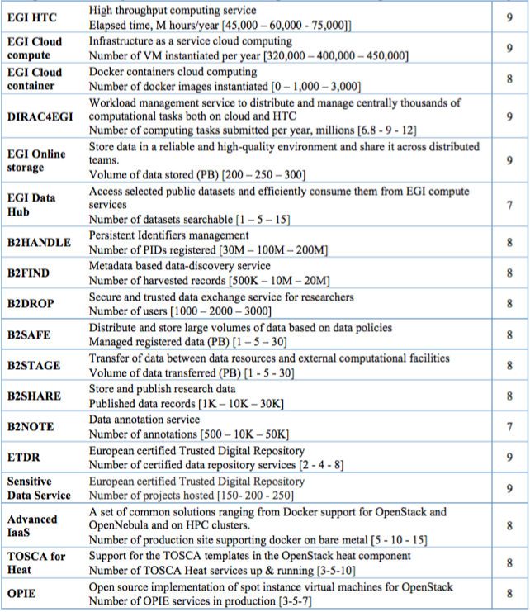
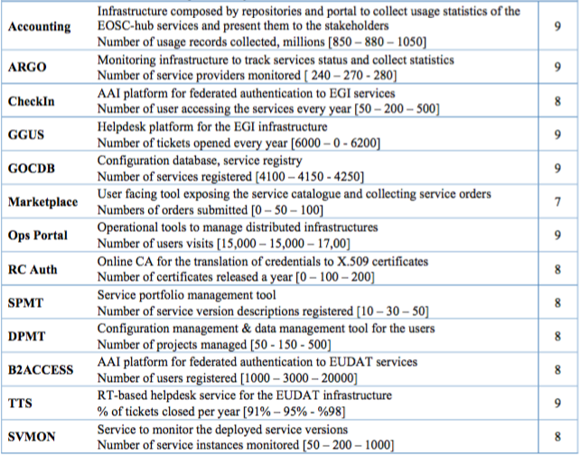
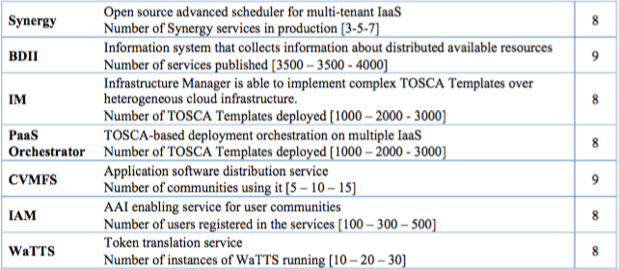
Basic infrastructure and Added value services:
Open Collaboration services:
Federation services:

Slide 9
WP11.5 – Domain-specific training to data providers and data scientists
Budget: 69 PMs in total
Lead partner: EGI Foundation
Participants: AS, ASTRON, CESNET, CIRMMP, CMCC, CNR, CNRS-UR, CSC, DKRZ, EGI Foundation, EAA, EISCAT, EMBL-EBI, GFZ, GWDG, IFREMER, INFN, KNMI, LNEC, LUND, MEEO, MTA-SZTAKI, MU, RBI, Sinergie, Terradue, UNICAN, UPV, USE and UU
Activities:
Develop training content and deliver events targeted at data providers and data scientists within structured scientific communities linked to the Competence Centre and Thematic Services

Slide 10
WP11: Baseline support for training in EOSC-hub
WP11
Common and Federated services relevant for the selected TS and CC (11.4)
Domain-specific training to target researchers organized in TS and CC (11.5)
Generic training content: DMP, FitSM (11.2, 11.3)
WP07
WP08
WP09

Slide 11
EOSC-hub / OpenAIRE-Advance
Complementary grants in EINFRA-12
Mandated to deliver joint activities
Initial preliminary joint activity plan https://indico.egi.eu/indico/event/3511/overview
JA2.2 – Training and Support
Joint organize training events on DMP and FAIR (2 webinars/year)
Support the training of “ambassadors”: NOADs, NGIs, community leaders, RI representatives
Organize training events based on user/community requirements
Provide integration workshops (years 2 and 3)

Slide 12
WP11 Tasks, Members and Roles
Task | Task leader | Deputy
T11.1 | Rene van Horik (DANS-KNAW) | Ilona von Stein (DANS-KNAW)
T11.2 | Rene van Horik (DANS-KNAW) | Ilona von Stein (DANS-KNAW)
T11.3 | Sy Holsinger (EGI Foundation) | Małgorzata Krakowian (EGI Foundation)
T11.4 | Yin Chen (EGI Foundation) | Giuseppe La Rocca (EGI Foundation)
T11.5 | Yin Chen (EGI Foundation) | Giuseppe La Rocca (EGI Foundation)

Slide 13
Deliverables
Deliverable name | Short name | Type | Diss. Level | Due month
D11.1 Training materials about common services and thematic services | DANS-KNAW | O | PU | M12
D11.4 Second Report on training activities, infrastructure and materials | EGI.eu | R | PU | M24
D11.2 Training materials about competence centre services | EGI.eu | R | PU | M24
D11.5 Updated training materials about common, thematic and thematic services | EGI.eu | O | PU | M34
D11.3 Updated training materials about common services, thematic and competence services | EGI.eu | O | PU | M34

Slide 14
Milestones
Milestone name | Short name | Due month | Means of verificationM4
MS40 - M11.1 Process is defined for allocating financial support for trainers to attend f2f events | EGI.eu | M02 | Processes defined via internal project space
MS41 - M11.2 Online services for training | EGI.eu | M02 | Training services available
MS42 - M11.3 Training programme of first project year | EGI.eu | M03 | Training programme online
MS43 - M11.4 Training programme of second project year | EGI.eu | M12 | Training programme online
MS44 - M11.5 Training programme of third project year | EGI.eu | M24 | Training programme online

Slide 15
Training plans and needs from other WPs
Contributions from:
WP7 (Claudio Cacciari)
WP8 (Gergely Sipos)
WP9 (Sy Holsinger)
WP10 (Giacinto Donvito)
Open Discussion

