Slide 1
EOSC-hub WP9: Joint Digital Innovation Hub
Sy Holsinger, EGI Foundation
Senior Strategy and Policy Officer - WP9 Manager
EOSC-hub Kick-off, 9-12 Jan 2018, Amsterdam

Slide 2
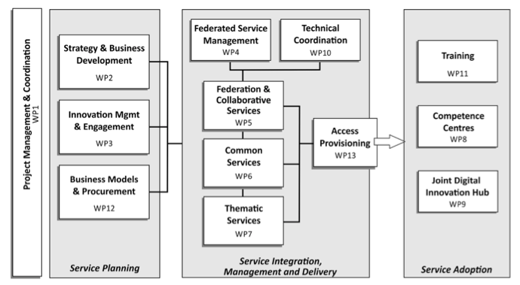
Work packages

Slide 3
WP9 Objectives
Create partnerships with SMEs/industry, innovation clusters, accelerators and investors that stimulate innovation (new products, services). Provide access to funding/grants, and increase visibility. Facilitate access to e-Infrastructure resources to support pilots, prototyping, scaling-up, design, performance verification, testing, demonstration, etc.
Offer business oriented coaching to “accelerate” market uptake and exploitation results of pilots and Competence Centers. Connect with the Pan-European network of DIHs and selected regionals. Share best practices and competencies to expand the knowledge/human capital between the public and private sector. Develop long-term business relationships outside of/beyond the project.

Slide 4
EOSC-hub Joint DIH (WP9): Tasks/Activities
WP9 Joint Digital Innovation Hub
T9.1 | Joint DIH ecosystem (Lead: EGI Foundation) | Establishing and evolving of the DIH Collaborating with other DIHs Managing the DIH platform/tool
T9.2 | Business Pilots (Lead: PSNC) | Coordinating pilots (6 initially selected in open call) Ensuring access to services and tech support Assessing and validating results Identifying additional experiments
T9.3 | Commercialization Support (Lead: F6S) | Identifying business opportunities from the pilots Supporting technology transfer process models Mentoring program towards pilots and competence centres Defining pre-commercial agreements

Slide 5
Deliverable and Milestones
Deliverable | Lead Beneficiary | Author | Due Date (month) | Type | Dissemination Level
D9.1 Initial Business Pilots Overview & Work Plans | PSNC | Marcin Plociennik | M03 March 2018 | Report | CO
D9.2 Joint Digital Innovation Hub Intro and Strategy | EGI.eu | Sy Holsinger | M06 June 2018 | Report | PU
D9.3 Business Pilots Results | PSNC | Marcin Plociennik | M21 Sept 2019 | Report | CO
D9.4 Joint Digital Innovation Hub Final Results and Sustainability Plan | EGI.eu | Sy Holsinger | M36 Dec 2020 | Report | PU
Milestone | Lead Beneficiary | Author | Due Date (month) | Means of verification
MS37 Business Pilot Success Stories | EGI.eu | Sy Holsinger Marcin Plociennik | M24 Dec 2019 | Published Online

Slide 6
Task and Deliverable Timelines
PM1
PM6
PM12
M18
PM24
PM30
PM36
T9.1
Joint DIH
T9.2
Business Pilots
T9.3
Commercialization Support
PM3
PM21
PM6
PM24
PM36
D9.1
1st Business Pilot Work plans
D9.3
Business Pilot Results
D9.2
Joint DIH Strategy
D9.4
Joint DIH Final Results
M9.1
Publication of Business Pilot Success Stories

Slide 7
WP9 Relation to other WPs
Exploitable Services
WP2: Service Portfolio/Catalogue
New services
Innovation Input
DIH
Engagement Strategy
WP3: Innov Mgmt./ Comms / Open Calls
Marketing Support
Open Call Mgmt.
Expertise
WP8: CCs
Mentoring
Training/Material
WP11
Provisioning
WP13

Slide 8
Project KPIs – WP9
KPI# | Name | Area | BT | ST
KPI03 | Services/technologies increased in TRL via the DIH | T | 7 | 10
KPI04 | Published business pilot success stories | SE | 5 | 8
KPI05 | Signed (pre-)commercial agreements for EOSC-hub services from DIH | SE | 3 | 6
O = operational, T = technical, SE = socio-economic
BT = base target, ST = stretch target

Slide 9
WP9 Training and Needs
Initial focus on 6 business pilots
One-to-one consultancy/support
Understand the ”service heat map”
Wider Digital Innovation Hub Promotion
Individual service demos/online material (for them)
Webinars (from us)
WP9 business coaching available to other WPs (e.g. WP7, WP8)
Timelines
Initial 6 pilots run up to M12-M18
D9.2 Joint Digital Innovation Hub Intro and Strategy (M6)
D3.1 EOSC-Hub Comm. & Stakeholder Engagement Plan (M4)
Summary
2 types of trainings foreseen, but not until 2nd half of year

Slide 10
sy.holsinger@egi.eu
Thanks! Questions?
@syholsinger
EOSC-hub Kick-off Meeting, 9-12 Jan 2018, Amsterdam

