Slide 1
EOSC-hub Integrating and managing services for the European Open Science Cloud
09 January, EOSC-hub Kickoff
Tiziana Ferrari/EOSC-hub Project Coordinator

Slide 2
EOSC-hub mobilises providers from 20 major digital infrastructures, EGI, EUDAT CDI and INDIGO-DataCloud jointly offering services, software and data for advanced data-driven research and innovation.

Slide 3
Project figures
100 Partners, 76 beneficiaries (75 funded)
3874 PMs, 108 FTEs, more than 150 technical and scientific staff involved
€33,331,18 of which the European Commission funds €30,000,000
€2,155,540 (~8 FTEs) are co-funded by the EGI Foundation and its participants + €1,221,094 (~5 FTEs) from EGI participants
36 months: Jan 2018 – Dec 2020 (18 month reporting period)

Slide 4
Mission
The project will create the Hub a federated integration and management system for the future EOSC
Resources and Services
Processes and policies
Federated operations
Federation “core” services

Slide 5
What does the Hub provide?
Contact point for researchers and innovators to discover, access, use and reuse a broad spectrum of resources for advanced data-driven research
Catalogue of resources and services
Humanities, Engineering, Medical and Health Sciences, Natural Sciences
Corpus of policies, processes and federation services (community-defined)
Principles of engagement and EOSC “core” services
Quality assurance reviews
Manage end-to-end service level management performance
Competence Centres and a Joint Digital Innovation Hub
Specialized Technical support, training

Slide 6
The Hub and the Three Os
Open Science
Resources and services for sharing, discovery access, use and reuse
Collaboration with OpenAIRE-Advance
Open Innovation
A open collaborative effort of service providers and user communities
Co-design of process with Competence Centres and a Joint Digital Innovation hub
Open to the world
Aggregates services from local, regional and national e-Infrastructures in Europe and other regions of the world

Slide 7
From integration to utilization
Integrate production-ready services
Operate and Provide
Access and Consume

Slide 8
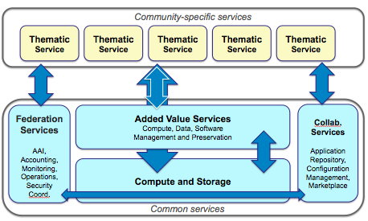
Architecture

Slide 9
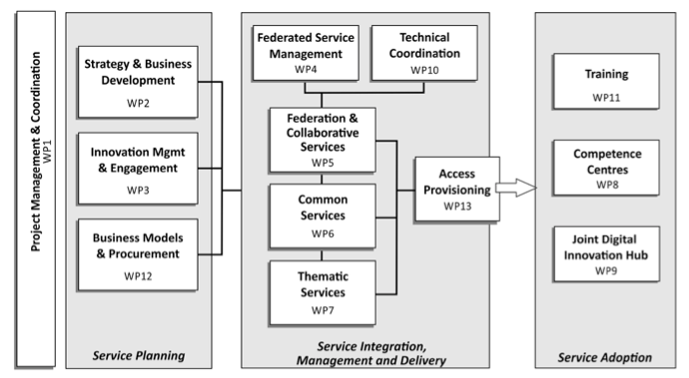
Work packages

Slide 10
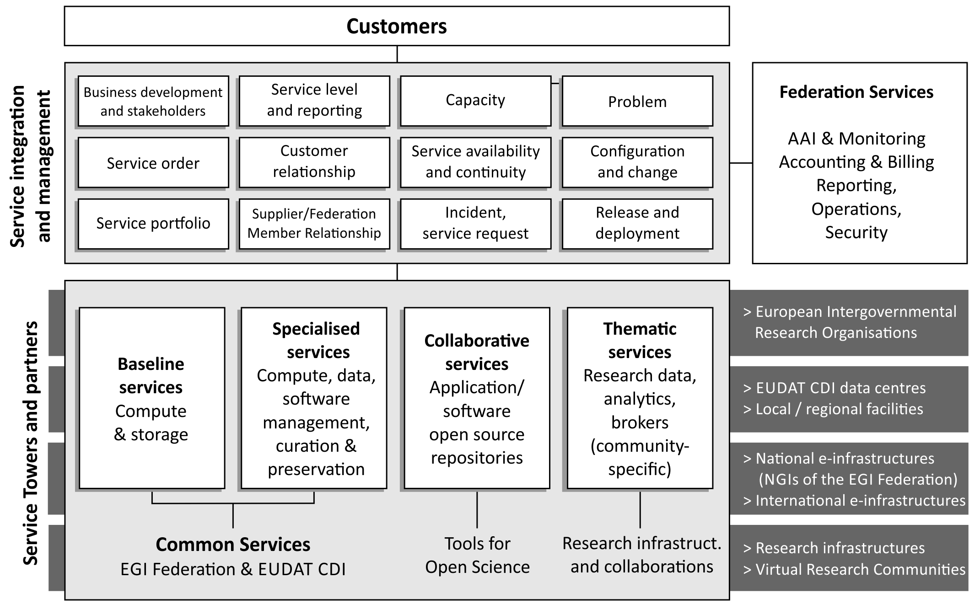
Service Integration and Access Management

Slide 11
Service Providers 1/2
e-Infra
EGI Federation
EUDAT CDI
Humanities
Language and literature (CLARIN)
Arts (DARIAH)
Engineering
Environmental engineering (sea vessels, LNEC)
Civil Engineering (Disaster Mitigation)
Medical and Health Sciences
Biological Sciences (ELIXIR)
Structural biology (WeNMR)

Slide 12
Service Providers 2/2
Natural Sciences
Physical Sciences
Earth Science
Astronomy (LOFAR)
Fusion (ITER)
High Energy Physics (CMS and VIRGO)
Space Science (EISCAT-3D)
EO Pillar
GEO
Climate Research (ENES)
Seismology (ORFEUS, EPOS)
Biological Sciences
Marine and freshwater biology (IFREMER)
Biodiversity conservation (LifeWatch)
Ecology (ICOS)

Slide 13
EOSC Domains and the Hub: what model?
Hub
EOSC Domain
EOSC Domain
EOSC Domain
EOSC Domain

Slide 14
EOSC-hub Domain
Manages
The internal governance, strategy and funding
The internal portfolio, policies and processes
Participates in the Hub with
Resources and services as needed
Internally certified to comply to the Hub policies
Input to the EOSC standards roadmap and policies
Domain-specific FAIR implementation guidelines etc.
The Hub is governed as a Commons

Slide 15
Support to the Declaration: Governance and Funding
EOSC-hub
Provides an EOSC service integrator and federator.
Develops the know-how and the prototype procurement and purchasing framework to acquire digital services from publicly funded infrastructures and commercial providers.

Slide 16
Support to the Declaration: Data Culture and FAIR
EOSC-hub
Provides production-quality FAIR data and services through the participating Domains
Ensures data can be used as widely as possible across scientific disciplines and between the private and public sector by
Making core data resources discoverable and accessible
Federating existing data infrastructures

Slide 17
Support to the Declaration: Research Data Services and Architecture
EOSC-hub
Realizes a system of EOSC domains
Delivers the Hub as a delivery channel of resources and services
Improves skills and knowledge among researchers and service operators by delivering specialised trainings and co-design

Slide 18
Impact 1/4
The operation of a federated European data and distributed computing infrastructure for research and education communities will optimise the access to IT equipment and services
Creation of an EOSC-hub service portfolio, initially integrating EGI, EUDAT and INDIGO products
Establishing partnerships with industrial and private partners
Joint Digital Innovation Hub

Slide 19
Impact 2/4
Train people in research and academic organisations
Training programme benefiting 20 research collaborations and external user groups
Common and other federated services, data management planning, federated services management, domain-specific trainings (bioinformatics, marine, radio astronomy, seismology, language, earth observation, structural biology, coastal analysis, climate, high-energy physics, arts and humanities

Slide 20
Impact 3/4
Avoid the locking-in to particular hardware or software platforms
Increase service interoperability by exposing well-defined interfaces based on open specifications that improve reusability
Develop technical and service roadmaps to ensure a coherent evolution of the technical solutions and service offering

Slide 21
Impact 4/4
More scientific communities will use storage and computing infrastructures with state-of-the-art services
Expand the access to services outside the traditional user base through the virtual access mechanism
Stimulate engagement via Competence Centres in the following areas: life science, fusion, marine, radio astronomy, seismology, climate change, disaster mitigation

Slide 22
Some Key Exploitable results
Integration of common software and services for storage, compute and data
Thematic services and Research Data
Federation and collaboration service and tools (Marketplace, Accounting, Security, Helpdesk, Monitoring)
Procedures and policies for federated service management
Purchasing and procurement framework
Training platform and materials
Technical standards roadmap
Strategy roadmap

Slide 23
EOSC-hub and OpenAIRE-Advance
EOSC-hub and OpenAIRE-Advance are complementary grants in EINFRA-12
Collaboration ag
External review panel in charge of monitoring the progress of the joint work plan and usage of services funded through virtual access/transnational access

Slide 24
Public launch
On Commission premises on 21 February 2018 in Brussels
‘ceremonial’ event by invitation, 15:00-17.30 with a networking cocktail afterwards
Joint event with OpenAIRE-Advance
Waiting for the confirmation of the Commissioner Mariya Gabriel (Digital Economy and Society) and other high level speakers

Slide 25
Events - 2018
EOSC-hub week, Spring 2018 (April or May)
Internal project meetings with co-located public events and sessions
Support to Digital Infrastructures 4 Research 2018
Conference-style event with call for participation, for promotion of project activities and results

Slide 26
Useful links
http://go.egi.eu/EOSC-hub-doa
http://go.egi.eu/EOSC-hub-budget
https://confluence.egi.eu/display/EOSC/Home
Links are temporary, work space and collaborating tools hosted by a project-dedicated domain are being set-up

Slide 27
Summary
EOSC-hub will
Create and providing the Hub as federated integration and management system for the future EOSC
Implement the Hub as open community-lead framework
Provide a wide range of services from many major digital infrastructures and research communities

