Slide 1
EOSC-hub Integrating and managing services for the European Open Science Cloud
Gergely Sipos (EGI Foundation)
WP8 Coordinator
Contributor to T3.2 Stakeholder engagement
Contributor to T4.2 CRM

Slide 2
EOSC-hub mobilises providers from 20 major digital infrastructures, EGI*, EUDAT CDI** and INDIGO-DataCloud jointly offering services, software and data for advanced data-driven research and innovation.
* EGI is not an acronym (any more)
** CDI – Collaborative Data Infrastructure

Slide 3
Project figures
100 Partners, 76 beneficiaries (75 funded)
3874 PMs, 108 FTEs, more than 150 technical and scientific staff involved
€33,331,18 of which the European Commission funds €30,000,000
€2,155,540 (~8 FTEs) are co-funded by the EGI Foundation and its participants + €1,221,094 (~5 FTEs) from EGI participants
36 months: Jan 2018 – Dec 2020 (2x18 month reporting period)

Slide 4
EOSC-hub Mission
The project will create EOSC hub:
a federated integration and management system for EOSC
From the consortium AND from external contributors
Usage according to Principles of engagement (see also EOSCpilot WP2)
Services
Processes and policies
Federated operations
Federation services
Data
Applications & tools
Baseline services (storage, compute, connectivity)…
Marketplace
AAI
Accounting
Monitoring
…
Lightweight certification of providers
SLA negotiation
Customer Relationship Management
…
Security regulations,
Compliance to standards,
Terms of use,
FAIR implementation guidelines
…
Based on FitSM

Slide 5
What does the Hub provide?
Contact point for researchers and innovators to discover, access, use and reuse a broad spectrum of resources for advanced data-driven research
Catalogue of resources and services
Humanities, Engineering, Medical and Health Sciences, Natural Sciences
Corpus of policies, processes and federation services (community-defined)
Principles of engagement and EOSC “core” services
Quality assurance reviews
Manage end-to-end service level management performance
Competence Centres and a Joint Digital Innovation Hub
Specialized Technical support, training

Slide 6
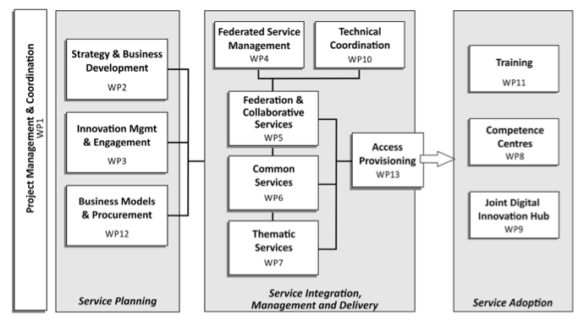
Work packages

Slide 7
Service Providers 1/2
e-Infra
EGI Federation
EUDAT CDI
Humanities
Language and literature (CLARIN)
Arts (DARIAH)
Engineering
Environmental engineering (sea vessels, LNEC)
Civil Engineering (Disaster Mitigation)
Medical and Health Sciences
Biological Sciences (ELIXIR)
Structural biology (WeNMR)

Slide 8
Service Providers 2/2
Natural Sciences
Physical Sciences
Earth Science
Astronomy (LOFAR)
Fusion (ITER)
High Energy Physics (CMS and VIRGO)
Space Science (EISCAT-3D)
EO Pillar
GEO
Climate Research (ENES)
Seismology (ORFEUS, EPOS)
Biological Sciences
Marine and freshwater biology (IFREMER)
Biodiversity conservation (LifeWatch)
Ecology (ICOS)

Slide 9
Events - 2018
EOSC-hub week, Spring 2018 (April or May)
Internal project meetings with co-located public events and sessions
Support to Digital Infrastructures 4 Research 2018
Conference-style event with call for participation, for promotion of project activities and results

Slide 10
WP8 - Tasks and leaders
Task nb., title | Task leader | Deputy/technical leader | Represented Research infrastructure
WP8.1 ELIXIR / EMBL-EBI | Steven Newhouse | Susheel Varma | ELIXIR
WP8.2 Fusion / CCFE | Shaun de Witt |  | ITER
WP8.3 Marine / IFREMER | Thierry Carval |  | Euro-Argo, SeaDataNet
WP8.4 EISCAT_3D / EISCAT | Ingemar Häggström | Carl-Fredrik Enell | EISCAT_3D
WP8.5 EPOS-ORFEUS / KNMI | Luca Trani | Javier Quinteros | EPOS
WP8.6 Radio astronomy / ASTRON (SurfSARA) | Hanno Holties | Rob van der Meer | LOFAR, SKA
WP8.7 ICOS / University of Uppsala | Alex Vermeulen |  | ICOS, eLTER
WP8.8 Disaster Mitigation Plus / Academia Sinica | Eric Yen | Simon Lin

Slide 11
CC overview (WP8+WP11+WP13)
WP8 supports the design, integration and dissemination of new, community-specific e-Infrastructure service platforms. […] Activities are complemented by WP11 to deliver training to research communities and related relevant data providers and data scientists and by WP13 to deliver Thematic Services under Virtual Access.
Objectives
Running proofs of concept to test the feasibility of use cases, based on specific scientific and technical requirements defined by high impact research communities.
Conducting pilots to define and test the architecture of solutions.
Preparing the production environments to make platforms available to users beyond the CC.
Defining business models to sustain the solutions within EOSC after the end of the project.
Members
EGI Foundation, CSC, ACK Cyfronet, ASTRON, CCFE (UKAEA), CEA, CESNET, CINECA, CNRS, EAA , EISCAT, EMBL, GFZ, GRNET, IFREMER, INGV, JUELICH, KIT, LUND, MARIS, MU, NOA, PSNC, SNIC (UU), STFC, SURFsara (ASTRON), ULG, AS (ASGC)

Slide 12
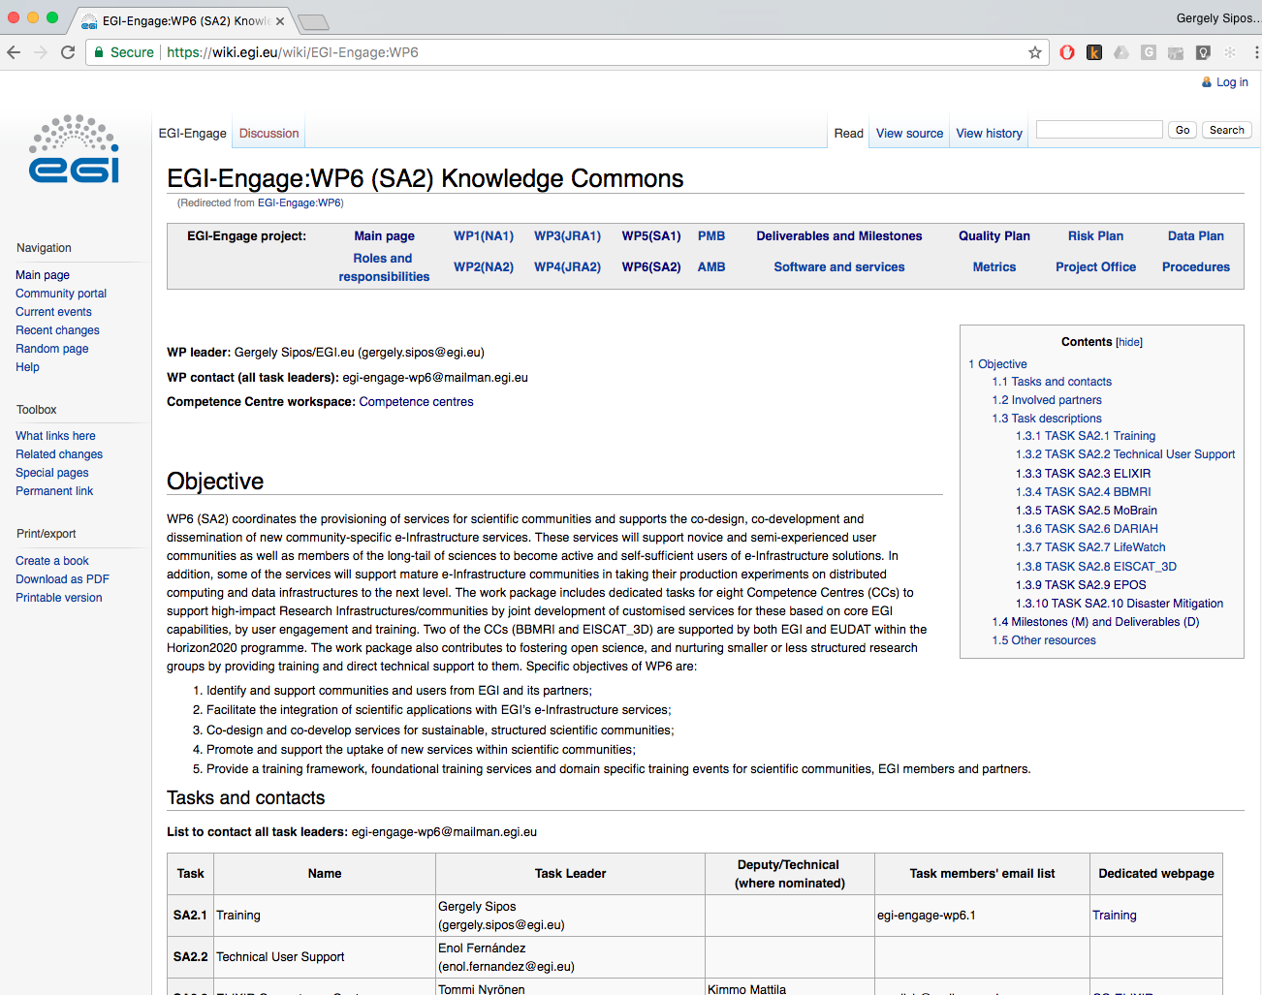
A bit of history: CCs in EGI-Engage WP6 (2014-2017)
ELIXIR
BBMRI
MoBrain
DARIAH
LifeWatch
EISCAT_3D
EPOS
Disaster Mitigation

Slide 13
Competence Centres in EOSC-hub
EOSC hub
A federated integration and management system for EOSC
Service catalogue: https://wiki.eosc-hub.eu/display/EOSC/Service+catalogue
Thematic services
Common services
Data analytics & Community-specific Services
WP5
WP6
WP5
WP7
Federation Services
AAI, Accounting, Monitoring, Operations, Security
Added value services
Compute, data, software management, curation & preservation
Open Collaboration Services
Application/software repository, Configuration management, Marketplace
integration
WP6
Basic infrastructure
Compute and storage
integration
WP10: Tech. support, Service roadmaps
WP11: Training
WP13: Virtual Access
incubate
Competence Centres
Competence Centres
WHO:
Research community experts
Service providers
Technology providers
WHAT:
Run proof-of-concepts and pilots
Service co-creation
Bring new services into the catalogue
Dissemination and training
WP7, WP11, WP13

Slide 14
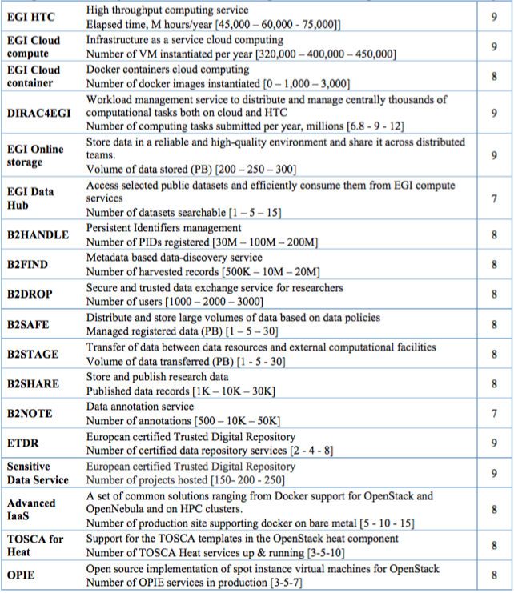
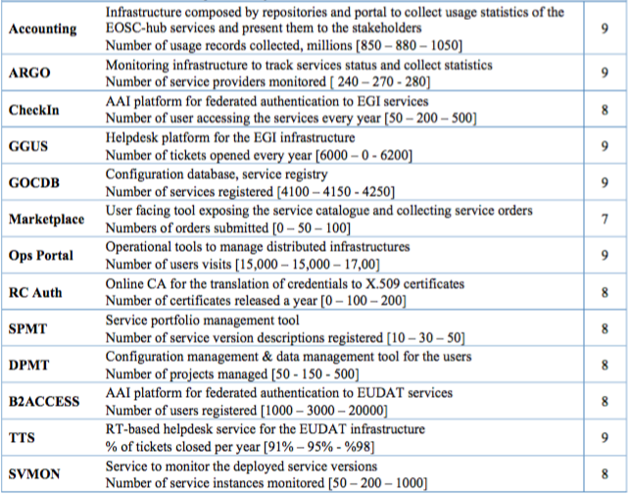
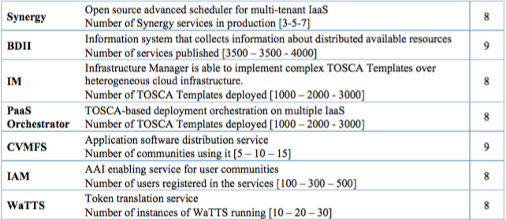
Basic infrastructure and Added value services:
WP6
WP5
Open Collaboration services:
integration
integration
Competence Centres
integration
Federation services:
WP5

Slide 15
EOSC-hub OpenAIRE-Advance collaboration
Both in EINFRA-12 (topic A and B)
OpenAIRE-Advance kickoff this week
Let’s support Open Science together!
Joint workplan plan
Technical integration – Based on driver use cases
Dissemination, support, training
Governance
Early adopter communities: DARIAH, ELIXIR, EPOS
EPOS contact: Michele Manuta (CNR, Italy)
What can the CC do with Michele’s team?

Slide 16
EC Milestones and deliverables
Nb. | Title | Description | Lead beneficiary | Type | Due date
M35 | Technology assessment, architecture integration & validation plan for CCs |  | EGI Foundation | Report | PM13 (Feb 2019)
M36 | Online platforms from Competence Centres are available |  | EGI Foundation | Other | PM18 (Aug 2019)
D8.1 | Report on progress, achievements and plans of the Competence Centres | Status report about the prototypes, pilots and production services that were setup by the Competence Centres, together with their further development plans to EOSC services. | EGI Foundation | Report | PM18 (Aug 2019)
D8.2 | Final report on Competence Centre key results and exploitation status and plans | Final report about the achievements of the Competence Centres, and plans for evolving, operating and exploiting the CC prototypes/pilots/services beyond the project. | EGI Foundation | Report | PM36 (Dec 2020)

Slide 17
Collaborative tools, Useful links (as of today)
http://go.egi.eu/EOSC-hub-doa → Description of Action
http://go.egi.eu/EOSC-hub-budget → Budget
http://wiki.eosc-hub.eu → Confluence
https://wiki.eosc-hub.eu/display/EOSC/WP8+Competance+Centres
Indico → Meeting agendas and materials:
https://indico.egi.eu/indico/category/211/ → WP8 or task meetings
Mailing lists (in preparation):
WP8 mailing lists to be setup → Task leaders and deputies
Task email lists to be setup
Google drive shared folder (in preparation)
Some tools are provisional offered under the EGI.eu domain
Switch to the EOSC-hub domain foreseen in January
Teleconference tool (Gotomeeting): To be setup

Slide 18
Next steps
Regular CC teleconferences
Monthly ?! → To be arranged by CC coordinator
CC detailed activity plan for the first year
Enter activities into this table: https://docs.google.com/spreadsheets/d/1COZzwEArRexybn1zXx9D14vXNKWqAlH7mnWEWMuIZ0M/edit#gid=1736025157

Slide 19
Summary
EOSC-hub will
Create and providing the Hub as federated integration and management system for the future EOSC
Implement the Hub as open community-lead framework
Provide a wide range of services from many major digital infrastructures and research communities
Competence Centers contribute as incubators of thematic services
Launch & capturing detailed activity plan

