Slide 1
Requirements Gathering
Nuno L. Ferreira, Steve Brewer, UCST
EGI.eu UCST
@
TCB 20110228

Slide 2
Outline
Requirements gathering process
Requirements tracking
Update on prioritised themes
How to use the RT system:
Submitting
Investigating
What happens next?

Slide 3
The process
UCST
UCST with NGIs and VRCs
USAG, OTAG
HUCs
1) 2) 3)
EIROs
VRCs
EEF
Input Channels for User requirements
EGI Request Tracker
TCB
External technology providers
UCB
4) 5)
VOs
NGIs
Input Channels for Operation requirements
ESFRIs
1) Normalisation, categorisation, filtering bugs
2) Resolve requirements
3) Discuss work-plans of InSPIRE tools
4) Unresolved requirements; work-plans
5) Endorsed and weighted categorised requirements
MS305 – User feedback and recommendations

Slide 4
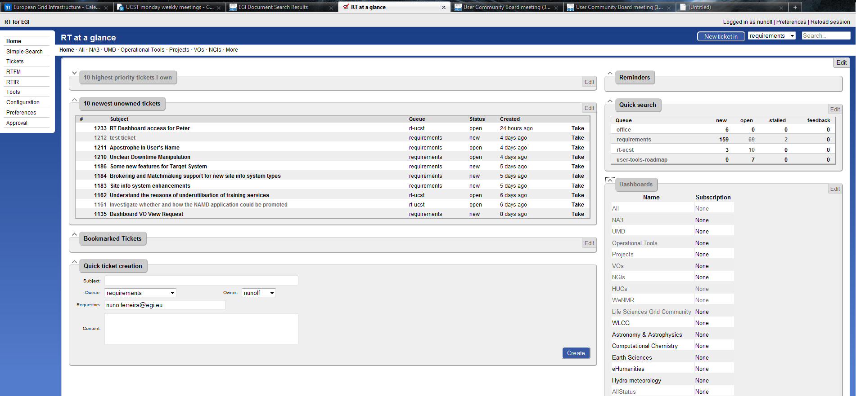
Request Tracker
http://rt.egi.eu
Notes:
EGI SSO account

Slide 5
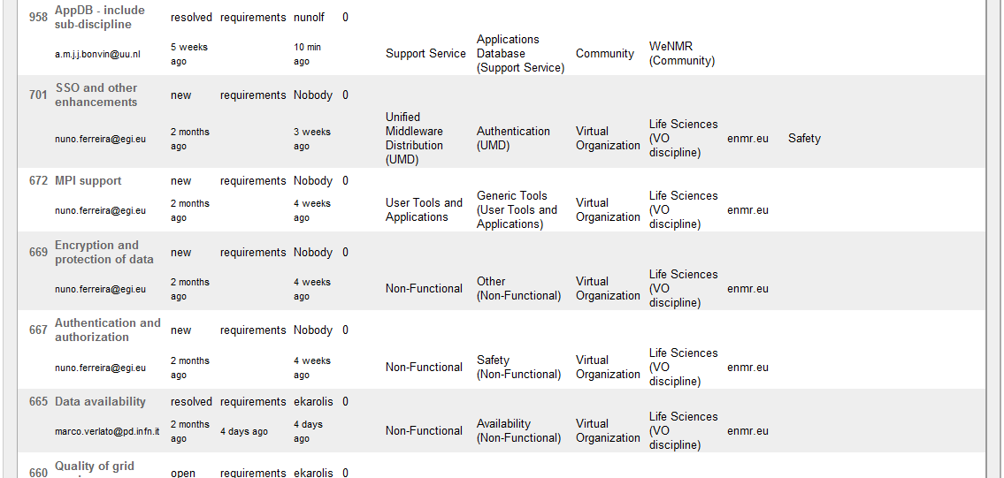
Dashboard example

Slide 6
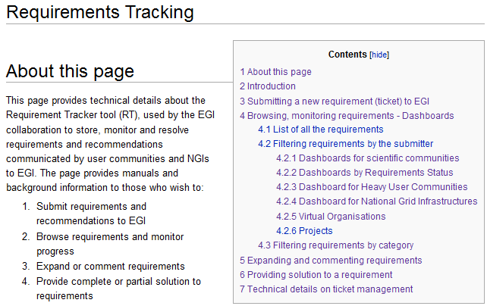
RT manual
http://go.egi.eu/wrt

Slide 7
Prioritised MW requirements
High priority requirements identified by 1st UCB meeting:
Increased stability and scalability for gLite WMS
Better (more verbose and informative) error messages
Fixing the known bugs before adding new features
Coherency of command line commands, parameters and APIs
Better feedback about jobs, automated resubmission of jobs that are stuck on sites
MS305
UCB
TCB
EMI
From 2nd UCB meeting:
Data management
Easier login
http://go.egi.eu/267
Notes:
The requirements collected by NA3 from the EGI User Community and other sources are captured in
MS305. This document provides an analysis of these requirements by categorising them with respect
to the EGI Capabilities described in the UMD Roadmap and includes prioritisation information from
the recent UCB meeting on 30th November 2010. This information will be used to inform the
middleware prioritisation discussions with the Technology Providers that will take place at the TCB
on 6th December 2010.

Slide 8
Weekly stats - tickets
UCST are now tracking statistics about many aspects of the requirements capturing process. Apart from a blip over Christmas, these are ramping up. However, the high level priorities remain constant.

Slide 9
Drill in
MS305
UCB
TCB
EMI
HUCs
EIROs
VRCs
EEF
UCST
VOs
NGIs
ESFRIs
Use Case
Configuration
Expectation
Impact
http://go.egi.eu/wrkt

Slide 10
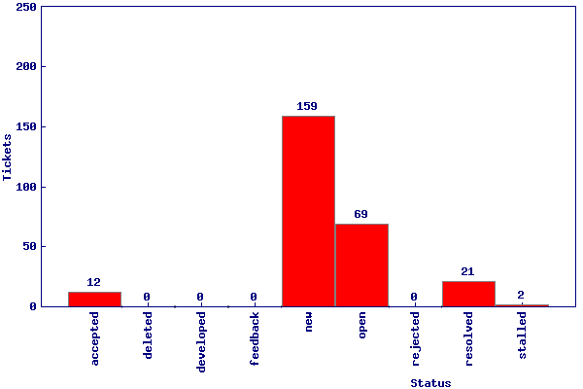
Current status
Requirements queue:
User Com’ty.: 178
Operation Com’ty.: 85
Total: 263

Slide 11
A requirement
These parts must be clear and detailed
Use Case (based on experienced issue)
Configuration, Environment (where issue was experienced)
Expectation (what is expected)
Impact for user community (the impact of solved requirement)

Slide 12
Providing solution
Consistency check
Responsible allocated
Completeness check
Providing in-house solution
Involve external solution providers
Validation
Notes:
Consistency check
Allocation to responsible person/group
Completeness check
Providing solution from the EGI-InSPIRE project
Involving external solution providers
Closing the ticket
Validating the solution

Slide 13
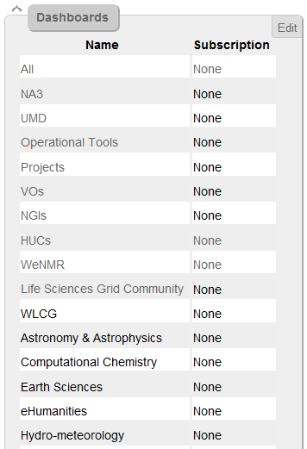
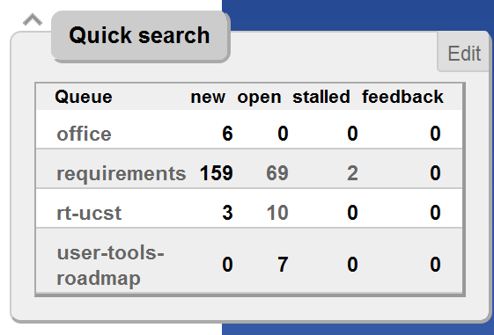
Some RT features
Notes:
EGI SSO account

Slide 14
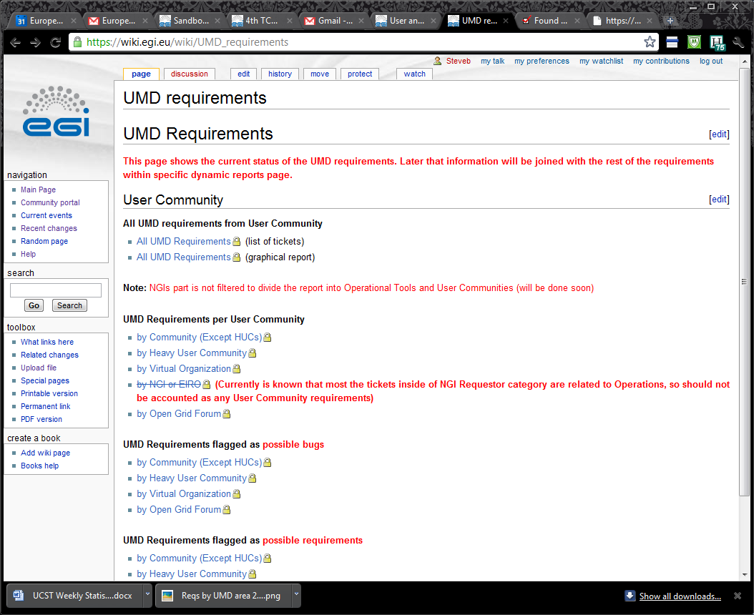
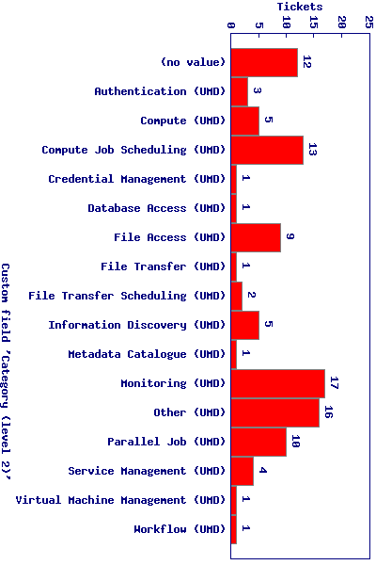
UMD related tickets (summary)
https://wiki.egi.eu/wiki/UMD_requirements

Slide 15
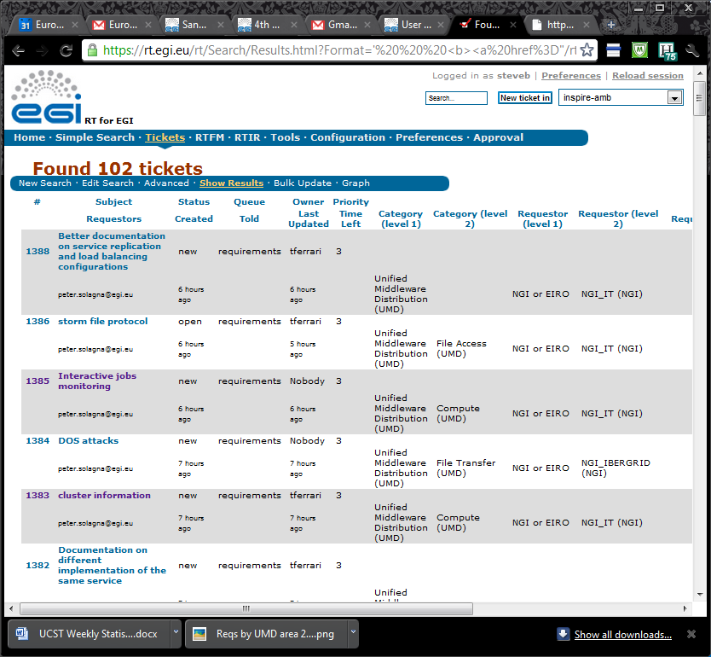
UMD related tickets (detail)
Further detailed commentary available within tickets.
Soon container tickets will track the overall investigation summary.

Slide 16
What happens next?
UCST can create more dashboards
UCST can create more wiki/web pages with queries embedded (RSS feeds)
UCST will create container tickets for Priority topics to group tickets and associate investigation results
UCST will continue to investigate and identify:
Existing solutions to priority topics;
Best practice around priority topics (eg. WMS);
Key developers who want to exploit the technology.

