Slide 1
EGI User Communities Requirements for Technology Providers
Steve Brewer, UCST
EGI.eu UCST
@
TCB 20110228

Slide 2
Outline
Where to find information
Where to find queues
Update on prioritised themes
What happens next?

Slide 3
Prioritised MW requirements
High priority requirements identified by 1st UCB meeting:
Increased stability and scalability for gLite WMS
Better (more verbose and informative) error messages
Fixing the known bugs before adding new features
Coherency of command line commands, parameters and APIs
Better feedback about jobs, automated resubmission of jobs that are stuck on sites
MS305
UCB
TCB
EMI
From 2nd UCB meeting:
Data management
Easier login
http://go.egi.eu/267
Notes:
The requirements collected by NA3 from the EGI User Community and other sources are captured in
MS305. This document provides an analysis of these requirements by categorising them with respect
to the EGI Capabilities described in the UMD Roadmap and includes prioritisation information from
the recent UCB meeting on 30th November 2010. This information will be used to inform the
middleware prioritisation discussions with the Technology Providers that will take place at the TCB
on 6th December 2010.

Slide 4
UCB 5 key topics (I)
Increased stability and scalability for gLite WMS
# Requirements: 7
High-Energy Physics (VOs: calice, cdf, hone, ilc)
Astronomy, Astrophysics and Astro-Particle Physics (VO: lofar)
Life Sciences (VO: lsgrid)
Fusion (VO: fusion)
Better (more verbose and informative) error messages
# Requirements: 6
High-Energy Physics (VOs: ilc)
Astronomy, Astrophysics and Astro-Particle Physic (VO: lofar)
Life Sciences (VO: lsgrid, vlemed)
Life Sciences Grid Community
NGI_IL
Fixing the known bugs before adding new features
# Requirements: 1
Other (VO: desktopgrid.vo.edges-grid.eu)

Slide 5
UCB 5 key topics (II)
Coherency of command line commands, parameters and APIs
# Requirements: 4
High-Energy Physics (VO: pheno)
Life Sciences (VO: vlemed, enmr.eu)
Life Sciences Grid Community
Better feedback about jobs, automated resubmission of jobs that are stuck on sites
# Requirements: 5
Astronomy, Astrophysics and Astro-Particle Physics (VO: lofar)
High-Energy Physics (VO: cdf)
Life Sciences (VO: enmr.eu)
Fusion (VO: fusion)
HealthGrid project

Slide 6
Increased stability and scalability for gLite WMS
We have investigated this issue and contacted those who originally raised the issue.
To date, we have had limited significant feedback
We will now target specific developers

Slide 7
Better (more verbose and informative) error messages
Error messages: Best of
1.) 'Unhandable situation' - glite-wms_R_1_5_45 (logmonitor)
12 Apr, 10:20:44 -F- EventPostTerminated::process_event(): Unhandable situation, aborting the daemon.
2.) 'Cannot failed' - glite-wms 3.0.2 - RC2 (/var/log/messages)
Jun 25 04:51:18 lxb2032 glite-wms-ns: Cannot failed
3.) 'Failure: ping successful' - globus-gatekeeper (/var/log/messages)
Failure: ping successful Notice: 5: Authorized as local user: dteam022
4.) 'CGSI-gSOAP: Error reading token data: Success‘
Error reading token data: Success
5.) ETICS build: Execution Summary
Execution Summary Result: Failed Success rate: 100% (1/1)
https://twiki.cern.ch/twiki/bin/view/LCG/BestErrorMessages

Slide 8
Fixing the known bugs before adding new features
There is still support for this requirement

Slide 9
Coherency of command line commands, parameters and APIs
Further investigations have been conducted to no avail
We will continue to pursue this and target the developers of applications and portals
Better documentation may be the answer
Technology providers should ensure that all of their documentation is up to date and in place – do let us know.
Portals, gateways and other applications may improve the user experience

Slide 10
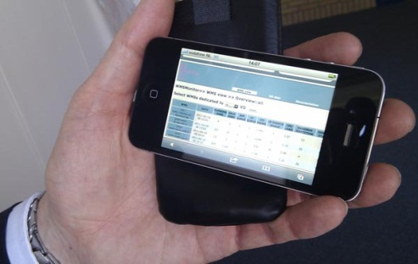
Better feedback about jobs, automated resubmission of jobs that are stuck on sites
The WeNMR VRC will be able to provide some very specific scenarios of how monitoring tools should capture full data about all jobs (from anywhere.)
Data should not be lost when jobs fail. More information is needed about where jobs were run etc. to aid with the diagnostics if they do fail. However, ideally they should automatically run again until the task is complete.

Slide 11
New topics
At the most recent UCB meeting the following two topics were added:
Data management
Login simplification
We don’t have specific data yet but these do relate to existing known themes…keep checking the wiki/RT

Slide 12
What happens next?
UCST can create more dashboards if TCB require?
UCST can create more wiki/web pages with queries embedded (RSS feeds) if TCB require?
UCST will create container tickets for Priority topics to group tickets and associate investigation results
UCST will continue to investigate and identify:
Existing solutions to priority topics;
Best practice around priority topics (eg. WMS);
Key developers who want to exploit the technology.

