Slide 1
EGI Engagement & NILs meeting
16 Feb 2018

Slide 2
Agenda
Indico Agenda: https://indico.egi.eu/indico/event/3618/

Slide 3
The EOSC-hub Project
EOSC-hub mobilises providers from 20 major digital infrastructures, EGI*, EUDAT CDI** and INDIGO-DataCloud jointly offering services, software and data for advanced data-driven research and innovation.
* EGI is not an acronym (any more)
** CDI – Collaborative Data Infrastructure

Slide 4
Project figures
100 Partners, 76 beneficiaries (75 funded)
3874 PMs, 108 FTEs, more than 150 technical and scientific staff involved
€33,331,18 of which the European Commission funds €30,000,000
36 months: Jan 2018 – Dec 2020 (2x18 month reporting period)

Slide 5
The EOSC-hub mission
The project will create EOSC hub:
a federated integration and management system for EOSC
Services
Processes and policies
Federated operations
Federation services
Data
Applications & tools
Baseline services (storage, compute, connectivity)…
Marketplace
AAI
Accounting
Monitoring
…
Security regulations,
Compliance to standards,
Terms of use,
FAIR implementation guidelines
…
Lightweight certification of providers
SLA negotiation
Customer Relationship Management
…

Slide 6
What does the Hub provide ?
Community-defined corpus of policies for service providers and users
Compliance to standards, security regulations, terms of use, FAIR implementation guidelines
Processes for federated service management
Lightweight certification of providers
Quality assurance reviews
Define/maintain/review service level agreements
Manage end-to-end service level management performance retaining overall accountability
Federated authentication and authorization, accounting
Procurement framework
Catalogue of services (from multiple providers)
Competence centres and technical support to integrate services into the catalogue
Joint Digital Innovation Hub

Slide 7
EOSC-hub objectives
O1 Simplify access to a broad portfolio of products, resources and service provided by major pan-European and international organisations through an open and integrated service catalogue
O2 Remove fragmentation of service provisioning and access to high-quality digital services in Europe and beyond through the technical integration and adoption of standards for interoperability of compute, storage, data and software platforms

Slide 8
EOSC-hub Objectives (cont.)
O3 Consolidate e-Infrastructures by expanding capacity and capabilities and improving service quality
O4 Widen the access to services to all user groups including researchers, high-education, business organisations and expand the user base
O5 Provide a knowledge hub
O6 Increase innovation capacity of Research e-Infrastructures → Joint Digital Innovation Hub

Slide 9
Services Catalogue
Federation Services
Baseline services
Collaborative Services
Community-specific services

Slide 10
Phased Approach
Integrate production-ready services
Operate and Provide
Access and Consume

Slide 11
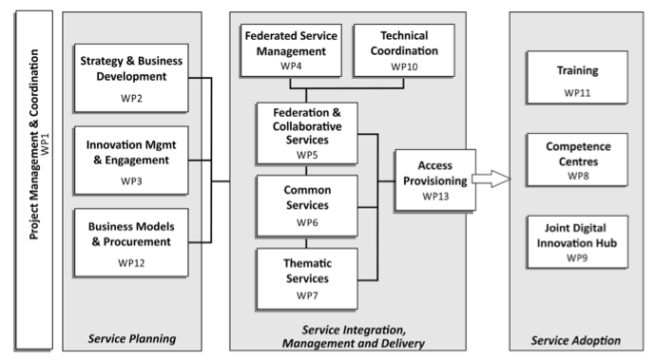
EOSC-hub Work Packages

Slide 12
EOSC – Service Architecture
Community Support services
Thematic
Service
Thematic
Service
Thematic
Service
Thematic
Service
Thematic
Service
Thematic
Service
Federation Services
AAI,
Accounting,
Monitoring,
Operations, Security Coord.
Added Value Services
Orchestration of Compute, Data, Software
Curation and Preservation
Open
Collaboration
Platforms
Application Repository,
Configuration Management,
Marketplace
Baseline services
Compute and Storage
Common services

Slide 13
Thematic service providers and CCs
Thematic service providers (7)
CMS, astronomy/astro-particle physics
Climate change/ENES
GEO/Global Earth Observation System of Systems
Costal protection/LNEC
Structural biology/WeNMR
Earth Observation core data resources/ESA, Copernicus sentinel data, LANDSAT and other major EO data archives
Biodiversity / Lifewatch
Competence Centres (8)
Marine research/Euro-Argo
LOFAR
EuroFusion/ITER
EPOS/EIDA seismic data and computational seismology services
EISCAT-3D
ELIXIR/BBMRI/ECRIN
DARIAH
ICOS
13

Slide 14
Summary
EOSC-hub will:
Create and providing the Hub as federated integration and management system for the future EOSC
Implement the Hub as open community-lead framework
Provide a wide range of services from many major digital infrastructures and research communities

Slide 15
Role of NILs in the new landscape

Slide 16
A bit of background
The ‘Engagement activity’ in EGI is responsible for identifying and reaching potential new customers and support them in the uptake of EGI services
The NGI International Liaisons (NILs) are key enablers in the development and implementation of the EGI Engagement strategy.
During the last 2.5 years EGI engaged with RIs, international research collaborations (H2020 projects), SME/industry and NGIs

Slide 17
Action plan for the next period
EOSCpilot and EOSC-hub projects introduce new challenges in running the engagement activities
>> New roles and priorities for NILs <<
1.) Not all the NGIs are represented in these projects
2.) EGI.eu is keen to keep them updated on regular basis about EOSCpilot and EOSC-hub projects

Slide 18
EGI Engagement in EOSC-hub
WP3 (T3.2) – Stakeholder Engagement: Identify stakeholders and engage them into the EOSC-hub ecosystem (EGI.eu, CINECA and CSIC)
WP4 (T4.2) – Customer Relationship Management: Handle requests from customers and communities submitted via the EOSC-hub marketplace
WP7 Thematic services: Operating community-specific services together with the communities. These services will help EGI to reach ‘end users’
WP8 Competence Centre: Prototyping, piloting community-specific applications and tools on top of EGI/EUDAT infrastructures.

Slide 19
EGI Engagement in EOSC-hub (cont.)
WP9 Joint Digital Innovation Hub: Work with 6 business pilots and SMEs to setup technical collaboration, share business plans and facilitate market uptake
WP10 Technical coordination: Provide technical support to new communities for the update of EOSC-hub services and analyses new requirements
WP11 Training: Operated a training framework to maintain and develop training events

Slide 20
EGI Engagement in EOSCpilot
EOSCpilot (2017-2018) supports the first phase of EOSC
15 Science Demonstrators selected from different scientific domains
EOSC-hub (T3.2) is tasked to evolve the EOSCpilot demonstrators into Thematic Services
EGI will update not involved NILs on a regular basis about the status of these pilots

Slide 21
Research Infrastructures (RIs)
18 RIs will be supported in EOSC-hub
RIs are expected to create cluster projects and bid in the INFRAEOSC-04-2018 call
The EGI community should be involved as partners in each cluster project
Already established links Environment Sciences, Astrophysics Laser, Neutron and Photon Physics and Life Sciences communities

Slide 22
SMEs and industry
WP9 will continue the engagement in EOSC-hub
Identify the services to target SMs and industry
Define access fees

Slide 23
Collaboration with OpenAIRE-Advance and the National Open Access Desks (NOADs)

Slide 24
The OpenAIRE-Advance project
Both in EINFRA-12 (topic A and B)
Let’s support Open Science together!
Joint workplan plan
Technical integration – Based on driver use cases
Dissemination, support, training
Governance
Early adopter communities: DARIAH, ELIXIR, EPOS

Slide 25
Motivation (Slide from Natalia Manola)
How, what, when, where?
Open Peer Review?
How to enhance Impact?
Research idea
Research Object = Workflow+
Data+
Provenance+
Publication
0
Monitor & report impact
Publish + Share
8
OpenAIRE
Post Analysis
Who works on similar topics?
Who can I collaborate with?
7
Extract more knowledge
Plan (DMP)
What data created? How shared with colleagues? What policies for use and re-use?
Data
DMP templates, examples, training
1
Select Results
Find Re-usable Datasets and
Services
Online in EOSC-hub (from e- and Research infras.)
6
2
How described? Where stored? Temporary? How made accessible? What policies? How preserved?
Tools used? Big data? Software?
Create Workflow
Where to run? What facilities? How to prepare and transfer?
Prepare data for analysis
Process + Analyze
Established data? Services? Protocols?
5
3
4
Curation
Co-located compute&storage
Portals, Applications, …

Slide 26
Integrated services
How, what, when, where?
Open Peer Review?
How to enhance Impact?
Research idea
OpenAIRE-Advance (OAA)
Research Object = Workflow+
Data+
Provenance+
Publication
0
Monitor & report impact
Report impact
Publish + Share
8
Register research objects
OpenAIRE
OAA & EOSC-hub
Post Analysis
EOSC-hub
Who works on similar topics?
Who can I collaborate with?
7
Extract more knowledge
OAA & EOSC-hub
Plan (DMP)
What data created? How shared with colleagues? What policies for use and re-use?
Data
DMP templates, examples, training
1
Import research objects
Select Results
Find Re-usable Datasets and
Services
Online in EOSC-hub (from e- and Research infras.)
6
2
How described? Where stored? Temporary? How made accessible? What policies? How preserved?
Tools used? Big data? Software?
Create Workflow
Where to run? What facilities? How to prepare and transfer?
Prepare data for analysis
Process + Analyze
Established data? Services? Protocols?
5
3
4
Curation
Co-located compute&storage
Portals, Applications, …

Slide 27
Collaboration Agreement – Areas of joint work
Communication, Engagement, Support and Training
Support early adopter communities (DARIAH, ELIXIR, EPOS)
Reach out to and support researchers
NOAD–NIL workshops → Organise these together
We will facilitate this and organise ‘train the trainer’ events for NILs and NOADs
Start with a webinar → Doodle to come about last week of March
Harmonised, aligned communication
Service Integration
Staging research objects from OpenAIRE to EOSC-hub (input)
Registering new research objects from EOSC-hub to OpenAIRE (results)
Gather research impact data about EOSC-hub research objects
Governance
Looking forward into EOSC

Slide 28
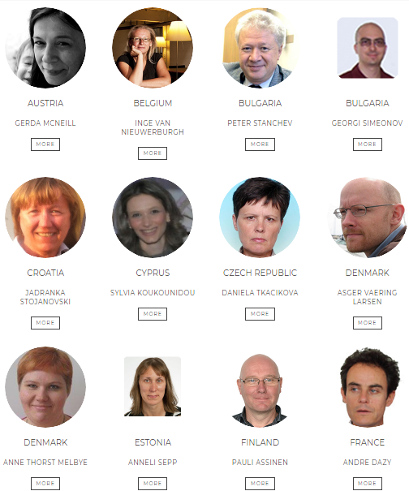
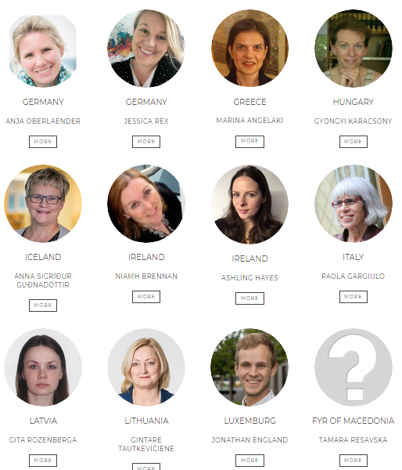
NOADs – https://www.openaire.eu/contact-noads

Slide 29
Upcoming events

Slide 30
Events 2018
RDA 11th Plenary Programme, 21-23 March 2018, Berlin
EOSC-hub week, 16-20 April 2018, Malaga
Internal project meetings with co-located public events and sessions
Support to Digital Infrastructures 4 Research 2018
Conference-style event with call for participation, for promotion of project activities and results

Slide 31
Thank you
for your attention!
Questions?

