Slide 1
EOSC-hub Task 4.1 EGI Operations - Boards and Policies
Matthew Viljoen
matthew.viljoen@egi.eu
EGI Operations Team
14 February 2018

Slide 2
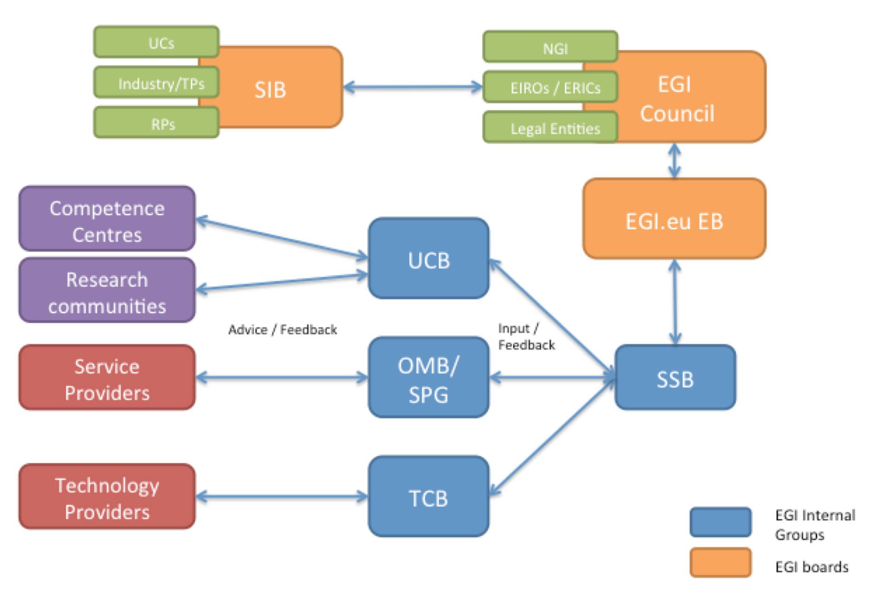
EGI Foundation Governance
Notes:
Diagram showing loose interactions between entities
Council – defines strategic direction of EGI federation – participants are members of the foundation
(SIB – strategy & innovatoin board) - ext. board providing strategic advice & guidance to Council wrt. srv provision, relationship with other eInfras etc.)
Exec Board (EB) – manages the foundation
Srvs & Solns Board (SSB) - manages portfolio of srvs/solns - planned, active and retired. Gets input from:
User & Community Board (UCB) in contact with user communities & gets feedback over their needs
Ops Mgmnt Board (OMB) develops strategy & tech. priorities regarding DEPLOYMENT & OPS of prod. infrastructure
Security Policy Board (SPB) develops policy req. for a safe, secure & trustworthy dist. comp. infra.
and..
Technical Coordination Boards (TCB) – Data, Cloud, AAI – provides focus for technologies – drives roadmaps and coordinating technology evolution

Slide 3
Operations Management Board
EGI
Council
Advisory body aimed at:
Developing strategy, technical priorities
Overseeing status of overall EGI/NGI operations services
Overseeing development of:
policies
procedures
via approval of NGI ops managers*
Requirements collection from RPs
Developing evolution in operations
EGI.eu
EB
SSB
Service/Resource Providers
OMB
Policies
Procedures
Operations evolution
* however, policies may additionally require approval from the EB

Slide 4
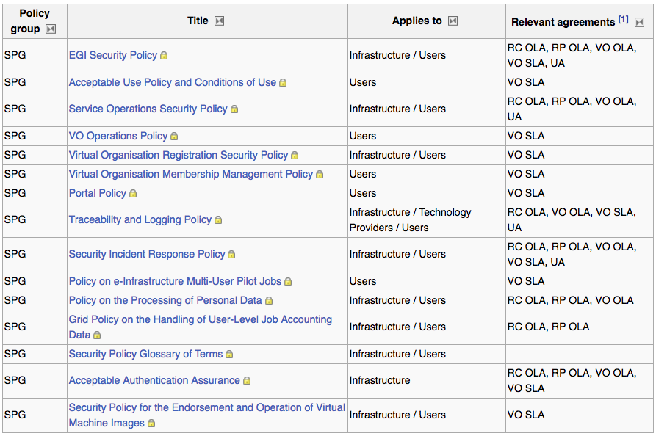
Policies
https://wiki.egi.eu/wiki/Policies_and_Procedures

Slide 5
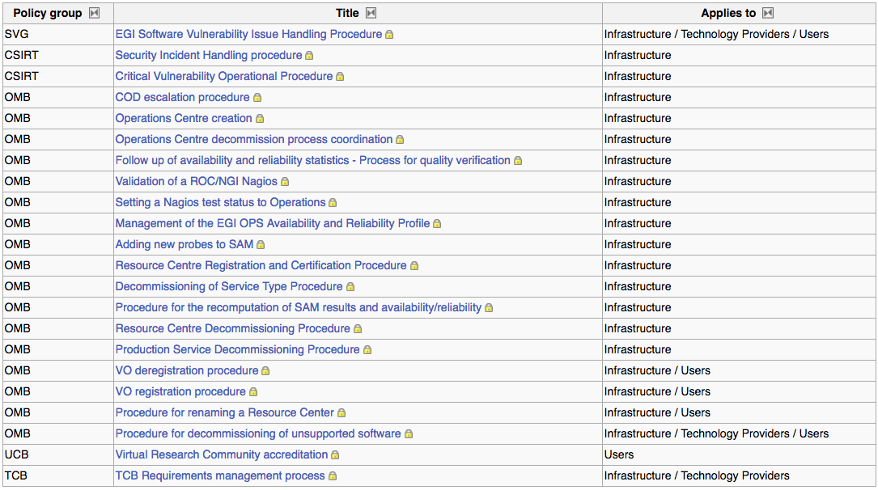
Procedures
https://wiki.egi.eu/wiki/Policies_and_Procedures

