Slide 1
EUDAT CDI
Operational Environment
Slides shown at the EOSC-hub T4.1 meeting on 8 Feb 2018
Johannes Reetz, MPCDF
CDI Operations Coordinator

Slide 2
The CDI – A Service Infrastructure & Network
Notes:
EUDAT is 2 things:
1) A set of data services to store, share, publish and process data
2) A Collaborative infrastsructure which is open to generic and thematic service providers

Slide 3

EUDAT CDI Agreement
Objective: Sustain the EUDAT Collaborative Data Infrastructure (CDI) beyond project-based agreements
How? by formalising Partnership between service providers which:
    is based on common service management guidelines
    ensures clear long-term commitments from service and resource providers (currently for 10 years)
    run a coordinating secretariat paid through membership fees
  Who? Generic (cross-disciplinary) & Thematic (discipline-oriented) service providers
  Two levels of engagement:
  Interoperable (level 2) and Integrated (level 1) nodes

Slide 4
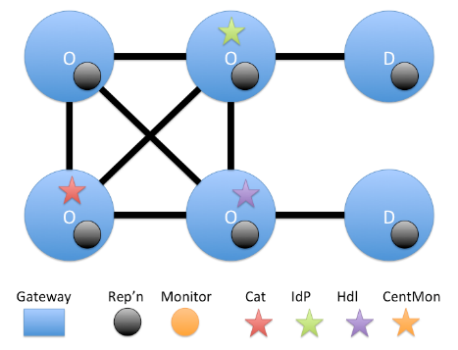

Interoperable nodes
a) Interoperable – “the CDI Web”
  Service Providers are connected to the CDI using a CDI compliant approach for data access and discoverability.
  Interoperable nodes:
    must have a data repository in which they preserve or curate data from a single research community or host data from several research communities or experiments (storage and access services).
    must identify the data hosted in the repository via some form of persistent identifier (persistent identification),
    and it must be possible to harvest and discover the associated metadata through EUDAT’s B2FIND service (metadata).
  Benefits:
    Better discoverability of data hosted at the site
    Interoperability with other service providers through CDI compliant repository
    Possibility to deploy and run EUDAT services and tools for local customers with support from central staff

Slide 5
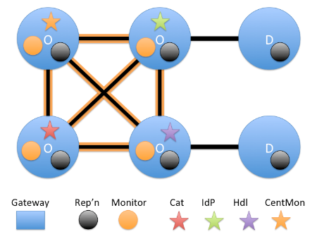
Integrated nodes
b) Integrated – “the CDI Cloud” (includes a)
  Service providers are integrated; there is a single service desk, and this part of the CDI infrastructure is monitored – and in part managed – centrally..
  Integrated nodes:
    are interoperable (as in a)
    provide a common data access layer
    integrate with a common authentication & authorization infrastructure (AAI)
    integrate their local data infrastructure with the CDI’s data management services
    connect their services to the common CDI service management infrastructure framework.
  Benefits: a) +
    Tighter integration with other service providers, offering seamless integration of resources to pan-European communities.

Slide 6
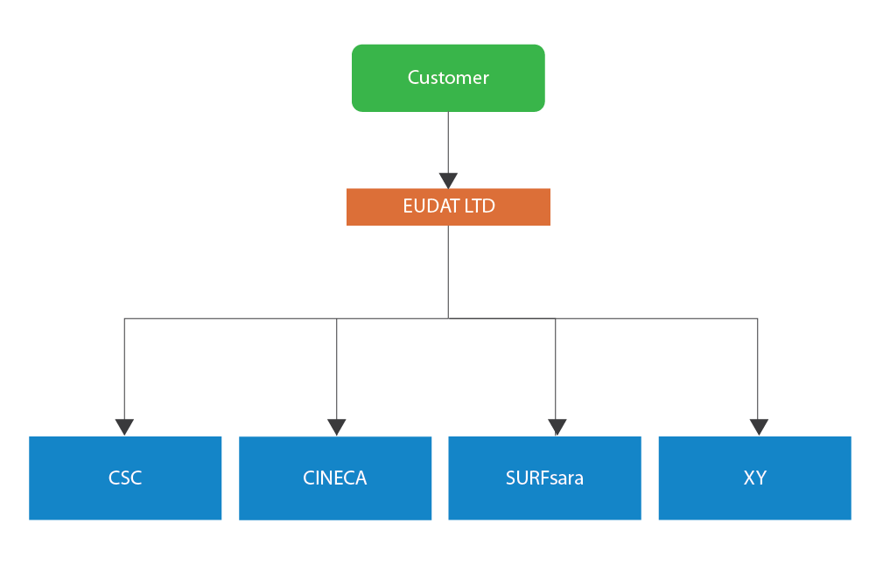
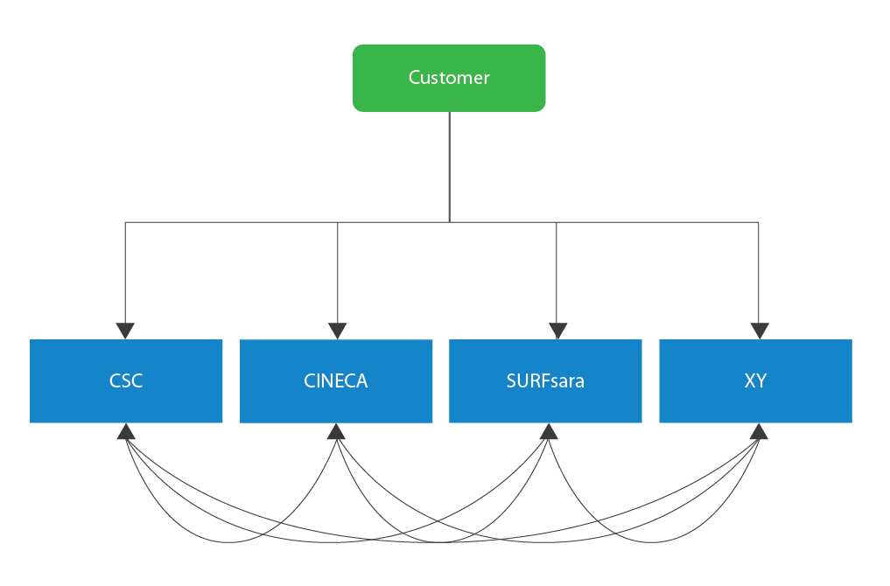
Multi-service provider Service Provisioning
Now
Near Future

Slide 7
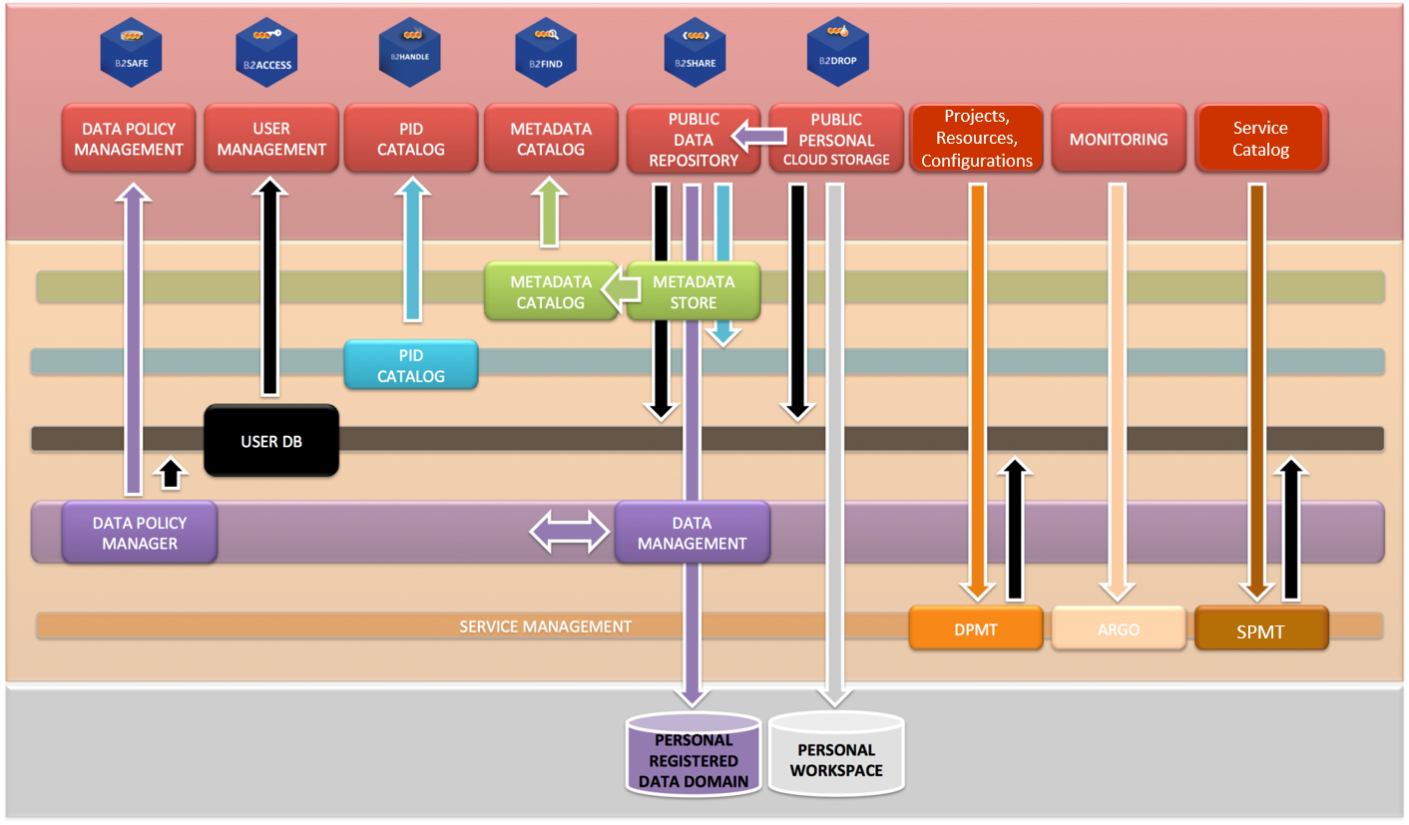
EUDAT CDI Architecture

Slide 8
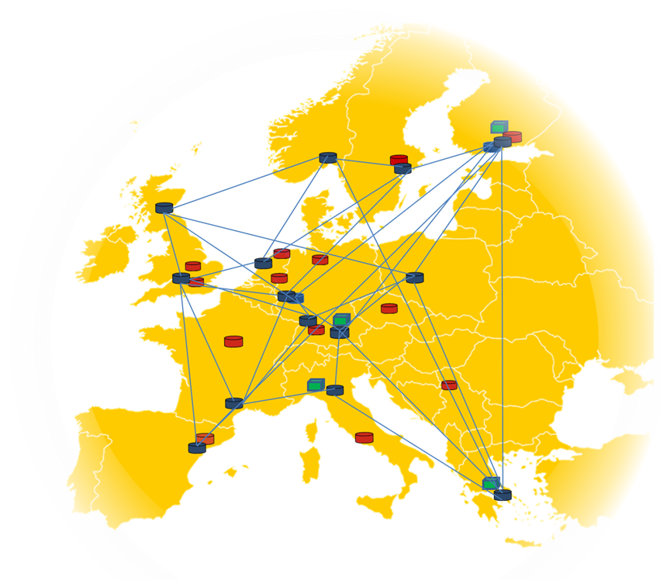


Operations within EUDAT CDI
1st level support: 1st level support team David Vicente, BSC
2nd level support: -> Providers‘ Helpdesk, -> Service Experts
3nd level support: Service Developers
Project Enabling
Service Enabling
Helpdesk & Support
Enabling Team
Giovanni Morelli, CINECA
EUDAT Security Officer
Security Team, CSIRT
Urpo Kaila, CSC
Security
Network, Configuration
Compute Resources
Service Hosting,
Service on Demand
Service Deployment
Wiki, JIRA, Gitlab, DPMT, SPMT, ARMT, ACCT, SVMON, PID, AAI
Operations Coordinator
Storage, Storage Services
Service and Resource Provisioning & Coordination
Operational Services
OPC Team, Service Provider, Suppliers
Pavel Weber, KIT
Notes:
14 general data centres of national or European importance which are involved and engaged in national and European projects (PRACE, EGI, WLCG, HBP) and various ESFRI collaborations.
the potential of extendable
- aggregated storage capacity beyond the order of 1000 PB
- network connectivity of 10Gb/s per centre
- large capacity and capability computing facilities (different platforms, technologies, vendors)
long experiences with storage and archive technologies
operational tools & policies known across different e-infrastructures
The centres (sites) provide Resources and Service Components within their administrative domain according to specified levels of quality.
The Operations Coordination with Security, Helpdesk and Data Project enabling Teams ensure a reliable service-oriented collaboration of all participating Service Providers.

Slide 9
Customer Facing EUDAT Service Catalog
Jan 2018
Service | Function | Version | TRL | Individual Researcher | Community Manager | Service Provider
Data Discovery
B2FIND | Multi-disciplinary joint MD catalogue | 2.3.2 | 9 | ✓ | ✓
Data Hosting, Registration & Management & Sharing
B2DROP | Cloud storage, sync & exchange | 12 | 9 | ✓ | ✓ | ✓
B2SAFE | Policy-driven data management | 4.1.0 | 9 |  | ✓ | ✓
B2SAFE-DMP | Data Policy Manager | 1.2.0 | 8 |  | ✓
B2SHARE | Repository for sharable digital objects | 2.1 | 9 | ✓ | ✓ | ✓
B2HANDLE | Policy-based prefix & PID management | 8.1 | 9 |  | ✓ | ✓
B2NOTE | Data Annotation | 1.0 | 8 | ✓ | ✓
TDR | Trusted Digital Repository |  |  |  | ✓ | ✓
SensitiveData | (third party) Sensitive Data Services |  |  | (✓) | ✓ | ✓
easyDMP | DMP service |  |  | (✓) | ✓
Data Access, Interface & Movement
B2ACCESS | Federated multi-protocol AAI | 1.9.6 | 8 | ✓ | ✓ | ✓
B2STAGE-GRIDFTP | Data staging service (GRIDFTP) | 1.9 | 8 | ✓ | ✓ | ✓
B2STAGE-HTTP | Data staging service | 1.0 | 8 | ✓ | ✓ | ✓

Slide 10
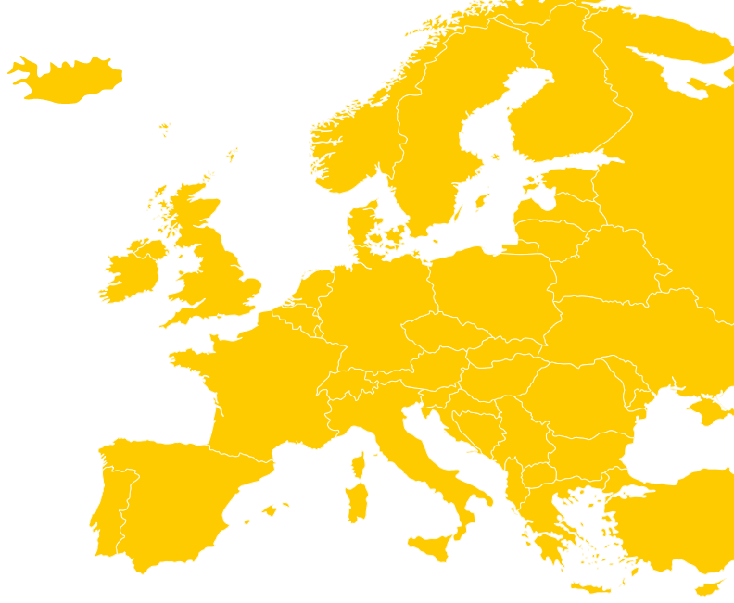









CDI Infrastructure (EUDAT2020)
Operational Services
Service Portfolio & Catalogue Management Tool
Project (Configuration) Management: DPMT
AAI
A&R Monitoring, Software Version Monitoring Accounting, Reporting
PID
providing PIDs
Helpdesk
Thematic Service Provider
Repository Provider
Generic Service Provider
(Archive, Large Storage System, HTC/HPC)
Vulnerability Scanning, CSIRT
Operational and Support services
Service Hosting
Framework
10
PID Service Provider

Slide 11
CDI catch-all and distributed B2-Services
Abbrev | Provider
B2ACCESS (AAI) | JUELICH
B2HANDLE (PID) | SURFsara, GRNET, DKRZ, MPCDF, BSC, PDC
B2SHARE | CSC
B2DROP | JUELICH
B2FIND | DKRZ
B2SAFE-DPM | SIGMA2
B2NOTE | BSC
B2SAFE/irods to be provided by all „Level 1“ Generic Service Providers
B2STAGE/gridftp to be provided by all „Level 1“ Generic Service Providers
B2STAGE/http to be provided by all „Level 1“ Generic Service Providers
Repository with MD harvesting endpoint
to be provided by all „Level 1“ Thematic Service Providers

Slide 12
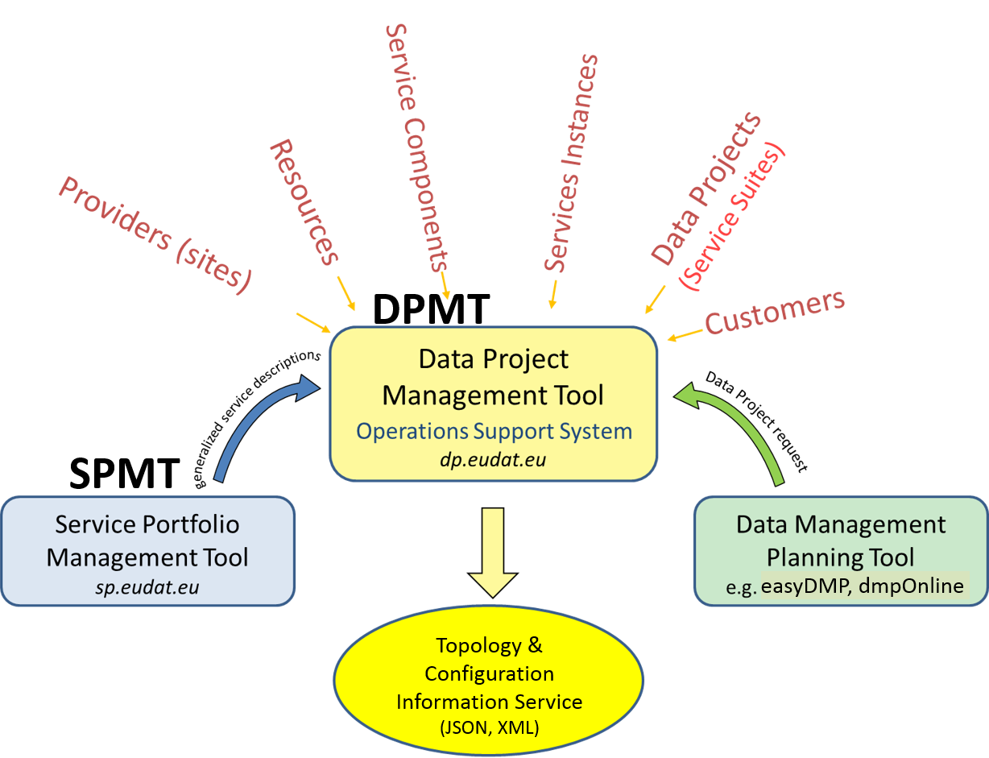
Integrated Service & Project Management
Configuration Information

Slide 13
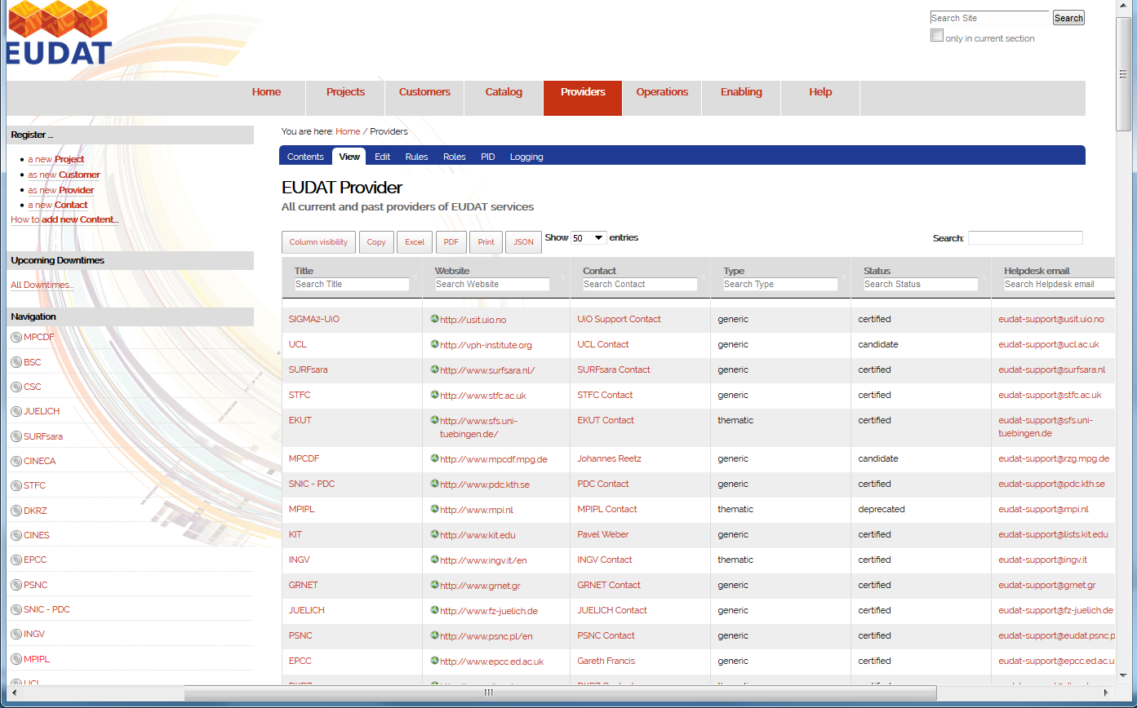
DPMT – Provider Overview panel

Slide 14
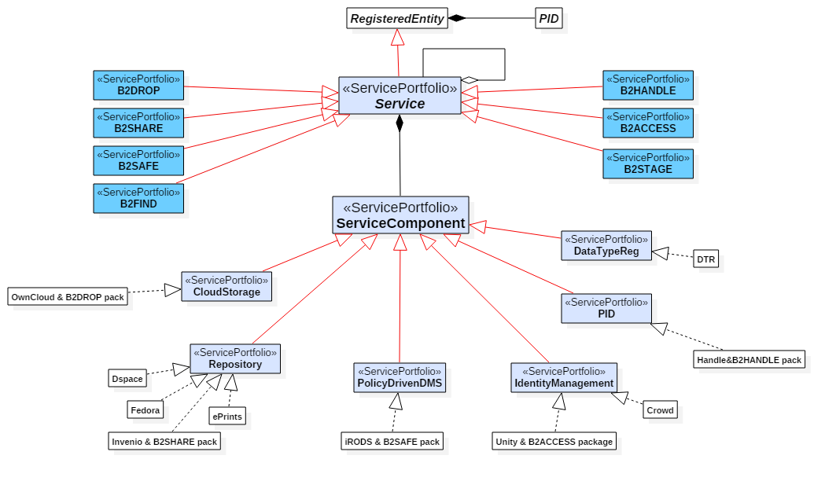
Data Model of the SPMT and DPMT
Service Components and Service Dependencies
A Service can comprise multi-tenant Service Components that can be distributed
can depend on other services (e.g. support or customer facing B2- services)

Slide 15
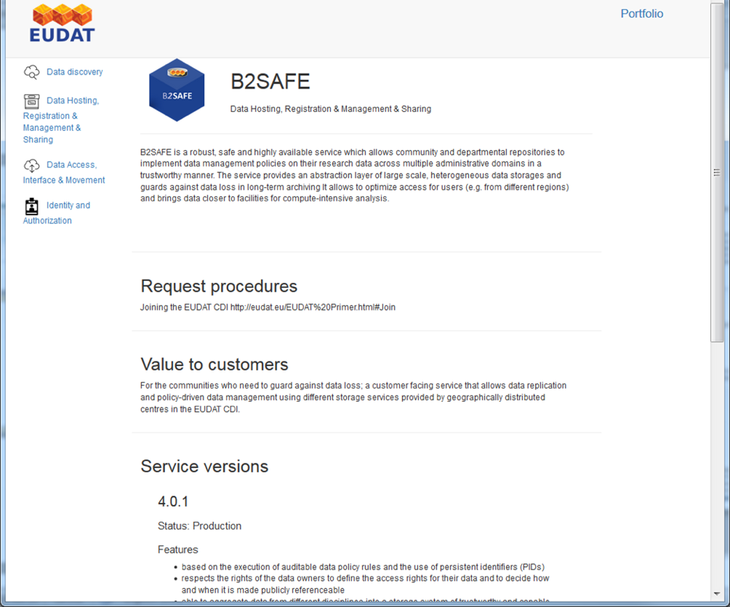
SPMT Catalogue (B2SAFE description)

Slide 16
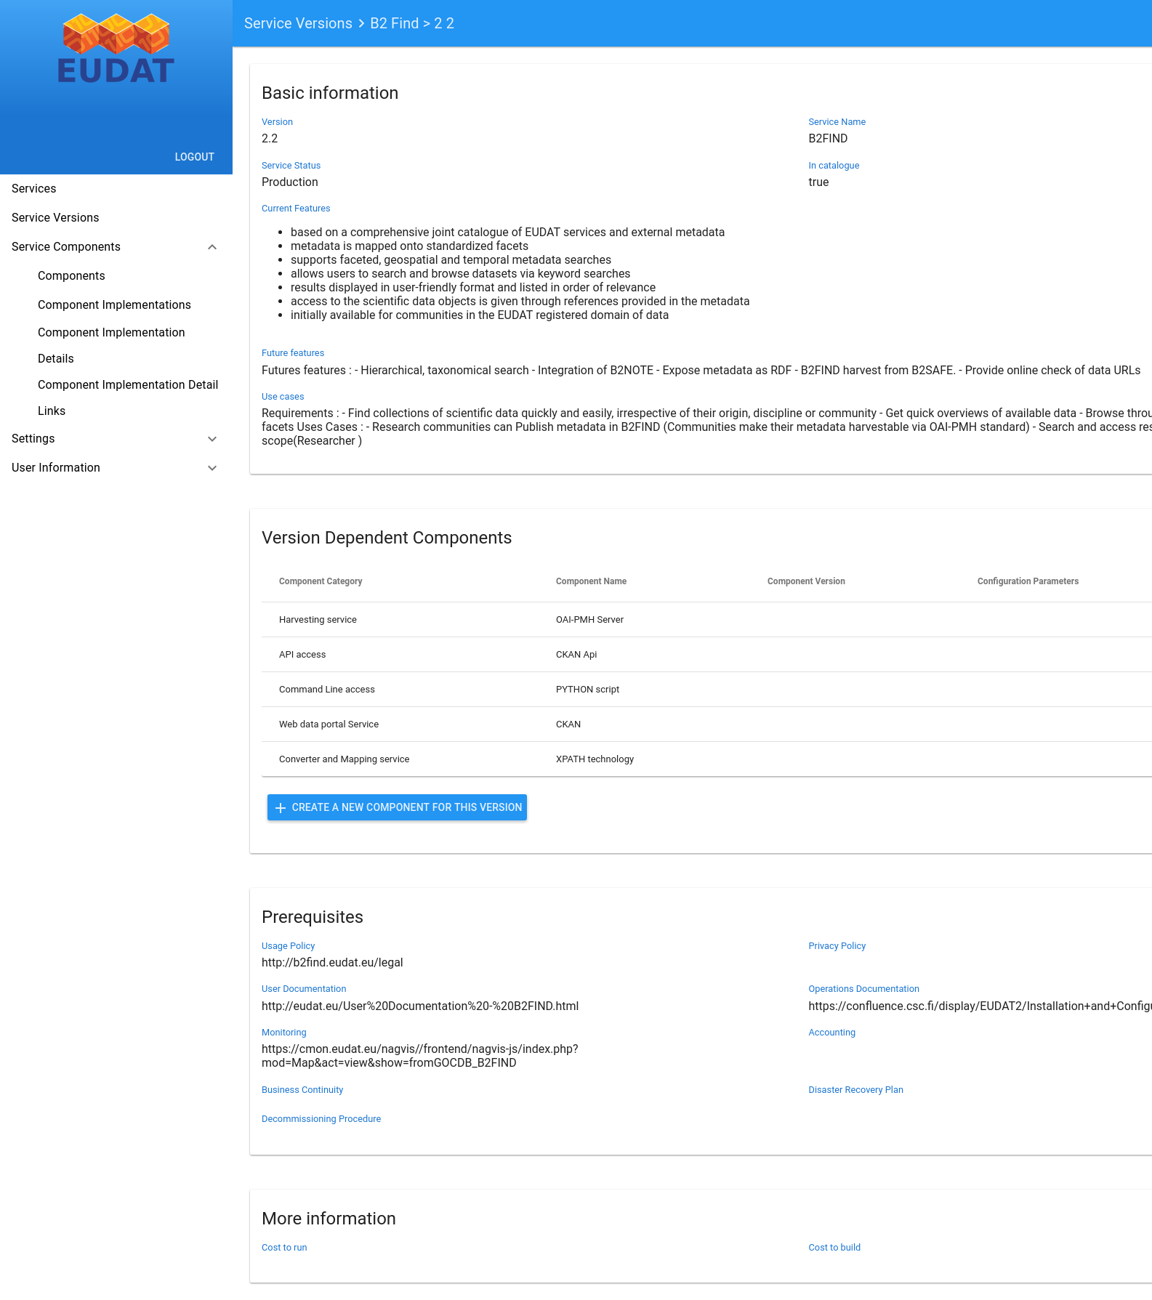
SPMT Editor (Service Versions Panel)

Slide 17
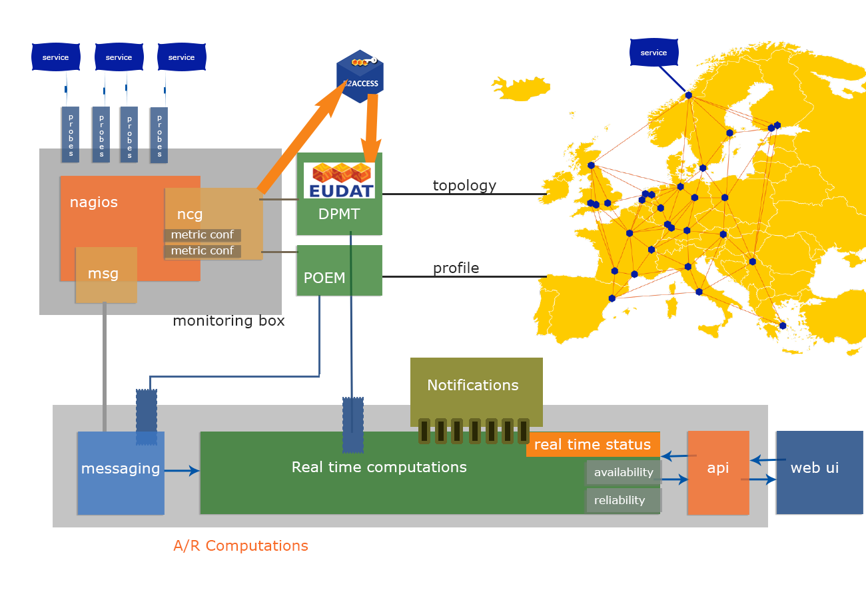
ARGO Monitoring

Slide 18
ACCT: Architecture
Storage Accounting Record:
Project X (t, Resource-ID, volume, #objs, ...)
User queries
view 1
Actual list of storage spaces:
Project X – Provider A
(Resource-ID, volume, #objs)
Project Y – Provider B
(Resource-ID, volume, #objs)
Provider A
Project X
Agent
Project Z
Front-end
RCT
acctDB
API
view 2
Provider B
Details Project Y – Provider B:
Timestamp 1 (RID, volume, # objs)
. . . . . .
Timestamp N (RID, volume, # objs)
Project W
Resource ID assignment
Project X
Agent
Project Z
export
XML
StAR records Project Y – Provider B:
<sr:StorageUsageRecords>
. . . .
</sr:StorageUsageRecords>
Storage Accounting Record:
Project Y (t, Resource-ID, volume, #objs, ...)

Slide 19
Federation and Collaboration Services in EUDAT2020
Abbrev | Tool | Provider | Host | Instance /URL
AAI | AAI Gateway (B2ACCESS) Token Translation Service (WaTTS) | JUELICH KIT |  | https://b2access.eudat.eu https://watts-dev.data.kit.edu/
SPMT | Service Portfolio and Service Level Management Tool | GRNET |  | http://sp.eudat.eu/
DPMT | Data Project Management Tool with Configuration Information Service (Site & Service Registry) | MPCDF |  | https://dp.eudat.eu/ (Web UI, API,GOCDB compatibility layer)
easyDMP | EUDAT - OpenAIRE H2020 DMP tool | SIGMA2
ACCT | CDI Accounting Information Service | MPCDF |  | https://accounting.eudat.eu (API
ARMT | Availability & Reliability Monitoring Tool | GRNET |  | https://avail.eudat.eu (API, Web UI)
WEB | EUDAT Website | Trust-IT | CSC | https://www.eudat.eu
COLLAB | Community Collaboration Platform | Trust-IT | CSC | https://b2gether.eudat.eu (Web UI)
CodeRep | Subversion Gitlab | CSC KIT |  | https://svn.eudat.eu/EUDAT/ (API, Web UI) https://gitlab.eudat.eu (API, Web UI)
TTS | Helpdesk | BSC | CINECA | https://helpdesk.eudat.eu (Web UI) https://www.eudat.eu/support-request (Web UI)
WIKI | Collaboration Wiki (Confluence) | CSC |  | https://confluence.csc.fi/display/EUDAT2/Home
SVMON | Software Version Monitoring | KIT |  | http://eudat-tags.scc.kit.edu/eudat/
MSGB | Message Broker | GRNET
PID | B2HANDLE | SURFsara, GRNET, DKRZ, MPCDF, PDC, BSC
B2SAFE-DPM | Data Policy Manager | SIGMA2-UIO

Slide 20
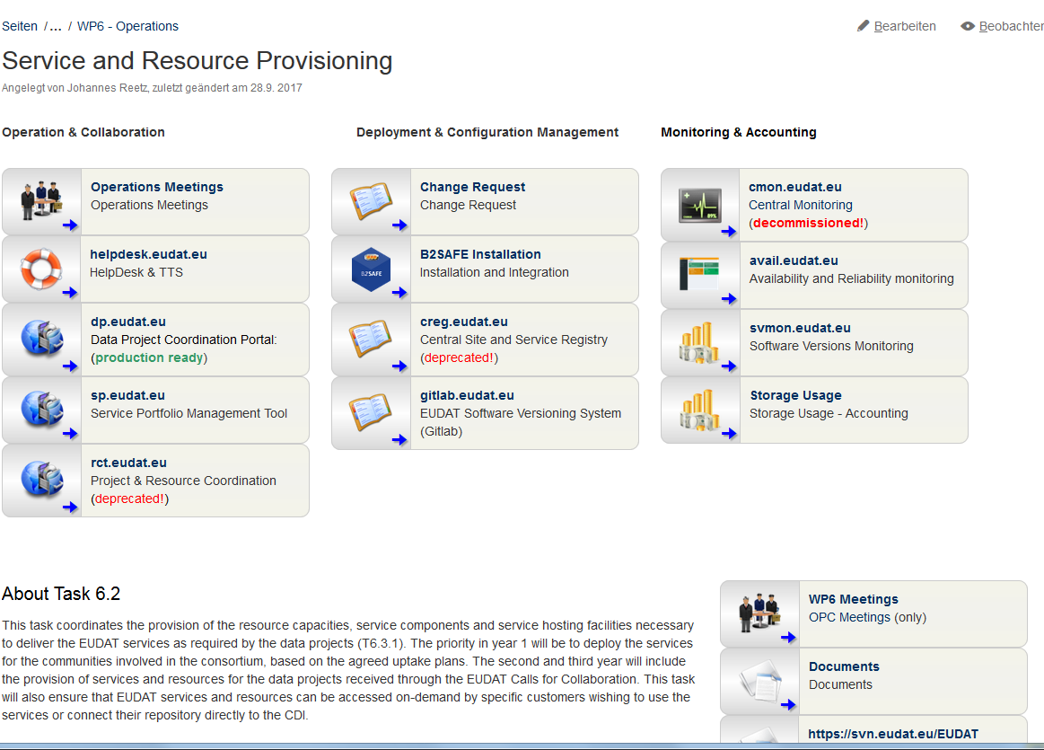
Operation
https://confluence.csc.fi/display/EUDAT2/Service+and+Resource+Provisioning

Slide 21


From Software Release to Deployment
Technology & Service Development
Service Experts
Service Area Manager
B2Service Owner
SPMT
New Service Catalog entry informs the
Site Deputies that new Software of their stack is available. OPC Team is planning for a concerted software upgrade
DPMT
OPC leader / OPC team
The OPC is planning the deployment of software
and software updates of running and new services.
Operations Coordination
Provider Principal
Provider Principal
Provider Principal
Local Resource & Service Managers
(Local Service Expertise)
Local Resource & Service Managers
(Local Service Expertise)
Local Resource & Service Managers
(Local Service Expertise)
Provider 1
Provider 2
Provider 3

Slide 22
Release and Deployment Management
Technology & Service Building
Service Area Manager
Service Area Manager decides about a new Service Catalogue entry. This new entry may trigger the OPCT and Site Deputies about a new Software Version available.
Service Owner maintains
service description via the SPMT
SPMT
DPMT compares supported software
versions against installed versions.
DPMT
DPMT
Software versions
monitoring system
If the comparison indicates a new service or new software version, the OPC Team is plan-ning for a coordinated software upgrade or first deployment of the software on the CDI.
SVMON
OPC Team
sites

Slide 23
Operations following FitSM in EUDAT2020
Service Management Processes and Tools
# | FitSM Process | Responsible | Tools
1 | Service Portfolio Management | CINES | SPMT
2 | Service Level Agreement | CINES (CSC) | SPMT, DPMT
3 | Service Reporting, including Service Monitoring | GRNET (KIT) | ARMT, DPMT, ACCT
4 | Service Availability & Continuity Management | KIT (MPCDF) | ARMT, DPMT, SVMON
5 | Service Capacity Management | MPCDF (KIT) | DPMT, ACCT
6 | Information Security Management | CSC (JUELICH) | Vulnerability Scanner, DPMT
7 | Customer Relationship Management | CLARIN ERIC (CINECA) | WEB, B2GETHER, DPMT
8 | Supplier Relationship Management | MPCDF | DPMT
9 | Incident and Service Request Mngmt (1st Level Support) | BSC | TTS, DPMT
10 | Problem Management, incl. 2nd Level Support | MPCDF (KIT, CINECA) | TTS, JIRA
11 | Configuration Management | MPCDF (CINECA, KIT) | DPMT
12 | Change Management | KIT (CINECA) | JIRA, Confluence Wiki
13 | Release and Deployment Management | KIT | JIRA, TTS
14 | Continuous Service Improvement Management | KIT | JIRA, Confluence Wiki
- Operation Hand Book (Registry of Operational Procedures) under consolidation
Notes:
A collaboration between Service Providers and Research Communities
A Partnership Agreement specifying the mutual obligations between the EUDAT centres
a portfolio of data management services
A data and service model that ensures the CDI’s interoperability, extensibility and stability
Looking to the future we have the CDI partnership agreement and a secretariat as a basis for future coordination.

Slide 24
CDI Process Managers within EUDAT
Process Managers | Objectives | Reporting to | Assigned Partner
Service Portfolio Manager | Maintain the EUDAT CDI Service Portfolio. | CDI Steering Group | CINES
Service Level Manager | Define and maintain the CDI Service Catalogue and agreed SLAs. … | CDI Operations Coordinator | CINES
Availability & Capacity Manager | Manage provisioning and configuration of resources and services. Manage requests for the delivery of services. | CDI Operations Coordinator | MPCDF, KIT
Security Manager | Manage information security risks & policies for the CDI. | CDI Operations Coordinator | CSC
Customer Relationship Manager | Manage the relationship between Service Providers and Customers. | CDI Steering Group | CLARIN ERIC CINECA [& Enabling team]
Supplier Relationship Manager | Manage the relationship between Service and Software Providers. | CDI Steering Group | MPCDF, KIT
Incident & Service Request Manager | Manage service desk and 1st line support. | CDI Operations Coordination | BSC
Problem Manager | Manage in-depth (2nd line) support and problem resolution. | CDI Operations Coordinator | MPCDF (CINECA, KIT)
Configuration Manager | Provide and maintain a logical model of all configuration items and their relationships and dependencies. | CDI Operations Coordinator | MPCDF, KIT (CINECA)
Change Manager | Ensure changes to configuration items are planned, approved, implemented… | CDI Operations Coordinator | KIT
Release Manager | Manage the bundling changes of configuration items into releases. | CDI Technical Coordinator | KIT
CSI Manager | Identify opportunities for improvement, review service improvement proposals. | CDI Steering Group | KIT, MPCDF

Slide 25
Service Management lead roles
(current CDI PA)
Role | Responsibility
CDI Head of Secretariat | Service Management System Senior Responsible Owner. Chair, CDI Steering Group.
CDI Technical Architect | CDI service design, development and release. Member, CDI Steering Group.
CDI Operations Coordinator | CDI service operations & support. Member, CDI Steering Group.
CDI Service Owners | Defined for each service in the Service Catalogue. Responsible overall for a given service (typically a B2 service) as offered by EUDAT.
SM Process Managers | Defined for each process. Responsible for the implementation of a particular SM process across the whole CDI.
CDI Site Managers | Defined for each Service Provider site. Responsible both for the operation of CDI services or service components running at their site (accountable to CDI Service Owners) and for the site-local execution of required SM process activities (accountable to SM Process Managers).

Slide 26
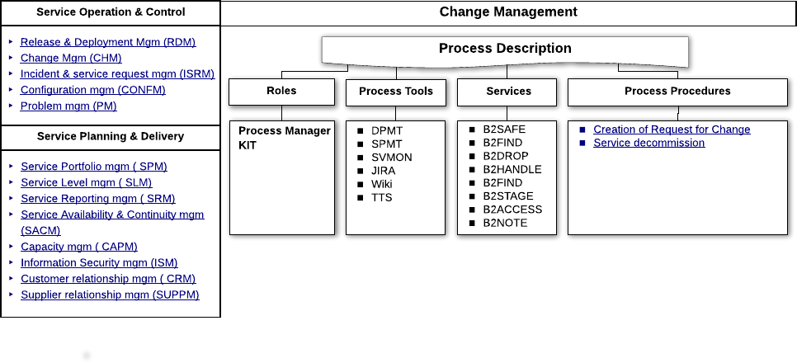
Federated IT Service Management System

Slide 27
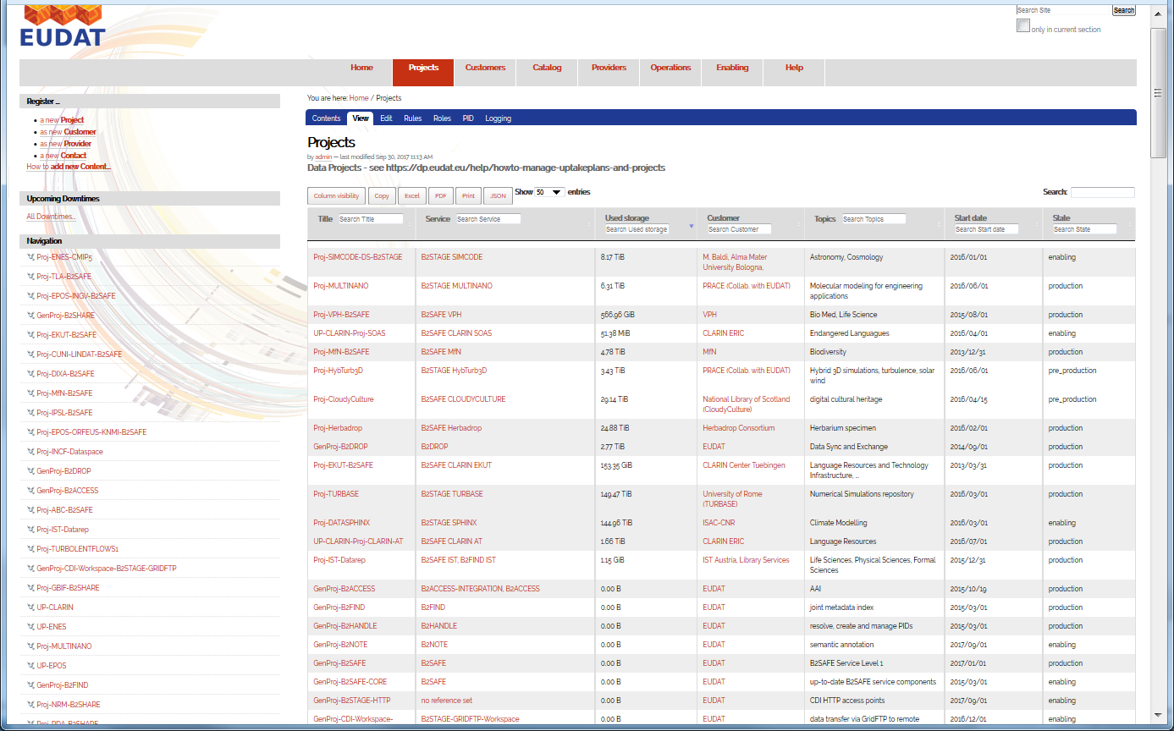
DPMT – Projects Overview Panel

Slide 28
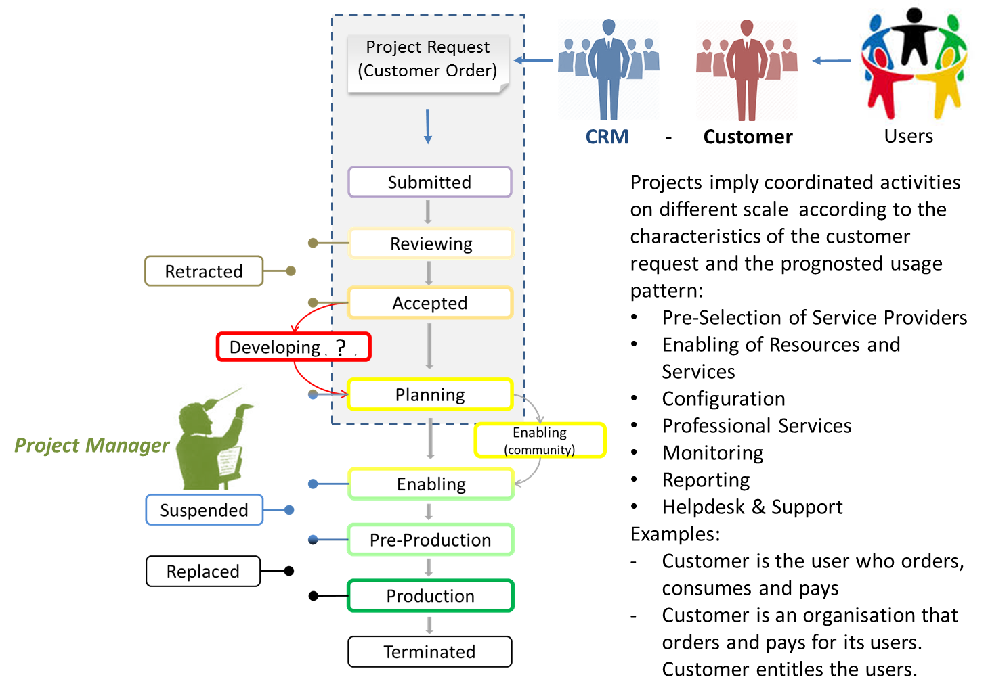
Data Project Life Cycle Management

Slide 29
From Data Project to Production Project
Data Project
Service Experts
Project Enabler
B2Service Enabler
Triggers the Provisioning of Resources
and Service Components and gives advice for the deployment and configu-ration of the service software.
DPMT
OPC leader
The OPC is planning the deployment of software
and software updates of running services.
Operations Coordination
Provider Principal
Provider Principal
Provider Principal
Local Resource & Service Managers
(Local Service Expertise)
Local Resource & Service Managers
(Local Service Expertise)
Local Resource & Service Managers
(Local Service Expertise)

Slide 30
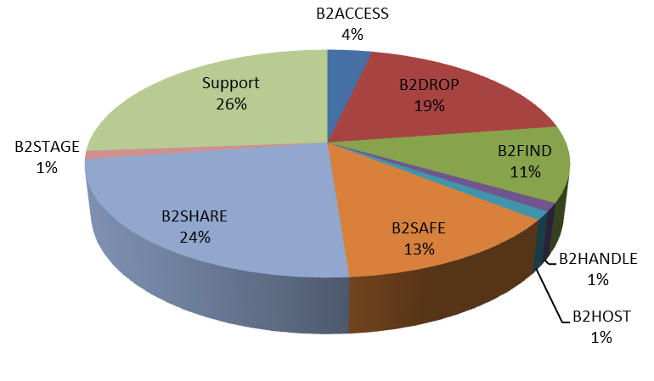
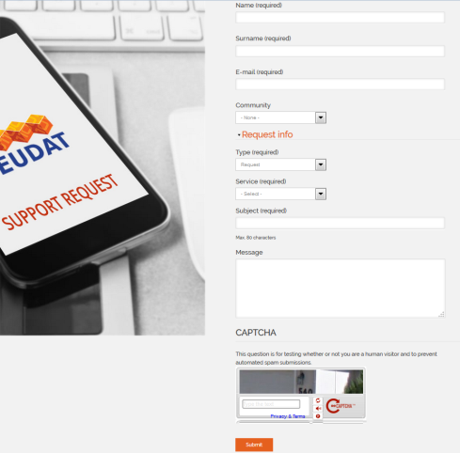
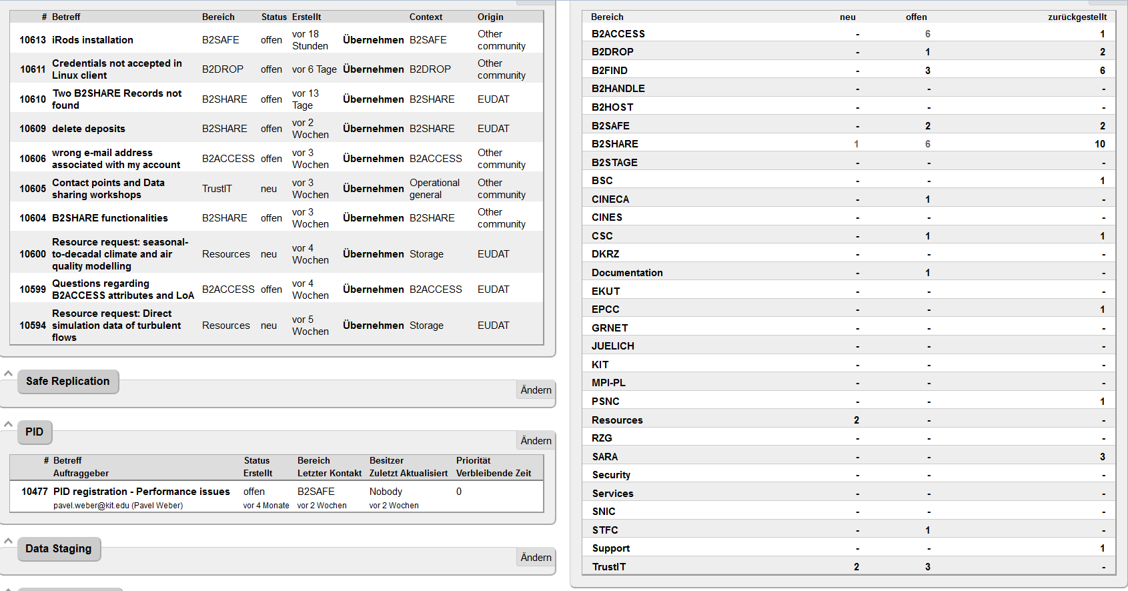
Helpdesk and Support Team
Requests via the Helpdesk Webform
Helpdesk Channels
Support Request Webform
Trouble Ticketing System
  B2-Service Queues
  Site Queues
Responsibilities
1st Level Support (BSC)
2nd Level Support:
Project Enabling Team (OP)
3rd Level Support
Service Developer Teams (DEV)

Slide 31
Security
UK/2015-10-14
Security policy that defines the security roles and defines security guidelines.
  EUDAT Security officer, deputy security officer
  CSIRT team
  Incident handling procedure in place
Proactive security vulnerability scans for services and the infrastructure
  Port scans & application vulnerability scans
  Uses service endpoints from Configuration Information Service:
  B2DROP, B2SHARE, B2ACCESS, B2FIND, B2SAFE, OP services
  Warnings on vulnerabilities for sites sent to site security officers
  Reports to site security officers: critical vulnerabilities timely fixed
Security assessments: B2ACCESS (Unity), ….
Consultancy on
  e-infrastructure security and Data Privacy practises and issues
Cross-infrastructure Collaboration on Security
  Joint IT security workshop/training
  Close collaboration with PRACE, EGI, GÉANT, WLCG WISE

