Slide 1
T4.5 Incident and Service Request Management, Problem Management
David Vicente

Slide 2
Index
Introduction to the task
Subtasks
partners
Links to WP5 “support service tools”
Milestones
tools
Workplan for the first 12M

Slide 3
Introduction
The task provides support to users and service operators through a single interface.
The levels of support are grouped in :
1st level support is responsible for initial analysis of the incoming ticket, requesting additional information and then either delivering a solution or assigning the ticket to 2nd level support.
2nd level support will be provided by experts from the e-Infrastructures service providers.
The team will also maintain 1st level support processes and knowledge base.

Slide 4
sub-tasks
T4.5.1 Find synergies between EUDAT and EGI for the incident and service request management and problem management procedures
T4.5.2 Analysis the current processes to generate a knowledge database from the different helpdesk systems
T4.5.3 Provide a 1st level support service and keep track of the 2nd level support tickets from a EOSC-hub project perspective

Slide 5
partners
Lead: BSC; Participants:CESNET
BSC will provide the support for EUDAT
BSC will be the leader of the task, however the tasks will be split between the 2 partners, as the service will be done independently for the 2 infrastructures.
CESNET provides both 1st and 2nd level support for EGI core, cloud and community services
1st level support provided by CESNET's 24/7 Helpdesk
2nd level provided by CESNET experts
Routine process, in place for many years. We can discuss changes and integration, but support is being provided as usual. There are no pressing issues.

Slide 6
links to the WP5.5 task :milestones
This task depend on the tools developed on the task 5.5, where the helpdesk tool for EOSC-hub should be provided.
The milestone 5.5 scheduled on M10 is an important point for our task :
M5.5 Consistent Helpdesk system available with 1st and 2nd line support

Slide 7
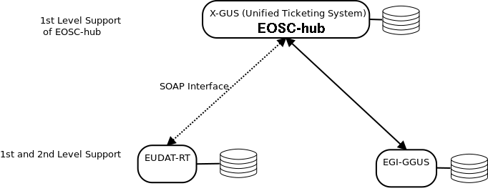
links to the WP5.5 task : tools
Basic idea of the solution from WP5.5

Slide 8
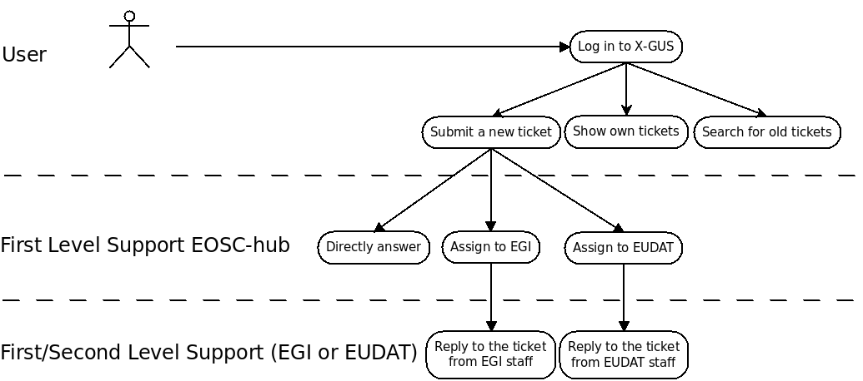
Use case

Slide 9
required integration of EUDAT-RT and xGUS
Workflow:
The user logins in the xGUS helpdesk
The user submits a ticket in the xGUS helpdesk
A First level Support member of EOSC-hub checks the ticket and depending on the topic, it is directly answered or assigned to an infrastructure (EGI or EUDAT)
If the ticket is for EUDAT-RT, the xGUS systems creates a new ticket in the EUDAT-RT. The xGUS id and the EUDAT-RT id is saved in the EUDAT-RT database.
A First or Second level Support member from EUDAT will take the ticket.
The owner of the ticket in the EUDAT-RT will reply to the ticket and the user will receive the reply via email. This action will generate an update in the EUDAT-RT database and in the xGUS system.
The user will reply to the ticket via email. The EUDAT-RT system will process this action and update the ticket both in EUDAT-RT and xGUS systems.

Slide 10
workplan M1-M12
from M1 - keep providing the support for the EGI and EUDAT infrastructures ( CESNET-> EGI, BSC->EUDAT)
M1-M6 -Find synergies between the processes used in the 2 infrastructures for Incident and Service Request Management and Problem Management , and define a process for the EOSC-hub helpdesk (in progress)
M6 - Define the best way to provide the 1st level support from a EOSC-hub perspective.
M10 - provide a stable 1st level support for EOSC-hub

Slide 11
workplan M1-M12
Open Question: which is the best way to distribute the work of the 1st level support of EOSC-hub between the partners of the task ?

