Slide 1
T10.2 Service Catalogue

Slide 2
T10.2 Service Catalogue Technical Evolution
Partners: SURFsara, EGI.eu, INFN
This task will define the project's Rules of Engagement (RoE), including guidelines, policies and procedures to assess conformance of services to the RoE and to the FAIR principles. Compliance to the RoE will be used to brand services in the project as trustworthy and interoperable.
This activity will monitor the evolution of reference standards (and contribute where relevant) and track the evolution of the main software technologies in the Open Source communities. The task will also evaluate external technologies and software stacks that could be included into the Services Catalogue.
Output:
  ● The project Rules of Engagement (RoE)
  Rules of Participation (RoP) OR Principle of Engagement (PoE)
  ● Evaluation reports about candidate services/software components;
  ● Recommendations on product or software stacks to support services

Slide 3
Collaborations within the project
T2.2: Service roadmap, service portfolio and service catalogue
  This task will support the evolution of the service offering from the project by managing:
    A service catalogue (the public list of services that can be requested including all the information for making them operational);
T4.1 Operations Coordination and Continual Improvement of the Operations Framework
  D4.1 Operational requirements for the services in the catalogue
T5.2 Marketplace and Order Management Tools

Slide 4
Collaborations outside of the project
EOSCpilot
  This study aims to identify and propose a preliminary set of Principles of Engagement for Service Providers and Users in EOSC
  Preliminary analysis and consultations (since May 2017)
    Analysis of 7 e-Infrastructures, 11 Research Infrastructures, 2 commercial cloud providers and scientific initiatives established on the basis of charters/codes of conduct.
  Current Draft Open for Comments
    https://docs.google.com/document/d/1MXOV8_kTzy8-wh9pK6ZEmzouvNqQs4Kr2ci_FDS568s/edit

Slide 5
Collaborations outside of the project
eInfraCentral
  Providing the European e-Science Services Gateway
    Service Catalogue
  Partners: EGI, EUDAT, PRACE, GEANT, OpenAIRE, EFIS, JNP, Leibniz University, University of Athens
  Template for service descriptions
    http://einfracentral.eu/sites/default/files/ServiceDescriptionTemplate/1.00.xlsx
  Beta Service Catalogue
    http://beta.einfracentral.eu/home
  API for harvesting service catalogues
    http://beta.einfracentral.eu/developers

Slide 6
Rules of Participation
Entering the EOSC
How high must be the bar
Lose
Mandatory
Tight

Slide 7
Possible Scenarios
Scenario 1
Independent ITSM processes
Mainly for service promotion
Agree to EOSC RoE; Service Description template
Scenario 2
Services that are partly relying upon components operated by other service providers, such as EOSC federating core services.
ITSM focus is limited to strategic interfaces to ensure regular operation of the service(s)
  e.g. OLAs, incident handling and problem management of component dependencies)
Scenario 3
Services being offered as part of EOSC supported services.
Services that are fully integrated to the EOSC federating core services.
All ITSMS processes are managed via the EOSC SMS
  e.g. services definition follow a structured approach, consumers of the services can request services directly via the EOSC Portal, incidents and changes are centrally managed
Federation type
Loose
Not one or the other
Co-exist
Service specific
Multiple roles
Tight

Slide 8
Principles of Engagement
Requirements
Machine-readable metadata: All services must include machine readable metadata and be identifiable by means of a common and persistent identification. Minimal information should be provided to the appropriate catalogue to allow users to assess the service providers (e.g. quality indicators, FAIR indicators, licences, etc).
Terms of Use/Access Policies: All EOSC services must have Terms of Use and/or Access policies displayed publicly online and/or via the EOSC Service catalogue(s).
Accessibility: EOSC Service Providers must describe how they ensure accessibility and provide information in the appropriate service catalogue on, e.g. their metadata, APIs, standards, protocols, etc..
Portability: The legal and technical infrastructure should enable the portability of data and services. Service providers (e.g. tools service providers) should enable the deployment and execution of their service by users in compatible cloud instance.
Access costs and charging model: Service providers may apply user charges/fees, which could vary by type of service, type of service provider and location of users. This information must be made clear to users online and via the appropriate EOSC service catalogue. Underlying costs could be indicated, e.g. for data-related services, service providers could indicate maintenance costs, curation, stewardship, etc.
Quality of service: Service providers should conform to the quality guidelines that are being developed within EOSC. Services that provide “Excellence-based access” - where research groups are allocated resources based on competitive processes - should operate with transparent expert peer-review.
Relation to users: Service providers must convey information on data management mechanisms they use to store-process-publish content. If applicable, service providers
  must publicly indicate if they provide the users with the means, and list them, to apply FAIR principles to research data.
  must publicly indicate if they offer the mechanisms, and list them, to ensure sustainability and reproducibility of data.
  must publicly disclose details on what data about users is collected and how the user statistics is tracked, managed and used for service improvement.
  must publicly indicate if they offer the mechanisms to apply data protection rules according to the General Data Protection Regulation, especially in terms of Data Protection by Design and Data Protection by default, using relevant shields and information.
All services must be accompanied by corresponding support and training material and possibly a helpdesk.

Slide 9
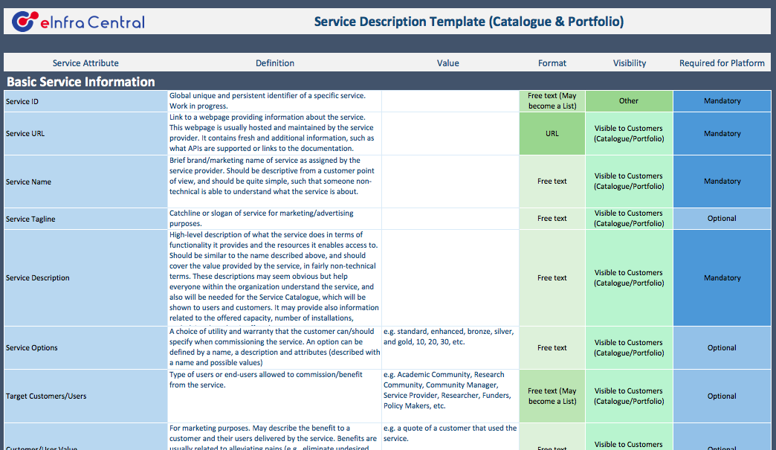
eInfraCentral Service Description

Slide 10
eInfraCentral Service Description
Basic Service Information (11 criteria, 4M, 7O)
Service Classification (14 criteria, 8M, 6O)
Service Support Information (5 criteria, 1M, 4O)
Service Contractual Information (4 criteria, 2M, 2O)
Service Performance Information (7KPI, 14 criteria, 0M, 14O)
Service Operations Information (16 criteria)
Advanced Service Information (5 criteria)
Service Business Case Information (6 criteria)
Other Service Provider Service Information (2 criteria)
Other Stakeholder Service Information (2 criteria)
79 Criteria to describe a service, 15M, the rest is optional

Slide 11
(WP4 view) Entry into Service Catalogue
Pre-requisite for entry to Service Catalogue
Information required:
  Basic information
  Service classification
  Service support
  Contractual information
  Architecture
  Work in progress – for more details see:
  https://wiki.eosc-hub.eu/pages/viewpage.action?spaceKey=EOSC&title=Service+Portfolio+Entry+Template

Slide 12

EOSC-hub Service catalogues
  EOSC-hub Service Catalogue
  Set of services offered to research communities that can be ordered
  (e.g. B2SAFE, EGI AppDB VMops Dashboard
  EOSC-hub Internal Service Catalogue
  Set of supporting services needed to poperate the EOSC_hub & support the delivery of its functions. Cannot be ordered.
  (e.g. EOSC-hub helpdesk, marketplace etc.)
  And we have the EOSC-hub Marketplace!
Notes:
internal – support delivery & coordination
external – consumed by external customers/users

Slide 13
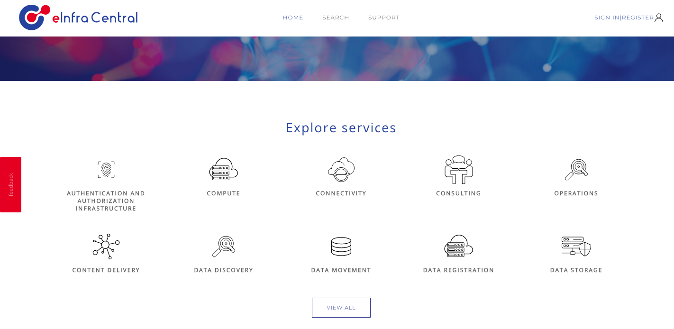
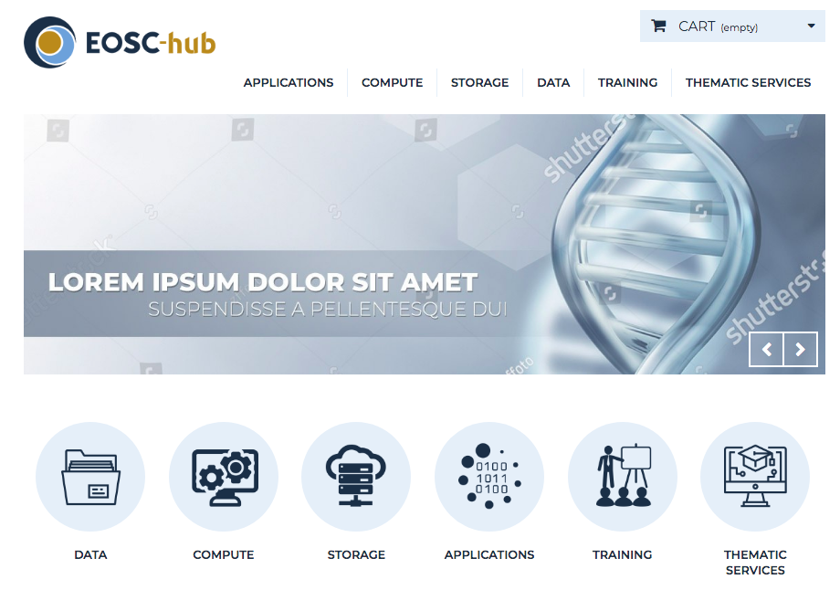
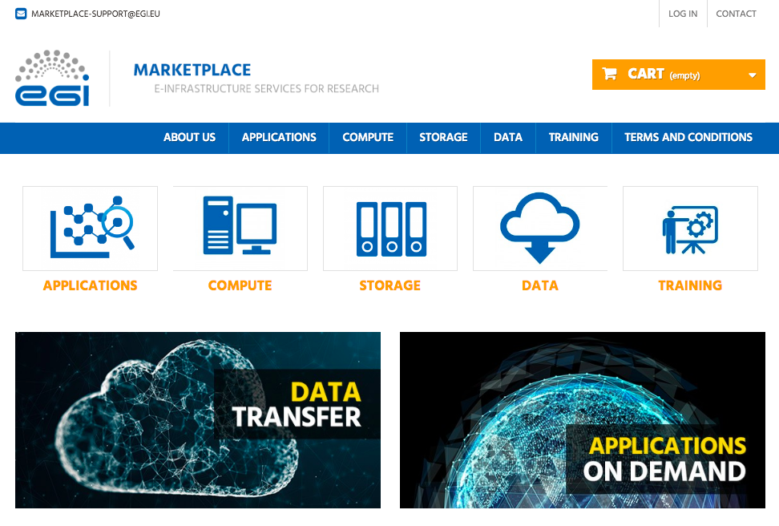
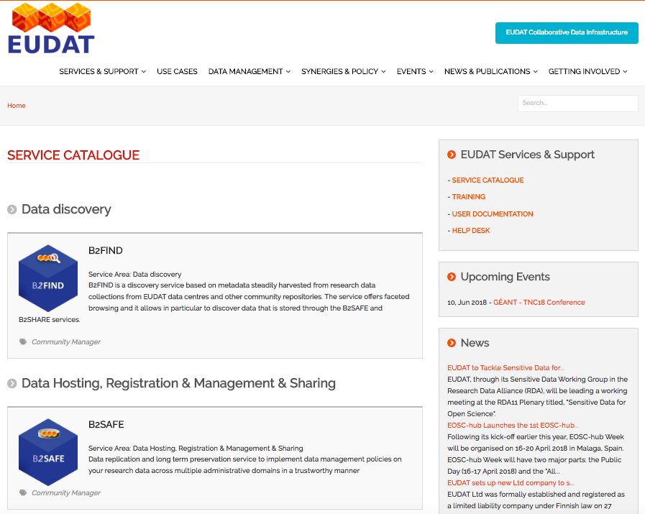
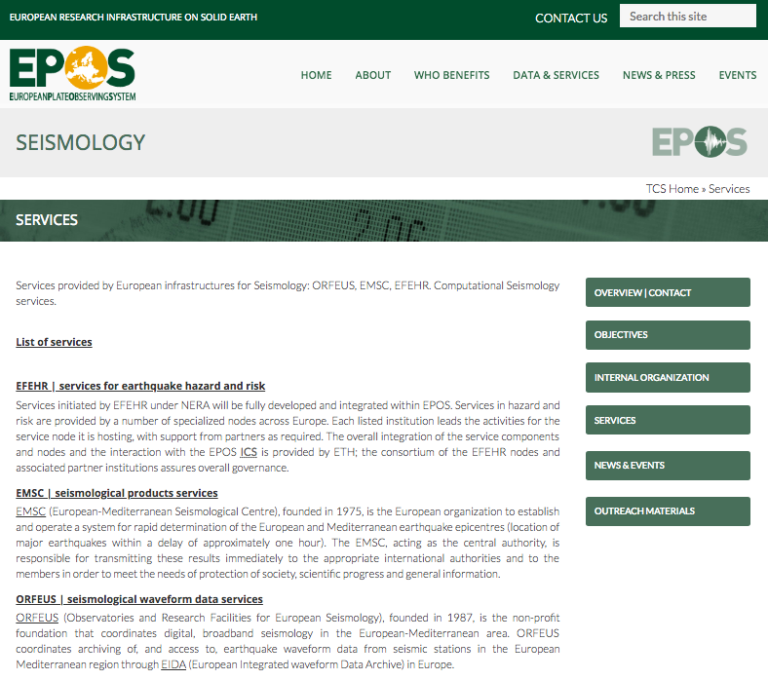
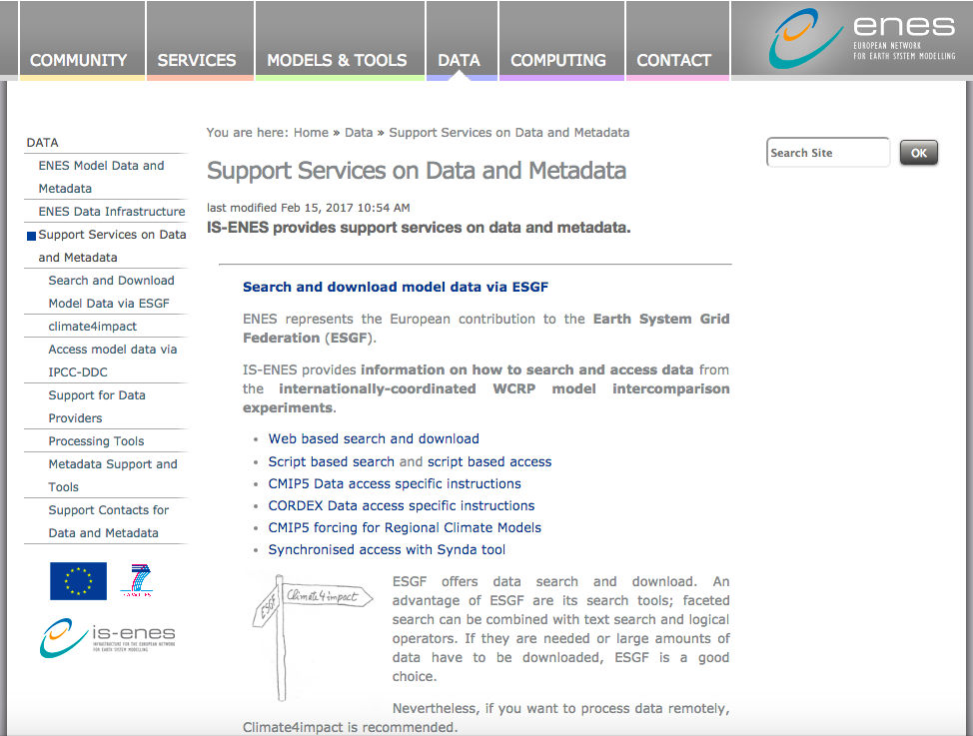
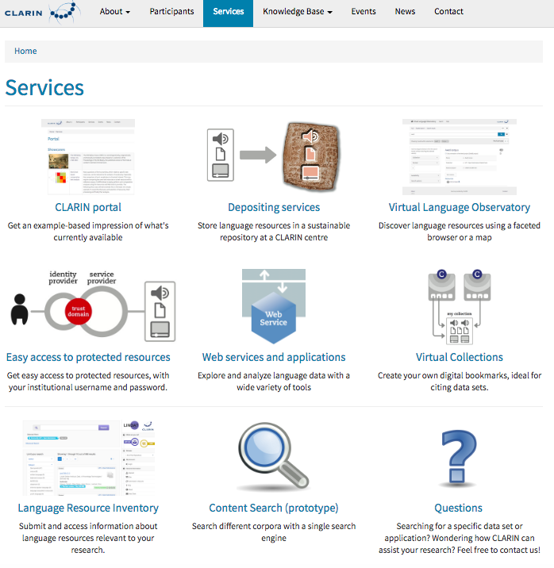
Service Catalogues
eInfraCentral
EOSC-hub
Different
Channels
Harvesting
EGI
EUDAT
Research Infrastructures

Slide 14
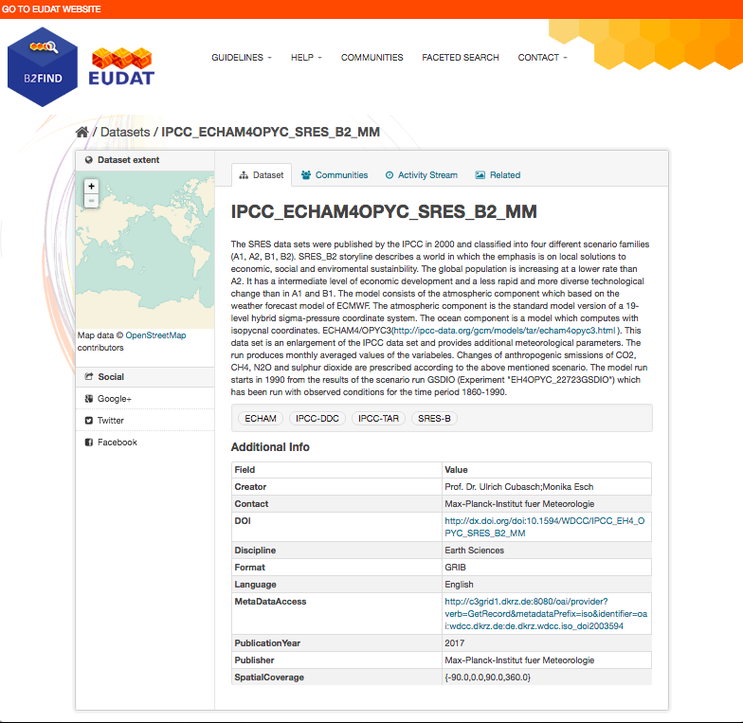
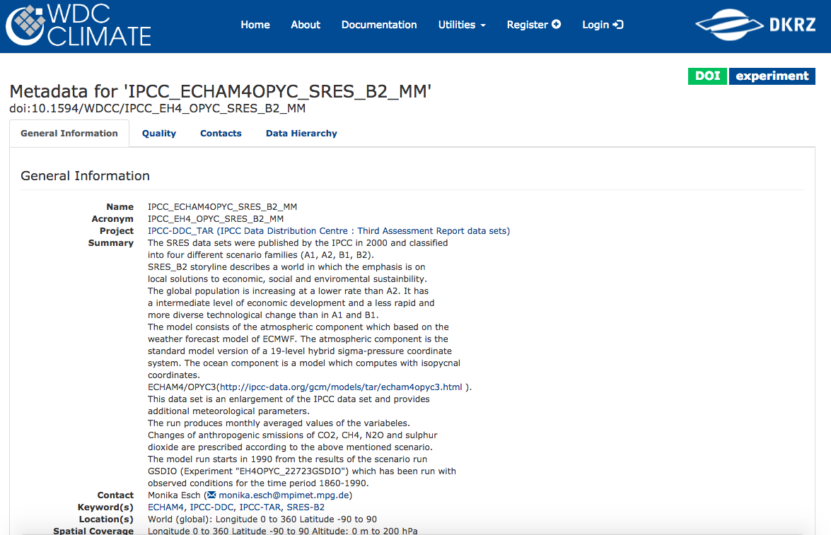
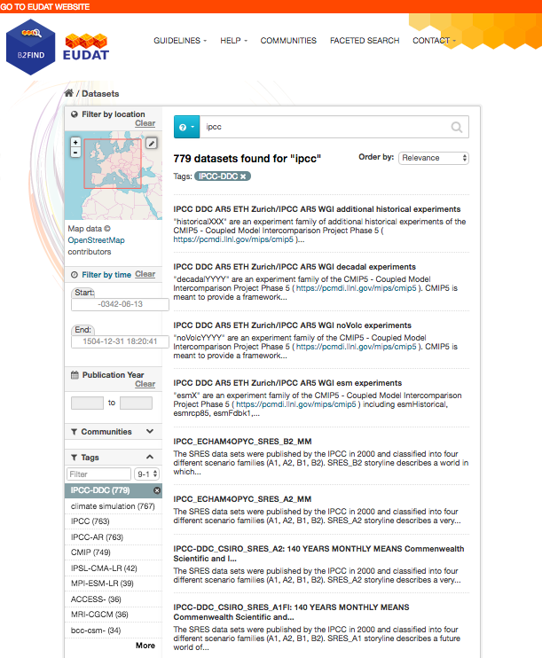
Is this something new?

Slide 15
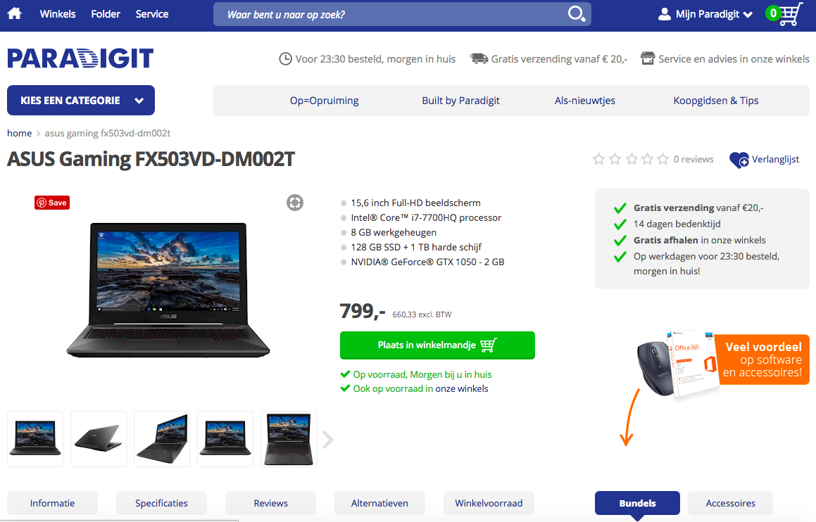
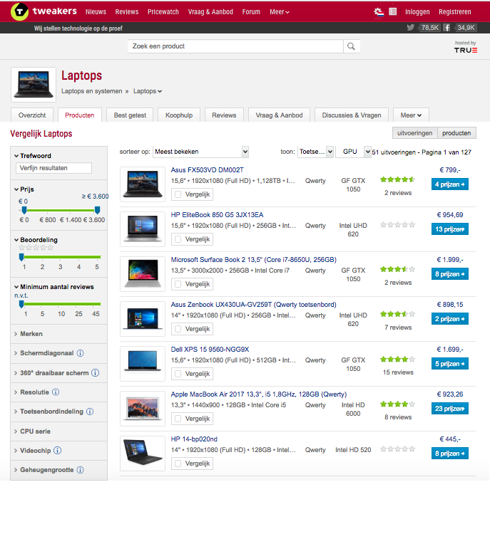
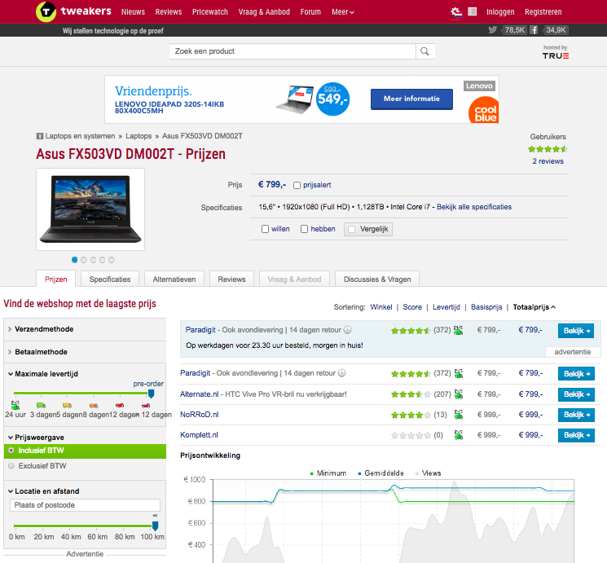
Is this something new?

Slide 16
Summary
Established contact with EOSCpilot and had a meeting to discuss draft document
Session and some discussion on the EOSC-hub public days
We are not far!

Slide 17
Discussion
We should not reinvent the wheel
  Engage with EOSCpilot and eInfraCentral
We should minimize the overlap across different tasks
  How do we organise the cross WP/Task collaboration
Discussion on Rules of Participation is a longer fundamental discussion
  Is part of the overall Service Management Framework
  But we want to allow service providers to publish services into the catalogue
  Which procedure do we adopt

