Slide 1
T6.3 Processing and Orchestration
Miguel Caballer & Germán Moltó
Universitat Politècnica de València

Slide 2
T6.3 Processing and Orchestration (DoA)
Maintenance and integration of orchestration services with the Cloud Compute and Cloud Container services.
Build complex virtual infrastructures based on standards
OASIS TOSCA Simple YAML Profile
Integration of the INDIGO PaaS components as orchestrator for EOSC-hub services.
Adapt them to use the configuration information services (WP5).
Optimisations to speed-up the deployment of virtual appliances.
Maintain the INDIGO Generic Web Frontend (FutureGateway) for building Science Gateways.
The product will be also integrated with the Science Application on-demand platform

Slide 3
Components
Future Gateway: build Science Gateways
The Orchestrator receives a TOSCA document and fulfil the request.
SLAM (SLA Manager): Allows to negotiate SLAs among users and the providers.
CMDB (Configuration Manager Database): Includes the information about the endpoints for the Cloud sites and the Virtual Machine Images registered in each site.
Cloud Provider Ranker (CPR): Receives the information obtained from the aforementioned services in order to produce a ranked list of the most appropriate Cloud sites to fulfil the request.
Infrastructure Manager (IM). The IM performs the deployment on Cloud sites that do not natively support TOSCA-based local site orchestration.

Slide 4
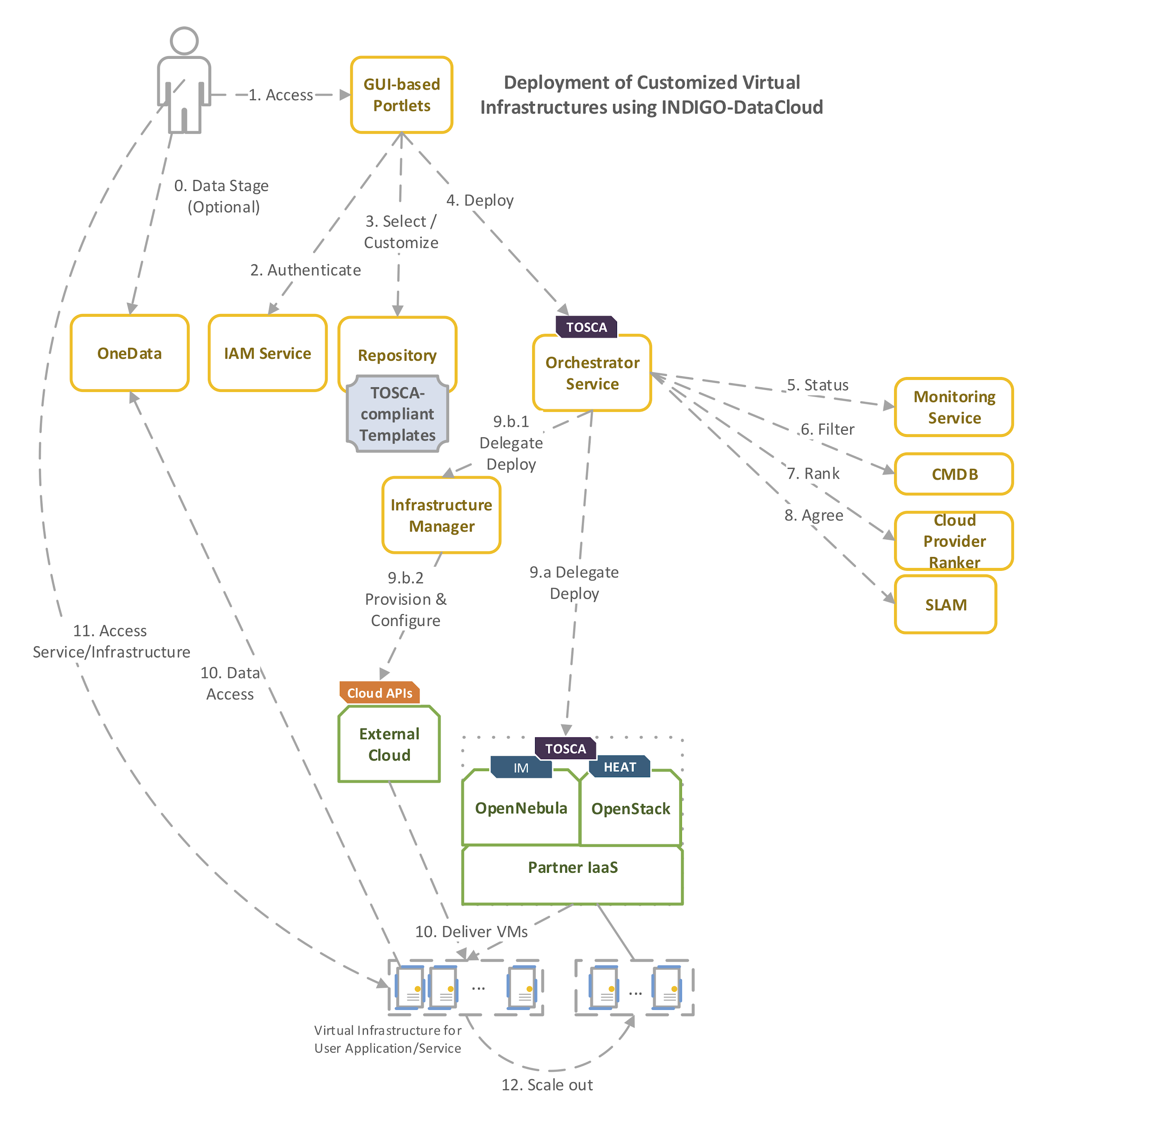
Components in INDIGO-DataCloud
Deploys scientific applications through FutureGateway which creates TOSCA templates that are submitted to the Orchestrator and executed on local sites, or external sites (through the IM).

Slide 5
Infrastructure Manager
Supports TOSCA YAML with INDIGO-DataCloud custom types.
Already integrated in the VMOps Dashboard.
Used to perform hybrid deployments across multiple Cloud sites.
Supports OpenID auth:
Tested with EGI Check-in.
Pending to test with B2ACCESS.
Integrated with AppDB to get VM images URL.
appdb://RECAS-BARI/egi.docker.ubuntu.16.04?fedcloud.egi.eu

Slide 6
Infrastructure Manager
Currently at DEEP – Hybrid DataCloud an Alien 4 Cloud plugin is being developed:
A UI to graphically design the TOSCA template and submit to the IM and the Orchestrator (A Demo was made yesterday): see the videos:
https://youtu.be/yLxwNoO7VQo
https://youtu.be/8iTQWSPJlUw
The goal is to introduce easy composition of TOSCA templates while maintaining virtual infrastructure deployment through the INDIGO PaaS Orchestrator.

Slide 7
FutureGateway: Overview
The FutureGateway (FG) has been developed during INDIGO DataCloud project.
Principally it aids the creation of Science Gateways (SGs) providing an easy entry point for final users, in order to access distributed computing infrastructures (DCIs), just using graphical user interfaces.
Its core component consists of a set of RESTful APIs that manage three main entities:
Infrastructures (DCI configuration)
Applications (Actions to perform on top of the DCI)
Tasks (Application instances performing on top of the configured DCI)
It has a modular shape and it is specifically designed to encourage communities’ customizations to best fit any possible usage scenario.

Slide 8
FutureGateway: current status
Although FG has been successfully presented during the INDIGO final review; its latest release was not included in the last official indigo Release.
The last release is under testing and few little issues arose have been already fixed and code changes have been also tracked on its official GitHub repository.
In order to access any possible DCI, the FG uses modules named Executor Interfaces (EIs), in this moment, two of them are available:
GridEngine - Module that exploits the JSAGA library allowing to principally access:
SSH (Clusters, remote hosts, VMs)
OCCI (Principally virtual appliances available from EGI FedCloud)
EMI/gLite (European Grid Infrastructure)
ToscaIDC - Module that exploits the Orchestrator’ APIs to execute TOSCA receipts.

Slide 9
FutureGateway: workplan
Make latest changes and bugfixes in FG production-ready
Create external test suite for webservices published by the FG API server
Enhance decoupling among FG components: fgAPIServer, fgDatabase, fgAPIServerDaemon and fgExecutorInterfaces
Integrate AAI mechanism natively (EGI AAI Proxy and INDIGO IAM) superseding the current PTV interface
Identification and eventually plan the development for new strategic EIs; DIRAC seems one of the most promising.^{(*)}
(*) Activity not officially present in the T6.3 EOSC-hub workplan

Slide 10
PaaS Orchestrator: Overview
The PaaS Orchestrator is based on the developments carried out during the INDIGO DataCloud project.
It allows to coordinate the provisioning of virtualized compute and storage resources on different Cloud Management Frameworks (like OpenStack, OpenNebula, AWS, etc.) and the deployment of Dockerized services and jobs on Mesos clusters.
The PaaS orchestrator features advanced federation and scheduling capabilities ensuring the transparent access to heterogeneous cloud environments and the selection of the best resource providers based on criteria like user’s SLAs, services availability and data location.

Slide 11
PaaS Orchestrator: current status
The Orchestrator provides TRL8 features like TOSCA-based orchestration of cloud resources and deployments of dockerized services and jobs on Mesos clusters.
Advanced features like support for specialised computing hardware (GPUs, infiniband, etc.), hybrid deployments spanning over multiple sites and support for complex data management workflow will be brought from prototype level (TRL6) to production-ready level (TRL8) in the framework of the DEEP-HybridDataCloud and eXtreme-DataCloud projects.

Slide 12
PaaS Orchestrator: workplan
Orchestrator Maintenance:
Improve software quality, performance and stability;
Detect and correct faults.
Revise and improve documentation (admin and user guides); ensure fully automated installation of the component.
INDIGO Orchestrator Evolution:
Implement potential new requirements raised during the design phase of the EOSC-HUB service architecture. Ensure that the Orchestrator functionalities are properly extended in order to support the integration in the EOSC-HUB system.

Slide 13
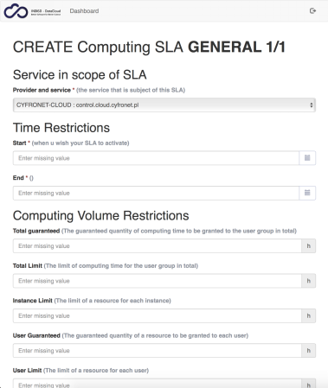
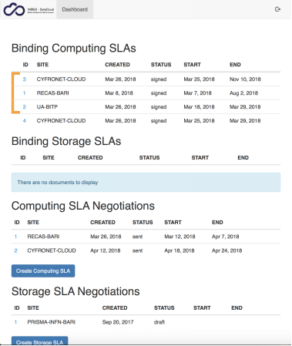
SLAM
Current status:
Testing deployment in EOSC-hub PaaS
Improvements/fixes in system configuration and business logic
Preparation of Marketplace integration scenario
Work plan
Adaptation to multi-organizational use case
Integration with EOSC-hub security solutions
Integration with EOSC-hub Marketplace

Slide 14
CMDB
Current status
Testing deployment in EOSC-hub PaaS
Work plan
Schema adaptations for EOSC-hub
Collecting EOSC-hub services and providers configuration data
Integration with EOSC-hub security solutions

Slide 15
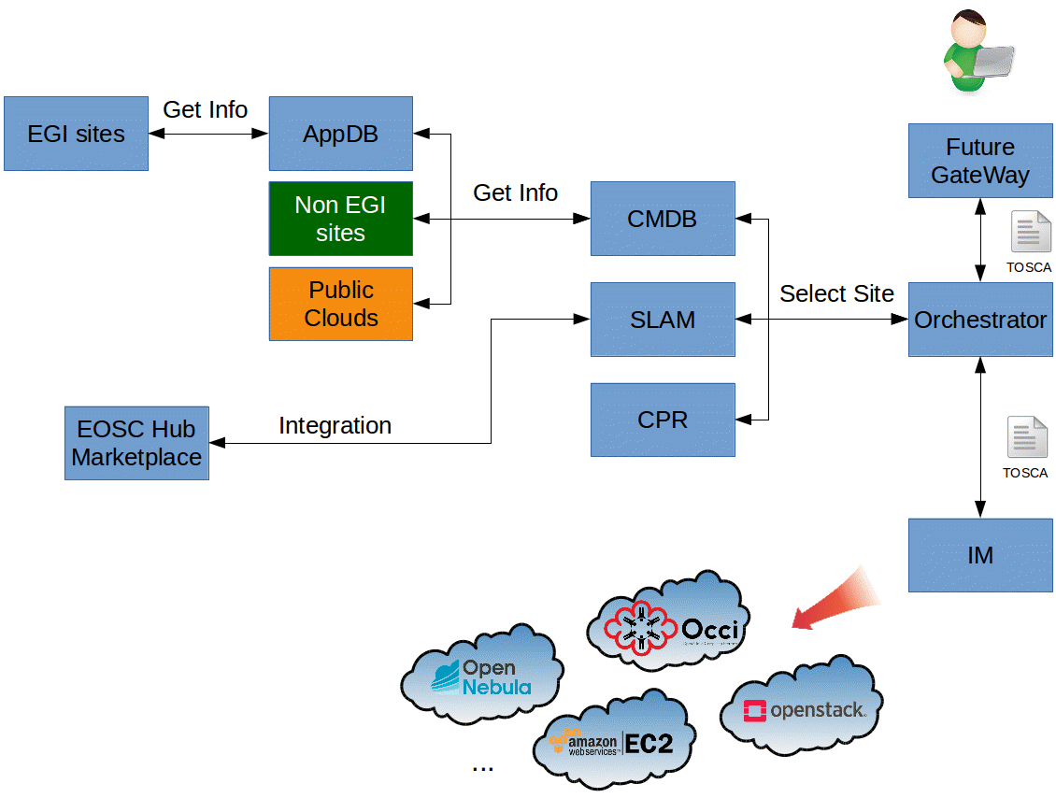
Proposed architecture
- FG: User interface
- Orch: connects with CMDB, SLAM and CPR to select best site to deploy.
- CMDB: Gets information from AppDB and from non EGI sites and Public Cloud providers.
- SLAM: Integration with EOSC-hub Marketplace
- CPR: Gets info from CMDB and SLAM and monitorization and selects best sites.
- IM: Deploys the infrastructure.

Slide 16
Contact:
Miguel Caballer
micafer1@upv.es
Germán Moltó
micafer1@upv.es
Questions?

