Slide 1
OMB May 2018
Matthew Viljoen – EGI Foundation
EGI Operations Manger

Slide 2
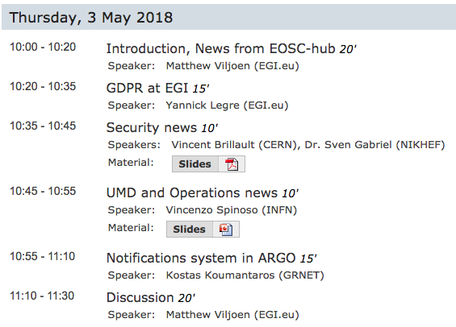
Agenda

Slide 3
EGI Strategic and Innovation Fund launched
Established by EGI Council for discrete projects which benefits the community during short/medium term
Open to Council participants, affiliated participants + represented organizations
Different project types considered:
Proof of Concept (-> at least TRL3. <3mo, <€5k)
Prototype (from TRL3 to TRL6. <6mo, <€15k)
Major innovation (from TRL6 -> TRL8. 12mo, <€50k)
Patch (<3mo, €5k)
Interested? More info here + how to apply:
https://www.egi.eu/about/egi-council/egi-strategic-and-innovation-fund/

Slide 4
PROC26: Verify and review GGUS SUs
procedure for verifying that a GGUS SU is still working and perform a periodic review: https://wiki.egi.eu/wiki/PROC26
Unresponsive SUs report:
Every 2 weeks GGUS team sends to EGI Operations a report about the unresponsive SUs
SUs periodic review:
the SUs that haven't received any ticket for the last 24 months are eligible to be dismissed
Not working email addresses
GGUS team notifies EGI Operations as soon as there is a problem with the email addresses behind the SUs

Slide 5
Central Operations Team – Operator on Duty (OD) role
Introduced Operator on Duty (OD) role
operations@egi.eu monitoring/responding
verifying GGUS tickets
long standing CRITICAL alarms on Operations Portal
monitoring requests for change in central CHM
etc.
Role rotates weekly among team members
more info:
https://wiki.egi.eu/wiki/EGI_Infrastructure_operations_oversight

Slide 6
June OMB
Next OMB on Thu 14th June at 10am CET
To be confirmed on ML

Slide 7
Operational News from EOSC-hub Week
Matthew Viljoen – EGI Foundation
EGI Operations Manger

Slide 8
EOSC-hub Levels of Integration
Two service catalogues
EOSC-hub internal service portfolio the set of supporting services needed to operate the EOSC-hub
EOSC-hub (external) service portfolio the set of services that are offered to research communities via the EOSC-hub marketplace
Guidance proposed (and agreed) for implementation of Service Management System processes: SLM, SUPPM, SACM, CAPM, CONFM, ISRM, PM, ISM, CHM, RDM, CSI
Next steps:
populate service catalogues
checklist/reqs for entering catalogue
https://indico.egi.eu/indico/event/3903/session/29/?slotId=0#20180419

Slide 9
Operational Requirements for Entry to the Catalogue
First presented during the Public Day
TRL levels, service definition, defined user support mechanisms, process integration (SFRM, CHM, RDM, SACM, ISM, CONFM) and operations integration
To be finalized for D4.1 (due end of June)
Work incluced in new Task Force for Rules of Participation (RoP) chaired by MV and Mark van der Sanden

Slide 10
Operational harmonization with EUDAT
Proposal for EUDAT sites to become to integrate as regional operations rejected
Now investigating joint MoU with EUDAT outlining:
operational coordination
security coordination
alignment of processes/procedures etc.

Slide 11
Fedcloud security - Short term improvements
Comprehensive monitoring using probes
Identify, develop and deploy missing security-related probes
Discussing Pakiti and/or similar tools usage at site level
Security training for VM operators
Shifting vulnerability handling to EGI Operations
Using security experts knowledge and time efficiently

Slide 12
Fedcloud security - Following up
Security aspects part of FedCloud 2.0 design
Discussing some new models for FedCloud
Taking security into account from the beginning
Automated Infrastructure testing
Infrastructure as Code
Actual state vs desired state
Promoting and supporting DevSecOps practices
Guidelines, tools for user communities and developers

Slide 13
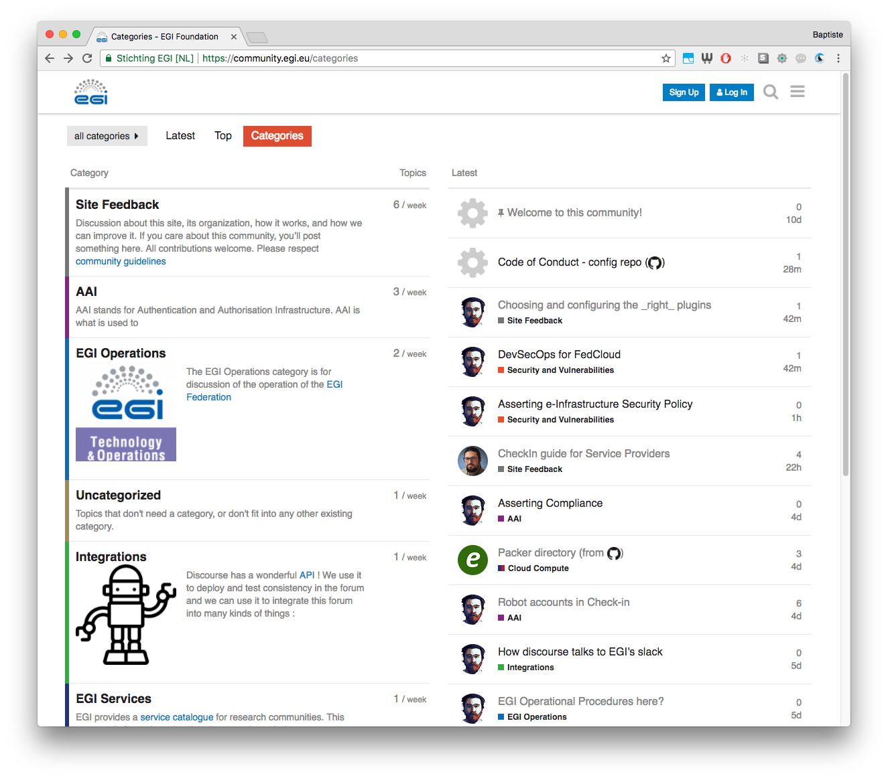
FedCloud: community-powered
React and share your thoughts
Join the discussion!
https://community.egi.eu

