Slide 1
EOSC-hub-OpenAIRE-Advance webinar-meetup for national stakeholders
Gergely Sipos
(EGI Foundation)
Najla Rettberg
(U. Goettingen)

Slide 2
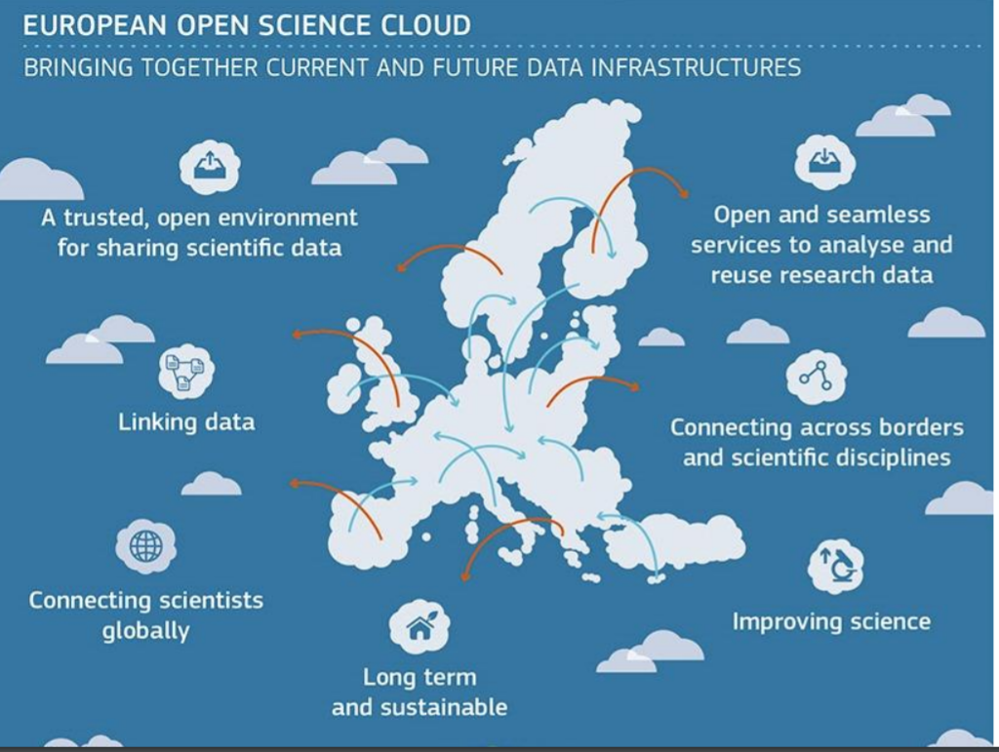

Slide 3
EOSC-hub and OpenAIRE-Advance
Both in EINFRA-12 H2020 (topic A and B)
  EOSC-hub ~ storage, compute, application services
  OpenAIRE ~ RDM; Publication services
Let’s work towards EOSC together!
  Joint workplan plan
    Dissemination, community building (Najla, Gergely)
    Technical integration of online services
    Governance

Slide 4



Supporting the research lifecycle together
Research idea
Research Object = Workflow+
Data+
Provenance+
Publication
0
Monitor & report
impact
Publish + Share
8
Post Analysis
7
Plan (DMP)
Data
DMP templates, examples, training
1
Select Results
Find & Produce Datasets
Discover Services
6
2
Prepare data for analysis
Create Workflow
Process + Analyze
5
3
4
Curation
Co-located
compute&storage
Applications,
Virtual Research Environments

Slide 5
Supporting the research lifecycle together
Research idea
OpenAIRE-Advance
Research Object = Workflow+
Data+
Provenance+
Publication
0
Monitor & report
impact
Impact reports
Publish + Share
8
Research objects
OpenAIRE-Advance &
EOSC-hub
EOSC-hub
Post Analysis
7
Plan (DMP)
Data
DMP templates, examples, training
1
Data and DMPs
Select Results
Find & Produce Datasets
Discover Services
6
2
Prepare data for analysis
Create Workflow
Process + Analyze
5
3
4
Curation
Co-located
compute&storage
Applications,
Virtual Research Environments

Slide 6
Joint project workplan – Main items
Dissemination & community building | Technical integration | Governance
Bring NGIs and NOADs together Common Communication Joint Training & Events | Support FAIR Publishing of data and services Data Management Plans Integration of OpenAIRE Guidelines in EOSC hub Services Common authentication-authorization | Cross Project Governance Common vision and strategy Common Advisory Board

Slide 7
Support for NGIs and NOADs
Today
  Get to know each other – And RDA too!
  Brainstorm about possible collaborations
Agenda
  OpenAIRE-Advance and EOSC-hub intros
  NGI and NOAD flash talks (examples)
  RDA national nodes
  Q&A, Discussion, Next steps
Follow up within & with the member states

