Slide 1
OpenAIRE Croatian NOAD’s cooperation activities
EOSC-hub & OpenAIRE-Advance: national nodes meetup, April 24th, 2018
Jadranka Stojanovski, Alen Vodopijevec
Ruđer Bošković Institute, Zagreb, Croatia

Slide 2
OpenAIRE and EOSC Hub teams
cooperation started two months ago
how to bring together teams working on the related projects
two main goals:
to raise awareness on the importance of the FAIR principles for the research data
to use available technologies and infrastructure of different projects to offer cooperative services to the researchers

Slide 3
Seminar „Collaboration in social and human sciences in a networked European research area”
OpenAIRE Advance, EOSC Hub, Dariah HR, CESSDA representatives
for the first seminar we decided to approach researchers from the social sciences and humanities

Slide 5
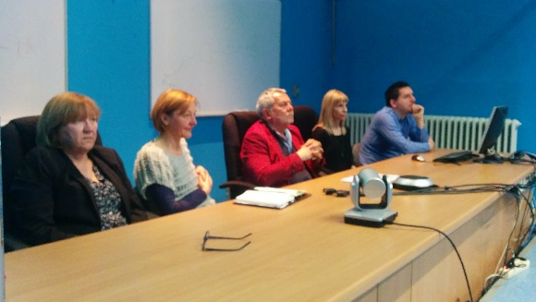
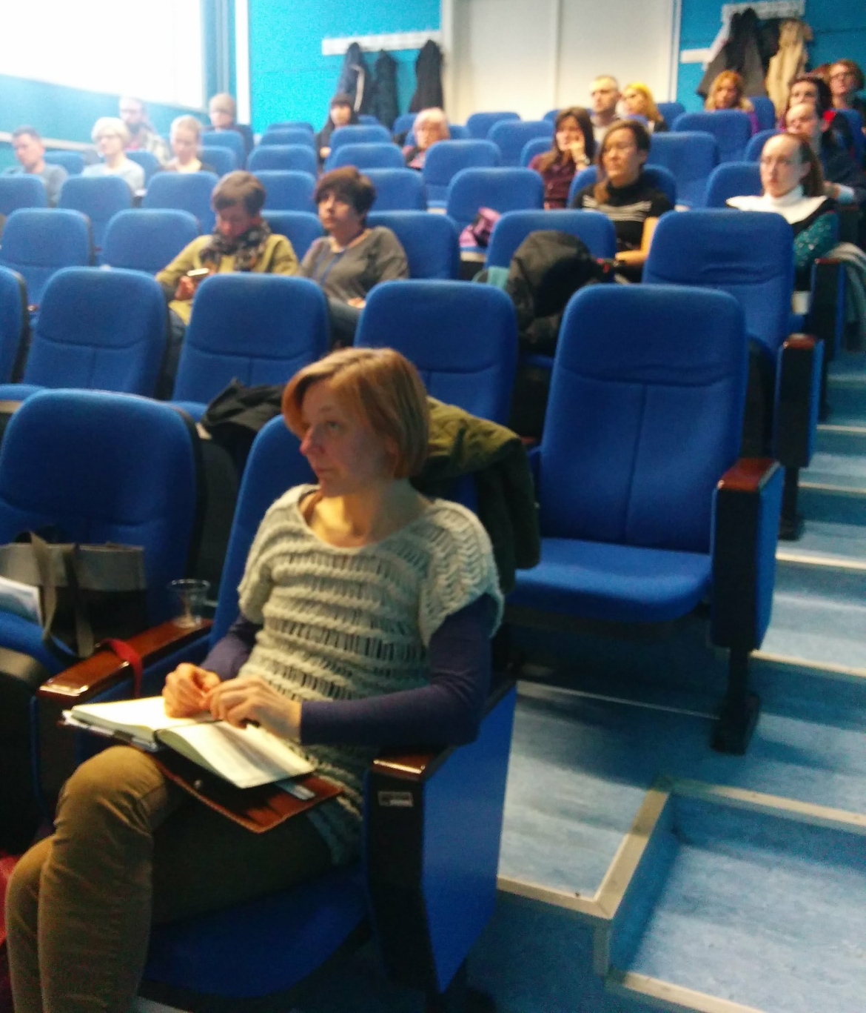
Program
Introduction, Karolj Skala, Ruđer Bošković Institut /Center for informatics and computing
DARIAH-HR as a platform for networking institutions and individuals, Koraljka Kuzman Šlogar, Institute for Ethnology and Folklore Research (DARIAH-HR coordinator)
CESSDA - Collaboration and exchange of knowledge in social sciences, Marijana Glavica, Faculty of Philosophy, University of Zagreb
Open Science as EU commitment, Jadranka Stojanovski, University of Zadar / Ruđer Bošković Institute(OpenAIRE NOAD)
European Open Science Cloud: EOSC Hub, Karolj Skala, Ruđer Bošković Institut /Center for informatics and computing (leader of DARIAH thematic service EOSC-hub)
What does the European Open Science offer to humanists?, Davor Davidović, Ruđer Bošković Institut /Center for informatics and computing (EOSC-hub)
Open discussion

Slide 6
Presenter: Davor Davidović

Slide 7
Presenter: Koraljka Kuzman Šlogar

Slide 8
Presenter: Marijana Glavica

Slide 9
Natalia Manola
Athena Research and Innovation Center
& University of Athens, Greece
OpenAIRE
Advancing Open Scholarship
Presenter: Jadranka Stojanovski

Slide 10
Cooperation with CESSDA ERIC
CESSDA stands for Consortium of European Social Science Data Archives and ERIC stands for European Research Infrastructure Consortium
network of social science data archives
partner from Croatia is Faculty of Social Sciences and Humanities at University of Zagreb
current phase: pilot infrastructure for the research data deposit
RBI IT experts are preparing test cases and scenarios for a possible integration of the current data repositories with the cloud infrastructure for online analyses and calculations
challenges: security, privacy, harmonisation...

Slide 11
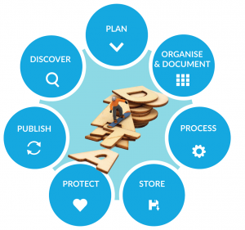
Cooperation with CESSDA ERIC
CESSDA’s research data repository network as a data provider for OpenAIRE

Slide 12
QUESTIONS?
@jadr4nka, jadranka@irb.hr
@alenkovich, alen@irb.hr
@mglavica, mglavica@ffzg.hr
@ddavidov_1, ddavid@irb.hr
@koraljkak, koraljka@ief.hr
@KSkala4, skala@irb.hr

