Slide 1
Lightning talk: Helping users focusing on being users
DI4R 2018, Lisbon
Karl Meyer
10 October 2018

Slide 2
WE ARE
EXPERTS
Notes:
We are experts ( you see always works)
We live and breathe Information Technology. From Advanced Networking, through AAI, Cloud Services, Network Management and Security, this is what we do.
It’s our day job – and we love it. That’s why we’re here this week in Trondheim, talking, sharing, learning and collaborating with each other

Slide 3
We design and build
amazing things
Notes:
We do incredible stuff.
We design, develop, build and support amazing things.
Services that have changed the way research and education in Europe and around the world takes place and these changes are accelerating.
We have removed geographical barriers to research and are developing systems that help researchers collaborate in radically new ways.
Our services have made the impossible, possible and the difficult easy.
We know our stuff.
But even with all our knowledge and experience it is impossible for anyone in this room to be an expert in all these services.
Then add in all the services developed by all the different e-infrastructure providers across Europe and the problem gets even more complex. There simply isn’t enough space in our days or in our heads for us to understand everything that goes on.
And we’re IT experts – if anyone is going to be able to understand this stuff it should be us.

Slide 4
OUR USERS ARE NOT EXPERTS
Notes:
our users on the other hand are not IT experts.
This, simply put, is not what they do.

Slide 5
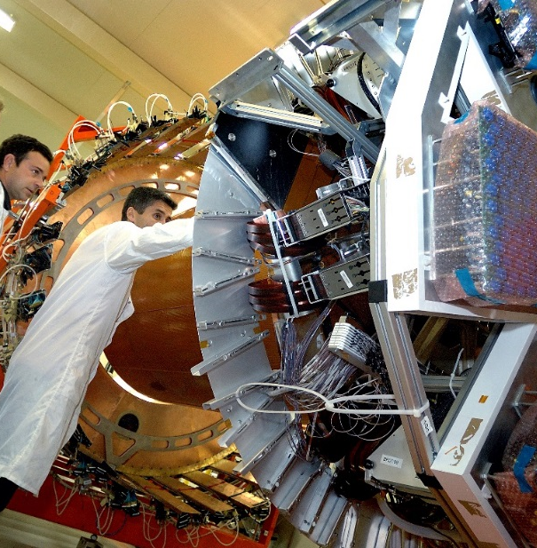
Our users are...
Notes:
The point is, they are users of e-infrastructure services not IT experts – they’re IT USERs not IT DOERS and this is a key distinction.
(and I’ll let you into a secret – many of them don’t really care) Just like the average car driver has no real interest in how an internal combustion engine works as long as it gets them from A to B , our users just want the IT to work so that they can get from where they are to where they want to be.
And to complicate matters for them there are dozens of different e-infrastructure services from many different e-infrastructure providers. Each with their own particular language, terminology and way of doing things.

Slide 6
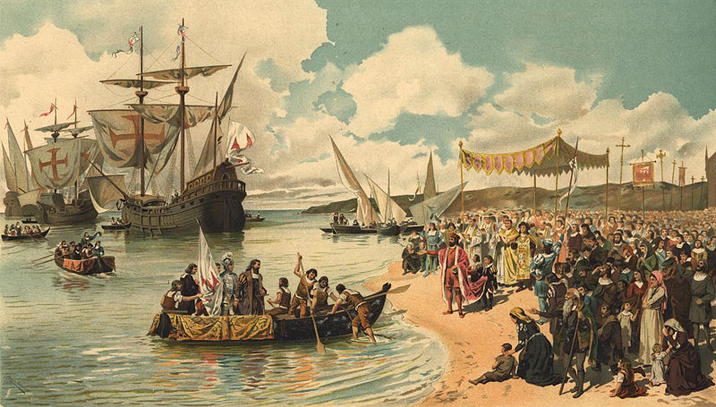
How can our users navigate this complex landscape?
This project has received funding from the European Union’s Horizon 2020 research and innovation programme under grant agreement No 731049
Notes:
So we have a problem
How do we help our users navigate through this mysterious, complex and foreign landscape of different e-infrastructures AND LINK VARIOUS AVAILABEL RESOURCES AND DATA? LIKE WHAT VASCO DA GAMA DID ON HI SVOYAGE TO INDIA AND WAS FIRST CONNECTING THE WEST AND THE ORIENT.

Slide 7
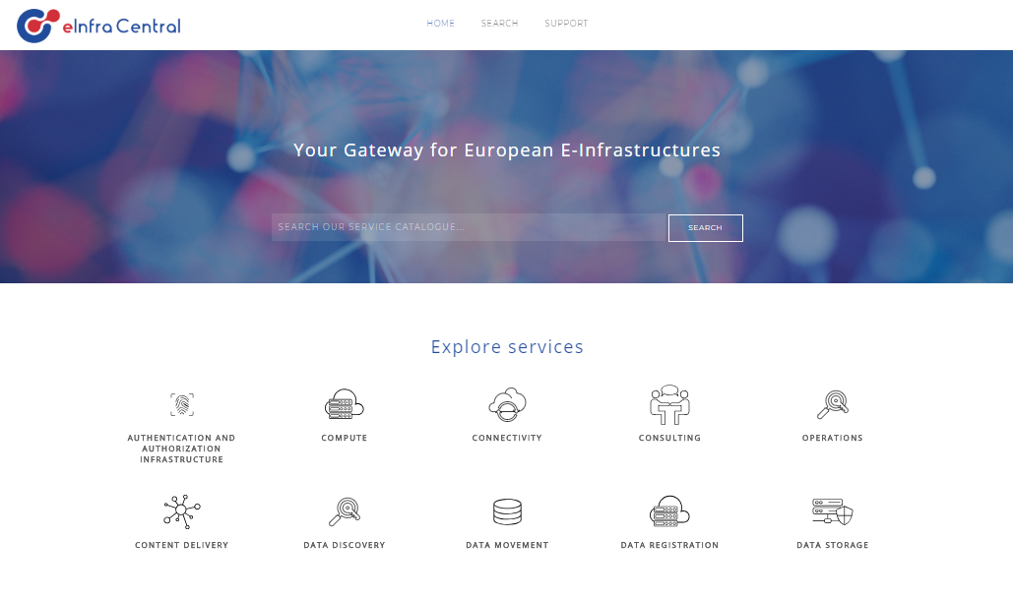
> 90 services from 11 service providers
AAI authentication
This project has received funding from the European Union’s Horizon 2020 research and innovation programme under grant agreement No 731049
Notes:
This is where e-infraCentral comes in, hopefully to save the day

Slide 8
Letting users focus on being users
eInfraCentral helps users find, compare, select and ultimately access e-Infrastructure services
Providing an all inclusive Service Catalogue with services described following the standard Service Description Template – all making the selection easier
Increase visibility of e-infrastructures
Key building block of EOSC
Notes:
e-infracentral helps users find, compare, select and ultimately access e-infrastructure services from a range of providers
It provides a common platform and consistent structure and language to make that selection easier
It is designed to increase visibility of e-infrastructures beyond our usual stakeholders and supports visibility into the long-tail of research and education that is so hard for us to reach.
It is a key building block of the European Open Science Cloud.

Slide 9
Who are eInfraCentral
Nine partners focused on supporting users and increasing take-up
Notes:
e-infracentral helps users find, compare, select and ultimately access e-infrastructure services from a range of providers
It provides a common platform and consistent structure and language to make that selection easier
It is designed to increase visibility of e-infrastructures beyond our usual stakeholders and supports visibility into the long-tail of research and education that is so hard for us to reach.
It is a key building block of the European Open Science Cloud.

Slide 10
Ways to engage
- Check out the Service Catalogue on the eInfraCentral Portal:
beta.einfracentral.eu
Add your services to the portal
Give us feedback
Meet us for bilateral discussions
Follow us:
einfracentral.eu/#newsletter
@eInfraCentral

Slide 11
beta.einfracentral.eu
einfracentral.eu
This project has received funding from the European Union’s Horizon 2020 research and innovation programme under grant agreement No 731049

