Slide 1
atmosphere-eubrazil.eu
@AtmosphereEUBR
Ignacio Blanquer (UPV)

Slide 2
Trust and ATMOSPHERE
ATMOSPHERE is a 24-month project aiming at the design and development of a framework and a platform to implement trustworthy cloud services on a federated intercontinental hybrid resource pool.
Expected Results
A Hybrid federated VM and container platform
A development framework with three sets of services
Trustworthy evaluation and monitoring framework
Trustworthy Distributed Data Management
Trustworthy Distributed Data Processing
A pilot use case on Medical Imaging Processing
Applications
Trustworthy Data Processing Services (TDPS)
Trustworthiness Evaluation Platform (TEP)
Distributed Trustworthy Data Management Services (DTDMS)
Cloud & Container Services Management Layer
Federated Resources
Notes:
ATMOSPHERE is a two-year project funded under the fourth Europe-Brazil Coordinated call aiming at developing a framework and a platform to implement trustworthy cloud services on top of an intercontinental hybrid and federated intercontinental hybrid resource pool.
ATMOSPHERE consortium comprises 7 European and 7 Brazilian partners co-coordinated by the Universitat Politècnica de València and the Universidade Federal de Campina Grande.
The expected results of ATMOSPHERE, which will be partially described along the presentation, are:
A Hybrid federated cloud platform using Virtual Machine and containers both for application delivery and as first-class hypervisors.
On top of this cloud & container services Management Layer, we will build a Distributed Trustworthy Data Management Services to provide secure and efficient data management services.
These services will be used by the Trustworthy Data Processing Services layer providing orchestration and autonomous resource management systems to deal with the dynamic adaptation.
A Trustworthiness Evaluation Platform measuring the properties and triggering the adaptations when needed.
These layers will be used to build up a medical imaging processing application

Slide 3
The problem
I need to build up a classifier that uses anonymised and sensitive data that requires a high computing demand. Once developed, I want to exploit it as a service securely and with a Quality of Service.
I do not want to care for the infrastructure, resource management, job scheduling, secure access and similar burdens. Moreover, I want to have a quantitative estimation of how trustable my service is.

Slide 4
What is trust?
Trust is a choice that is based on past experience. Trust takes time to build, but it can disappear in a second.
Trusting cloud services is as complicated as trusting people. You need a way to measure it and pieces of evidence to build trust.
Trust in a cloud environment is considered as the reliance of a customer on a cloud service and, consequently, on its provider.
Trust bases on a broad spectrum of properties such as Security, Privacy, Coherence, Isolation, Stability, Fairness, Transparency and Dependability.
Nowadays, few approaches deal with the quantification of trust in cloud computing.

Slide 5
Exploiting the Legacy
Develop a Trustworthiness evaluation framework and integrate SCONE, GPGPUS, Fogbow, IM, DAGSIM, LEMONADE and other supporting technologies.
CLOUDSCCAPE series & MarketPlace
High-level Data
Analytics Framework
(LEMONADE), a TOSCA orchestrator (IM) and a performance modelling system (DAGSIM)
CLOUDSCCAPE series
Federation capabilities (fogbow) to work in a trans-continental scenario
Basic foundations (SCONE) for the secure access and processing of data

Slide 6
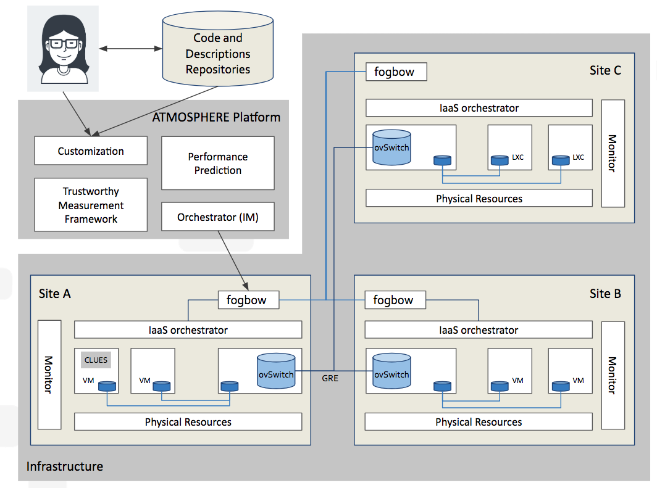
Hybrid federated platform
A hybrid and federated platform
Heterogeneous resources (Virtual Machines and containers at the same level) and GPGPUs.
Customizable and isolated virtual federated networks providing federation-level NFV services.
Target:
Resource providers requiring federating multiple sites.
Application developers who could find a way to distribute the different parts of an application workflow according to privacy and performance requirements.
Notes:
The lowest layer of ATMOSPHERE is the hybrid and federated cloud platform. The platform is hybrid in the sense that it considers both Virtual Machines and LxC/D containers as first-class hypervisors and federated as it provides consolidated and coherent access of the whole federation through any of the federation endpoints, managed by fogbow, as well as the support of federated virtual private NFV services.
This platform fits the needs of resource providers who need to federate multiple sites, application managers who need to measure integrity, privacy risk and performance, among other properties, and application developers who want o increase their performance and have scores of the trustworthiness properties of their application.
The orchestrator service will deploy application topologies on top of the federated infrastructure by customising application templates using the performance estimators and the desired trustworthiness properties.
The management of the federation is transparent to the user, which will select the rightmost site, according to the trustworthiness properties, workload and requirements such as specific hardware capabilities.

Slide 7
Trustworthiness life-cycle
Trustworthiness is considered in its multiple dimensions
Security, as the complexity of the attacks and the capability to defence from them.
Privacy, as the inherent risk of a dataset to contain re-identifiable data.
Coherence, as the capability of providing a coherent behaviour from any point of the federation.
Isolation, as the difference of trustworthiness when a service runs isolated or not.
Stability, as the idempotency and stability of the services.
Fairness, as the inexistence of undesirable or hidden biases.
Transparency, as the capability of understand the output of a system.
Dependability, mainly focusing on availability and reliability.
Obtaining metrics to define these trustworthiness properties
A priori and a posteriori evaluation of vulnerability, performance, re-identification risks, data loss rate, integrity, robustness, scalability, resource consumption, classification bias and isolation.
Notes:
ATMOSPHERE aims at supporting components for measuring and improving the trustworthiness of the applications both at the design and the run time, by providing a lightweight monitoring and actuation system that will trigger actions based on scalability, privacy enhancement, annotation or access denial.
ATMOSPHERE focuses on cloud services trustworthiness in a broad sense, considering not only properties such as dependability, security, privacy, isolation or stability, but also properties such as fairness, transparency and Explainability.
These properties will be obtained by means of metrics obtained during the design time and during the run time, evaluating vulnerabilities, performance, privacy protection, integrity, robustness, scalability, resource consumption, fairness and isolation.
Paying special attention to those properties that have a relation with the regulations of the European General Data Protection Regulation and the similar in Brazil.

Slide 8
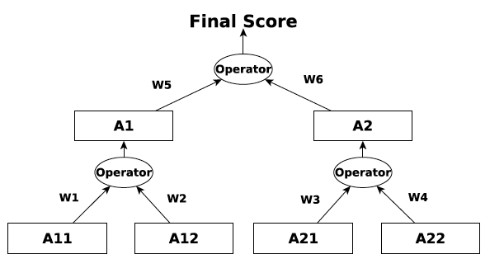
Trustworthiness Monitoring
The Trustworthiness Monitoring and Assessment Platform gathers data from the services by means of probes which are collected by the Monitoring Module and stored in the Knowledge module.
The Analyze Module processes the measurements and obtains the trustworthiness scores according to their definition.
The trustworthiness scores imply merging several metrics.
E.g. Privacy can be computed as a composition of the maximum of the privacy risk and the data loss rates for each dataset.
The Planning module enables the Analyze Module to request for adaptations
E.g. If the privacy score is above a specific threshold, the data must be processed in a privacy-enhanced resource.
An adaptation may involve several actions
The Execute module runs the adaptation actions from the Planning Module.
TMA_Analyze
TMA_Planning
FaultTolerantQueue
TMA_Knowledge
TMA_Monitor
TMA_Execute
monitoring
actuators
Design-time
Services

Slide 9
Distributed Trustworthy Data Management Services
ATMOSPHERE not only measures trustworthiness but provides a set of services to improve it.
Distributed Data Management Services for storage, retrieval, update and access of data in a cloud
Based on SGX enclaves to enable the execution even in non-trustable resources
Running on an encrypted memory area.
Guaranteeing features such as confidentiality and revocation and access authorization based on policies.
Policy engines for Secure Data Management.
Using anonymization techniques to protect sensitive fields and records
Including rewriting SQL queries.
Tusted Execution Environment
Tusted Execution Environment
Access Policies
Secured Access
Database
Notes:
ATMOSPHERE not only measures trustworthiness but provides a set of services to improve it. Easing application developers to reduce the development cycle.
One of the key elements is the Distributed Data Management Services for storage, retrieval, update and access of data in a cloud. These services are being designed and implemented to ensure that data remains inaccessible during processing time to system administrators and even application developers, by providing the execution of critical parts within enclaves, using the SGX technology, both for SQL and NoSQL Databases and filesystems.
The platform will also guarantee features such as confidentiality and revocation and access authorization based on policies, to guarantee a fine-grained Secure Data Management and privacy preservation and annotation.

Slide 10
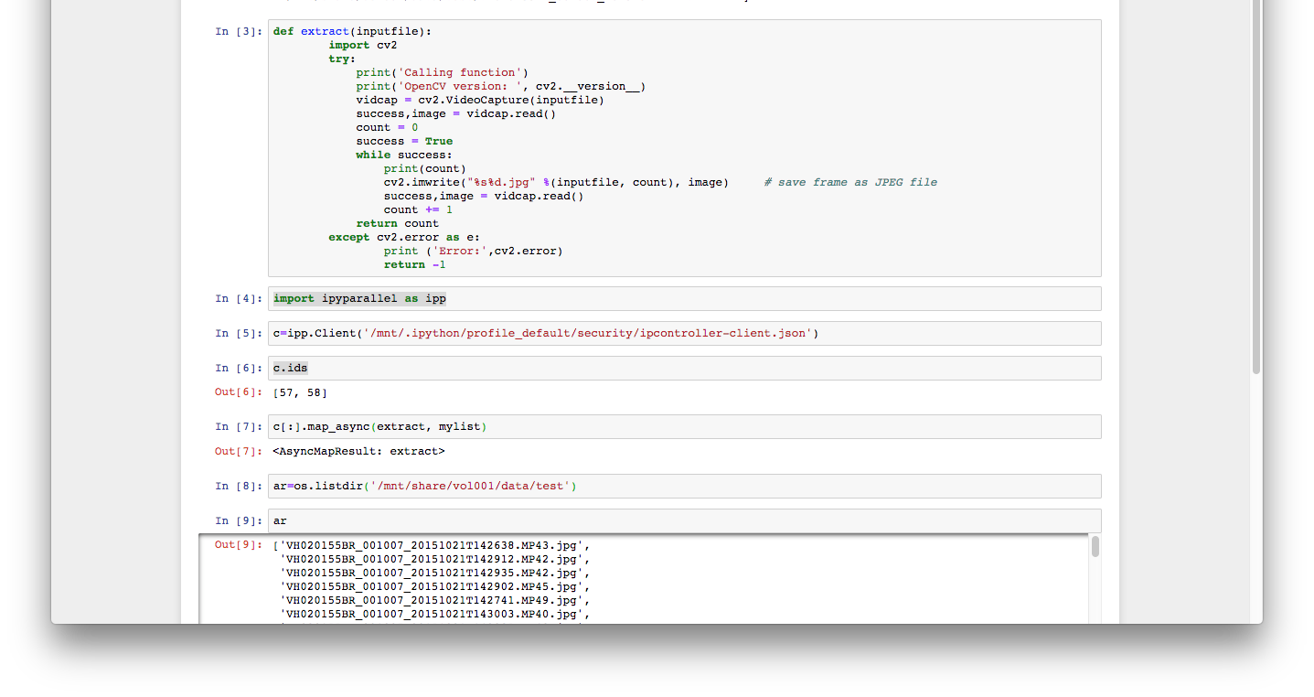
Distributed Trustworthy Data Processing Services
ATMOSPHERE Provides application developers with a layer of services to build up and deploy Data Analytic applications evaluating trustworthiness at design and runtime.
Ready-to-deploy data analytic applications topologies based on best practices and popular third-party software
E.g. a secured Elastic Kubernetes cluster linked to a persistent storage.
Notes:
ATMOSPHERE will provide application developers with a layer of services to build up and deploy Data Analytics applications evaluating trustworthiness in design and runtime.
These data processing layer comprises application topologies prepared for deploying complex applications based on job schedulers, data storages, network services and other components, ready to be deployed on the cloud and container platform, supporting special resources. These application topologies include self-management clusters (secured Elastic Kubernetes cluster linked to a MongoDB and a CEPH storage).
Among these services, we include the LEMONADE framework (Live Exploration And Mining Of A Non-Trivial Amount Of Data From Everywhere), to ease the development of Data Analytic Workflows by means of composable building blocks to evaluate Privacy risks and to estimate execution deadlines for a given resource allocation.
The platform will provide detailed monitoring for the evaluation of performance, fairness and robustness with adaptive measures, such as scalability, increased anonymisation or access blocking.

Slide 11
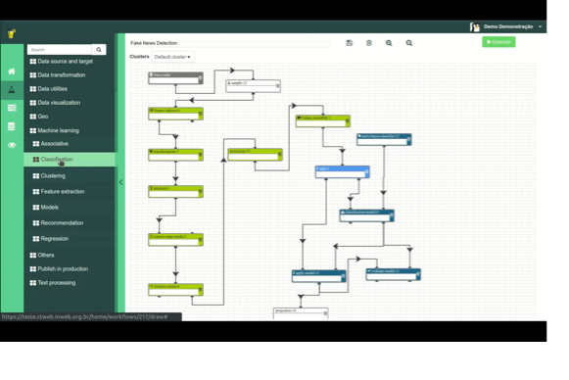
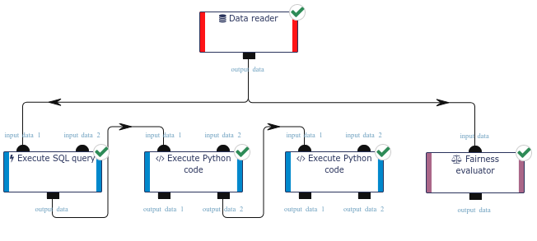
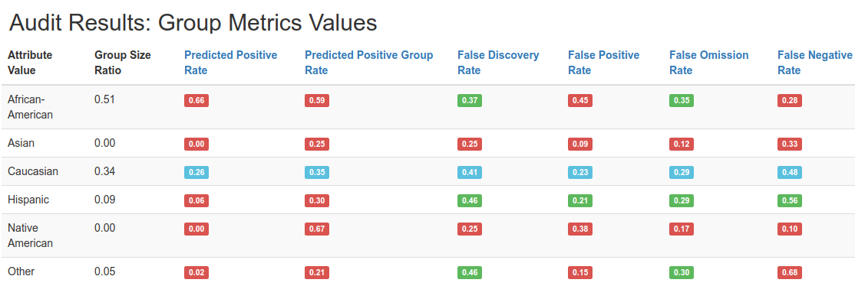
Distributed Trustworthy Data Processing Services
LEMONADE to create Data Analytic Workflows by means of composable building blocks
Provides a framework to build up data analytics workflows, which are automatically coded into Spark.
Evaluating Re-identification risks and estimating execution deadlines, given a resource allocation.
Detailed monitoring for the evaluation of performance, fairness and robustness with adaptive measures such as scalability.
Able to specify performance guarantees
e.g., A Spark cluster runs ML applications within a deadline, ATMOSPHERE will identify the node with the appropriate GPUs type and number.
Notes:
ATMOSPHERE will provide application developers with a layer of services to build up and deploy Data Analytics applications evaluating trustworthiness in design and runtime.
These data processing layer comprises application topologies prepared for deploying complex applications based on job schedulers, data storages, network services and other components, ready to be deployed on the cloud and container platform, supporting special resources. These application topologies include self-management clusters (secured Elastic Kubernetes cluster linked to a MongoDB and a CEPH storage).
Among these services, we include the LEMONADE framework (Live Exploration And Mining Of A Non-Trivial Amount Of Data From Everywhere), to ease the development of Data Analytic Workflows by means of composable building blocks to evaluate Privacy risks and to estimate execution deadlines for a given resource allocation.
The platform will provide detailed monitoring for the evaluation of performance, fairness and robustness with adaptive measures, such as scalability, increased anonymisation or access blocking.

Slide 12
Conclusions: What could you expect from ATMOSPHERE
A quantitative trustworthiness score on the isolation, reliability, performance, privacy and stability,.
Both at design time (virtuous cycle) and at runtime.
A set of trustworthy services for data processing
A Federated hybrid cloud infrastructure.
A convenient and interoperable cloud orchestrator to deploy complex applications.
A broker and a monitoring service for dynamically assessing and adjusting the applications.
A Data analysis framework with high-level trustworthiness scores such as fairness and explainability.
An environment to safely process data and expose processing algorithms with IPR restrictions.
Application Developers
(Code & Register Application)
Application Managers
(Deploy Application and Resources)
Data scientists
(Use Applications)

Slide 13
Dont miss a beat!
REGISTER FOR THE NEWSLETTER
Follow on Twitter
@AtmosphereEUBR
www.atmosphere-eubrazil.eu/user/register
Connect on LinkedIn
Contact
Ignacio Blanquer – iblanque@dsic.upv.es
Francisco Brasileiro – fubica@computacao.ufcg.edu.br
linkedin.com/in/atmosphere/
Check our landing page
http://www.atmosphere-eubrazil.eu/

